Slide 1
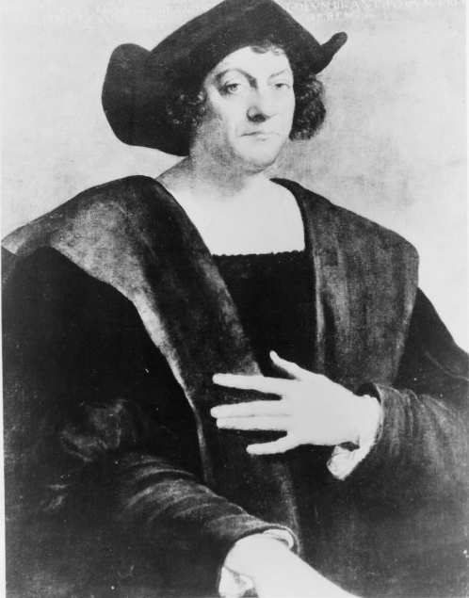
Unit 2:
Age of Contact
Lesson 5:
God, Gold, and Glory!
Guided Notes
Day 1
Notes:
Sebastiano, Del Piombo. Christopher Columbus, half-length portrait, facing slightly right. 1900. Photograph. https://www.loc.gov/item/91785883/.

Slide 2
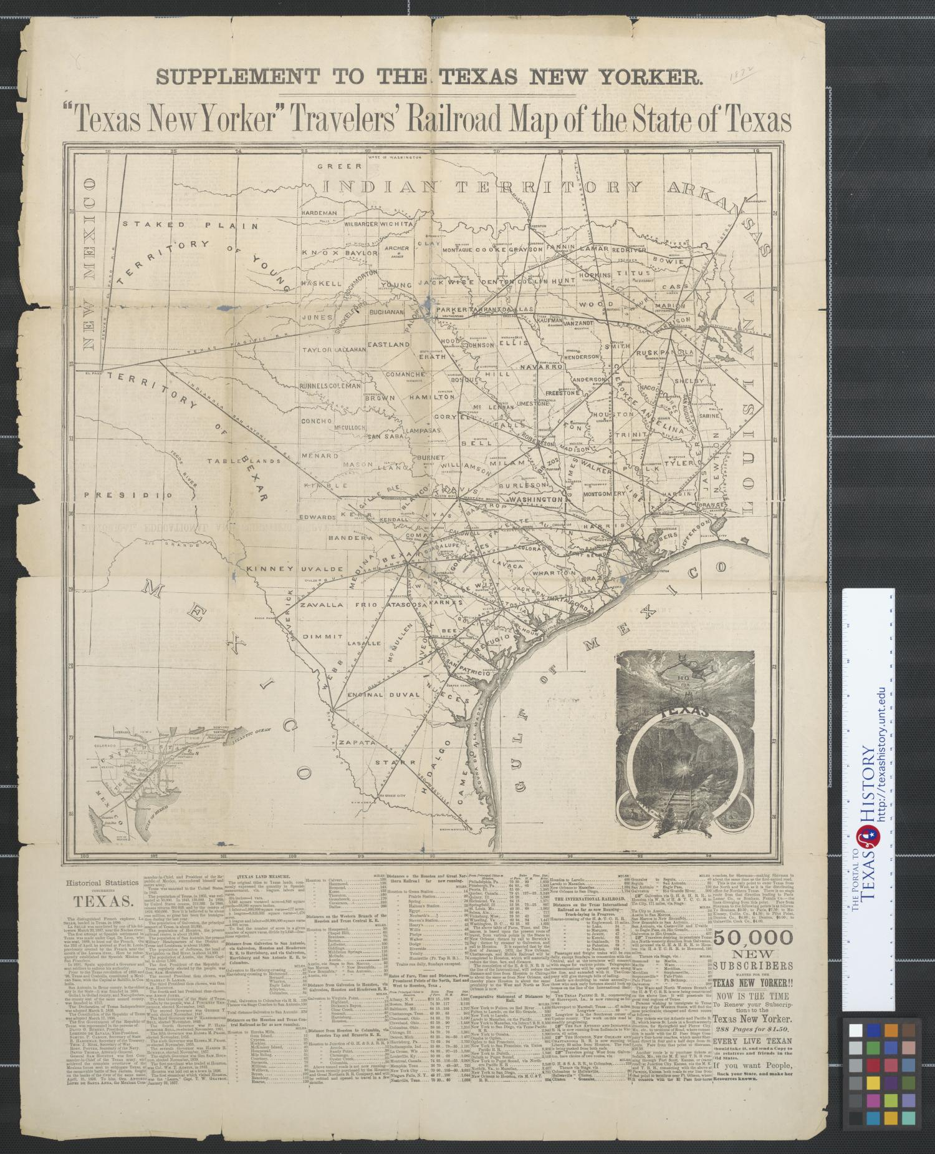


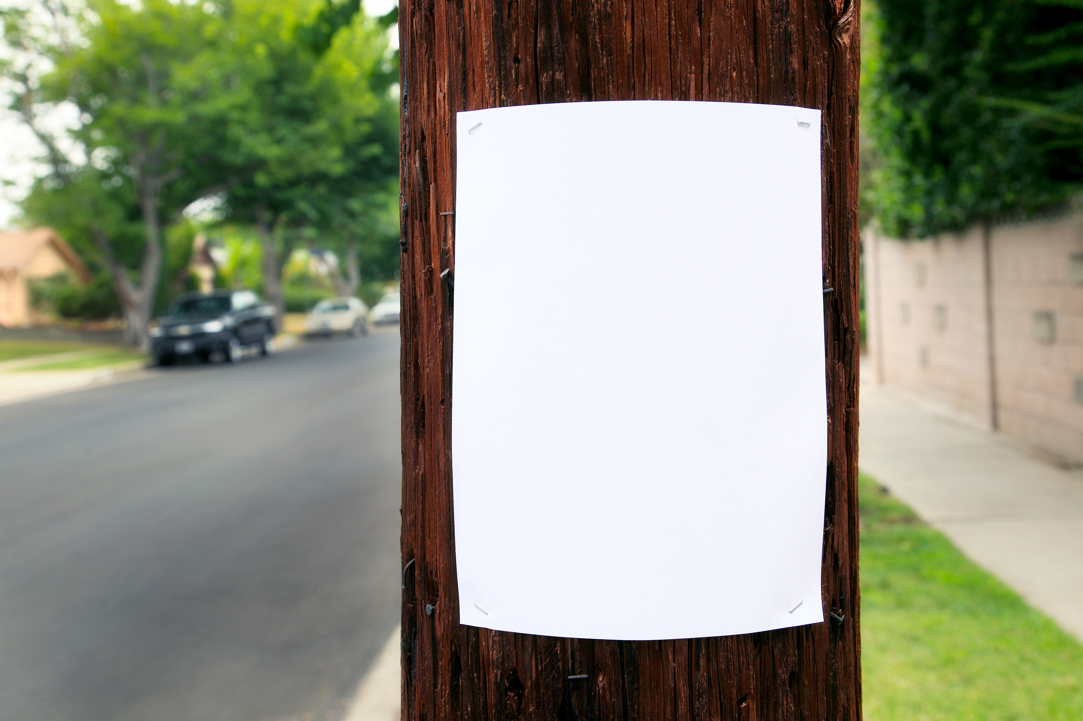



Warm-up
Follow the directions below to complete your warm-up
Would you take the job advertised on your warm-up?
Why or why not?
Share with a partner.
Job Opportunity for Adventurers!
https://education.texashistory.unt.edu

Slide 3
Share with the class: day 1
I would / wouldn’t take the job because ______________
https://education.texashistory.unt.edu

Slide 4
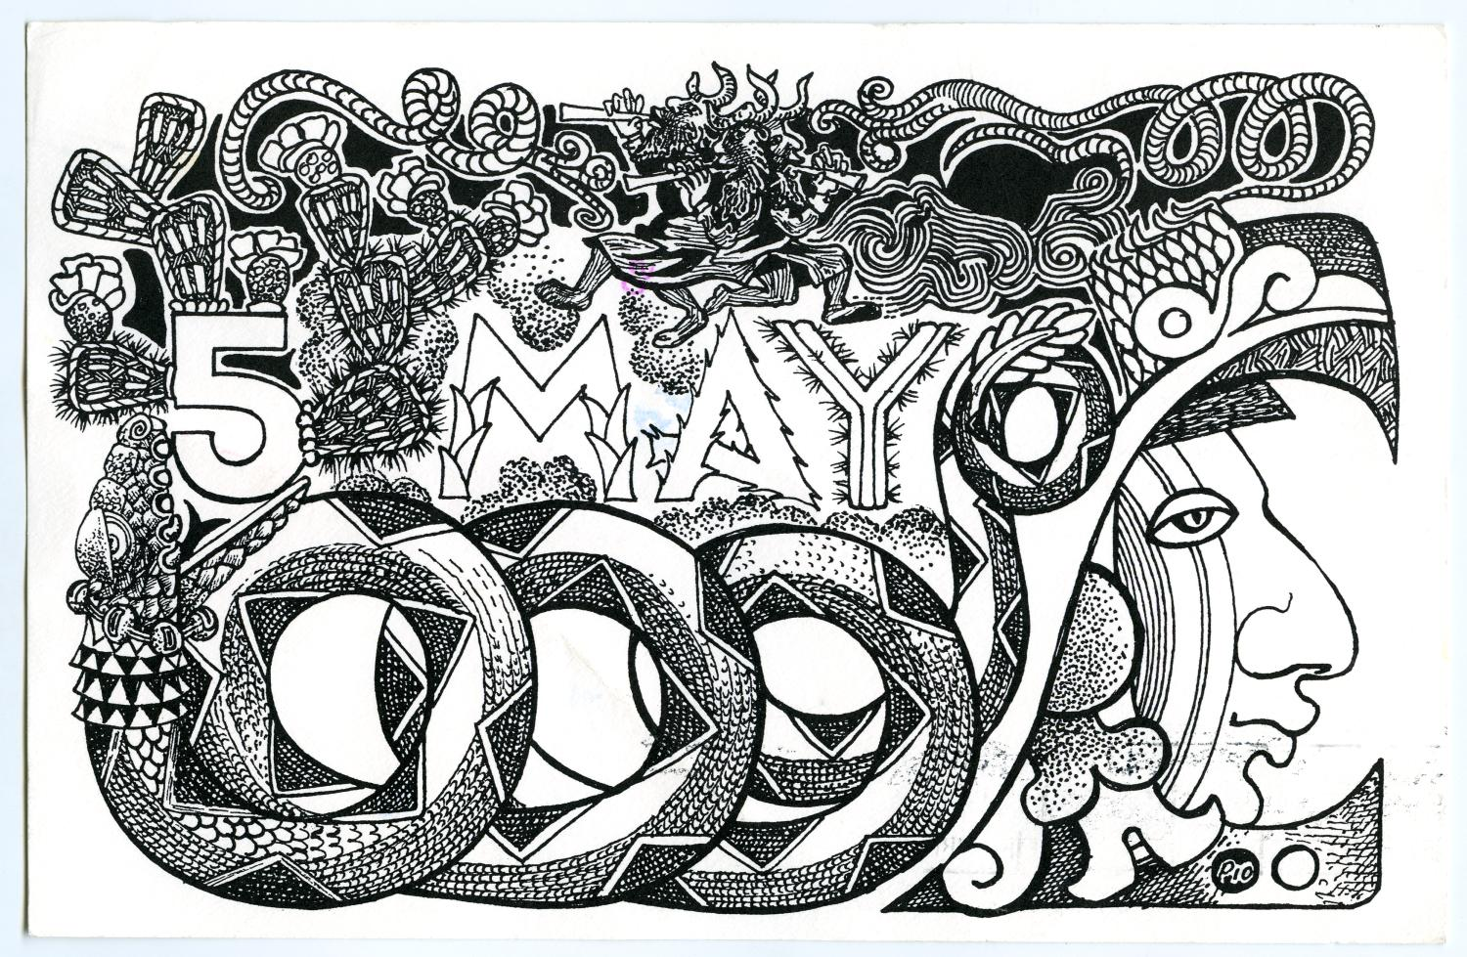
Essential Questions
What motivated Spanish conquistadors to explore the new world?
What were the positive and negative results of their exploration?
https://education.texashistory.unt.edu

Slide 5
In Today’s Lesson
We will examine the goals, causes, and effects of Spanish exploration. We will also identify the key events that began the Age of Contact.
I will complete my guided notes by summarizing the key points and significance of each topic. I will answer a comprehension question on each topic and, when applicable, label my maps.
https://education.texashistory.unt.edu

Slide 6
The Reconquista
Key Information
Spain’s 800-year power struggle with the African Moors
What do I need to write?
In the 8th Century, or the 700s, a group from Africa called the Moors invaded what is now Spain. The Moors took control of the land and its people, ruling over Spain for nearly 800 years.
The Spanish defeated the Moors in 1492 and united their lands under two monarchs: King Ferdinand and Queen Isabella. The king and queen took immediate steps to strengthen their new country and gain wealth by getting involved in global exploration.
Significance
Spain’s victory against the Moors allowed Spain to take part in the Era of Exploration
Essential Question
Why does Spain want to be involved in global exploration?
https://education.texashistory.unt.edu

Slide 7
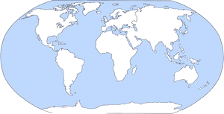

How does this image relate to the Reconquista?
https://education.texashistory.unt.edu

Slide 8
Christopher Columbus
Key Information
An Italian explorer who sailed for Spain. Arrived in the Americas, 1492
What do I need to write?
King Ferdinand and Queen Isabella hired an Italian explorer named Christopher Columbus to attempt to find a water route to the profitable markets in Asia in 1492.
Though Columbus didn’t make it to Asia, he did unintentionally find different profitable lands: the Americas. Columbus made several voyages to what is now the Caribbean. He and his men became wealthy by seizing resources like gold. His success drove other Spanish explorers to make expeditions to the new world to seek their fortunes.
Significance
His journeys inspired other explorers to travel to America for wealth.
Essential Question
What was Columbus’ original goal on his voyage?
https://education.texashistory.unt.edu

Slide 9
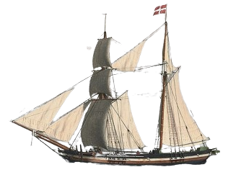
What route did Christopher Columbus take?
https://education.texashistory.unt.edu

Slide 10
The Columbian Exchange
What do I need to write?
Key Information
A system of trade across the Atlantic Ocean that began with Columbus’ voyages.
Columbus’ journeys across the Atlantic to the Americas began a system of trade known as the Columbian Exchange. This trade transported new fruits, vegetables, grains, animals, and diseases between Europe and the Americas.
Through this system of trade, Europeans and American Indians gained access to a wider variety of food sources. The arrival of horses changed life for many American Indian tribes who could now hunt and travel more easily. The introduction of Spanish diseases like smallpox tragically caused the death of millions of American Indians who had no immunity to the foreign illnesses.
Significance
New items were introduced into Europe and America.
Essential Question
What was one positive and one negative outcome of the Columbian Exchange?
https://education.texashistory.unt.edu

Slide 11
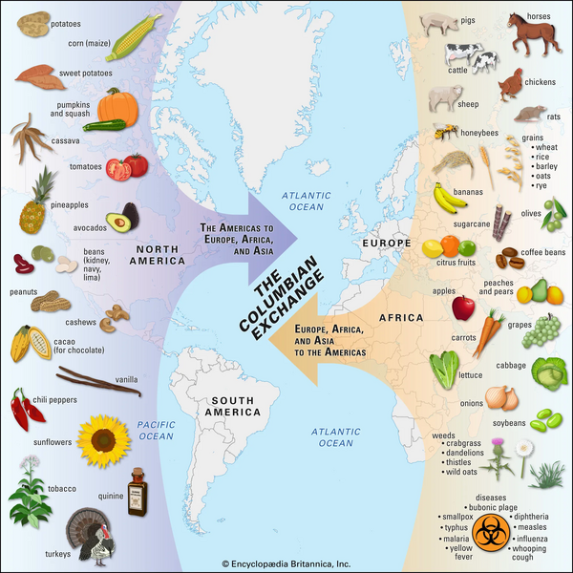
What items were traded in the Columbian Exchange?
https://education.texashistory.unt.edu
Notes:
Columbian Exchange. This file is licensed under the Creative Commons Attrib https://kids.britannica.com/students/article/Columbian-Exchange/632098ution 4.0 International license.

Slide 12
Reasons for Exploration
What do I need to write?
Key Information
Spanish explorers had three goals: God, Gold, and Glory. Gold was most important!
The journey from Spain to the Americas, and the expeditions in the new lands were often dangerous. People got lost, ran out of supplies, and even died during expeditions. Why would anyone take such a risk?
There were three reasons for Spanish exploration; we call them “The 3 Gs: God, Gold, and Glory.” They claimed to want to spread their religion. They wanted fame and power. But, more than anything, they wanted to become incredibly, wildly, unbelievably wealthy. Spanish conquistadors often seized gold and resources from American Indians. Spanish exploration and conquest of the Americas made Spain very wealthy.
Significance
Spain became incredibly wealthy exploring and claiming land and resources in the Americas.
Essential Question
How do you think Spain’s quest for gold affected relationships between the Spanish and American Indians?
https://education.texashistory.unt.edu

Slide 13
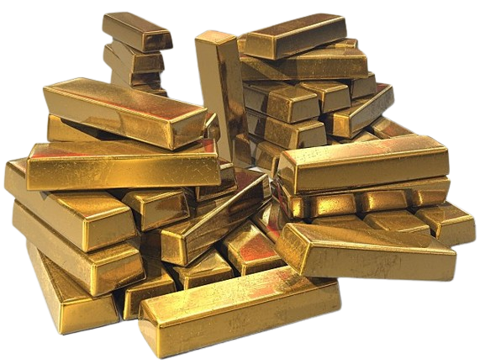
Where does Spain find the most gold in the Americas?
https://education.texashistory.unt.edu

Slide 14
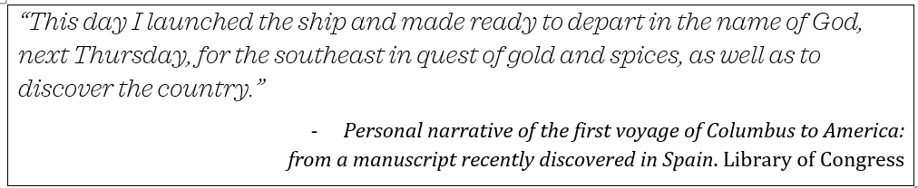
Exit Ticket
Follow the directions below to complete your warm-up
Read the quote by Christopher Columbus and answer the question that follows.
Discuss with a partner.
https://education.texashistory.unt.edu

