Slide 1
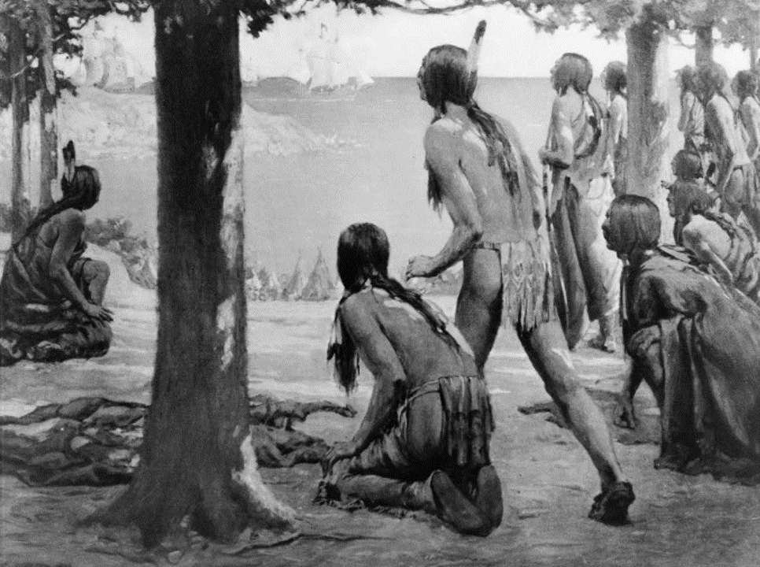
Unit 2:
Age of Contact
Lesson 2:
How do we know what we know?
Notes:
--The Coming of white man. 1914. Photograph reproduction of a painting. https://www.loc.gov/item/93500490/.

Slide 2

How do we know what we know?
Warm-up
https://education.texashistory.unt.edu

Slide 3
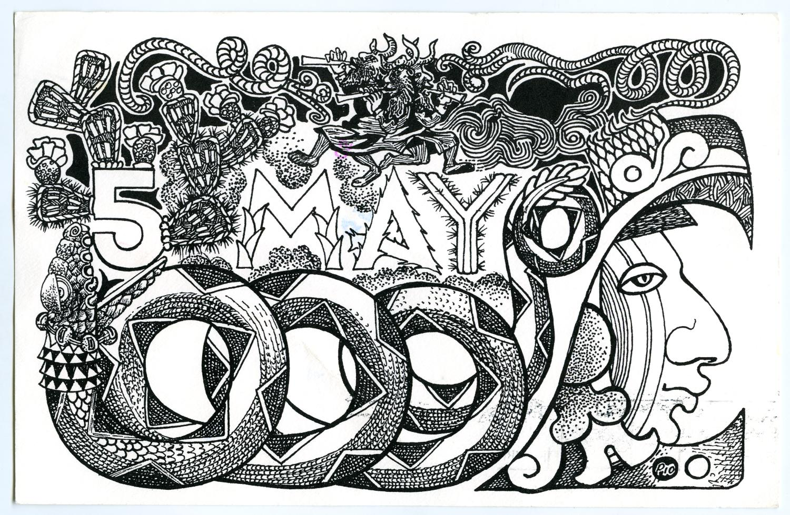


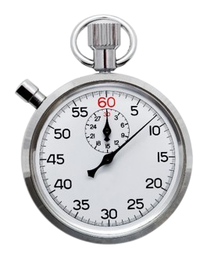


Warm-up
Read the scenario on your warm-up.
Give your response to the scenario in the space provided.
Share your response with a shoulder partner.
https://education.texashistory.unt.edu
Notes:
--Clock: Microsoft Powerpoint stock images

Slide 4
Share your response
I believe everything my classmates say about the new student because ________
I don’t believe everything my classmates say about the new student because ________
https://education.texashistory.unt.edu

Slide 5
Essential Question
How do we know what we know about the encounters between the Spanish and the American Indians during the Age of Contact?
https://education.texashistory.unt.edu

Slide 6
In today’s lesson…
We will examine primary source documents from the Age of Contact that present information about several American Indians tribes in Texas from a Spanish point of view.
I will match primary source excerpt cards with cards that offer modern translations. I will summarize each excerpt and answer comprehension questions about them.
https://education.texashistory.unt.edu

Slide 7
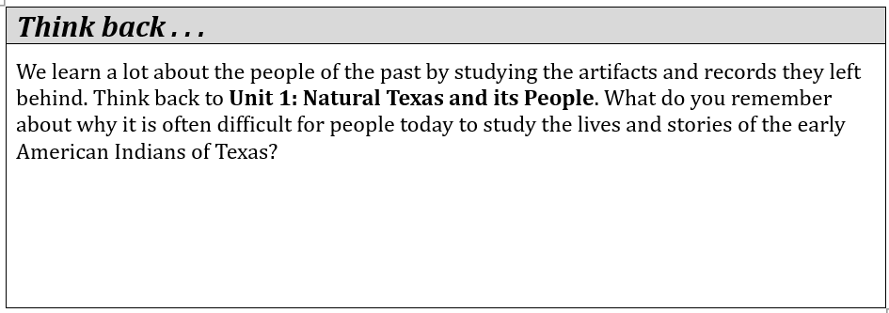
How do we know what we know? Lesson
“Think Back”- consider question.
Write your response in the box.
https://education.texashistory.unt.edu

Slide 8
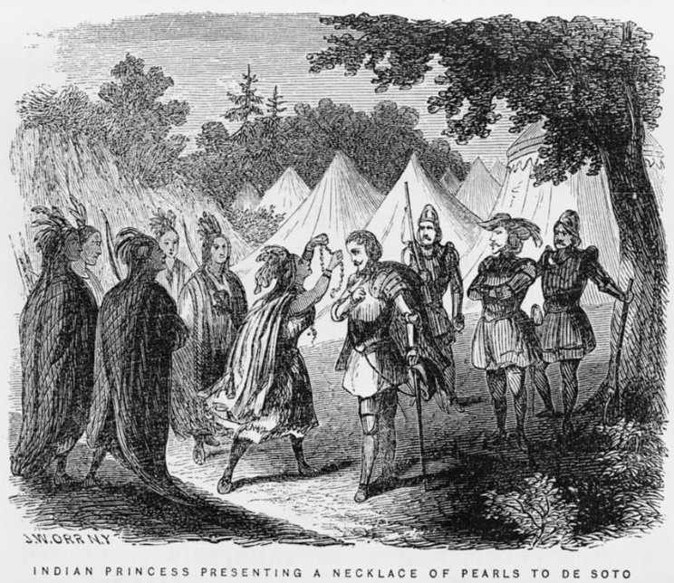
How do we know?
Much of what we believe to be true about early American Indians in Texas, we have learned from the European explorers who encountered them. These accounts have been useful at providing information we would not have otherwise. It is important to recognize, however, that they provide only one side of the story.
A painting by John Orr of an Indian Princess presenting a necklace to a Spanish explorer. Library of Congress.
https://education.texashistory.unt.edu
Notes:
--Orr, John William. Indian princess presenting a necklace of pearls to de Soto / J.W. Orr, N.Y. 1858. Photograph. https://www.loc.gov/item/91794402/.

Slide 9
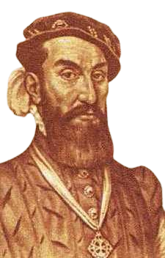
First Contact in Texas
Let’s take a look at one account written by the first known explorer to encounter American Indians in Texas – a Spanish man named Álvar Núñez Cabeza de Vaca.
A portrait of Cabeza de Vaca
https://education.texashistory.unt.edu
Notes:
--Portrait of Cabeza de Vaca. Wikimedia Commons. This media file is in the public domain in the United States. This applies to U.S. works where the copyright has expired, often because its first publication occurred prior to January 1, 1929, and if not then due to lack of notice or renewal. See this page for further explanation.

Slide 10
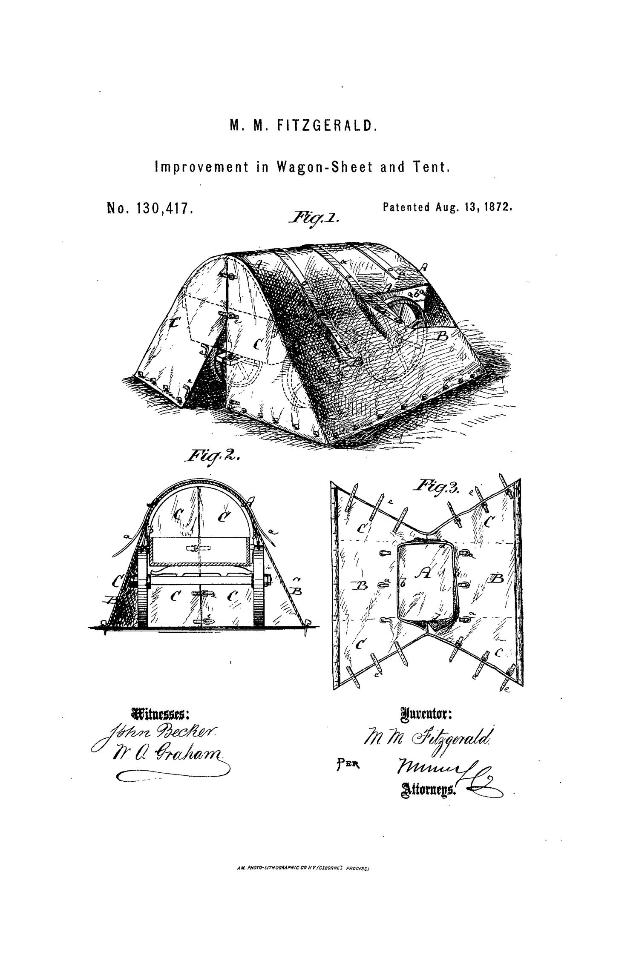
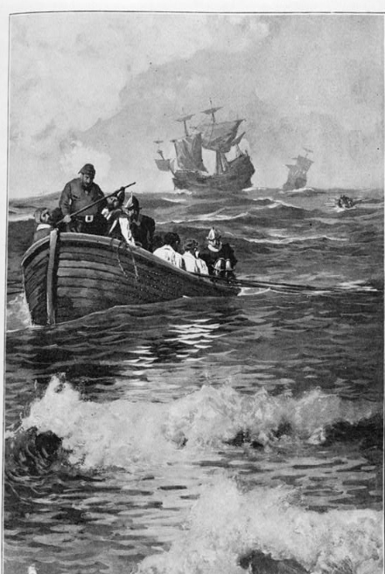
A little background information:
Cabeza de Vaca was a Spanish explorer who traveled with several hundred others to the Americas in the early 1500s. Like many Spanish explorers, their primary goal was to search for gold and riches.
Spanish caravels (small, fast ships) arriving in the Americas
https://education.texashistory.unt.edu
Notes:
--Gibbs, George. “The Caravels had Arrived.” Book illustration, 1898. Library of Congress. "The caravels had arrived" - b&w film copy neg. | Library of Congress (loc.gov)

Slide 11
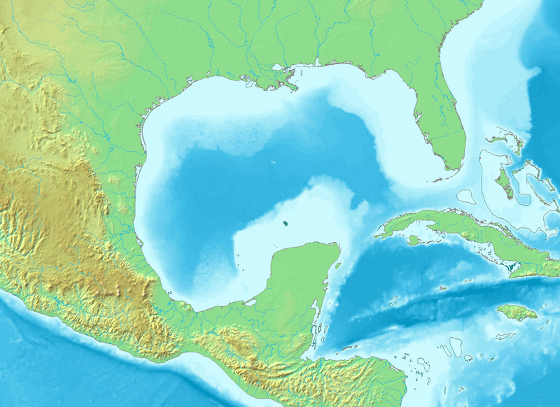
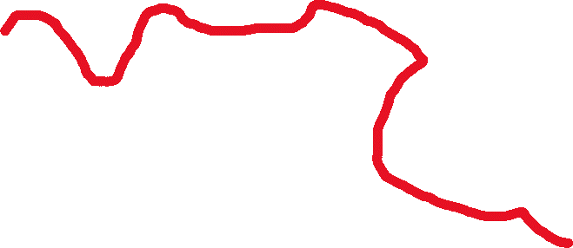

Cabeza de Vaca: Where did they go?
They started out in the Caribbean on their way to Mexico but got so lost they ended up in Florida and eventually even Texas! Can you imagine being that lost? They experienced disease, starvation, capture by various American Indian tribes, and even hurricanes. They lived among several American Indian tribes in Texas for years.
Texas
Florida
Gulf of Mexico
Mexico
Mexico City
Cuba
The route of Cabeza de Vaca and his men, from modern-day Cuba to Mexico City.
https://education.texashistory.unt.edu
Notes:
--Topographic map of the Gulf of Mexico. Demis Data Maps. This file is made available under the Creative Commons CC0 1.0 Universal Public Domain Dedication. File:Gulf of Mexico topographic location map.png - Wikimedia Commons Cabeza de Vaca’s route and modern locations labelled by The Portal to Texas History.

Slide 12
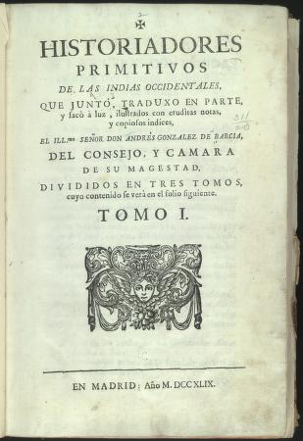
Cabeza de Vaca’s story
Finally, eight years after they had set out, the few who survived made it to their destination of present-day Mexico City, where they knew they would find many other Spaniards. Cabeza de Vaca wrote a book about his experiences. In English, it is called “The Narrative of Cabeza de Vaca.” The excerpts in your activity are from his book.
A printing of Cabeza de Vaca’s book in the original Spanish.
https://education.texashistory.unt.edu
Notes:
--Núñez Cabeza de Vaca, Alvar.Naufragios de Alvar Nuñez Cabeza de Vaca, y Relacion de la jornada, que hizo a la Florida con el adelantado Panfilo de Narvaez. 1749. Library of Congress. Naufragios de Alvar Nuñez Cabeza de Vaca, y Relacion de la jornada, que hizo a la Florida con el adelantado Panfilo de Narvaez. | Library of Congress (loc.gov)

Slide 13

Primary Source Activity
https://education.texashistory.unt.edu

Slide 14
Directions: Part I
Match each Excerpt Card with the Translation card that best restates the excerpt in modern language.
Excerpt Card
A, B, C, D
Translation Card
1, 2, 3, 4
https://education.texashistory.unt.edu

Slide 15
Directions: Part II
Complete the chart that follows using your excerpt and translation cards.
Excerpt Card
A, B, C, D
Translation Card
1, 2, 3, 4
https://education.texashistory.unt.edu

Slide 16
Directions: Part III
Using the excerpt and translation cards, and the information on your chart, answer the comprehension questions that follow.
https://education.texashistory.unt.edu

Slide 17
How do we know what we know?
Exit Ticket
https://education.texashistory.unt.edu

Slide 18
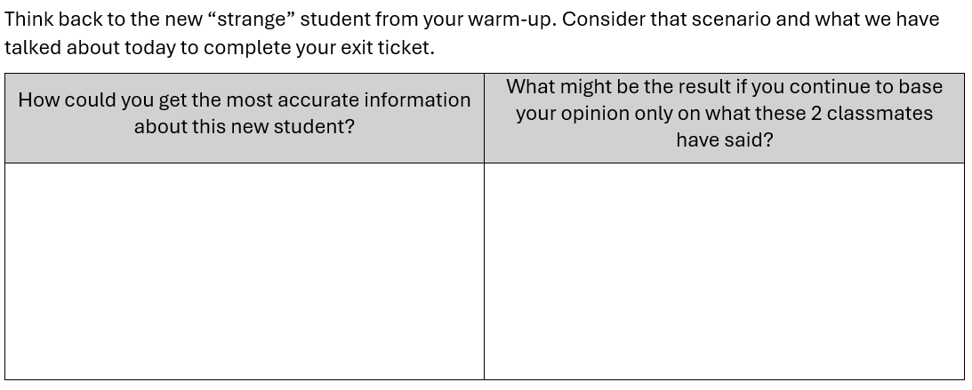
Follow the directions to complete your Exit Ticket
https://education.texashistory.unt.edu

Slide 19
Share your response 2
I could get the most accurate information about the new student by _________
If I base my opinion only what others have said, the result might be that _______
https://education.texashistory.unt.edu

