Slide 1
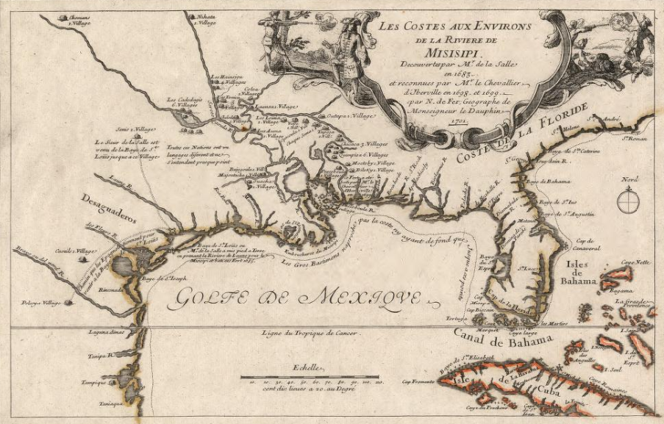
Unit 2: Age of Contact
Lesson 9:
The French Arrive!
Notes:
Fer, Nicolas De, and Vincent De Ginville. Les costes aux environs de la rivière de Misisipi: découvertes par Mr. de la Salle enet reconnues par Mr. le Chevallier d'Iberville en 1698 et 1699. 1701. Map. https://www.loc.gov/item/2003623128/.

Slide 2






Guided Notes: The French Arrive! Warm-up
https://education.texashistory.unt.edu

Slide 3
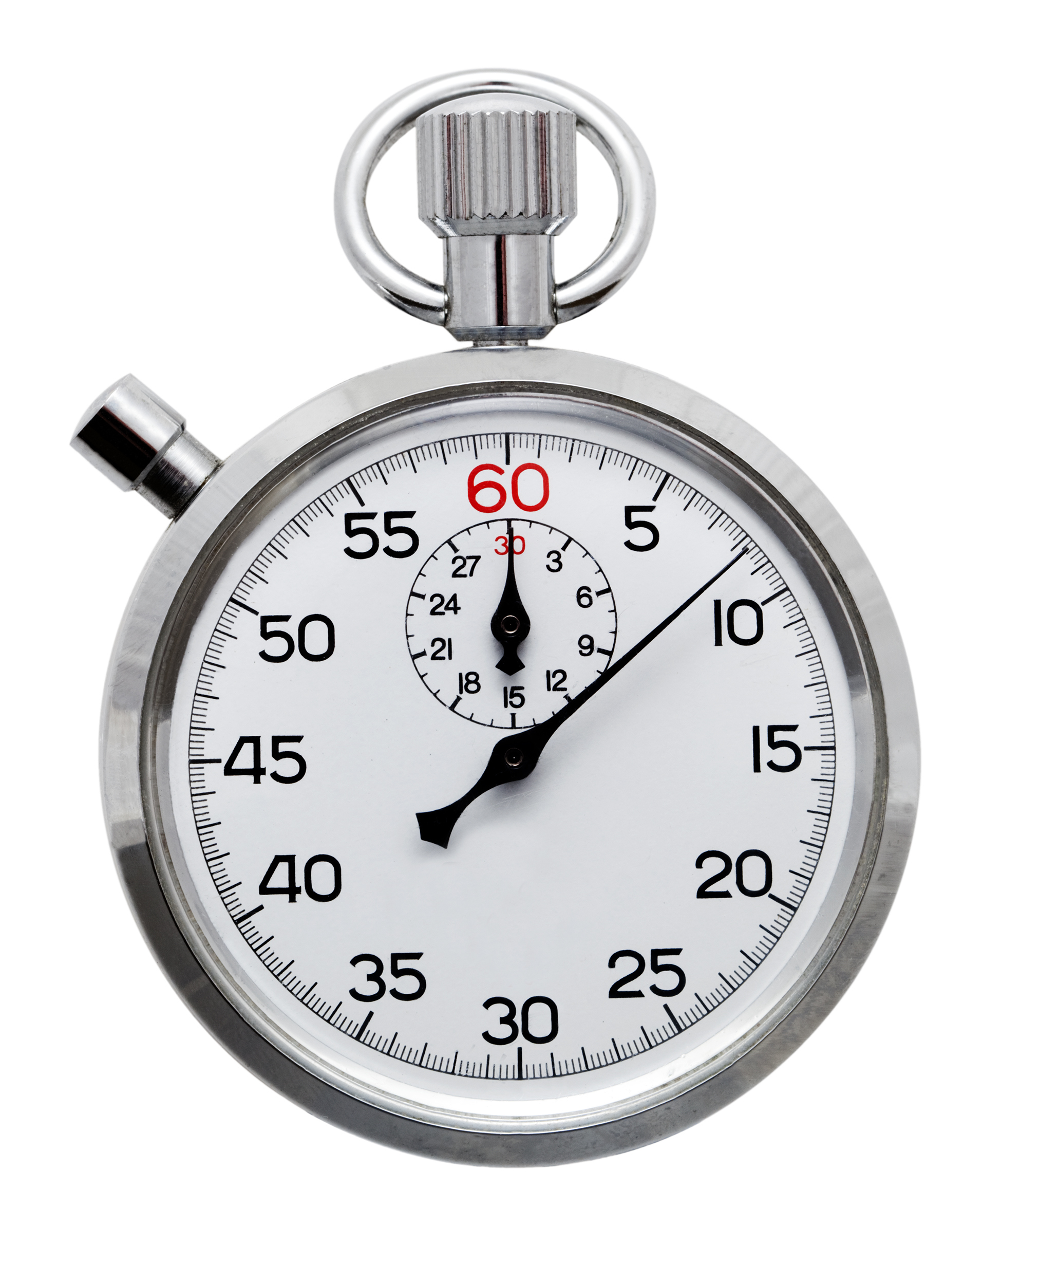
Warm-up: Follow the directions to complete your warm-up
Read each scenario and provide your opinion in the response.
Share with a partner.
https://education.texashistory.unt.edu
Notes:
Stock images of clock from Microsoft PowerPoint

Slide 4
Share with the class
When a child sees another kid playing with a toy that they had first, the first child often _____________
If two countries are exploring the same land that one of them claimed first, I think ____________
https://education.texashistory.unt.edu

Slide 5
Essential Questions
How successful was Spain at accomplishing its goals of “God, Gold, and Glory” in Texas?
What does Spain do as a result?
How does the arrival of the French change Spain’s response?
https://education.texashistory.unt.edu

Slide 6
In today’s lesson…
We will examine the significance of the last Spanish conquistadors to explore Texas and the first French explorer to arrive in Texas.
I will complete my guided note-taking chart including writing key information, the significance of each topic, and responding to an essential question about each topic.
https://education.texashistory.unt.edu

Slide 7
Hernando de Soto
Key Information
Explored the American southeast No gold Died near Texas
What do I need to write?
Even though neither Cabeza de Vaca nor Francisco Coronado had any success acquiring gold in North America, other conquistadors still tried their luck in the lands north of Mexico.
A man named Hernando de Soto led an expedition that began in Florida. He and his men traveled through present-day Georgia, North and South Carolina, Tennessee, Alabama, Mississippi, Arkansas, and Louisiana.
De Soto and his men were the first known Europeans to explore much of the American southeast. Unfortunately, he came down with a severe fever and died at the Mississippi River in May of 1542.
Before he died, he left another conquistador named Luis de Moscoso Alvarado in charge of his expedition. Moscoso would go on to explore Texas.
Significance
First known European to explore the southeastern part of North America.
Essential Question
Do you predict Moscoso will have any luck finding gold in Texas? Why or why not?
https://education.texashistory.unt.edu

Slide 8
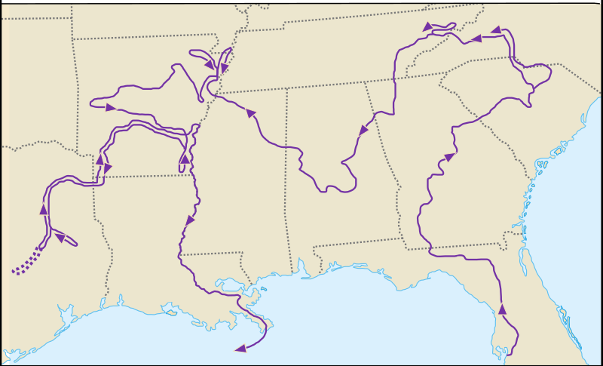




Hernando de Soto’s Expedition
https://education.texashistory.unt.edu
Notes:
Carte Expedition Hernando de Soto. This work has been released into the public domain by its author, I, Urban. This applies worldwide. In some countries this may not be legally possible; if so: I, Urban grants anyone the right to use this work for any purpose, without any conditions, unless such conditions are required by law. https://commons.wikimedia.org/wiki/File:Carte_expedition_Hernando_de_Soto_2.svg

Slide 9
Luis de Moscoso Alvarado
Key Information
Encountered the Caddo people Struggled in south TX Left with no gold.
What do I need to write?
After de Soto’s death in 1542, Moscoso continued into Texas. He led the expedition into northeastern Texas – part of the rich and fertile Coastal Plains. This area was populated primarily by different tribes within the Caddo Confederacy.
Moscoso encountered several groups of Caddo people, including the Naguatex, Hacanac, and Maye people. A member of Moscoso’s expedition kept a journal in which he documented many encounters with the Caddo and other Indigenous people of the Coastal Plains.
As Moscoso’s expedition made its way toward the southern portion of the Coastal Plains, they encountered difficulties resulting from the harsher climate and environment, and the lack of food and other resources there. Moscoso and his men decided to leave Texas because of these hardships.
Significance
His expedition in Texas failed to find any gold.
Essential Question
Does this information about the Coastal Plains support what we learned about the region in Unit 1? Why or why not?
https://education.texashistory.unt.edu

Slide 10
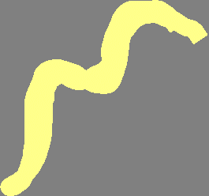
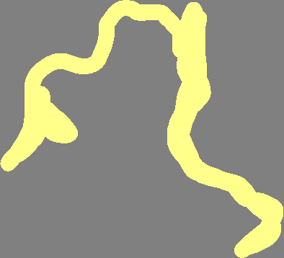
Luis de Moscoso Alvarado’s Expedition
https://education.texashistory.unt.edu
Notes:
Carte Expedition Hernando de Soto. This work has been released into the public domain by its author, I, Urban. This applies worldwide. In some countries this may not be legally possible; if so: I, Urban grants anyone the right to use this work for any purpose, without any conditions, unless such conditions are required by law. https://commons.wikimedia.org/wiki/File:Carte_expedition_Hernando_de_Soto_2.svg

Slide 11
Juan de Oñate
Key Information
Established a settlement at El Paso. Founded Santa Fe, NM Claimed New Mexico
Despite the fact that the expeditions of Cabeza de Vaca, Coronado, de Soto, and Moscoso all failed to find gold north of Mexico, another conquistador set out in search of riches. His name was Juan de Oñate. His expedition took place in 1598, more than 50 years after Moscoso passed through the Coastal Plains.
Oñate decided to search in the west. He established a settlement in the Mountains and Basins region at a place called El Paso del Norte. Does that sound familiar? It is modern-day El Paso, Texas!
He continued into present day New Mexico and claimed all the land there in the name of Spain. He is also credited with founding Santa Fe, New Mexico.
There were claims that Oñate was harsh and cruel to both American Indian people and his own men. After his expedition failed to find gold, he was put on trial for crimes including cruelty. He was found guilty and exiled, though his conviction was later overturned.
What do I need to write?
Significance
His expedition in Texas failed to find any gold.
Essential Question
Think back to the Mountains and Basins region of Texas. Based on your knowledge, what might Oñate have encountered there?
https://education.texashistory.unt.edu

Slide 12
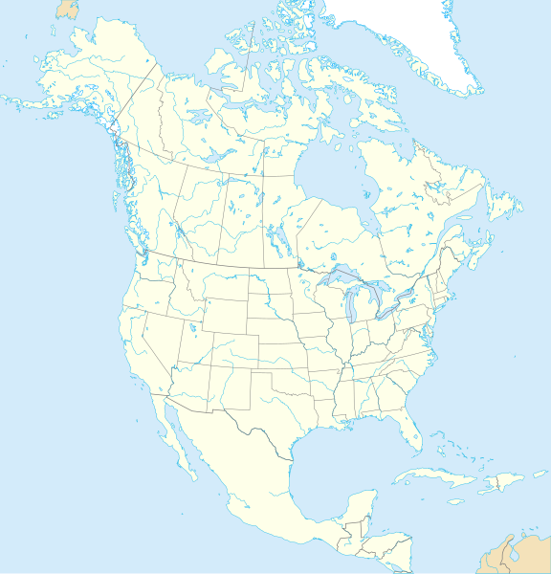

Juan de Oñate’s Expedition
New Mexico
Santa Fe
El Paso
Texas
Gulf of Mexico
Pacific Ocean
Mexico City
https://education.texashistory.unt.edu
Notes:
North America map with states and provinces. This file is licensed under the Creative Commons Attribution-Share Alike 3.0 Unported license. The map has been cropped and edited to add locations significant to Texas history. https://commons.wikimedia.org/wiki/File:North_America_map_with_states_and_provinces.svg

Slide 13
René-Robert Cavelier, Sieur de La Salle
Key Information
Mexican silver and gold made Spain rich. Spain ignored Texas. French Fort Saint Louis in TX
What do I need to write?
Spain had been growing extremely wealthy from resources like gold, and especially silver, in Mexico. In contrast, Texas had brought Spain no wealth at all. As a result, Spain essentially began to ignore its northern frontier and focus its attention mostly on Mexico.
Then, 87 years after Oñate and nearly 150 years after Moscoso, on a cold February day in 1685, a French man named Robert La Salle arrived with more than 100 other French people in Matagorda Bay, Texas. He built a fort he called Fort Saint Louis. He and his men quickly began exploring Texas, planning to take part in the fur trade with American Indians. This was a huge problem for Spain.
Spain and France had been enemies for hundreds of years. Spain might have lost interest in Texas, but the Spanish definitely didn’t want the French to have it! La Salle’s expedition was a failure. He even ended up being killed by his own men. Even so, La Salle’s arrival still made Spain worried enough to turn its attention back to Texas.
Significance
Spain wanted to keep Texas out of French hands.
Essential Question
Considering Spain’s goals of “God, Gold, and Glory,” what do you think Spain will focus on next in Texas?
https://education.texashistory.unt.edu

Slide 14

La Salle’s Expedition
La Salle Killed, 1687
Texas
Fort Saint Louis, 1685
Mexico City
Gulf of Mexico
Pacific Ocean
https://education.texashistory.unt.edu
Notes:
North America map with states and provinces. This file is licensed under the Creative Commons Attribution-Share Alike 3.0 Unported license. The map has been cropped and edited to add locations significant to Texas history. https://commons.wikimedia.org/wiki/File:North_America_map_with_states_and_provinces.svg

Slide 15
Guided Notes: The French Arrive! Exit Ticket
https://education.texashistory.unt.edu

Slide 16
Exit Ticket: Follow the directions to complete your warm-up
Read each box showing Spain’s possible response to France’s arrival in Texas.
Highlight or circle which three you think are most likely.
Share with a partner.
https://education.texashistory.unt.edu
Notes:
Stock images of clock from Microsoft PowerPoint

Slide 17
Share with the class 2
One thing I think the Spanish might do in response to the arrival of the French is ________
https://education.texashistory.unt.edu

