Slide 1
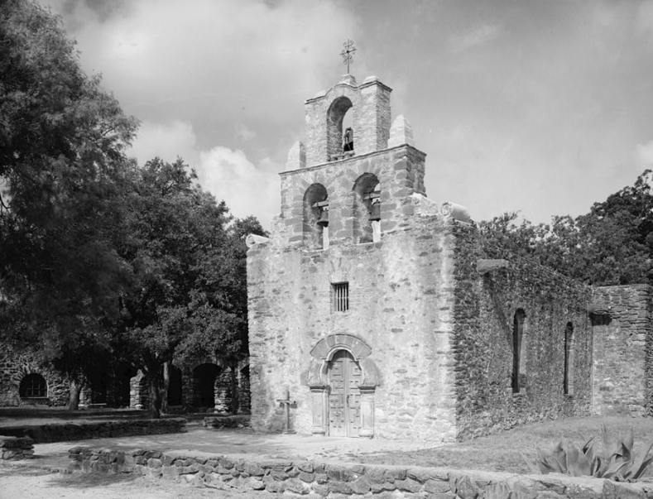
Unit 2:
Age of Contact
Lesson 12:
Looking Ahead
Notes:
Historic American Buildings Survey, Creator. Mission San Francisco de la Espada, Church, Berg's Mill Community, San Antonio, Bexar County, TX. Texas Bexar County San Antonio, 1933. Documentation Compiled After. Photograph. https://www.loc.gov/item/tx0499/.

Slide 2

Looking Ahead
Warm-up
https://education.texashistory.unt.edu

Slide 3

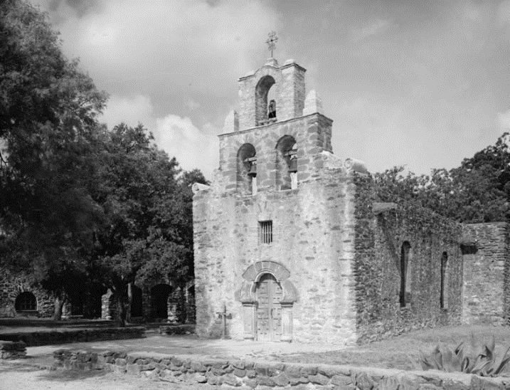


Warm-up:
Follow the directions to complete your warm-up
Observe the image on your warm-up and write your observations in the space provided.
Explain how you think this image connects to the Spanish in Texas.
Discuss your response with a partner.
https://education.texashistory.unt.edu
Notes:
Historic American Buildings Survey, Creator. Mission San Francisco de la Espada, Church, Berg's Mill Community, San Antonio, Bexar County, TX. Texas Bexar County San Antonio, 1933. Documentation Compiled After. Photograph. https://www.loc.gov/item/tx0499/.

Slide 4
Share with the class 1
One thing I observed about the image is ___________
This image might relate to the Spanish in Texas because_________
https://education.texashistory.unt.edu

Slide 5
Essential Question
How did Spain attempt to keep Texas out of the hands of the French, and what challenges did the Spanish face in carrying out this goal?
https://education.texashistory.unt.edu

Slide 6
In today’s lesson…
We will examine Spain’s new goal in Texas, why they chose to pursue this goal, and the challenges they face.
I will read 3 primary source excerpts about Spain’s new goal in Texas, answer comprehension questions, and make predictions about the next unit.
https://education.texashistory.unt.edu

Slide 7
Looking Ahead
Lesson
https://education.texashistory.unt.edu

Slide 8
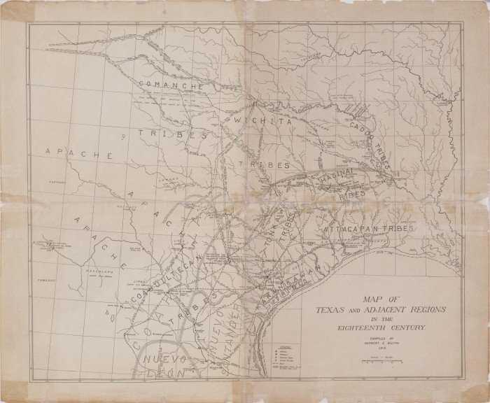
Part I: Transitioning to a New Era
A map of Texas, 18th Century
University of North Texas Libraries, The Portal to Texas History
https://education.texashistory.unt.edu
Notes:
Bolton, Herbert E. Map of Texas and Adjacent Regions in the Eighteenth Century, map, 1915; (https://texashistory.unt.edu/ark:/67531/metapth492871/: accessed September 11, 2024), University of North Texas Libraries, The Portal to Texas History, https://texashistory.unt.edu; crediting Hardin-Simmons University Library.

Slide 9
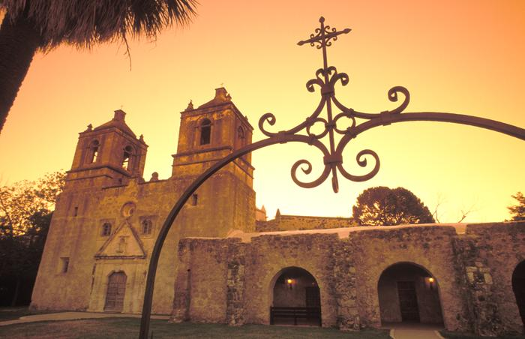
Part II: A New Approach to Texas
Mission Concepción in San Antonio, Texas
University of North Texas Libraries, The Portal to Texas History
https://education.texashistory.unt.edu
Notes:
Mallory, Randy. [Timeless Beauty: Mission Concepción, San Antonio's Living Heritage], photograph, 20XX; (https://texashistory.unt.edu/ark:/67531/metadc1980254/: accessed September 10, 2024), University of North Texas Libraries, The Portal to Texas History, https://texashistory.unt.edu; crediting UNT Libraries Special Collections.

Slide 10

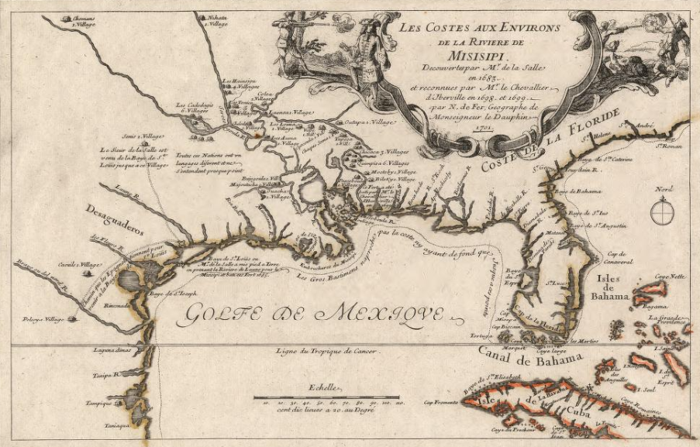
Excerpt I: The French Threat
A map of French exploration, including in Texas, 1698
Library of Congress
https://education.texashistory.unt.edu
Notes:
Fer, Nicolas De, and Vincent De Ginville. Les costes aux environs de la rivière de Misisipi: découvertes par Mr. de la Salle enet reconnues par Mr. le Chevallier d'Iberville en 1698 et 1699. 1701. Map. https://www.loc.gov/item/2003623128/.

Slide 11
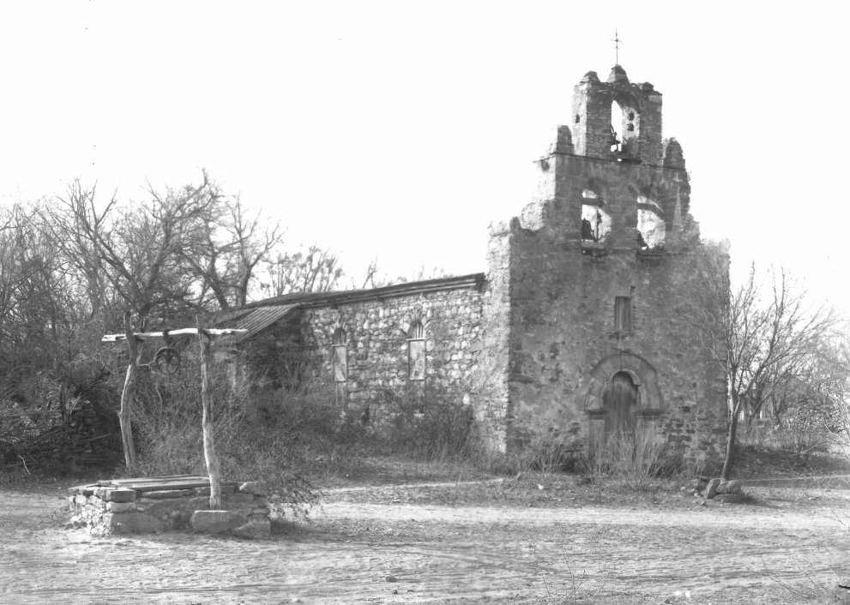
Excerpt II: Insufficient Support
Mission Espada, San Antonio Texas
University of North Texas Libraries, The Portal to Texas History
https://education.texashistory.unt.edu
Notes:
Raba, Ernst Wilhelm. Mission Espada. 8 x 10 in. The Portal to Texas History. https://texashistory.unt.edu/ark:/67531/metapth459952.

Slide 12
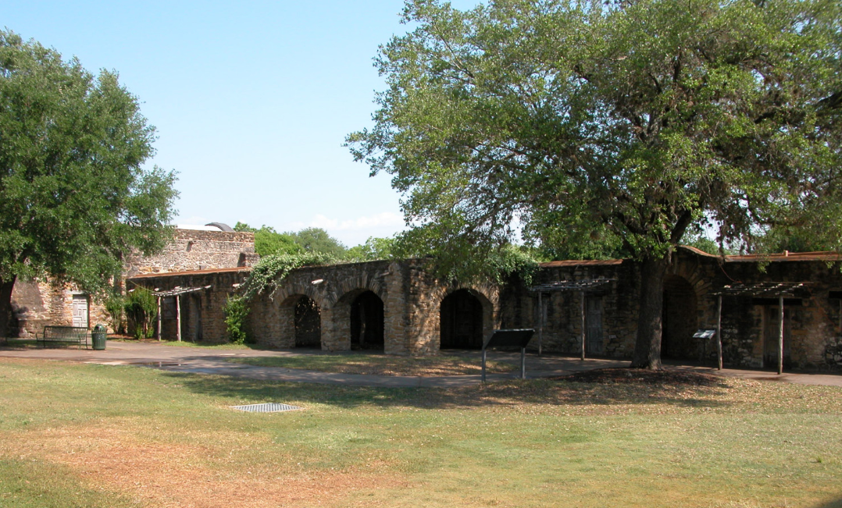
Excerpt III: American Indian Resistance to Religious Conversion
Mission San Jose, San Antonio Texas
University of North Texas Libraries, The Portal to Texas History
https://education.texashistory.unt.edu
Notes:
Belden, Dreanna. Mission San Jose. May 4, 2005. The Portal to Texas History. https://texashistory.unt.edu/ark:/67531/metapth3545/.

Slide 13
Looking Ahead
Exit Ticket
https://education.texashistory.unt.edu

Slide 14

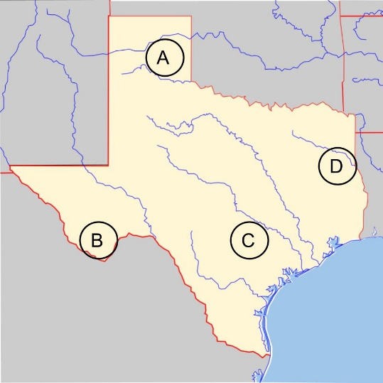
Exit Ticket:
Follow the directions to complete your warm-up
In which approximate location on the map was Fray Hidalgo attempting to establish missions?
Why was he attempting to establish missions in that area?
Discuss your response with a partner.
https://education.texashistory.unt.edu
Notes:
Blank map of Texas. Edited to include 4 labels lettered A through D for the assignment. Permission is granted to copy, distribute and/or modify this document under the terms of the GNU Free Documentation License, Version 1.2 or any later version published by the Free Software Foundation; with no Invariant Sections, no Front-Cover Texts, and no Back-Cover Texts. A copy of the license is included in the section entitled. This file is licensed under the Creative Commons Attribution-Share Alike 3.0 Unported license. GNU Free Documentation License. https://commons.wikimedia.org/wiki/File:Texas_blank_map.svg

Slide 15
Share with the class 2
Fray Hidalgo was attempting to establish missions at the location labeled letter _______.
He was attempting to establish missions in this area because ______
https://education.texashistory.unt.edu

