Slide 1

Unit 2: Age of Contact
Bingo Review Game
https://education.texashistory.unt.edu

Slide 2
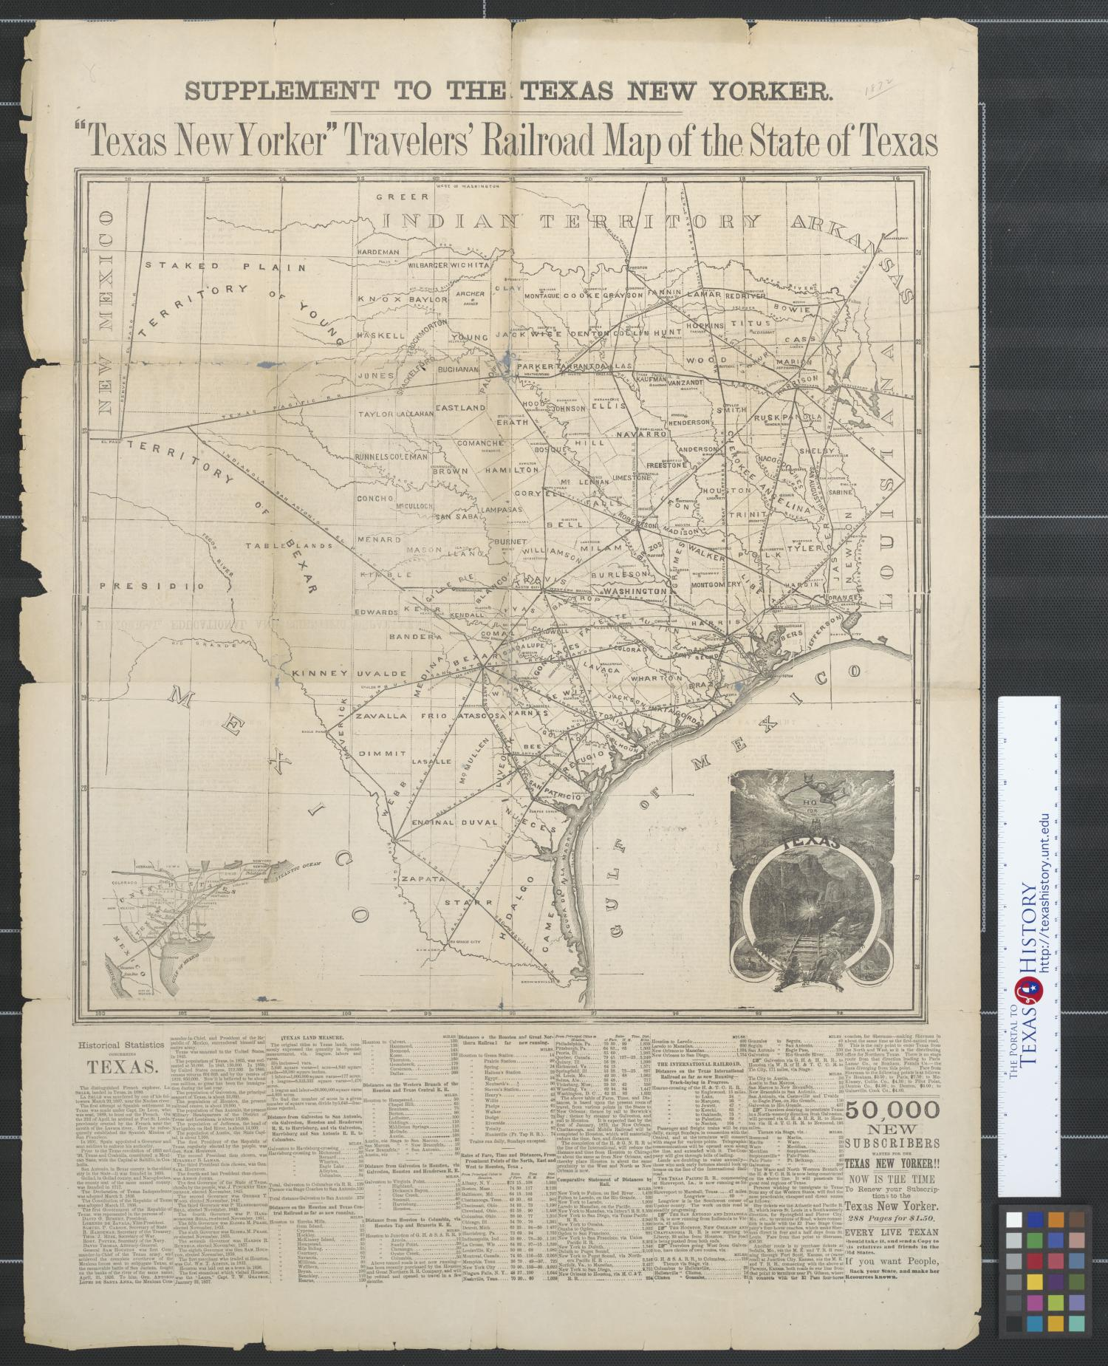
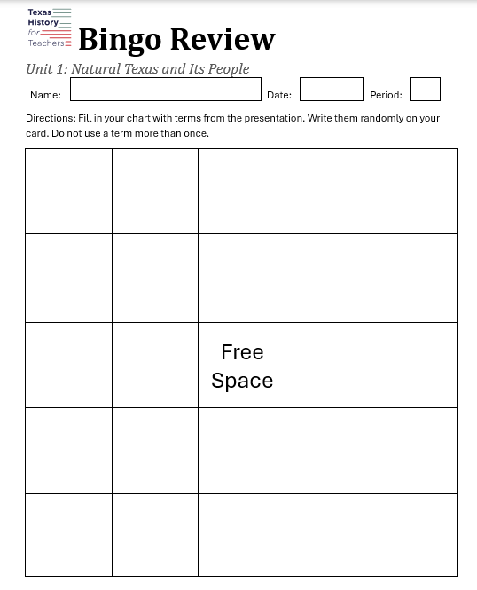
Fill In Your Card
Fill in every square on your Bingo card.
  Only write one term in each box.
  Do not use a term more than once.
  Advanced: Leave room in the box to make quick notes.
https://education.texashistory.unt.edu

Slide 3
How to Play:
Your teacher will call out clues related to each term.
If you think you know which term the clue is referring to, raise your hand.
If you are correct, everyone who has the term can cover it on their Bingo Card.
If you are incorrect, the class must keep trying to determine the correct term.
https://education.texashistory.unt.edu

Slide 4
How do you win?
You are trying to get 5 terms in a row horizontally, vertically, or diagonally.
https://education.texashistory.unt.edu

Slide 5
Unit 2 Bingo Review
Choose from the terms below to randomly fill in every square on your Bingo card. Do not use a term more than once. You will not use every term.
https://education.texashistory.unt.edu
1. Conquistador | 8. Hernán Cortés | 15. de Soto | 22. Disease | 29. Estevanico
2. Expedition | 9. Christopher Columbus | 16. La Salle | 23. Aztecs | 30. La Relación
3. Era | 10. Reconquista | 17. Pineda | 24. Mexico City | 31. France
4. Columbian Exchange | 11. Cabeza de Vaca | 18. Territorial Disputes | 25. New Spain | 32. Fort Saint Louis
5. Colonization | 12. God, Gold, and Glory | 19. 7 Cities of Cibola | 26. Cash Crops | 33. Gulf of Mexico
6. Viceroy | 13. Coronado | 20. 1519 | 27. El Paso | 32. Rio Grande
7. Plantations | 14. Oñate | 21. Horses | 28. Santa Fe | 33. Moscoso

Slide 6

Closing Activity
One term from my card is ________. Something I know about this term is __________
One term from my card is ________. Three key words related to this term are _____ , _____ , and ______.
https://education.texashistory.unt.edu

