Slide 1

Mind Map
Sub-topic
1
Additional information
Sub-topic
2
Main Topic
Additional information
Sub-topic
3
Additional information
Additional information
https://education.texashistory.unt.edu

Slide 2

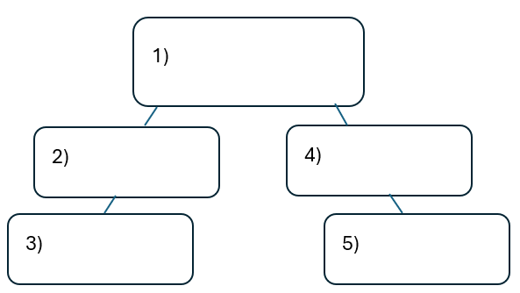


Warm-up: Follow the directions on your warm-up
Use the word bank provided to fill in the small mind map on your warm-up.
Place each term where you think it fits best in your mind map.
Discuss with a partner.
https://education.texashistory.unt.edu

Slide 3
Share with the class
I think the primary topic in box number one is _______
I think the subtopic in box number two is ____, and box number three is ____
I think the subtopic in box number four is ____, and box number five is ____
https://education.texashistory.unt.edu

Slide 4
Essential Question
How do the key terms and concepts from Unit 2: Age of Contact connect to each other?
https://education.texashistory.unt.edu

Slide 5
In today’s lesson…
We will make connections between key terms and concepts within all of Unit 2: Age of Contact
I will create a Mind Map using terms and concepts from the class slides presentation.
https://education.texashistory.unt.edu

Slide 6
Unit Topic
In the middle of your mind map, write the topic from the box below. Write it large but leave plenty of room around for more information
Spanish Exploration
https://education.texashistory.unt.edu

Slide 7
Unit Subtopics
Add the following subtopics around the main topic. Leave plenty of room around each for more information.
Causes
Effects
People
Events
https://education.texashistory.unt.edu

Slide 8
Make Connections
Connect each item below to one of the topics on your Mind Map.
There may be more than one place that these items connect. Be ready to explain where you put each one.
The Columbian Exchange
God, Gold, and Glory
Hernán Cortés
The Reconquista
Christopher Columbus
Conquistador
https://education.texashistory.unt.edu

Slide 9
Make Connections 2
Connect each item below to one of the topics on your Mind Map.
There may be more than one place that these items connect. Be ready to explain where you put each one.
Alonso Álvarez de Pineda
Cabeza de Vaca
The Aztecs
Plantations
Tenochtitlan
Food, Plants, Livestock
https://education.texashistory.unt.edu

Slide 10
Make Connections 3
Connect each item below to one of the topics on your Mind Map.
There may be more than one place that these items connect. Be ready to explain where you put each one.
Francisco Vazquez de Coronado
Horses
Cash Crops
1519
Stranded in Florida
Mexico City
https://education.texashistory.unt.edu

Slide 11
Make Connections 4
Connect each item below to one of the topics on your Mind Map.
There may be more than one place that these items connect. Be ready to explain where you put each one.
Disease
New Spain
La Relacion Book
Estevanico
1492
Gulf of Mexico Map
https://education.texashistory.unt.edu

Slide 12
Make Connections 5
Connect each item below to one of the topics on your Mind Map.
There may be more than one place that these items connect. Be ready to explain where you put each one.
La Salle
Colonization
7 Cities of Cibola
Hernando de Soto
Juan de Oñate
Explored Southwest
https://education.texashistory.unt.edu

Slide 13
Make Connections 6
Connect each item below to one of the topics on your Mind Map.
There may be more than one place that these items connect. Be ready to explain where you put each one.
Explored the southeast
Fort Saint Louis
El Paso, TX
French threat
Santa Fe, NM
Silver Mines
https://education.texashistory.unt.edu

Slide 14

Create Connections 6
Now take a few minutes to add any information you can think of to your Mind Map.
You can add facts, descriptions, explanations, cultural information, or anything else you can think of.
https://education.texashistory.unt.edu

Slide 15
Exit Ticket
Complete the sentence summarizing the main idea from our unit.
Discuss with a partner.
https://education.texashistory.unt.edu

Slide 16
Share your response
The ___________ is primarily characterized by __________
https://education.texashistory.unt.edu

