Slide 1
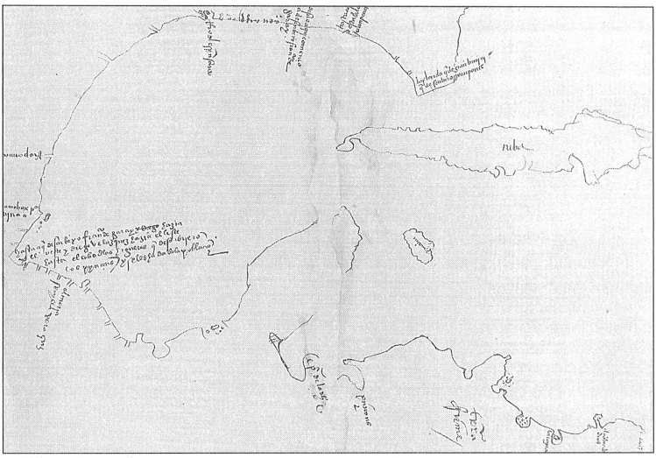
Unit 2 :
Age of Contact
Lesson 13 :
Study Guide
Notes:
Tyler, Ron, George B. Ward, Paula M. Marks, Martin D. Kohout, and Janice M. Pinney, eds. The Southwestern Historical Quarterly. (Austin: The Texas State Historical Association, 1995), 368, fig. 1. https://texashistory.unt.edu/ark:/67531/metapth101216/m1/424/.

Slide 2






Study Guide Review
Warm-up
https://education.texashistory.unt.edu

Slide 3

Warm-up:
Follow the directions to complete your warm-up
Read the list of social studies topics in the chart.
Circle or highlight any items that you think are likely to be on the unit 2 test.
Share with a partner.
https://education.texashistory.unt.edu

Slide 4
Share with the class
One thing that I think is likely to be on the unit 2 test is _______________
https://education.texashistory.unt.edu

Slide 5
Essential Question
What significant information do we need to know in order to be successful on the unit 2 test?
https://education.texashistory.unt.edu

Slide 6
In today’s lesson…
We will identify and review significant information for our upcoming test.
I will use my previous work and notes to complete my study guide. I will match information, create short answer responses, and answer practice test questions.
https://education.texashistory.unt.edu

Slide 7
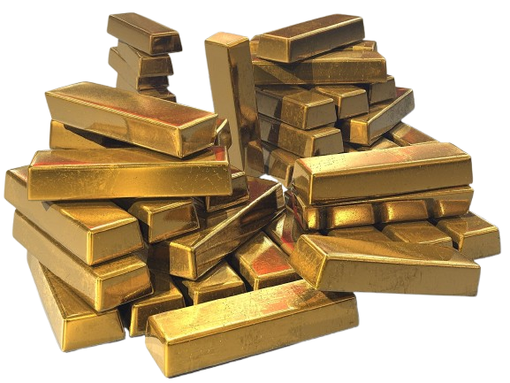
Part I: Key Terms and Definitions
Choose the correct term for each definition in the chart.
https://education.texashistory.unt.edu
Notes:
A pile of stacked gold bars. This file is from Pixabay, where the creator has released it explicitly under the license Creative Commons Zero (see here). File ID: 513062 Background removed by the Portal to Texas History. https://commons.wikimedia.org/wiki/File:Gold_bullion_bars.jpg

Slide 8
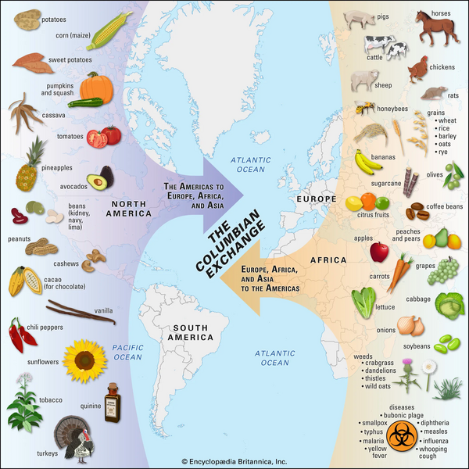
Part II: Matching
Match the term on the left with its correct significance on the right.
https://education.texashistory.unt.edu
Notes:
Columbian Exchange. This file is licensed under the Creative Commons Attribution 4.0 International license. https://kids.britannica.com/students/article/Columbian-Exchange/632098

Slide 9
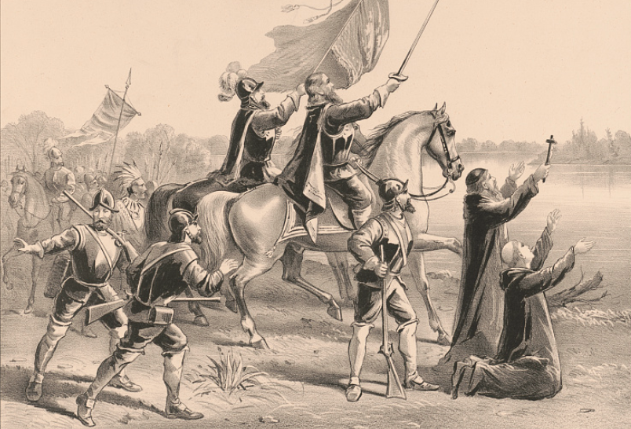
Part III: Practice Questions
Practice answering the following questions to prepare for the types of questions you may see on the exam. These questions are based on the new 8th grade social studies STAAR question types.
https://education.texashistory.unt.edu
Notes:
Currier & Ives. Discovery of the Mississippi: By Ferdinand De Soto, and his followers, May 1541. 1876. Photograph. https://www.loc.gov/item/91795960/.

Slide 10
Study Guide Review
Exit Ticket
https://education.texashistory.unt.edu

Slide 11
Exit Ticket:
Follow the directions to complete your warm-up
Assess your knowledge and preparation for the test
Respond to the prompts about your knowledge of unit 2 content.
Share with a partner.
https://education.texashistory.unt.edu

Slide 12
Share with the class 2
One thing the study guide helped me remember or understand is: _________
One thing I still have a question about is ______
One thing I will do to prepare for this test is ________
https://education.texashistory.unt.edu

