Slide 1
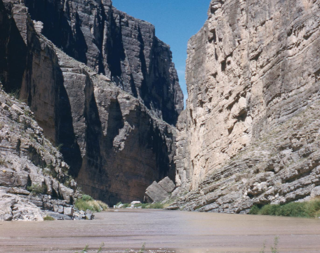
Unit 2: Age of Contact
Lesson 11:
Texas Today
The Rio Grande River
The Portal to Texas History
Notes:
Streng, Evelyn Fielder. Rio Grande River in Santa Elena Canyon 2. 1951. Photograph, 35 mm. The Portal to Texas History. https://texashistory.unt.edu/ark:/67531/metapth860548/.

Slide 2
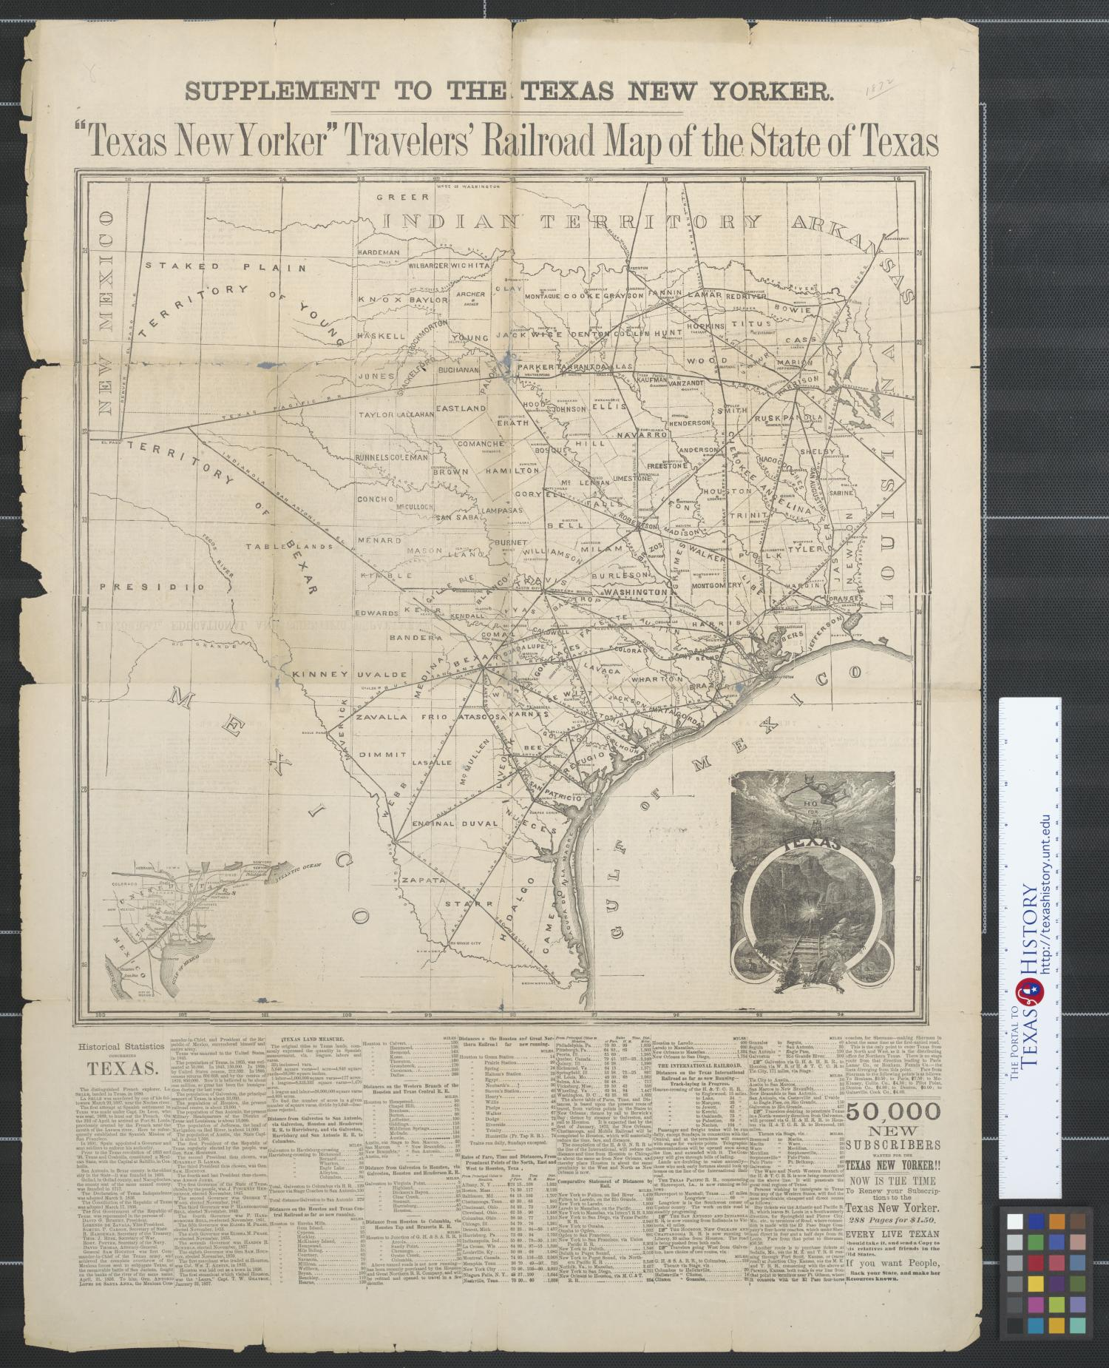



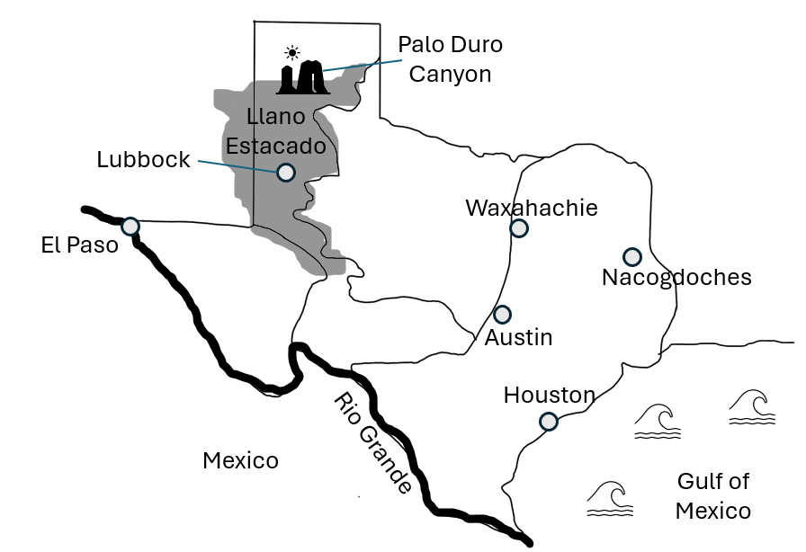



Warm-up Follow the directions below to complete your warm-up
Look at the map of some present-day geographic locations in Texas.
What evidence do you see of Spanish or American Indian history, life, or culture based only on this map
Discuss with a partner.
https://education.texashistory.unt.edu

Slide 3
Share with the class: day 1
I think _______ might show evidence of Spanish culture because __________
I think _______ might show evidence of American Indian culture because __________
https://education.texashistory.unt.edu

Slide 4
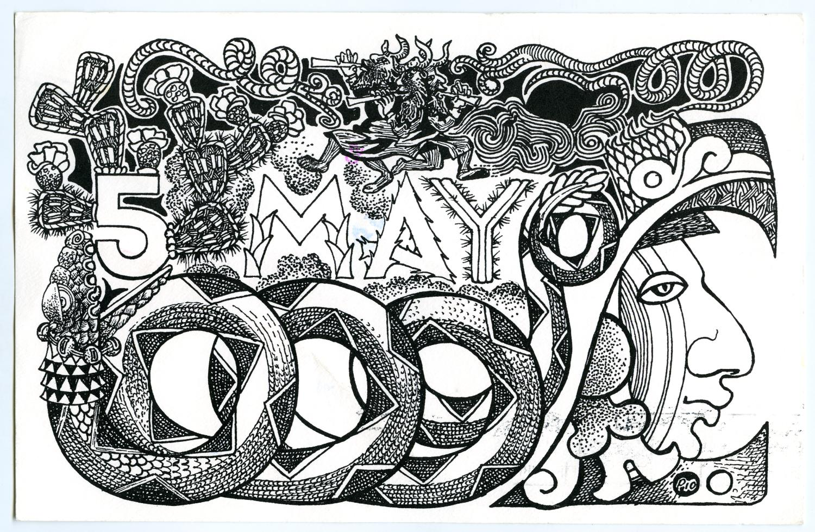
Essential Question
What evidence can we see today of Spanish or American Indian culture and influence on Texas geography?
https://education.texashistory.unt.edu

Slide 5
In Today’s Lesson
We will read short passages about various natural and human geographic features of Texas to identify Spanish and American Indian influence in modern Texas.
I will use the clues and information in each passage to correctly label significant geographic features on a map of Texas.
https://education.texashistory.unt.edu

Slide 6
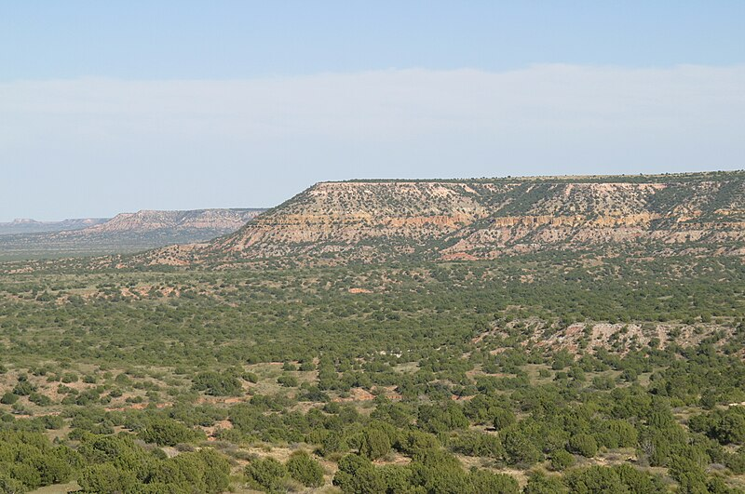
Llano Estacado
The northern edge of the Llano Estacado
https://education.texashistory.unt.edu
Notes:
Escarpment that defines the northern edge of high plains of the Llano Estacado. View looking east from a point 14 km south of San Jon, Eastern New Mexico. The view today is very different from that of 2003. Numerous wind turbines have been installed along these precipitous cliffs. This file is licensed under the Creative Commons Attribution-Share Alike 3.0 Unported license. https://commons.wikimedia.org/wiki/File:Llano_Escarpment.jpg

Slide 7
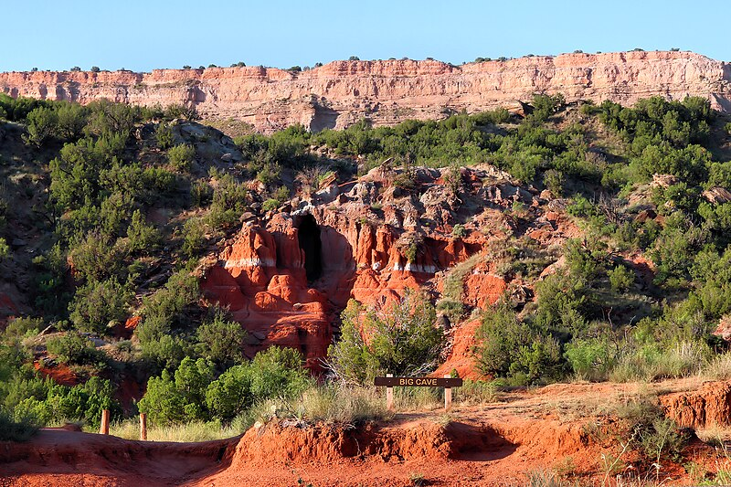
Palo Duro Canyon
The entrance to Big Cave in Palo Duro Canyon
Larry D. Moore Photograph
https://education.texashistory.unt.edu
Notes:
The entrance to Big Cave in Palo Duro Canyon in Randall County, Texas, United States. © 2024 Larry D. Moore. Licensed under CC BY 4.0. Attribution Specification: Reuse without attribution is a violation of the license. The photographer's name and the link to the license are required. A link back to this source is requested. Example: Larry D. Moore, CC BY 4.0, Wikimedia Commons. https://commons.wikimedia.org/wiki/File:Big_Cave_Palo_Duro_Canyon_Texas_2024.jpg

Slide 8
The Rio Grande
The Rio Grande River in Santa Elena Canyon
Photograph by Evelyn Streng
The Portal to Texas History
https://education.texashistory.unt.edu
Notes:
Streng, Evelyn Fielder. Rio Grande River in Santa Elena Canyon 2. 1951. Photograph, 35 mm. The Portal to Texas History. https://texashistory.unt.edu/ark:/67531/metapth860548/.

Slide 9
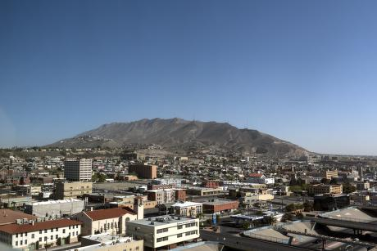
El Paso
Skyline view of El Paso, Texas by Carol Highsmith
Library of Congress
https://education.texashistory.unt.edu
Notes:
Highsmith, Carol M, photographer. Skyline view of El Paso, Texas. El Paso United States Texas, 2014. -03-23. Photograph. https://www.loc.gov/item/2014631659/.

Slide 10
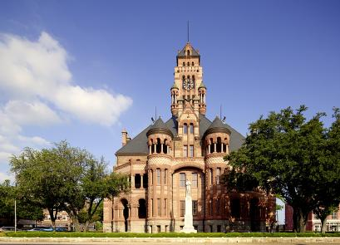
Waxahachie
The 1897 Ellis County Courthouse in Waxahachie, Texas
Library of Congress
https://education.texashistory.unt.edu
Notes:
Highsmith, Carol M, photographer. TheEllis County Courthouse in Waxahachie, Texas, south of Dallas. Waxahachie Ellis County United States Texas, 2014. -05-10. Photograph. https://www.loc.gov/item/2014632669/.

Slide 11
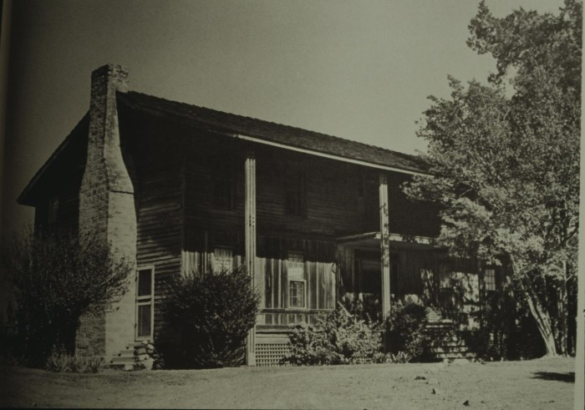
Nacogdoches
A photograph of the Stagecoach Inn founded in 1838
The Portal to Texas History
https://education.texashistory.unt.edu
Notes:
Texas Historical Commission. [Stagecoach Inn], photograph, Date Unknown; (https://texashistory.unt.edu/ark:/67531/metapth954743/: accessed September 10, 2024), University of North Texas Libraries, The Portal to Texas History, https://texashistory.unt.edu; crediting Texas Historical Commission.

Slide 12
Exit Ticket Follow the directions below to complete your warm-up
Read the question to determine which TWO answers provide the most accurate response.
Discuss with a partner.
https://education.texashistory.unt.edu

Slide 13
Share with the class: 2 day 1
One example of Spanish influence on Texas today is __________
One example of American Indian influence on Texas today is __________
https://education.texashistory.unt.edu

