Slide 1
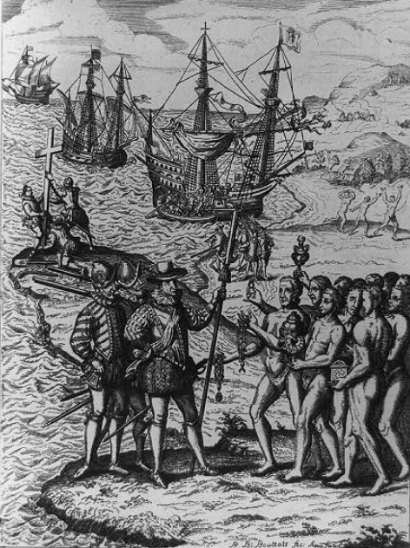
Unit 2: The Age of Contact
Lesson 1:
The Big Picture
Notes:
--Brion, Henry F. and Edmond McClure. Photo Relief Map of North America. 1885. The Portal to Texas History. https://texashistory.unt.edu/ark:/67531/metapth50293.

Slide 2
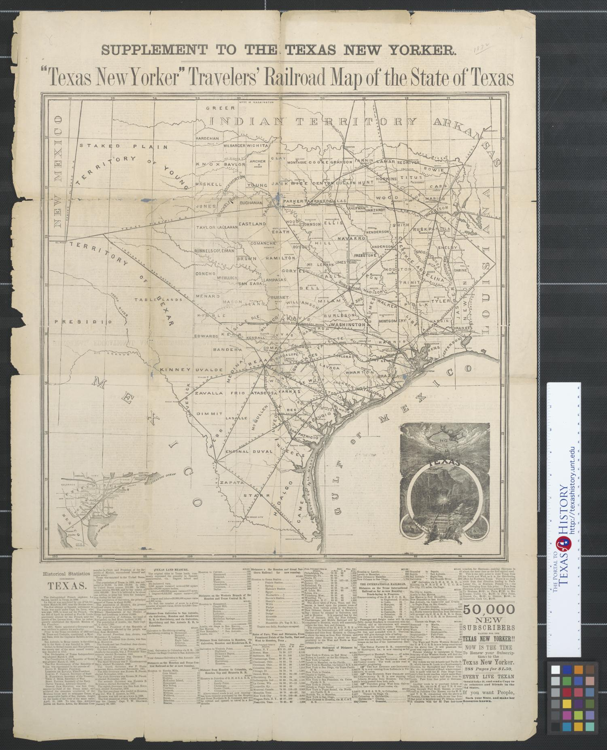





Warm-up: Follow the directions below to complete your warm-up
Read the introductory passage.
Choose the three items that you think were the primary goals of the Spanish.
Place a 1, 2, and 3 next to each goal based on how important you think each was.
Draw an X next to the items that you think were not primary goals for the Spanish.
Discuss with a shoulder partner.
https://education.texashistory.unt.edu

Slide 3
Share with the class: day 1
I think the most important goal for the Spanish was probably _______
I think the second most important goal for the Spanish was probably _______
I think the third most important goal for the Spanish was probably ______
https://education.texashistory.unt.edu

Slide 4
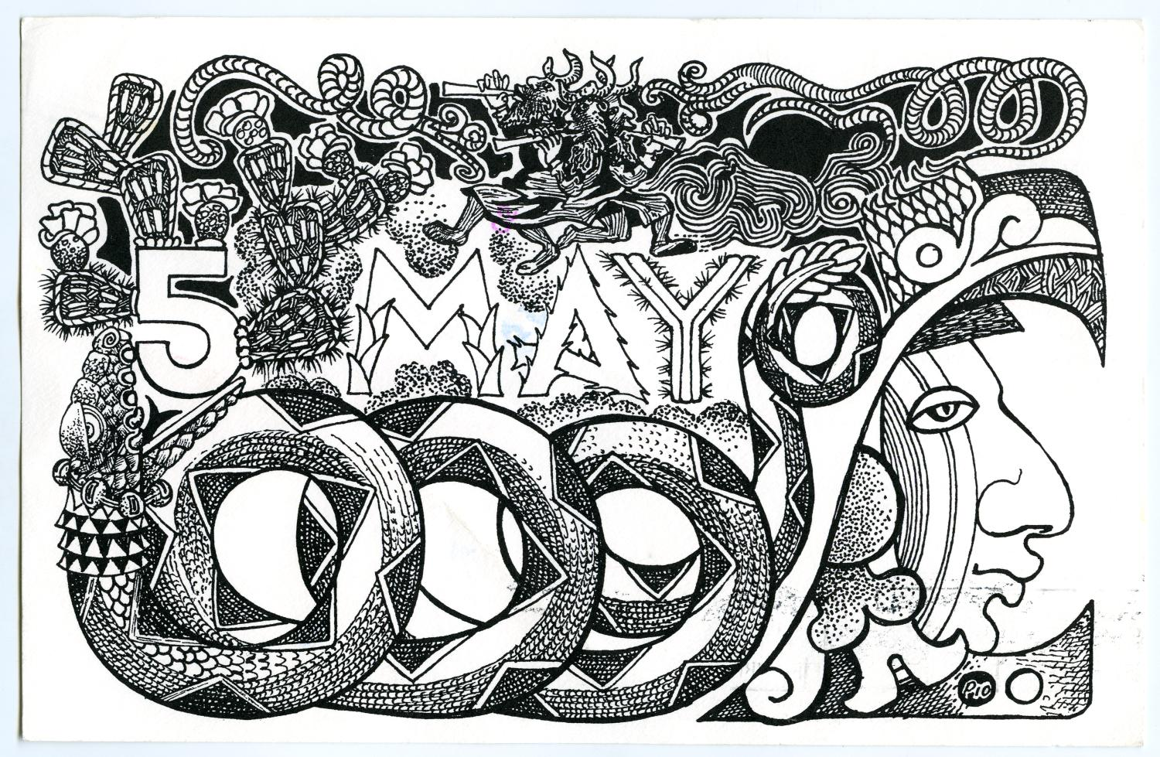
Essential Question
What are the defining characteristics and key concepts of Unit 2: The Age of Contact?
https://education.texashistory.unt.edu

Slide 5
In Today’s Lesson
We will identify key people, events, and concepts of Unit 2: Age of Contact.
I will read a passage about the unit, summarize each paragraph, and provide evidence to support claims about the passage.
https://education.texashistory.unt.edu

Slide 6
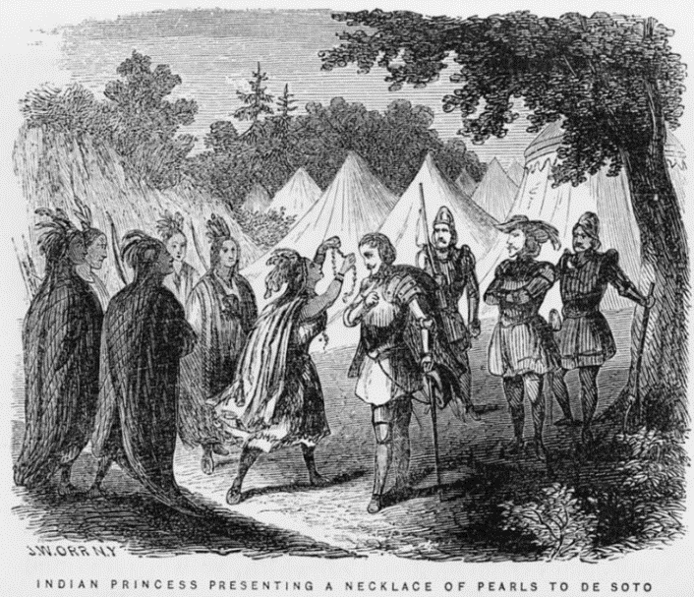
Part I: Analyze an Image
Look at the image on your worksheet, or enlarged here, to answer the questions.
https://education.texashistory.unt.edu
Notes:
--Orr, John William. Indian princess presenting a necklace of pearls to de Soto / J.W. Orr, N.Y. 1858. Photograph. https://www.loc.gov/item/91794402/.

Slide 7
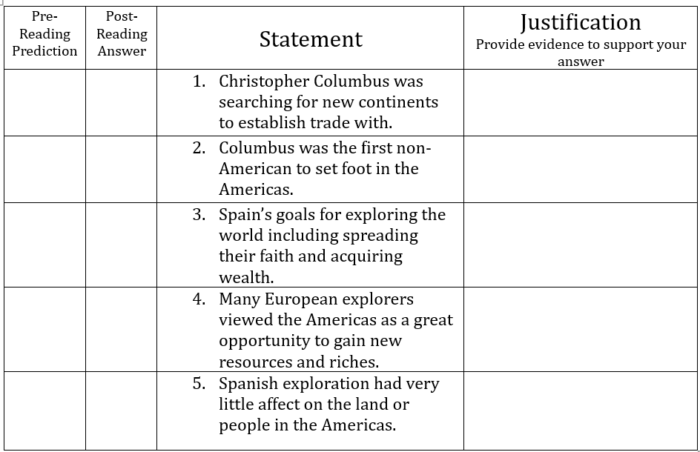


Part II: Essential Ideas Reading Passage
Before you read the passage:
Read each statement here.
Predict whether the answer will be TRUE (T) or FALSE (F)
Write T or F in the pre-reading prediction box
https://education.texashistory.unt.edu

Slide 8
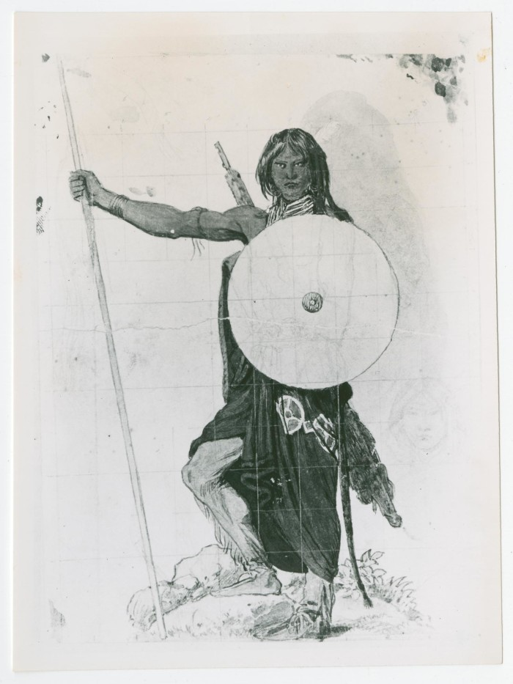


Essential Ideas Reading Image to accompany paragraph 1
Circle or highlight key words
Three-word summary
in the margin
Drawing of an American Indian man with a shield and a spear. Portal to Texas History
https://education.texashistory.unt.edu
Notes:
--Drawing of Man with Spear and Shield. Photograph, 16 x 12 cm (6.29921 x 4.72441 in.). The Portal to Texas History. https://texashistory.unt.edu/ark:/67531/metapth842676/.

Slide 9
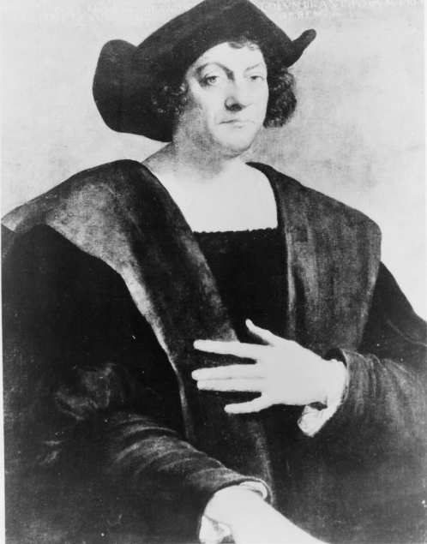
Essential Ideas Reading Image to accompany paragraph 2
Circle or highlight key words
Three-word summary
in the margin
Portrait of Christopher Columbus.
Library of Congress
https://education.texashistory.unt.edu
Notes:
--Sebastiano, Del Piombo. Christopher Columbus, half-length portrait, facing slightly right. 1900. Photograph. https://www.loc.gov/item/91785883/.

Slide 10
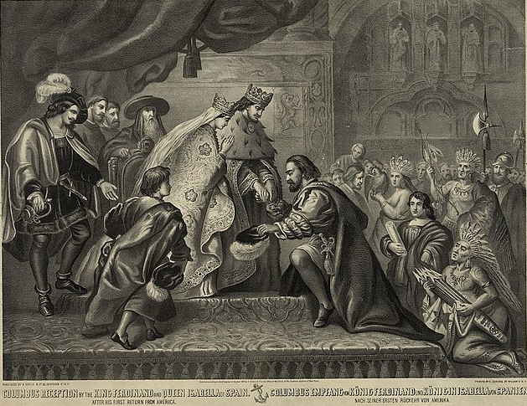
Essential Ideas Reading Image to accompany paragraph 3
Circle or highlight key words
Three-word summary
in the margin
Painting of the king and queen of Spain receiving Christopher Columbus after his first voyage to America. Library of Congress.
https://education.texashistory.unt.edu
Notes:
--Schlegel, George. Columbus reception by the King Ferdinand and Queen Isabella of Spain after his first return from America. Library of Congress. Columbus reception by the King Ferdinand and Queen Isabella of Spain after his first return from America = Columbus empfang von ... (loc.gov)

Slide 11
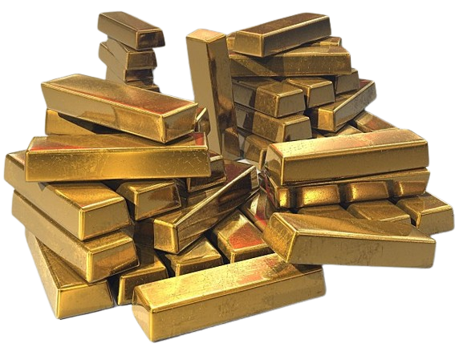
Essential Ideas Reading Image to accompany paragraph 4
Circle or highlight key words
Three-word summary
in the margin
Spain’s greatest goal for exploration: GOLD!
https://education.texashistory.unt.edu
Notes:
-- A pile of stacked gold bars. For use under the Creative Commons License through Pixabay and Wikimedia Commons. File:Gold bullion bars.jpg - Wikimedia Commons. Background removed.

Slide 12
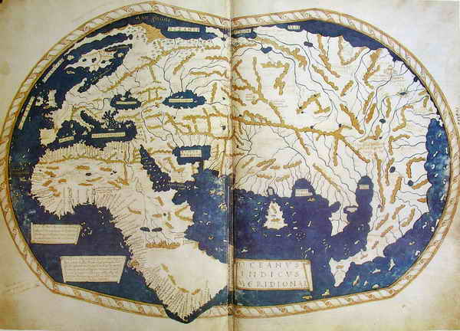
Essential Ideas Reading Image to accompany paragraph 5
Circle or highlight key words
Three-word summary
in the margin
Map of the known world according to most Europeans in 1488.
https://education.texashistory.unt.edu
Notes:
--Henricus Martellus Germanus. World map. 1489. This work is in the public domain in its country of origin and other countries and areas where the copyright term is the author's life plus 100 years or fewer. United States Public Domain Tag: Commons:Copyright tags/Country-specific tags - Wikimedia Commons

Slide 13
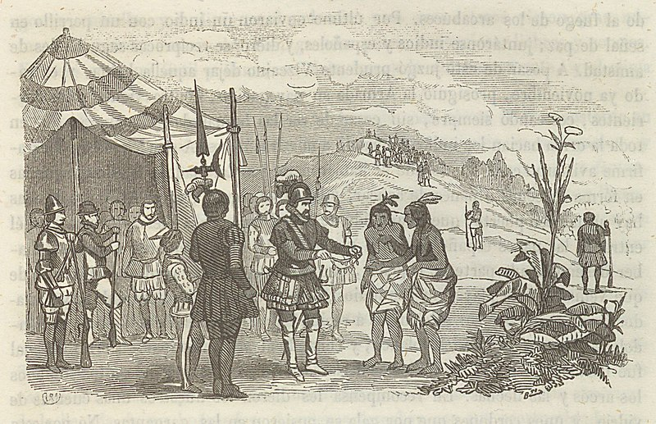
Essential Ideas Reading Image to accompany paragraph 6
Circle or highlight key words
Three-word summary
in the margin
Artwork depicting the Royal Marina Hispaniola
Conquistadors encountering Indigenous American people
https://education.texashistory.unt.edu
Notes:
--Ferrer de Couto, José 1820-1877. Historia de la Marina Real Española : desde el descubrimiento de las américas hasta el combate de Trafalgar Autor Ferrer de Couto, José 1820-1877 March y Labores, José m. 1865) This work is in the public domain in its country of origin and other countries and areas where the copyright term is the author's life plus 70 years or fewer.
File:A055a161 0572.jpg - Wikimedia Commons

Slide 14
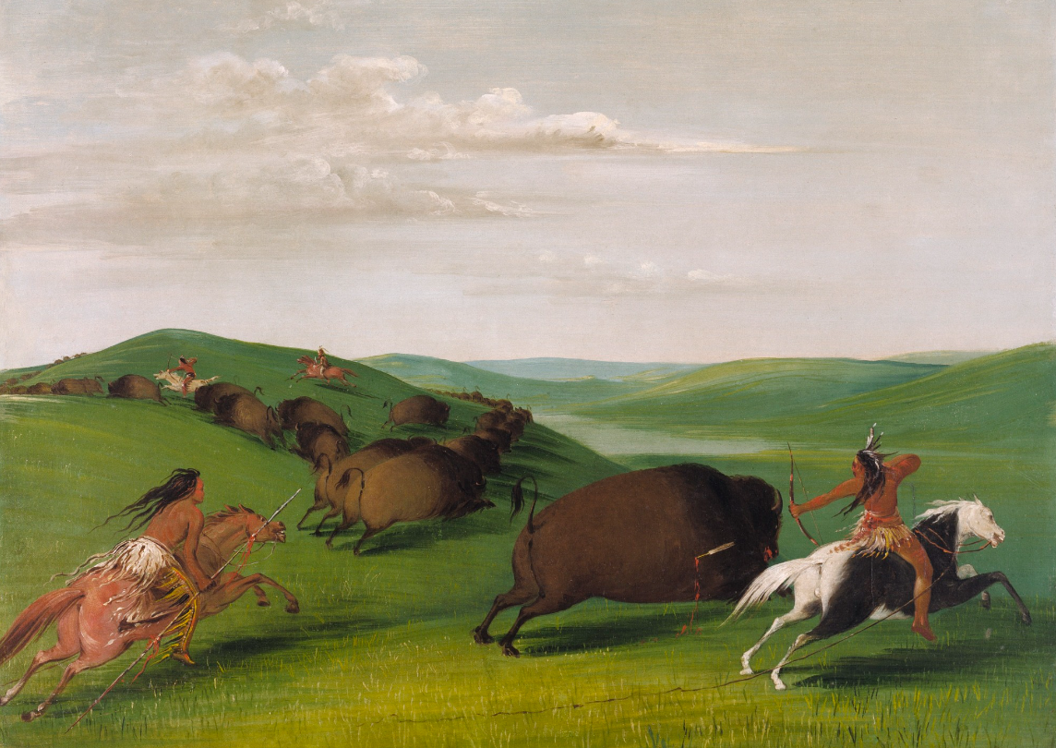
Essential Ideas Reading Image to accompany paragraph 7
Circle or highlight key words
Three-word summary
in the margin
A painting showing American Indian men hunting a herd of buffalo on horseback.
Smithsonian American Art Museum.
https://education.texashistory.unt.edu
Notes:
--Catlin, George. Buffalo Chase with Bows and Lances. 1832-33. Oil on canvas, 24 x 29 in. (60.9 x 73.7 cm). Smithsonian American Art Museum. https://americanart.si.edu/artwork/buffalo-chase-bows-and-lances-3960.

Slide 15
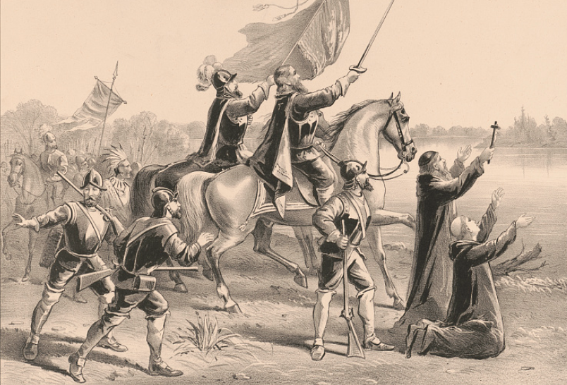
Essential Ideas Reading Image to accompany paragraph 8
Circle or highlight key words
Three-word summary
in the margin
Artwork titled “The Discovery of the Mississippi by De Soto and his Followers.”
Library of Congress
https://education.texashistory.unt.edu
Notes:
--Currier & Ives. Discovery of the Mississippi: By Ferdinand De Soto, and his followers, May 1541. 1876. Photograph. https://www.loc.gov/item/91795960/.

Slide 16

Part III: Return to the Reading Guide in Part II
After you read the passage:
Re-read each statement here.
Provide the correct True / False answer.
Justification: Provide text evidence for your answer.
https://education.texashistory.unt.edu

Slide 17
Exit Ticket
Based on the reading passage today, what are three things that we will learn about in Unit 2: Age of Contact.
Write in complete sentences.
Share with a partner
https://education.texashistory.unt.edu

Slide 18
Share with the class 2
One thing we will learn about in Unit 2: the Age of Contact is _______
https://education.texashistory.unt.edu

