Slide 1
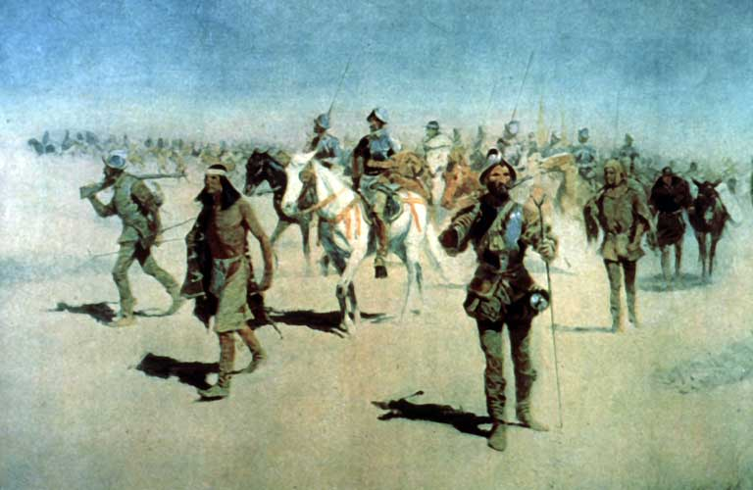
Unidad 2 :
Edad de contacto
Lección 8:
La búsqueda del oro en Texas
Voces de la historia de Texas
Lección de extensión
La expedición de Coronado por el suroeste
Notes:
Remington, Frederic. “Coronado Sets Out to the North” Oil painting. This is a faithful photographic reproduction of a two-dimensional, public domain work of art. The work of art itself is in the public domain for the following reason: This work is in the public domain in its country of origin and other countries and areas where the copyright term is the author's life plus 100 years or fewer. https://commons.wikimedia.org/wiki/File:Coronado-Remington.jpg
This work is in the public domain in the United States because it was published (or registered with the U.S. Copyright Office) before January 1, 1929.

Slide 2





Calentamiento
Sigue las instrucciones para completar tu calentamiento
Lee cada cita de fuente primaria y determina quién crees que pudo haberla dicho.
Escribe tu respuesta en el calentamiento.
Habla con una pareja
https://education.texashistory.unt.edu

Slide 3
Comparte con la clase
Creo que ______ pudo haber dicho "_____________" porque _______.
https://education.texashistory.unt.edu

Slide 4
Preguntas esenciales
Qué eventos significativos ocurrieron en las expediciones de Cabeza de Vaca y Francisco Vázquez de Coronado?
¿Cómo describieron estos hechos las personas que los registraron??
https://education.texashistory.unt.edu

Slide 5
En la lección de hoy...
Leeremos extractos de las expediciones de Cabeza de Vaca y Coronado que hablan de sus encuentros con pueblos indígenas americanos y sus experiencias viajando por Norteamérica.
Leeré cada extracto para conocer el contexto, las ideas principales y evaluar si hay sesgos. Responderé preguntas de comprensión sobre cada extracto.
https://education.texashistory.unt.edu

Slide 6
Observa la imagen de abajo
Qué notas de esta imagen? 1
Qué crees que está pasando aquí?
Cuáles son tres palabras que podrían describir esta imagen?
https://education.texashistory.unt.edu
Notes:
Remington, Frederic. “Coronado Sets Out to the North” Oil painting. This is a faithful photographic reproduction of a two-dimensional, public domain work of art. The work of art itself is in the public domain for the following reason: This work is in the public domain in its country of origin and other countries and areas where the copyright term is the author's life plus 100 years or fewer. https://commons.wikimedia.org/wiki/File:Coronado-Remington.jpg

Slide 7
Todos los siguientes extractos de fuentes primarias fueron tomados de "Exploradores españoles en el sur de Estados Unidos, 1528 – 1543"
Esta obra es una colección de relatos de primera mano de las expediciones de Cabeza de Vaca, Francisco Vázquez de Coronado y Hernando de Soto.
Esta obra está disponible en línea en el Portal de Historia de Texas con la Universidad de North Texas
https://education.texashistory.unt.edu

Slide 8
Conjunto de Fuentes Primarias 1:
Cabeza de Vaca
https://education.texashistory.unt.edu

Slide 9

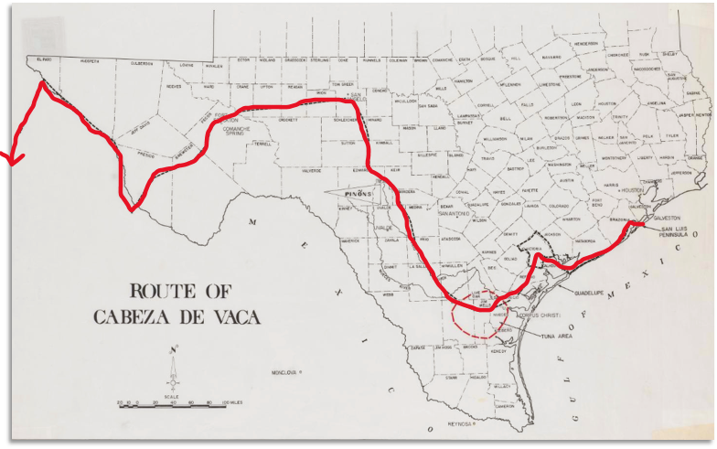
Conjunto de Fuentes Primarias 1:
Cabeza da Vaca
Durante sus viajes, Cabeza de Vaca se encontró con muchas tribus diferentes de indígenas americanos en todo Texas.
Lee los siguientes extractos de su libro y responde a las preguntas que los acompañan.
Extracto 1 Contexto: Tras vivir con una tribu indígena americana en la parte sur de las Llanuras Costeras, Cabeza de Vaca escribió sobre las dificultades de la vida en esa región de Texas.
https://education.texashistory.unt.edu
Notes:
Route of Cabeza de Vaca. The Portal to Texas History. https://texashistory.unt.edu/ark:/67531/metapth492978/.

Slide 10
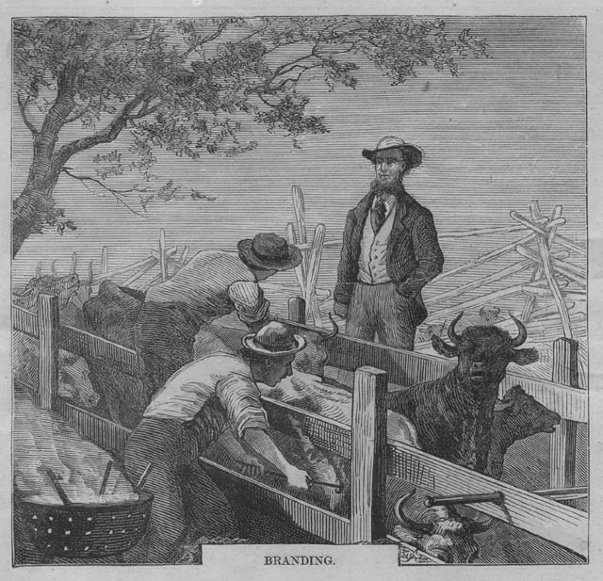
Cabeza de Vaca: Fragmento 1
“Negocié con estos indios en peines que les hice y en arcos, flechas y redes. Hicimos esteras, que son sus casas, de las que tienen una gran necesidad; y aunque saben cómo prepararlas, desean dedicar todo su tiempo a conseguir comida, ya que cuando trabajan en otro sitio se ven pellizcadas por hambre.”
https://education.texashistory.unt.edu
Notes:
Núñez Cabeza de Vaca, Alvar, 16th cent. & Castañeda de Nájera, Pedro de, 16th cent. Spanish Explorers in the Southern United States, 1528-1543, book, 1984; Austin, Texas. (https://texashistory.unt.edu/ark:/67531/metapth296846/: accessed August 29, 2024), University of North Texas Libraries, The Portal to Texas History, https://texashistory.unt.edu; crediting Texas State Historical Association.

Slide 11
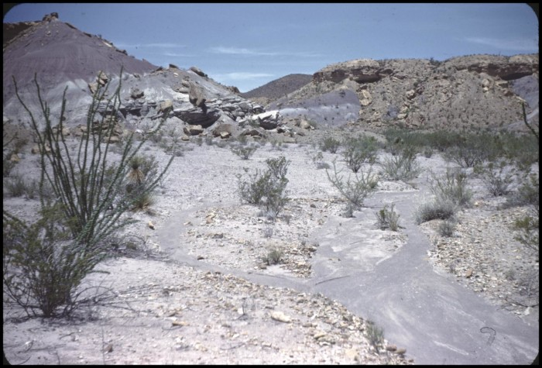
Cabeza de Vaca: Excerpt 2 Context
Cabeza de Vaca was headed toward the west Texas region we know as the Mountains and Basins. He was traveling with hundreds of American Indian companions and an African man named Estevanico, who had been a member of his original expedition in Florida. Cabeza de Vaca wanted to send some American Indian scouts ahead to examine the area.
The Chisos Mountains in the Mountains and Basins region of Texas.
The Portal to Texas History
https://education.texashistory.unt.edu
Notes:
Streng, Evelyn Fielder. Road From Marathon and Chisos Mountains. 1951. Photograph. The Portal to Texas History. https://texashistory.unt.edu/ark:/67531/metapth860209/.

Slide 12
Cabeza de Vaca: Excerpt 2
“We told [the American Indians] that we desired to go where the sun sets; and they said the inhabitants in that direction were remote … they strove to excuse themselves the best they could, the people being their enemies, and they did not wish to go to them. Not daring to disobey, however, they sent two women, one of their own, the other a captive from that people; for the women can negotiate even though there be war.”
https://education.texashistory.unt.edu
Notes:
Núñez Cabeza de Vaca, Alvar, 16th cent. & Castañeda de Nájera, Pedro de, 16th cent. Spanish Explorers in the Southern United States, 1528-1543, book, 1984; Austin, Texas. (https://texashistory.unt.edu/ark:/67531/metapth296846/: accessed August 29, 2024), University of North Texas Libraries, The Portal to Texas History, https://texashistory.unt.edu; crediting Texas State Historical Association.

Slide 13
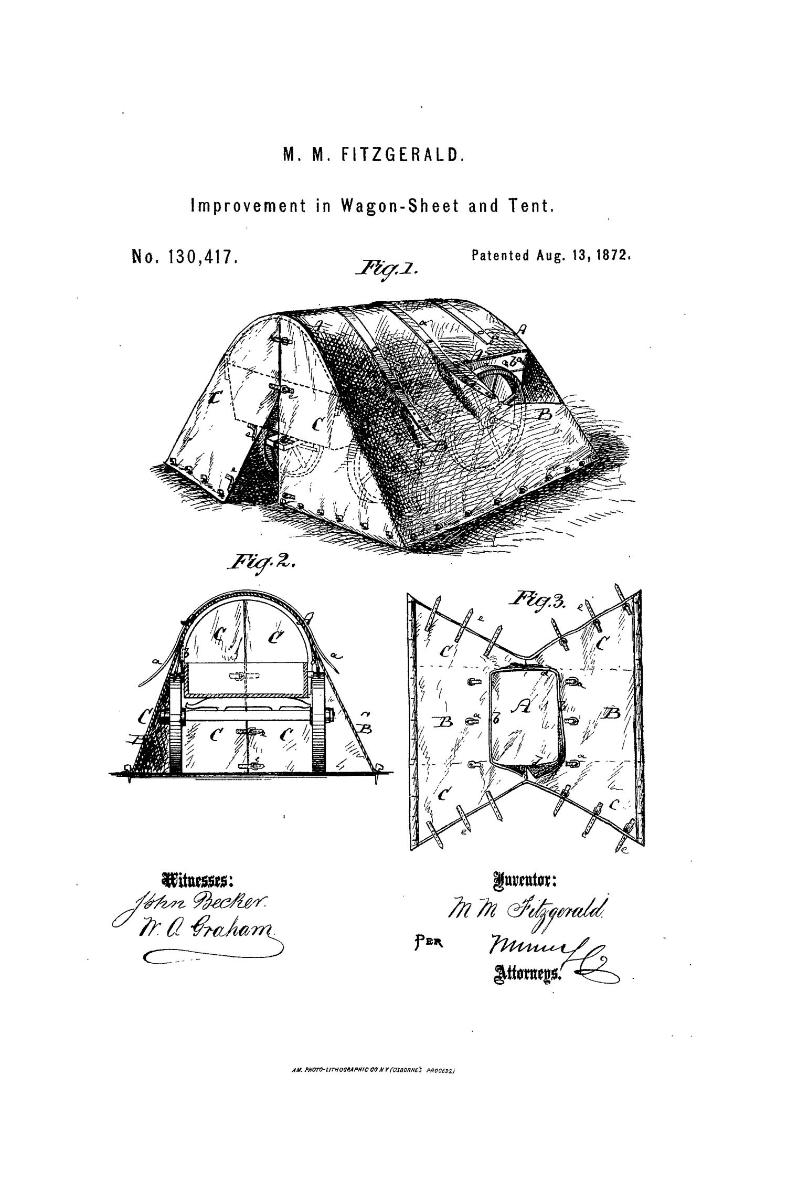
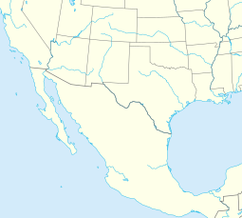
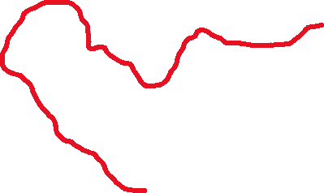
Cabeza de Vaca: Excerpt 3 Context
As Cabeza de Vaca and his men were traveling along the Gulf of California, they encountered many tribes with many types of valuable resources.
Texas
Gulf of California
Gulf of Mexico
Pacific Ocean
Mexico City
Cabeza de Vaca’s Route to Mexico City
https://education.texashistory.unt.edu
Notes:
Map of North America including states and provinces. This file is licensed under the Creative Commons Attribution-Share Alike 3.0 Unported license. https://commons.wikimedia.org/wiki/File:North_America_map_with_states_and_provinces.svg Edited by the Portal to Texas History to show the route of Cabeza de Vaca through Texas and Mexico with significant locations labeled.

Slide 14
Cabeza de Vaca: Excerpt 3
“Throughout this region, wheresoever the mountains extend, we saw clear traces of gold and lead, iron, copper, and other metals … The people of the fixed residences and those beyond regard silver and gold with indifference, nor can they conceive of any use of them.”
https://education.texashistory.unt.edu
Notes:
Núñez Cabeza de Vaca, Alvar, 16th cent. & Castañeda de Nájera, Pedro de, 16th cent. Spanish Explorers in the Southern United States, 1528-1543, book, 1984; Austin, Texas. (https://texashistory.unt.edu/ark:/67531/metapth296846/: accessed August 29, 2024), University of North Texas Libraries, The Portal to Texas History, https://texashistory.unt.edu; crediting Texas State Historical Association.

Slide 15
Primary Source Set 2:
Francisco Vazquez de Coronado
https://education.texashistory.unt.edu

Slide 16
Primary Source Set 2:
Francisco Vazquez de Coronado 2
Coronado was determined to locate the cities of gold that Cabeza de Vaca wrote about in his book. During his two years exploring the American Southwest, he was the first European to lay eyes on the region, and he encountered numerous American Indian tribes along the way.
An oil painting by Frederic Remington, “Coronado Sets Out for the North”
https://education.texashistory.unt.edu

Slide 17
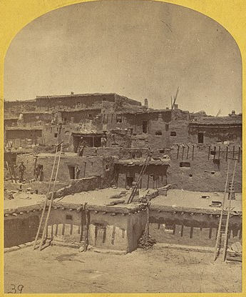
Coronado: Excerpt 1 Context
Estevanico, the African survivor of Cabeza de Vaca’s expedition, was brought on Coronado’s journey as a guide because of his knowledge of the land and its people.
A photograph from the 1800s of a Zuni Pueblo village, where Estevanico led Coronado’s expedition.
Boston Public Library
https://education.texashistory.unt.edu
Notes:
O'Sullivan, Timothy H., 1875. “Indian pueblo of Zuni, New Mexico.” Title from item.; On item: War Department, Corps of Engineers, U.S.A. Geographical Explorations and Surveys West of the 100th Meridian. Expedition of 1873. 1st. Lieut. Geo. M. Wheeler, Corps of Engineers, Commanding.; Plate number: No. 16; Indian Pueblo of Zuni, New Mexico; view from the interior. The "Pueblo" or town, encloses a quadrangular area within which are the ruins of a church built under the direction of the Jesuit missionaries. The houses are built one above the other to the height of five or six stories. The entrances are mostly from the top, the ascent and descent being made by ladders. This file was contributed to Wikimedia Commons by Boston Public Library as part of a cooperation project. The donation was facilitated by the Digital Public Library of America, via its partner Digital Commonwealth.

Slide 18
Coronado: Excerpt 1
“It seems that, after the friars I have mentioned and [Estevanico] had started, [Estevanico] did not get on well with the friars, because … he collected turquoise, and got together a stock of everything. Besides, the Indians in those places through which they went got along with [Estevanico] better, because they had seen him before. This was the reason he was sent on ahead to open up the way and pacify the Indians.”
https://education.texashistory.unt.edu
Notes:
Núñez Cabeza de Vaca, Alvar, 16th cent. & Castañeda de Nájera, Pedro de, 16th cent. Spanish Explorers in the Southern United States, 1528-1543, book, 1984; Austin, Texas. (https://texashistory.unt.edu/ark:/67531/metapth296846/: accessed August 29, 2024), University of North Texas Libraries, The Portal to Texas History, https://texashistory.unt.edu; crediting Texas State Historical Association.

Slide 19
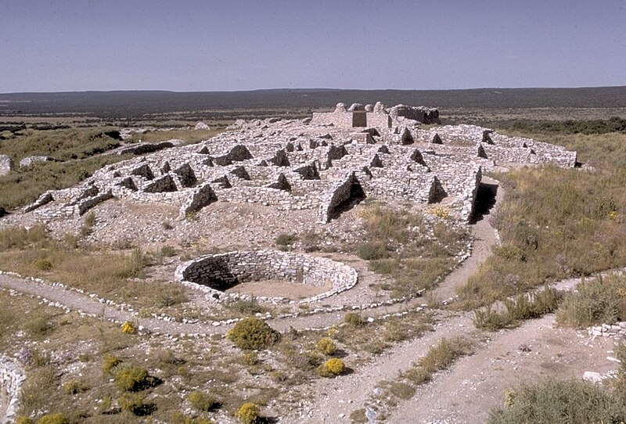
Coronado: Excerpt 2 Context
On his quest for gold, Coronado met an American Indian man who would go on to lead him across the southwestern portion of America in search of gold.
The modern-day remains of the American Indian city of Gran-Quivira, a location that Coronado believed would contain gold and riches.
National Park Service Digital Image Archive.
https://education.texashistory.unt.edu
Notes:
Gran Quivira in Salinas Pueblo Mission National Monument, New Mexico. National Park Service Digital Image Archives, http://photo.itc.nps.gov/storage/images/grqu/grqu-Thumb.00001.html This image or media file contains material based on a work of a National Park Service employee, created as part of that person's official duties. As a work of the U.S. federal government, such work is in the public domain in the United States. See the NPS website and NPS copyright policy for more information.

Slide 20
Coronado: Excerpt 2
“The Spaniards … talked with an Indian slave, a native of the country toward Florida … The fellow said that there were large settlements in the farther part of the country … He told [Alvarado] about the wealth of gold and silver in his country … They called the Indian “Turk” because he looked like one.”
https://education.texashistory.unt.edu
Notes:
Núñez Cabeza de Vaca, Alvar, 16th cent. & Castañeda de Nájera, Pedro de, 16th cent. Spanish Explorers in the Southern United States, 1528-1543, book, 1984; Austin, Texas. (https://texashistory.unt.edu/ark:/67531/metapth296846/: accessed August 29, 2024), University of North Texas Libraries, The Portal to Texas History, https://texashistory.unt.edu; crediting Texas State Historical Association.

Slide 21
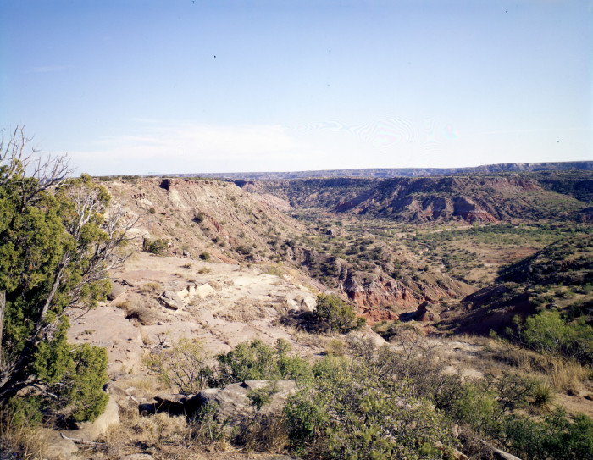
Coronado: Excerpt 3 Context
As Coronado’s expedition passed into the northern portion of the Texas Great Plains, he encountered a band of Apache people known as the Querechos.
The Palo Duro Canyon of the Texas Panhandle
The Querecho Apache often migrated through this area of Texas.
The Portal Texas History, University of North Texas
https://education.texashistory.unt.edu
Notes:
Bradly, Bill. [Palo Duro Canyon], photograph, Date Unknown; (https://texashistory.unt.edu/ark:/67531/metapth13833/: accessed August 30, 2024), University of North Texas Libraries, The Portal to Texas History, https://texashistory.unt.edu; crediting Deaf Smith County Library.

Slide 22
Coronado: Excerpt 3
“After ten days more, [the Spanish] came to some settlements of people who … are called Querechos in that region. They had seen the [bison] for two days. These folks live in tents made of the tanned skins of the [bison.] They travel around near the [bison], killing them for food. They did nothing unusual when they saw our army, except to come out of their tents to look at us … they had already talked with the Turk … they agreed with what he said.”
https://education.texashistory.unt.edu
Notes:
Núñez Cabeza de Vaca, Alvar, 16th cent. & Castañeda de Nájera, Pedro de, 16th cent. Spanish Explorers in the Southern United States, 1528-1543, book, 1984; Austin, Texas. (https://texashistory.unt.edu/ark:/67531/metapth296846/: accessed August 29, 2024), University of North Texas Libraries, The Portal to Texas History, https://texashistory.unt.edu; crediting Texas State Historical Association.

Slide 23
Primary Source Set 3:
“The Turk”
https://education.texashistory.unt.edu

Slide 24
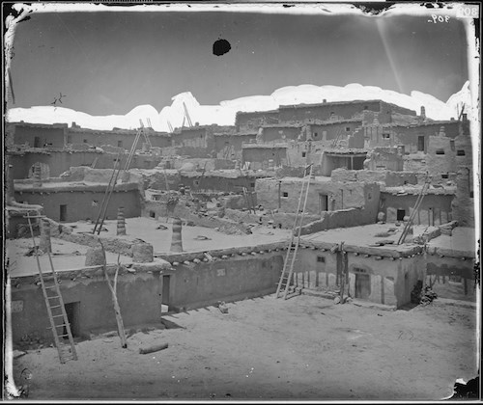
Primary Source Set 3:
“The Turk” 2
The only information we have about the Indigenous man known as “the Turk,” comes from Spanish texts about Coronado’s expedition. The excerpt on the previous page states that he was originally from somewhere in or near Florida, though he was living in the west Texas area as a captive of a group of Puebloan people. Read the following excerpts to learn more about “the Turk,” from different points of view.
Zuni Pueblo, 1873 - This may be an approximate representation of what Hawikuh looked like in 1540 – the village where Coronado met “the Turk.”
US National Archives and Smithsonian Institute
https://education.texashistory.unt.edu
Notes:
Zuni Pueblo, 1873 - This may be an approximate representation of what Hawikuh looked like in 1540.US National Archives and Smithsonian Institute. Photographer Timothy H. O'Sullivan, 1873. Public Domain. Stories - Coronado National Memorial (U.S. National Park Service) (nps.gov)

Slide 25
“The Turk”: Excerpt 1 Context
A conquistador called Hernando de Alvarado reported that the Turk told him many things about where he was originally from. Alvarado said he believed the Turk’s story “on account of the ease with which he told it.”
Coronado with his men and the American Indian scouts and guides on his expedition.
Painting by Frederic Remington.
https://education.texashistory.unt.edu
Notes:
Remington, Frederic. “Coronado Sets Out to the North” Oil painting. This is a faithful photographic reproduction of a two-dimensional, public domain work of art. The work of art itself is in the public domain for the following reason: This work is in the public domain in its country of origin and other countries and areas where the copyright term is the author's life plus 100 years or fewer. https://commons.wikimedia.org/wiki/File:Coronado-Remington.jpg

Slide 26
The Turk: Excerpt 1
“After ten days more, [the Spanish] came to some settlements of people who … are called Querechos in that region. They had seen the [bison] for two days. These folks live in tents made of the tanned skins of the [bison.] They travel around near the [bison], killing them for food. They did nothing unusual when they saw our army, except to come out of their tents to look at us … they had already talked with the Turk … they agreed with what he said.”
https://education.texashistory.unt.edu
Notes:
Núñez Cabeza de Vaca, Alvar, 16th cent. & Castañeda de Nájera, Pedro de, 16th cent. Spanish Explorers in the Southern United States, 1528-1543, book, 1984; Austin, Texas. (https://texashistory.unt.edu/ark:/67531/metapth296846/: accessed August 29, 2024), University of North Texas Libraries, The Portal to Texas History, https://texashistory.unt.edu; crediting Texas State Historical Association.

Slide 27
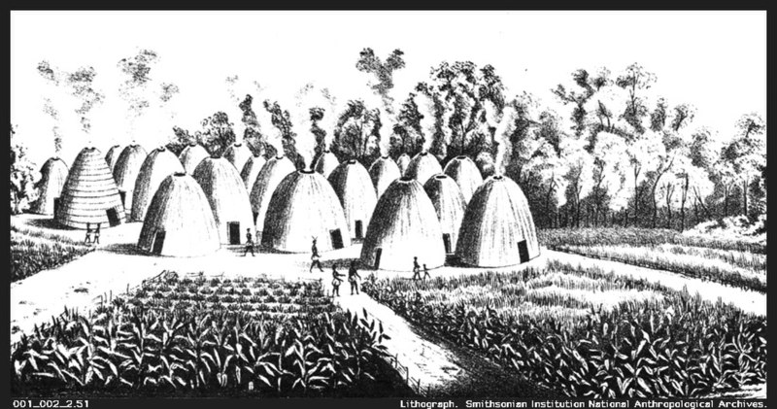
“The Turk”: Excerpt 2 Context
The Puebloan people who had held “the Turk” captive, had also captured a Wichita man named Ysopete. The Puebloan people gave Ysopete along with “the Turk” to Coronado as guides. Ysopete had his own opinions about “the Turk.”
A lithograph of a Wichita community.
Smithsonian Institution National Anthropological Archives
https://education.texashistory.unt.edu
Notes:
A lithograph of a Wichita Village, probably in Oklahoma, between 1850-1875. Smithsonian Institution National Anthropological Archives. This work is in the public domain in the United States because it is a work prepared by an officer or employee of the United States Government as part of that person’s official duties under the terms of Title 17, Chapter 1, Section 105 of the US Code. Note: This only applies to original works of the Federal Government and not to the work of any individual U.S. state, territory, commonwealth, county, municipality, or any other subdivision. This template also does not apply to postage stamp designs published by the United States Postal Service since 1978. (See § 313.6(C)(1) of Compendium of U.S. Copyright Office Practices). It also does not apply to certain US coins; see The US Mint Terms of Use. Accessed at Wikimedia commons https://commons.wikimedia.org/wiki/File:Wichita_Indian_village_1850-1875.jpg

Slide 28
The Turk: Excerpt 2
“There was another native of Quivira with the army, a painted Indian named Ysopete. This Indian had always declared that the Turk was lying, and on account of this, the army paid no attention to [Ysopete].”
https://education.texashistory.unt.edu
Notes:
Núñez Cabeza de Vaca, Alvar, 16th cent. & Castañeda de Nájera, Pedro de, 16th cent. Spanish Explorers in the Southern United States, 1528-1543, book, 1984; Austin, Texas. (https://texashistory.unt.edu/ark:/67531/metapth296846/: accessed August 29, 2024), University of North Texas Libraries, The Portal to Texas History, https://texashistory.unt.edu; crediting Texas State Historical Association.

Slide 29
“The Turk”: Excerpt 3 Context
After traveling for months at “the Turk’s” direction, Coronado found no gold at all. Coronado and his men ultimately confronted “the Turk” about this failure.
Coronado and his men searched the American southwest for months, guided by “the Turk.” They found no gold in the end.
https://education.texashistory.unt.edu
Notes:
Remington, Frederic. “Coronado Sets Out to the North” Oil painting. This is a faithful photographic reproduction of a two-dimensional, public domain work of art. The work of art itself is in the public domain for the following reason: This work is in the public domain in its country of origin and other countries and areas where the copyright term is the author's life plus 100 years or fewer. https://commons.wikimedia.org/wiki/File:Coronado-Remington.jpg

Slide 30
The Turk: Excerpt 3
“[The Spanish] asked the Turk why he had lied and had guided them so far out of the way. He said that his country was in that direction and that, besides this, the people at Cicuye had asked him to lead them off on to the plains and lose them, so that … they would be so weak if they ever returned that they could be killed without any trouble and thus [the American Indians at Cicuye] could take revenge for what had been done to them.”
https://education.texashistory.unt.edu
Notes:
Núñez Cabeza de Vaca, Alvar, 16th cent. & Castañeda de Nájera, Pedro de, 16th cent. Spanish Explorers in the Southern United States, 1528-1543, book, 1984; Austin, Texas. (https://texashistory.unt.edu/ark:/67531/metapth296846/: accessed August 29, 2024), University of North Texas Libraries, The Portal to Texas History, https://texashistory.unt.edu; crediting Texas State Historical Association.

Slide 31
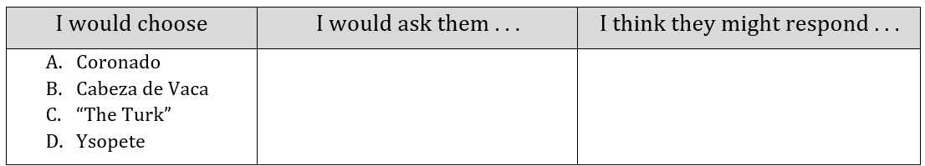
Exit Ticket
Follow the directions to complete your warm-up
Choose one person from our lesson today
Ask them any question
Write what you think their response would be
Discuss with a partner.
https://education.texashistory.unt.edu

Slide 32
Share with the class 2
I chose ____________.
I would ask him, “_____________?”
I think he might respond “________.”
https://education.texashistory.unt.edu

