Slide 1
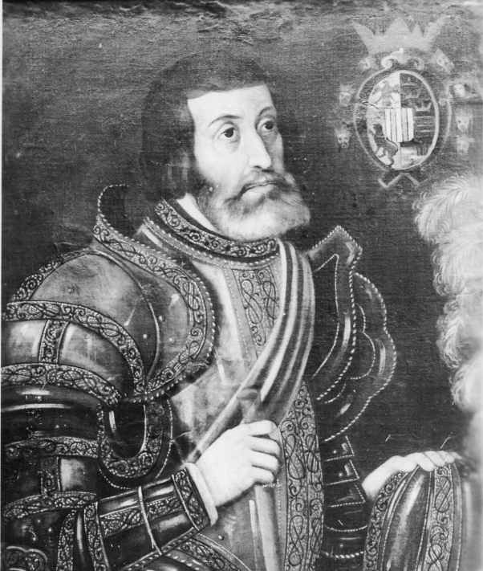




Unit 2:
Age of Contact
Lesson 7:
The Search for Gold
Guided Notes
Day 2
Hernán Cortés
Notes:
Tarjeta Postal. [Postcard of Fernando Cortés], postcard, Date Unknown; [Mexico]. (https://texashistory.unt.edu/ark:/67531/metapth222343/: accessed August 22, 2024), University of North Texas Libraries, The Portal to Texas History, https://texashistory.unt.edu; crediting Hoston History Research Center at Houston Public Library.

Slide 2


Warm-up
Follow the directions to complete your warm-up
Consider items that help you travel today compared to in the 1400s
Write your response on your warm-up.
Discuss with a partner
https://education.texashistory.unt.edu

Slide 3
Share with the class
An item that helps people travel today is ____________, while an item that might have helped people travel in the 1400s was ___________.
https://education.texashistory.unt.edu

Slide 4
Share with the class 2
An item they would not have had access to in the 1400s is _________. This could have made travel more difficult because __________.
https://education.texashistory.unt.edu

Slide 5
Essential Question
What were some of the difficulties of the first Spanish explorers in the Americas, and were they successful at achieving their goals?
https://education.texashistory.unt.edu

Slide 6
In today’s lesson…
We will examine four of the first significant Spanish explorers to the Americas. We will be able to explain their significance in history and if they were success at achieving their goals.
I will complete my guided note-taking chart including writing key information, the significance of each topic, and responding to an essential question about each topic.
https://education.texashistory.unt.edu

Slide 7
Alonso Álvarez de Pineda
Key Information
1519 Created the 1st known map of the Gulf of Mexico
What do I need to write?
When the Spanish conquistadors first began exploring North and South America, one of the biggest obstacles they faced was that they had no idea where they were going or what they might find in these new lands.
In 1519, a man named Álonso Alvarez de Pineda helped overcome this obstacle in one part of the Americas by creating the first known map of the Gulf of Mexico.
Explorers who came after him would have a better point of reference, and at least some knowledge of where they were headed and what they might find there as a result.
Significance
Provides more information about the geography of the Americas
Essential Question
Without modern technology like GPS, how do you think Pineda made his map?
https://education.texashistory.unt.edu

Slide 8
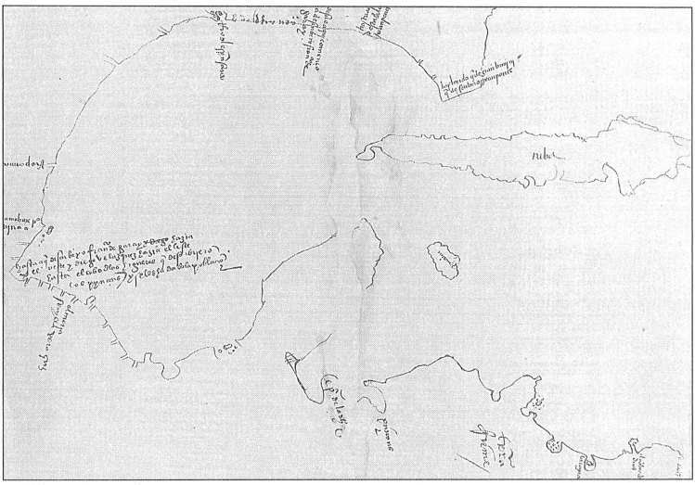
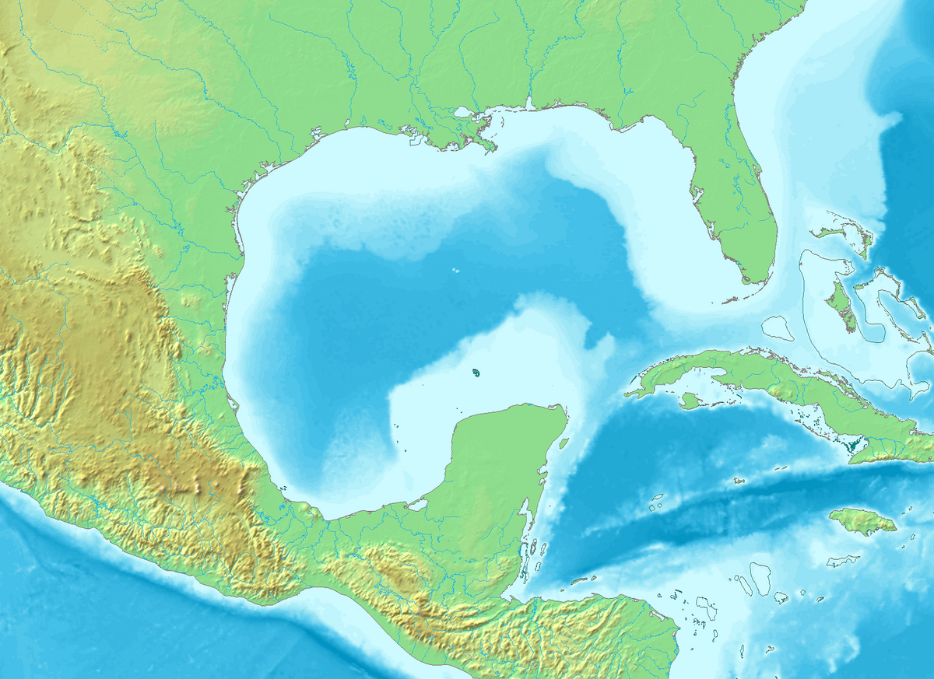
How does Pineda’s map on the left compare with the actual geography of the coast?
Pineda’s Map
The Portal to Texas History
University of North Texas
Contemporary map of the Gulf of Mexico
https://education.texashistory.unt.edu
Notes:
Texas State Historical Association. The Southwestern Historical Quarterly, Volume 98, July 1994 - April, 1995, periodical, 1995; Austin, Texas. (https://texashistory.unt.edu/ark:/67531/metapth101216/m1/424/: accessed August 22, 2024), University of North Texas Libraries, The Portal to Texas History, https://texashistory.unt.edu; crediting Texas State Historical Association.
Gulf of Mexico Topographic Location Map. This file is made available under the Creative Commons CC0 1.0 Universal Public Domain Dedication. Wikimedia Commons. https://commons.wikimedia.org/wiki/File:Gulf_of_Mexico_topographic_location_map.png

Slide 9
Hernán Cortés
Key Information
Cortés conquered the Aztecs – 1519 Established Mexico City Claimed the land for Spain: “New Spain”
What do I need to write?
In 1519, a Spanish conquistador named Hernán Cortés traveled with more than 800 other conquistadors to what is now Mexico. There was a large American Indian civilization called the Aztecs who ruled much of the region.
The Aztecs were often viewed as cruel and oppressive by the people they had conquered. For this reason, thousands of American Indians in the region worked with Cortés to defeat the Aztecs and conquer their capital city of Tenochtitlan.
By 1821, Cortés and his men had taken control of Tenochtitlan, seizing enormous wealth and gold from the Aztecs. Cortés established a new city in place of Tenochtitlan – Mexico City. He claimed the region for Spain, calling it “New Spain.”
Significance
Aztec gold made Cortés and Spain wealthy. Other conquistadors want the same success.
Essential Question
Was Cortés successful accomplishing Spain’s primary goal for exploration? Explain.
https://education.texashistory.unt.edu

Slide 10

1519
Map of Cortés’ Expedition
1521
Present-day Texas
Present-day Texas
Present-day Florida
Present-day Florida
Gulf of Mexico
Gulf of Mexico
Present-day Mexico
Present-day Mexico
Cortés’ Route
Cortés’ Route
Tenochtitlan
Mexico City
Aztec Empire
New Spain
What significant differences do you observe between the two maps? What caused these changes?
https://education.texashistory.unt.edu

Slide 11
Cabeza de Vaca
Key Information
Lost from Florida to Texas. Lived with Texas Indians for 8 years Explored and escaped to Mexico City
What do I need to write?
In 1528, another group of conquistadors set sail for Mexico City, hoping to follow in Cortés’ footsteps. They became lost almost immediately, landing in Florida rather than New Spain. They quickly found themselves stranded and starving in Florida.
They made rafts, hoping to sail south to other Spanish settlements. Instead, the few survivors including de Vaca, and an African man called Estevanico, eventually landed in Texas. Over the course of the next eight years, Cabeza de Vaca and Estevanico lived among various Texas Indian tribes, even at times being held captive.
Cabeza de Vaca and Estevanico eventually escaped and made it to Mexico City in 1536. He wrote a book called La Relación about his time as the first European explorer in Texas. In it, he included tales of Cíbola: the seven cities of gold.
Significance
Cabeza de Vaca’s claims of cities of gold inspired more conquistadors to explore Texas.
Essential Question
Do you think it was reasonable for the conquistadors to believe there were “Cities of Gold” in Texas? Why or why not?
https://education.texashistory.unt.edu

Slide 12
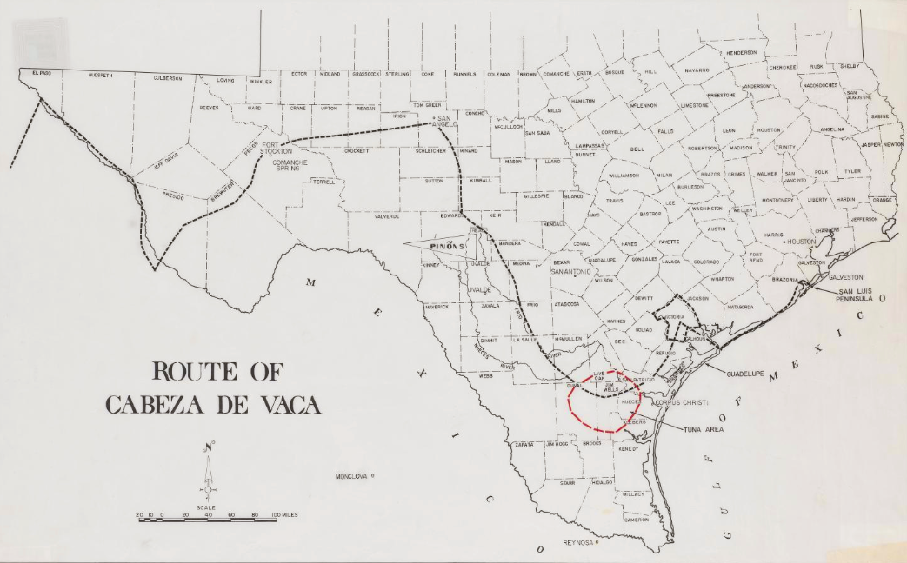
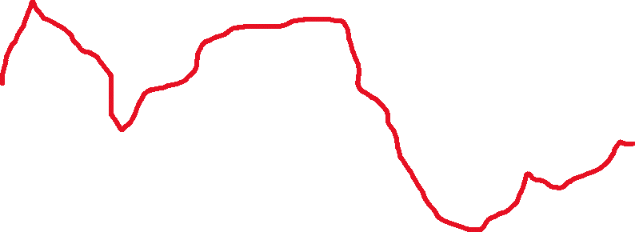
Cabeza de Vaca’s Approximate Route through Texas, 1528 - 1536
  The Route of Cabeza de Vaca
  The Portal to Texas History, University of North Texas
https://education.texashistory.unt.edu
Notes:
Route of Cabeza de Vaca. The Portal to Texas History. https://texashistory.unt.edu/ark:/67531/metapth492978/. Red line added to the route to emphasize the route taken.

Slide 13
Francisco Vázquez de Coronado
Key Information
Explored the American southwest in search of gold. 1st European to see the Grand Canyon.
What do I need to write?
Francisco Vázquez de Coronado was a wealthy governor of a province of New Spain. In 1540, he set out in search of Cíbola, or “the seven cities of gold” that Cabeza de Vaca had written about in his book.
He made the journey with three hundred other Spaniards, approximately 1000 American Indians, and various livestock. He and his men searched for two years. They encountered numerous American Indian tribes including the Tigua and the Zuni Pueblo people. He is credited as the first European to explore the American southwest and to see the Grand Canyon.
During his expedition, an American Indian, who the conquistadors referred to as “The Turk,” led Coronado and his men on their quest for gold. When Coronado ultimately failed to find any gold, he had “The Turk” executed. He eventually returned to New Spain, having failed to find any gold north of Mexico.
Significance
His expedition was considered a failure because of he found no gold.
Essential Question
What are some possible reasons an American Indian might lead the Spanish in search of gold?
https://education.texashistory.unt.edu

Slide 14
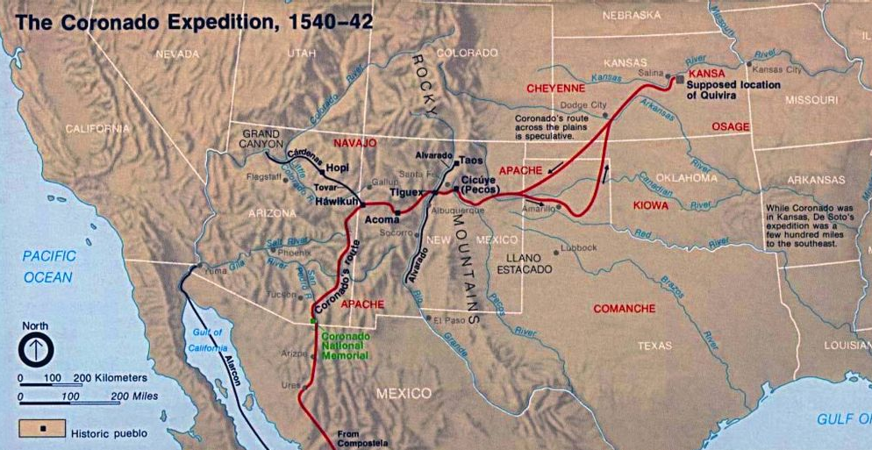
Map of Coronado’s Route, 1540 - 1542
https://education.texashistory.unt.edu
Notes:
Coronado Expedition. Wikimedia Commons. This image or media file contains material based on a work of a National Park Service employee, created as part of that person's official duties. As a work of the U.S. federal government, such work is in the public domain in the United States. See the NPS website and NPS copyright policy for more information. https://commons.wikimedia.org/wiki/File:Coronado_expedition.jpg.

Slide 15
Exit Ticket
Follow the directions to complete your warm-up
Consider the significant effect of three of the events we discussed in class today.
Write your response on your warm-up.
Discuss with a partner
Cause
Effect
https://education.texashistory.unt.edu

Slide 16
Share with the class 3
One effect of Pineda’s map of the Gulf of Mexico is ________.
One effect of Cortez conquering the Aztecs is ________.
One effect of Cabeza de Vaca’s claims of a city of gold is ________.
https://education.texashistory.unt.edu

