Slide 1
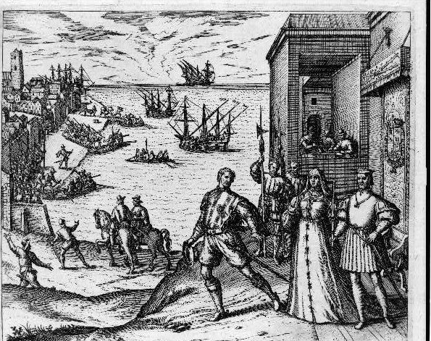
Unit 2:
Age of Contact
Lesson 4:
What’s the story?
Notes:
Christopher Columbus leaving Spain to go to America. 1800. Photograph. Library of Congress. https://www.loc.gov/item/90715316/.

Slide 2






What’s the Story?
Warm-up
https://education.texashistory.unt.edu

Slide 3
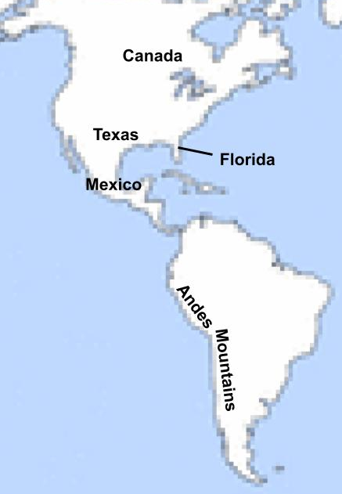
Use the map on your warm-up to make predictions about the unit
In which two modern-day locations on the map do you predict the Spanish will find gold?
Explain your answer.
https://education.texashistory.unt.edu
Notes:
Map of the World. This image is in the public domain because it contains materials that originally came from the United States Central Intelligence Agency's World Factbook. Edited for The Portal to Texas History to show North and South America with key locations labeled. Wikimedia Commons

Slide 4
Share your response
I predict the Spanish will find gold in __________ because _________
https://education.texashistory.unt.edu

Slide 5
Essential Question
What is the cause-and-effect relationship between the most significant chronological events of the Unit 2: Age of Contact?
https://education.texashistory.unt.edu

Slide 6
In today’s lesson…
We will identify cause and effect between the most significant chronological events that occur during the Age of Contact.
I will read a series of short passages showing significant events in the Age of Contact. I will summarize each passage and explain its significance to the Age of Contact.
https://education.texashistory.unt.edu

Slide 7
What’s the Story?
Lesson
https://education.texashistory.unt.edu

Slide 8
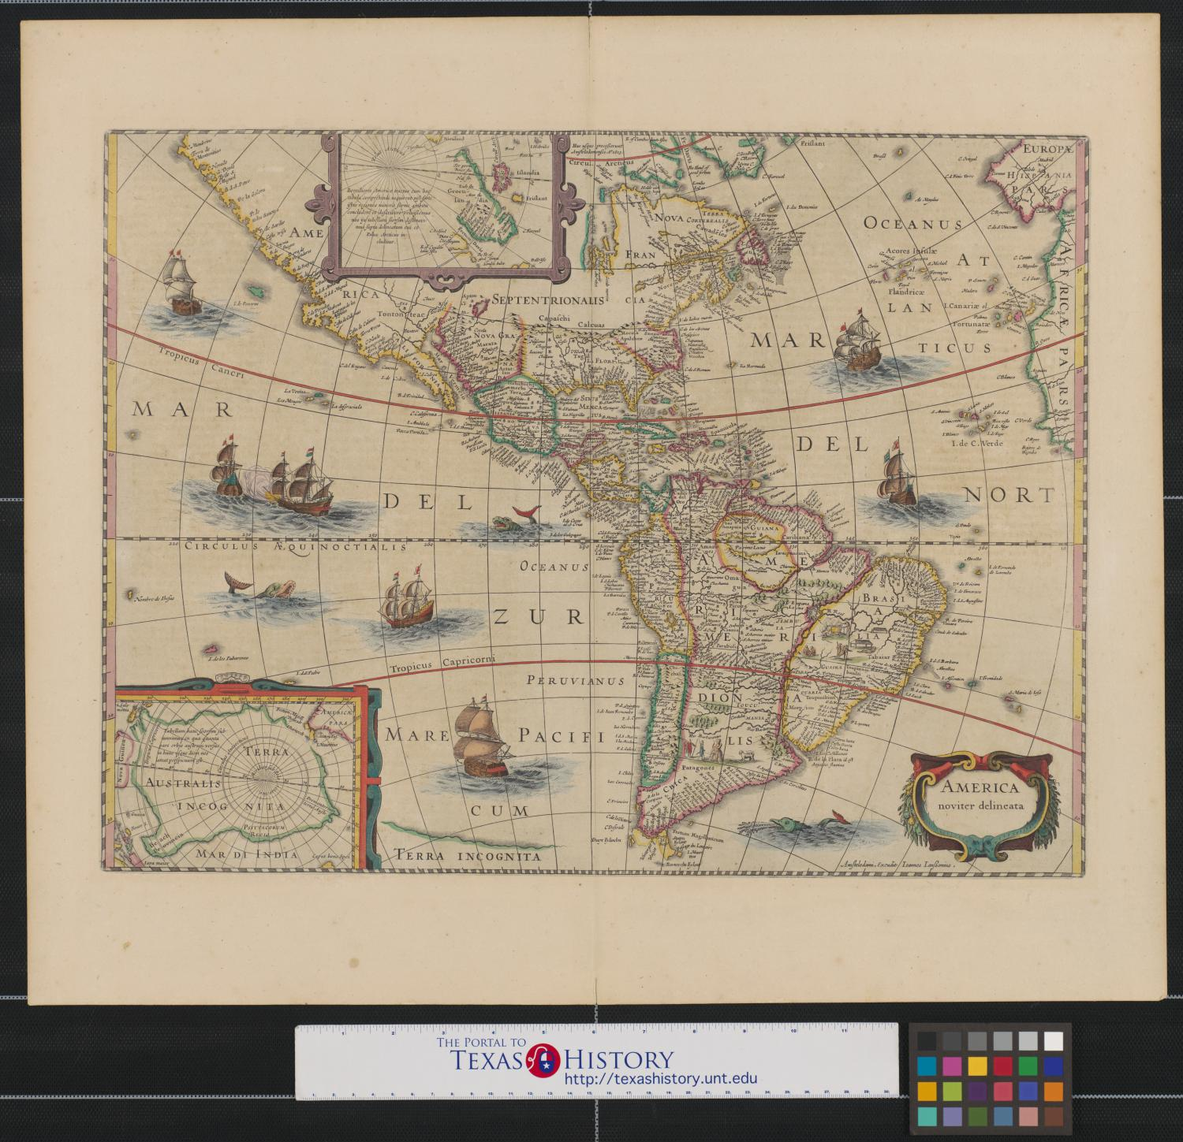
Directions for the Lesson
Read each short passage for information about an event or events from the Age of Contact.
Record information about each reading in the correct place on your timeline assignment.
Read the specific, step-by-step directions on your paper.
https://education.texashistory.unt.edu

Slide 9
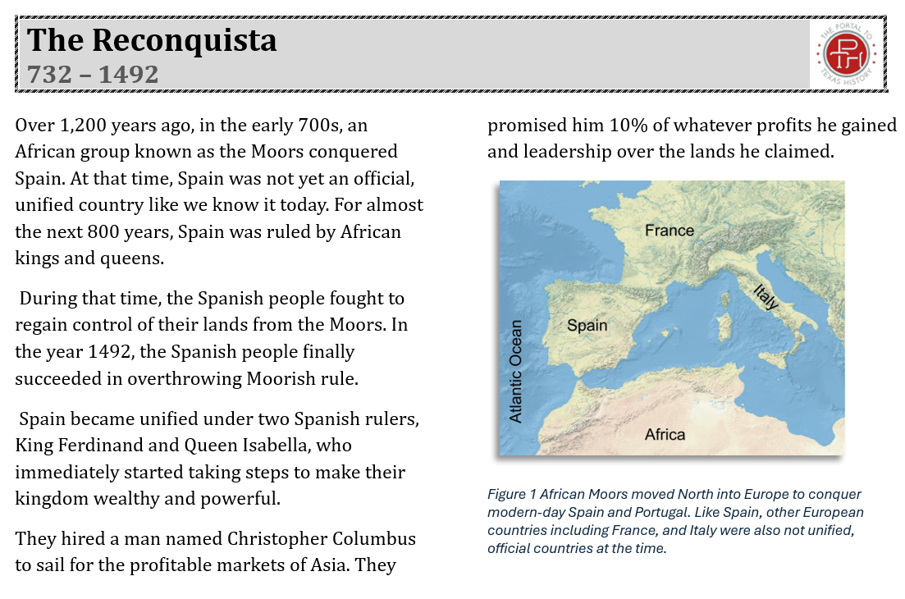
Let’s do the first one together!
Start with the reading passage titled, “The Reconquista 732 - 1492”
https://education.texashistory.unt.edu

Slide 10
Breaking Down Each Reading
Title & Date
How does the picture help us understand the reading?
Pay attention to people, places, events, and cause and effect relationships
What important information is in the caption?
What are the most important events?
Why are they significant?
https://education.texashistory.unt.edu

Slide 11
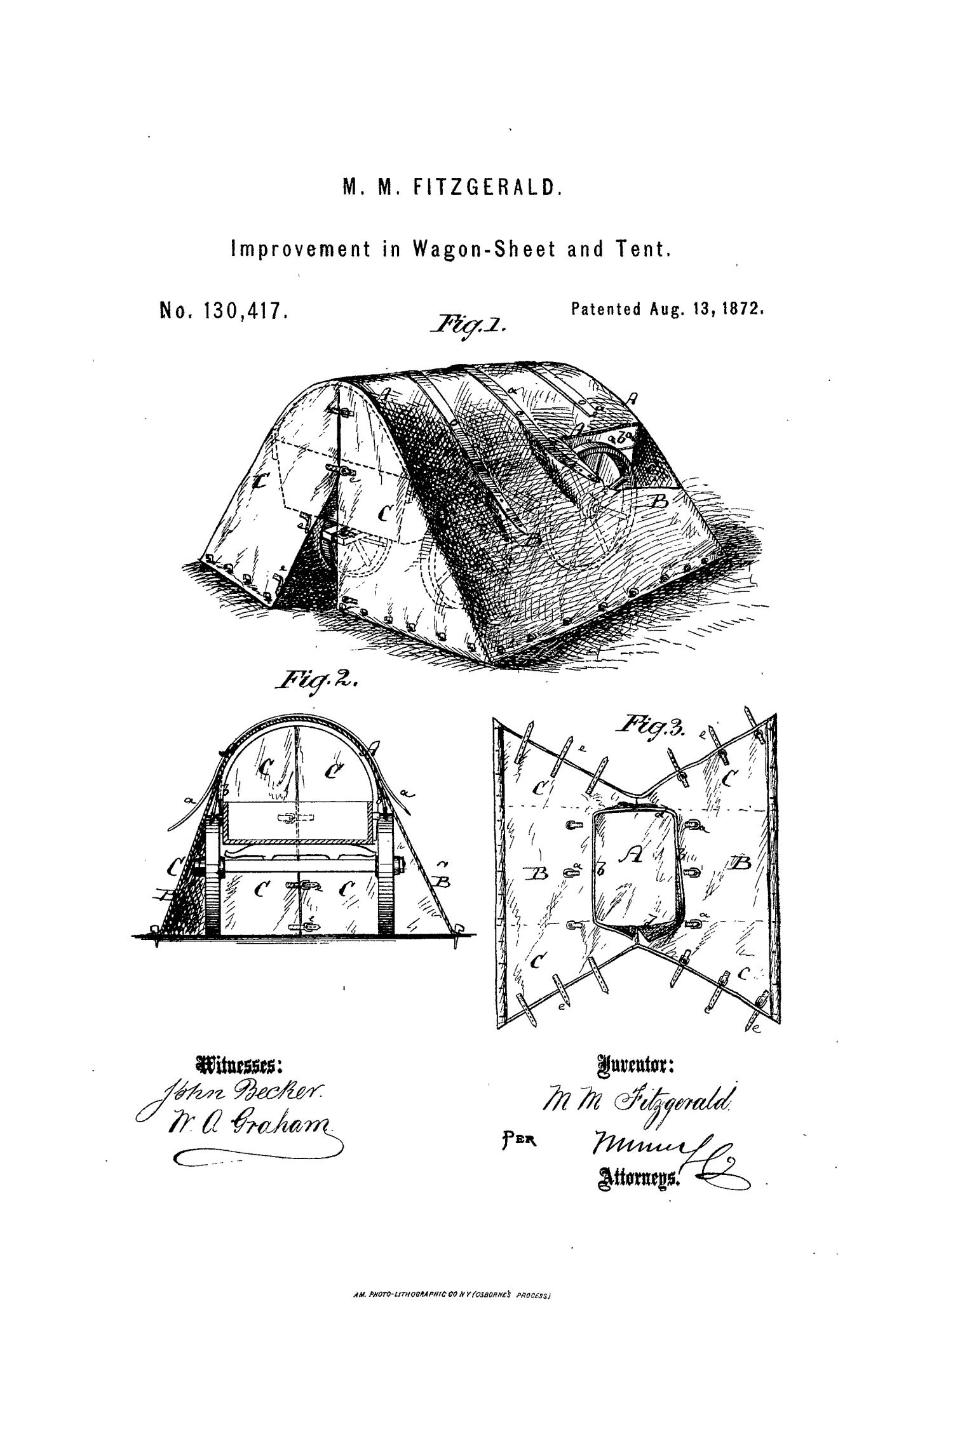
Read & Record Your Notes
Read the passage.
Record the title, date, the most important events, and the significance:
  Why is this important in history?
  How did it change things for the better or worse?
  What did it cause to happen next?
  Tip: Determine the significance of each passage, then determine which key events support that significance.
https://education.texashistory.unt.edu

Slide 12
Share one topic with the Class
The title of this topic is ________
It occurred from _____ to _____*
The most significant events of this topic are ___________
This topic is significant to the Age of Contact because ________
*Some events take place in only one year.
https://education.texashistory.unt.edu

Slide 13
Continue with the next readings to complete your timeline.
https://education.texashistory.unt.edu

Slide 14
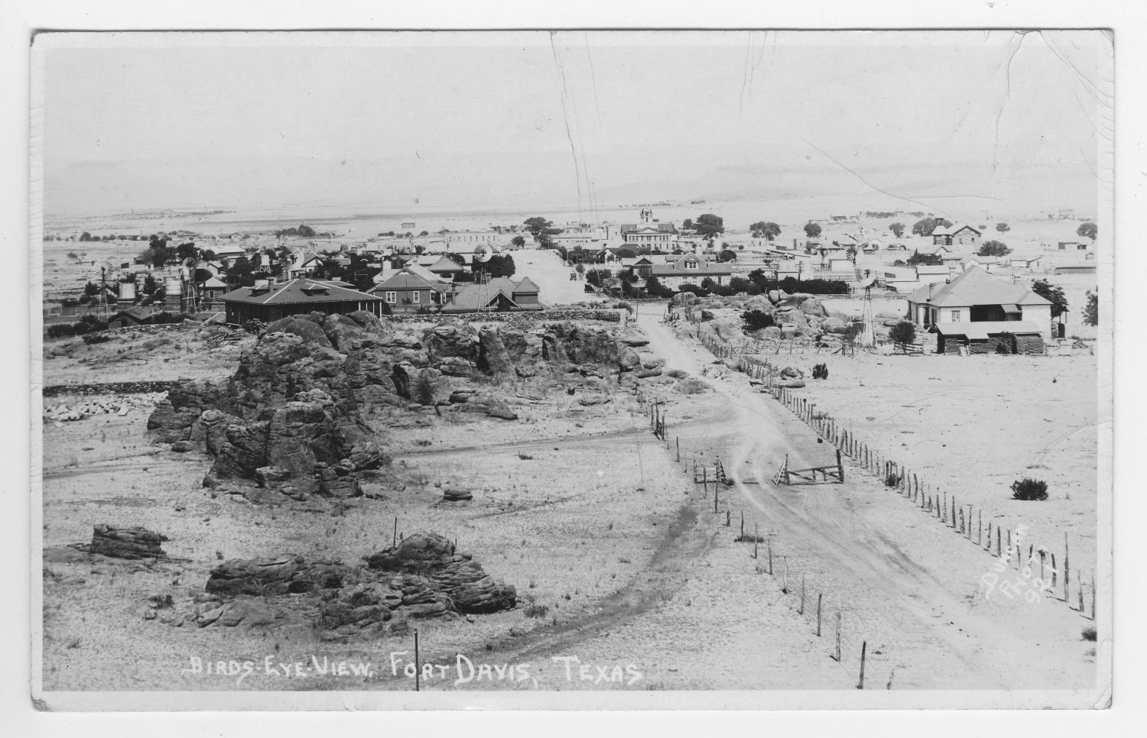
Significance of the Age of Contact
The Final Reading
I think one of the most significant changes that came about because of the Age of Contact was _________
https://education.texashistory.unt.edu

Slide 15
What’s the Story?
Exit Ticket
https://education.texashistory.unt.edu

Slide 16
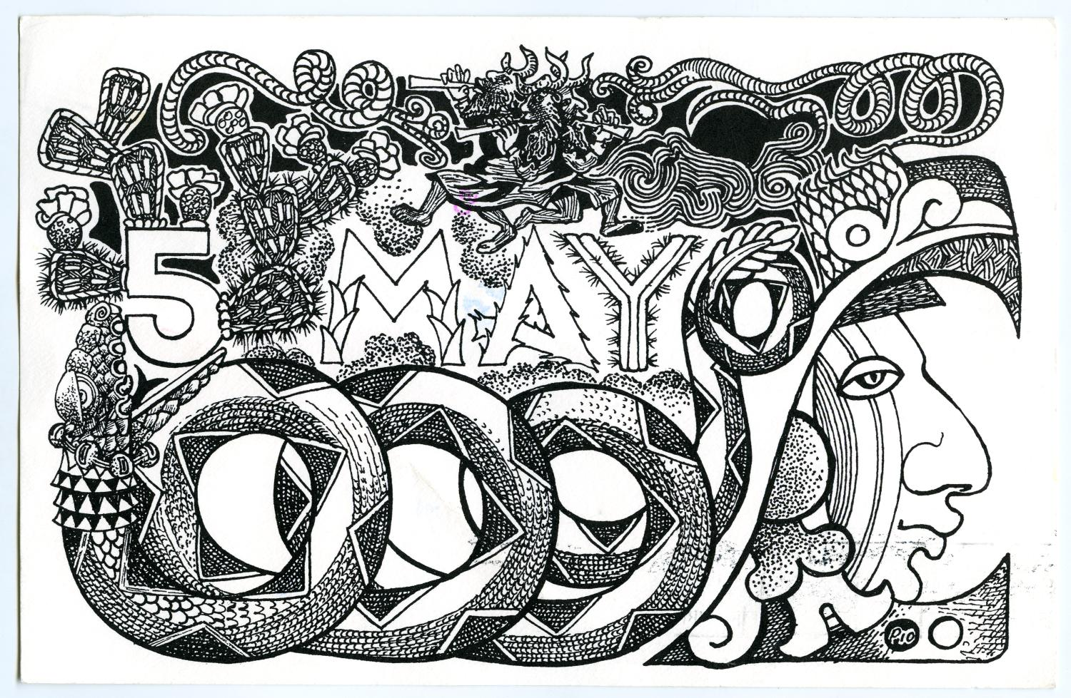
Follow the instructions to complete your Exit Ticket
Put the events listed in the correct chronological order.
Example: Write “1” beside the event that came first.
Discuss with a partner
https://education.texashistory.unt.edu

Slide 17
Share with the class 2
The _first / second / etc. event is _____________
https://education.texashistory.unt.edu

