Slide 1
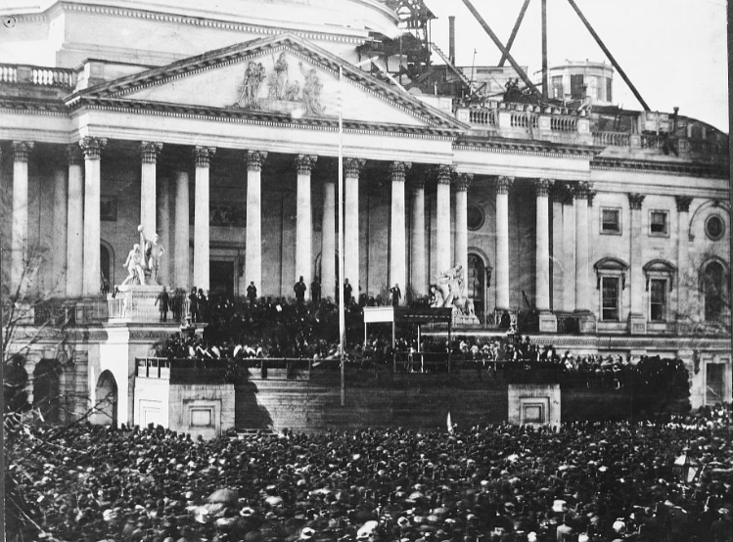
Unit 8:
Civil War
Lesson 6:
Causes of the Civil war
Abraham Lincoln’s Inauguration, March 4, 1861
Library of Congress
Notes:
Inauguration of Abraham Lincoln - March 4. Washington D.C, ca. 1935. [1861] Photograph. https://www.loc.gov/item/00652340/.

Slide 2




Warm-up
Follow the directions to complete your warm-up
Read the primary source excerpt from the State of Texas Declaration of Secession, 1861
Answer the question that follows.
Discuss with a partner

Slide 3
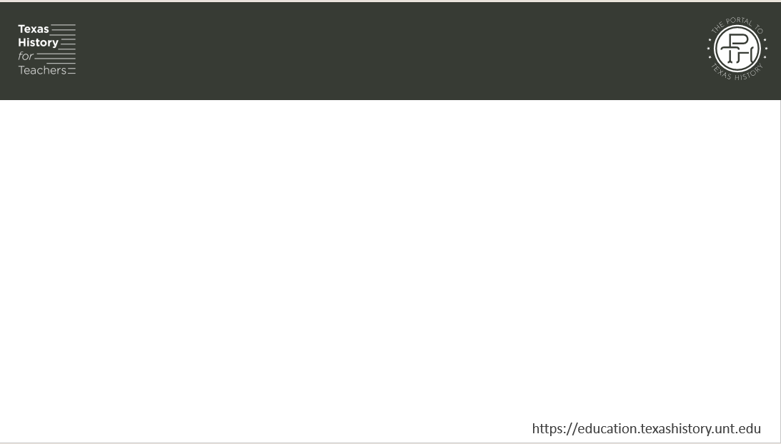
Share with the class
One complaint that Texas made against the North was ___________

Slide 4

Essential Question
What was the primary cause of the Civil War, and what events occurred from 1820 to 1860 that give evidence of this cause?

Slide 5

In today’s lesson…
We will identify the primary cause of the Civil War and examine seven significant events related to this cause that contributed to the outbreak of the Civil War.
I will consider and explain how each event contributed to the rising sectionalism that led to the Civil War.

Slide 6

Causes of the Civil War
Guided Notes

Slide 7
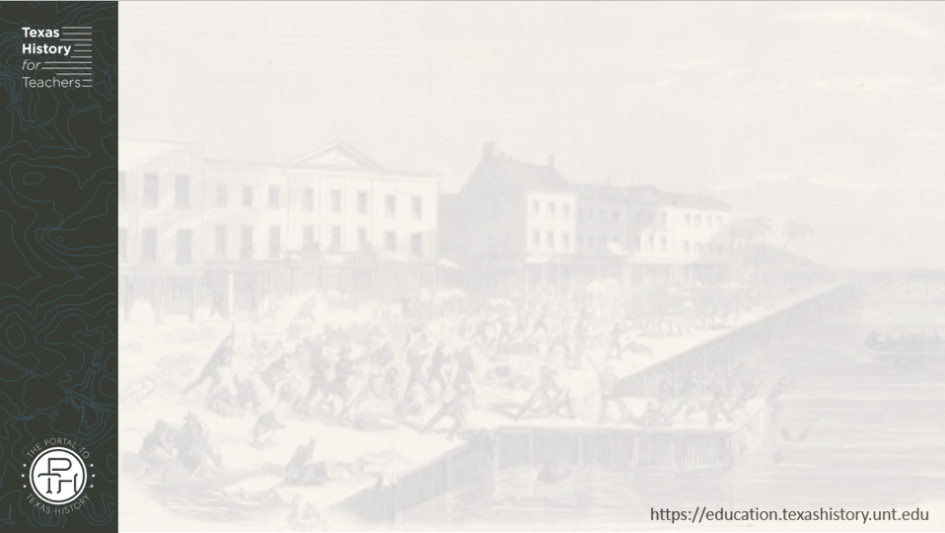
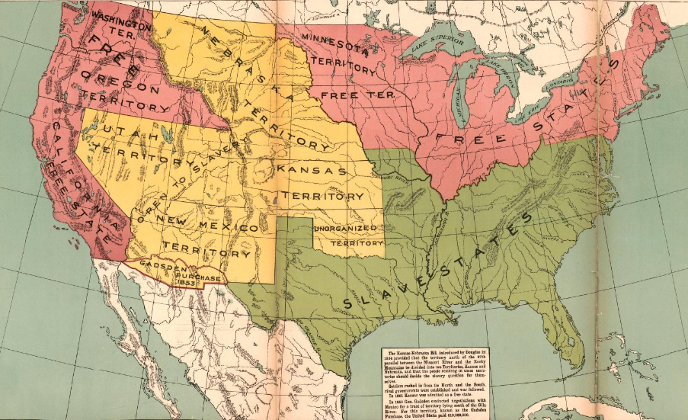
Part I: Slavery, Sectionalism, and States’ Rights
Map of the United States, 1854
The Library of Congress
Notes:
Mcconnell Map Co, and James McConnell. Kansas-Nebraska Act, 1854. 1919. Library of Congress Geography and Map Division. https://www.loc.gov/item/2009581130/

Slide 8
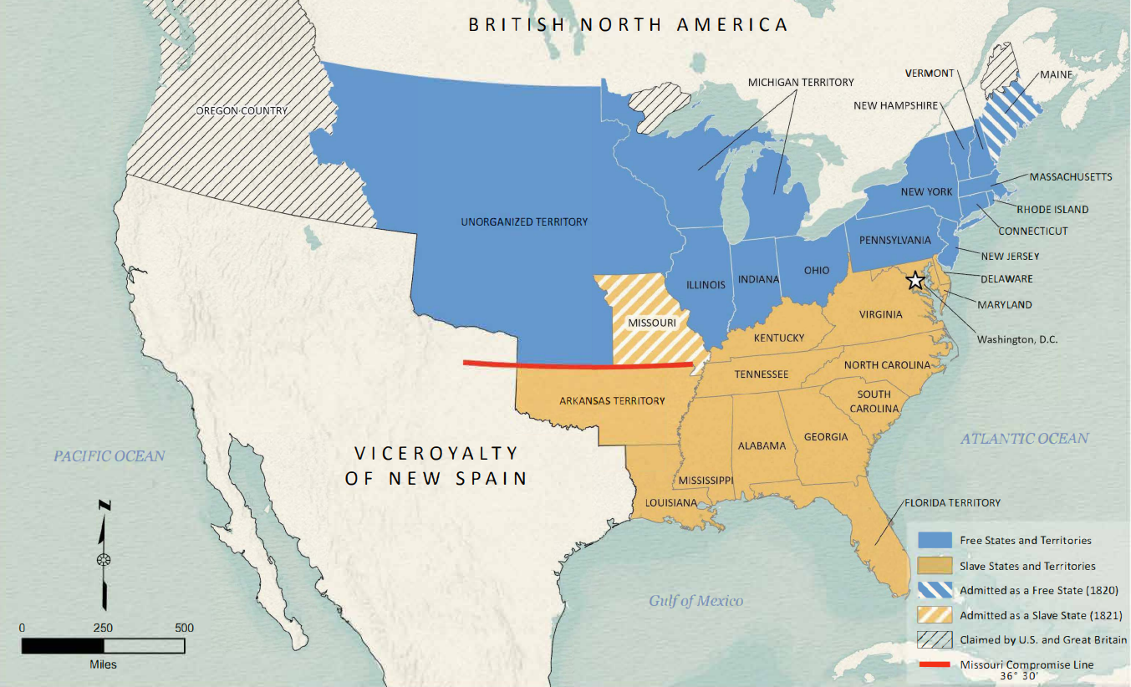
The Missouri Compromise
What: An 1820 law addressing the issue of slavery in the territory of Missouri.
Terms:
  Missouri admitted to the U.S. as a slave state.
  Maine admitted as a free state.
  Slavery was prohibited in the rest of the Louisiana Purchase north of the 36°30’ line.
Missouri Compromise Map
Texas General Land Office
Notes:
Missouri Compromise of 1820 Map. Justin Arroyos (Compiler) Lila Rakoczy (Compiler) Kelsey Bonnell (Compiler) GIS Educational Maps, Texas General Land Office. Accessed August 13, 2025. https://historictexasmaps.com/object/97357

Slide 9
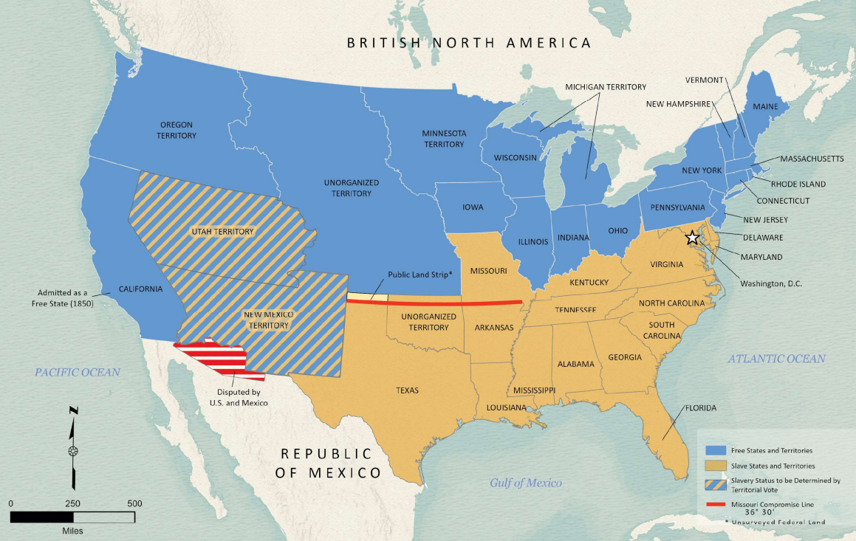
The Compromise of 1850
What: An 1850 law addressing the issue of slavery in the Mexican Cession Territory
Terms:
  California joined the U.S. as a free state.
  Slavery would be decided by popular sovereignty (vote) in Utah and New Mexico.
  Decreased the size of Texas
  Ended the slave trade in Washington D.C.
Compromise of 1850 Map
Texas General Land Office
Notes:
Arroyos, Justin, Lila Rakoczy, and Kelsey Bonnell. Compromise of 1850. 2024. Texas Glo Map Database and Store. Accessed August 6, 2025. https://historictexasmaps.com/collection/search-results/97358-compromise-of-1850-gis-educational-maps.

Slide 10
The Kansas-Nebraska Act
What: An 1854 law addressing the issue of slavery in the territories of Kansas and Nebraska.
Terms:
  Slavery would be decided in Kansas and Nebraska by popular sovereignty (vote).
This law effectively repealed the Missouri Compromise of 1820.
Map of the United States, 1854
The Library of Congress
Notes:
Mcconnell Map Co, and James McConnell. Kansas-Nebraska Act, 1854. 1919. Library of Congress Geography and Map Division. https://www.loc.gov/item/2009581130/

Slide 11
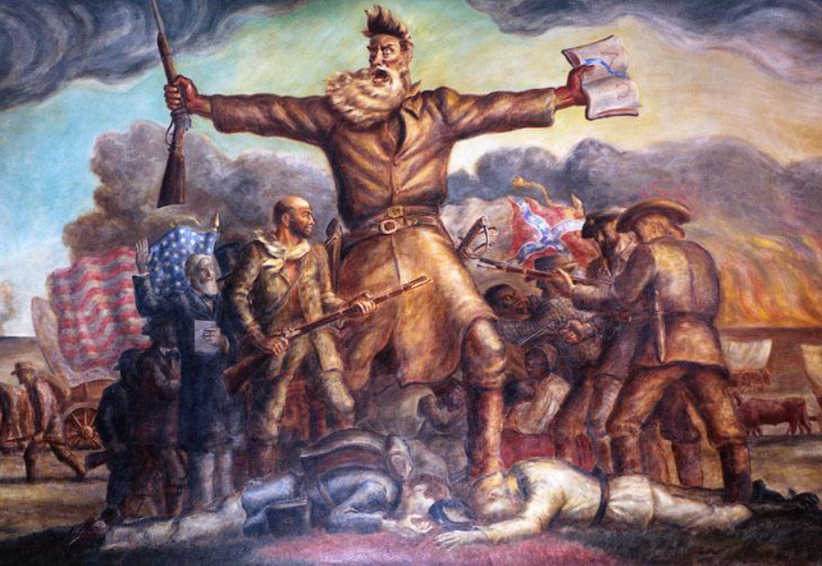
“Bleeding Kansas”
Northerners and Southerners flooded into Kansas to try to influence the vote on slavery.
From 1855 to 1859 violence broke out in Kansas between pro-slavery and anti-slavery groups.
May 1856, a radical abolitionist named John Brown and his sons killed 5 pro-slavery supporters at the Pottawatomie Creek.
“The Tragic Prelude” Mural at the Kansas State Capitol
John Brown stands in the front
Notes:
The Tragic Prelude John Brown by John Steuart Curry. 1938. This work is in the public domain in the United States because it was published in the United States between 1930 and 1977, inclusive, without a copyright notice. For further explanation, see Commons:Hirtle chart as well as a detailed definition of "publication" for public art.Note that it may still be copyrighted in jurisdictions that do not apply the rule of the shorter term for US works (depending on the date of the author's death), such as Canada (50 p.m.a.), Mainland China (50 p.m.a., not Hong Kong or Macao), Germany (70 p.m.a.), Mexico (100 p.m.a.), Switzerland (70 p.m.a.), and other countries with individual treaties. Accessed August 13, 2025. https://commons.wikimedia.org/wiki/File:The_Tragic_Prelude_John_Brown.jpg

Slide 12
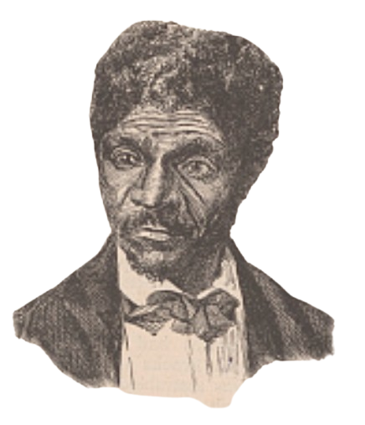
The Dred Scott Case
What: An 1857 Supreme Court case about the status of an enslaved man named Dred Scott.
The Case: Scott argued that he should be free, because his master brought him into free states and territories.
The Verdict:
  The Supreme Court ruled that Scott was not free, and that he had no rights in court because Black people were not citizens of the U.S.
  The court also ruled that Congress had no authority to ban slavery from a U.S. territory.
A Portrait of Dred Scott
The Library of Congress
Notes:
Century Company, Publisher. Dred Scott. Harriet, wife of Dred Scott. , 1887. [New York: Century Co., June] Photograph. https://www.loc.gov/item/2014645331/.

Slide 13
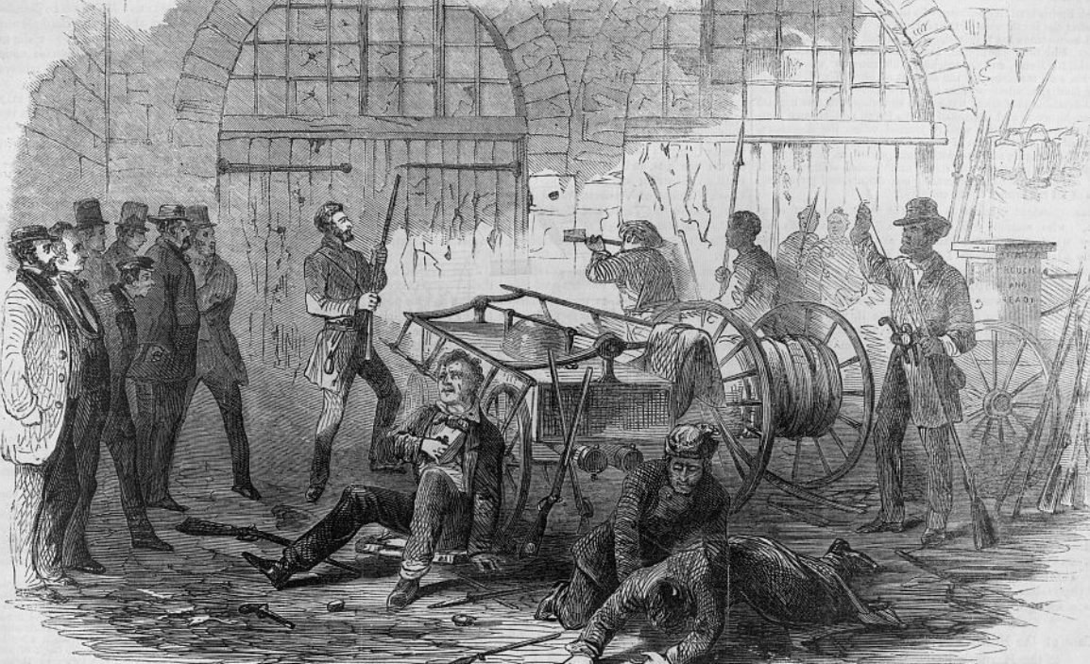
John Brown’s Raid on Harper’s Ferry
When: October 16, 1859
What: Radical abolitionist John Brown led a raid on a federal arsenal at Harper’s Ferry, Virginia.
Why: He wanted to steal federal weapons at the arsenal to arm slaves so they could revolt against Southern slave owners.
Outcome: Brown and his men were captured and executed.
The Harpers Ferry Insurrection
Library of Congress
Notes:
Harper's Ferry insurrection - Interior of the Engine-House, just before the gate is broken down by the storming party - Col. Washington and his associates as captives, held by Brown as hostages. Harpers Ferry West Virginia, 1859. Photograph. https://www.loc.gov/item/2002735881/.

Slide 14
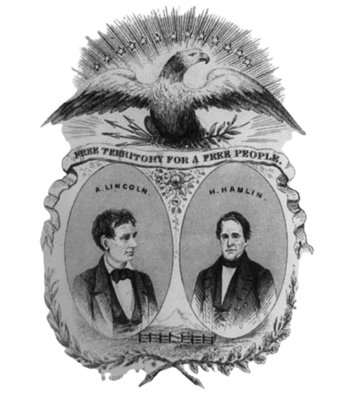
The Presidential Election of 1860
A Northern, anti-slavery Republican named Abraham Lincoln was elected president of the United States.
Southern states opposed the election of an anti-slavery president and began to secede from the Union.
A campaign poster for the 1860 election
The Library of Congress
Notes:
Lovett, J. D. Free Territory for a Free People. United States, 1860. Photograph. https://www.loc.gov/item/2008661602/.

Slide 15
Exit Ticket
Follow the directions to complete your exit ticket
Complete each portion of the graphic organizer to explain the primary cause of the Civil War and provide an example based on the lesson.
Discuss with a partner

Slide 16
Share with the class 2
The primary cause of the Civil War between the North and the South was ________.
One event related to this cause was _____.
This event was significant because ______.

