Slide 1
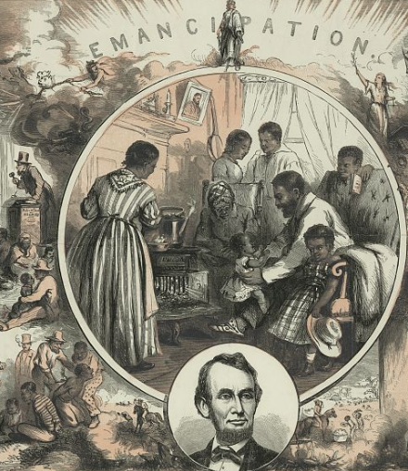
Unit 8:
Civil War
Extension Lesson:
The Emancipation Proclamation
Notes:
King & Baird, Thomas Nast, S Bott, and J. W Umpehent. Emancipation / Th. Nast ; King & Baird, printers, 607 Sansom Street, Philadelphia. ca. 1865. Wood engraving. Library of Congress Prints and Photographs Division. https://www.loc.gov/item/2004665360/

Slide 2

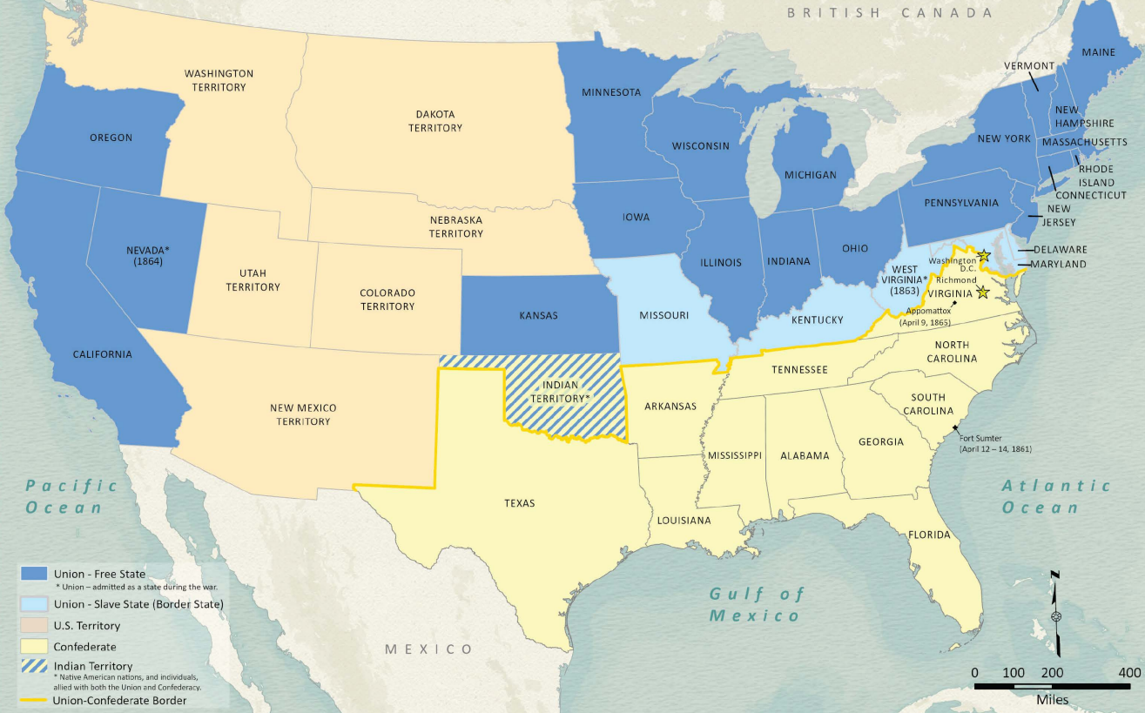
Warm-up:
Use the image to complete your warm-up
Notes:
Wang, Thomas, Lila Rakoczy, and James Harkins. American Civil War Political Loyalties. 2022. Texas General Land Office, GIS Educational Maps. Map Database and Store. https://historictexasmaps.com/object/97091

Slide 3

Share with the class
One observation I notice about slavery in the U.S. based on this map is ______________

Slide 4

Essential Question
What was the purpose and significance of the Emancipation Proclamation, and what limitations did it include?

Slide 5
In today’s lesson…
We will analyze excerpts of the Emancipation Proclamation to determine its significance.
I will read short excerpts of the Proclamation to identify and summarize its primary goals, limitations, and significance during the Civil War.

Slide 6
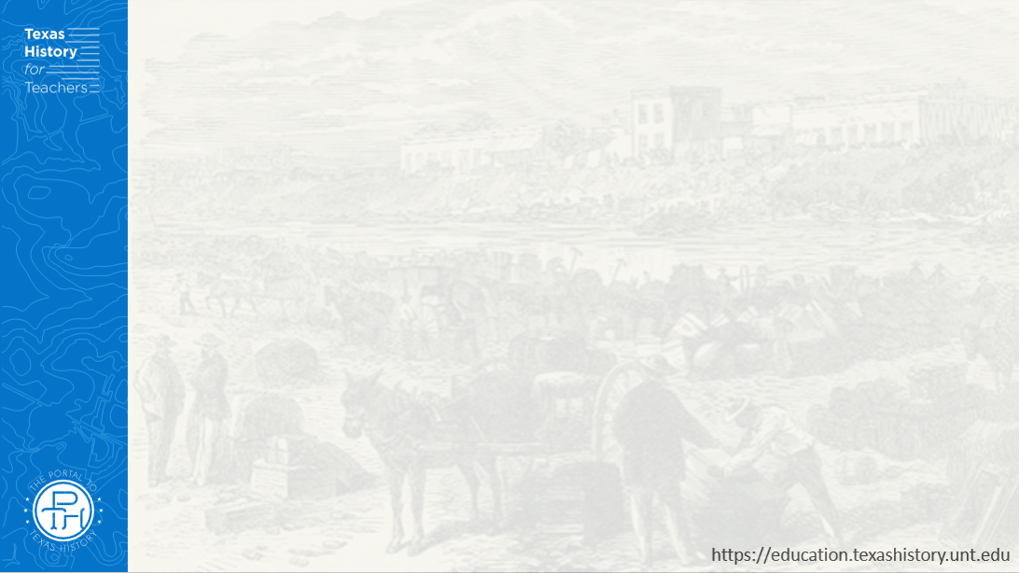
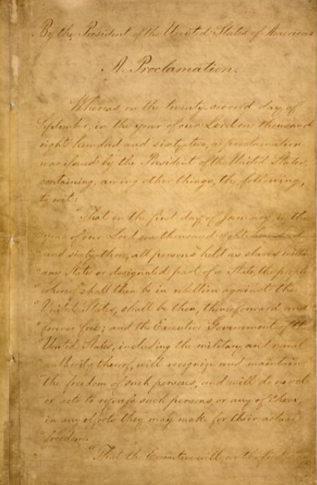
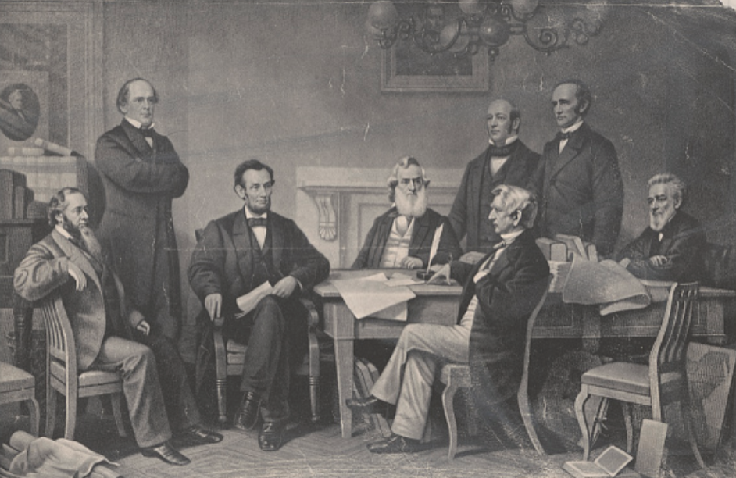
The Emancipation Proclamation
“The Proclamation of Emancipation”
The Library of Congress
First page of the Emancipation Proclamation
Library of Congress
Notes:
Lincoln, Abraham, Author. Emancipation Proclamation. [Place of Publication Not Identified: Publisher Not Identified, -09-22, 1862] Pdf. https://www.loc.gov/item/2021667576/.
The Proclamation of Emancipation. , 1895. [New York: publisher not transcribed] Photograph. https://www.loc.gov/item/2018697406/.

Slide 7



Exit Ticket:
Follow the directions to complete your exit ticket
Read the primary source excerpt story about Abraham Lincoln and the Emancipation Proclamation.
Respond to the question
Share with a partner

Slide 8
Share with the class 2
I think the meaning of the story in this article might be __________
I think this story relates to the Emancipation Proclamation because ________

