Slide 1
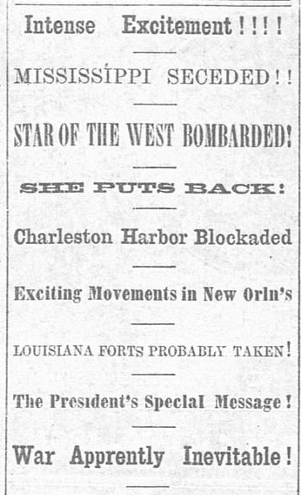

Unit 8: Civil War
Lesson 2:
How do we know what we know?
Notes:
The Weekly Telegraph (Houston, TX), January 15, 1861. The Portal to Texas History. https://texashistory.unt.edu/ark:/67531/metapth236128/

Slide 2







Warm-up: Follow the directions to complete your warm-up
Read the primary source excerpt on your warm-up.
What can you learn about this era based on the excerpt?
Share with a partner.

Slide 3

Share with the class
One thing I can learn about this era based on the primary source excerpt is _________

Slide 4

Essential Question
What were the different points of view on significant events of the Civil War era, and how were those events represented and discussed in a variety of primary source excerpts from the era?

Slide 5
In today’s lesson…
We will examine various topics and different points of view related to significant issues and events of the Civil War era by analyzing a variety of primary source materials.
I will summarize the main idea of each primary source material and explain what the material can tell me about the Civil War era of Texas history.

Slide 6
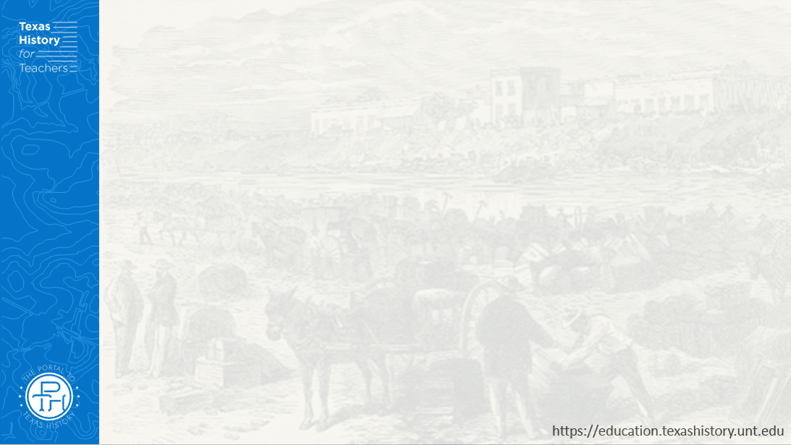
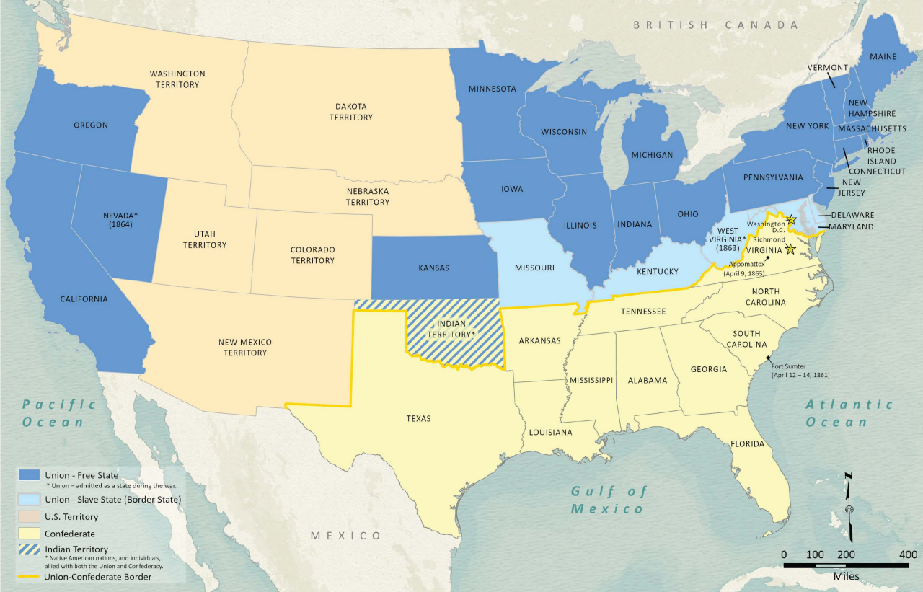
Part I: Texas Leaves the United States
Texas General Land Office
Notes:
Wang, Thomas, Lila Rakoczy, and James Harkins. American Civil War Political Loyalties. 2022. Texas General Land Office, GIS Educational Maps. Map Database and Store. https://historictexasmaps.com/object/97091

Slide 7
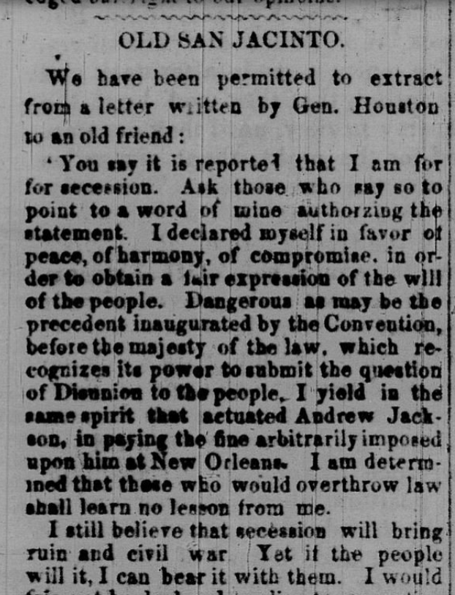
Part II: Primary Source Analysis
Primary Source A
Sam Houston’s Thoughts on Secession
Tri-Weekly Alamo Express, Feb. 18, 1861
The Portal to Texas History

Slide 8
Exit Ticket: Follow the directions to complete your exit ticket
Read the different statements in the graphic organizer.
Choose FOUR statements that are true for Texas during the Civil War era.
Share with a partner.

Slide 9
Share with the class 2
One statement that is true of the Civil War era of Texas history is that ________

