Slide 1
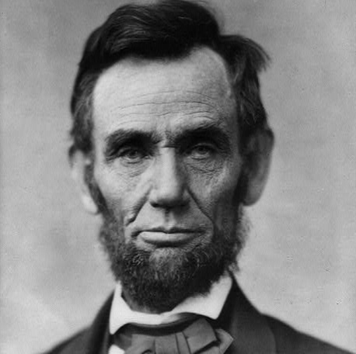
Unit 8:
Civil War
Lesson 11:
Looking Ahead
Notes:
Gardner, Alexander. President Abraham Lincoln, head-and-shoulders portrait, facing front. 1863. Photograph. https://www.loc.gov/item/2013649738/

Slide 2





Warm-up
Follow the directions to complete your warm-up
Imagine it: Read the scenario on your warm-up
Questions to Consider: Choose at least one question to respond to.
Discuss with a partner

Slide 3

Share with the class
If I were the president at the end of the Civil War, I would ___________________________

Slide 4

Essential Question
How did Abraham Lincoln plan to deal with the end of the war and the Southern states who had rebelled?

Slide 5

In today’s lesson…
We will analyze Abraham Lincoln’s Second Inaugural Address to determine his approach to dealing with the end of the Civil War.
I will read excerpts from Abraham Lincoln’s Second Inaugural Address to make observations and inferences about his goals for the country after the Civil War.

Slide 6
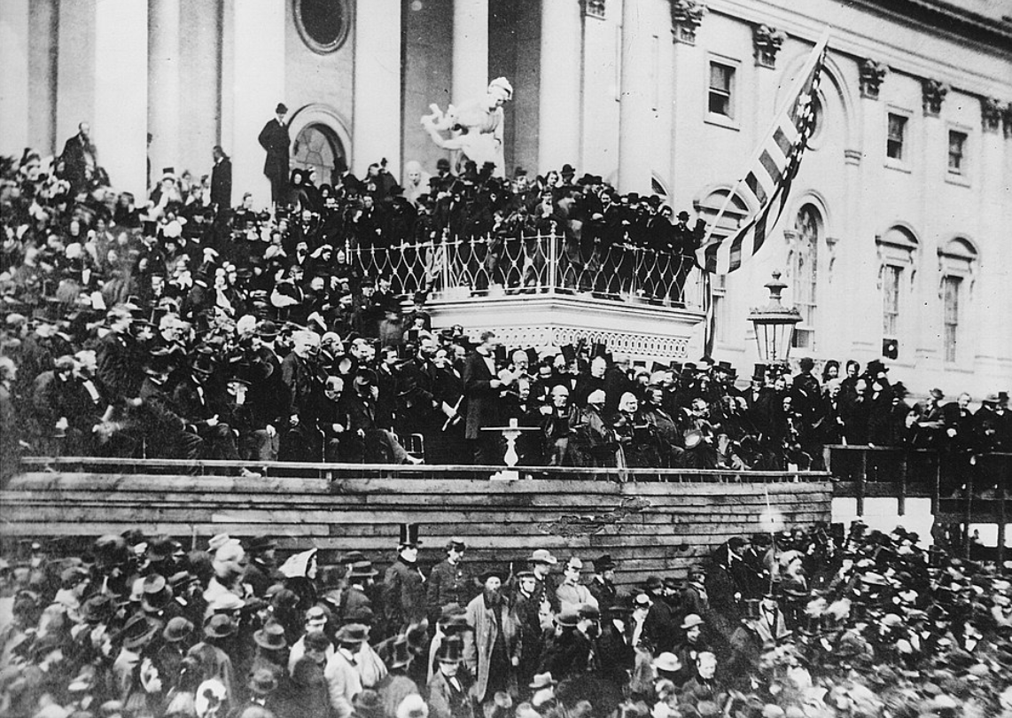
Lincoln’s Second Inaugural Address
Photograph taken at the east portico of the U.S. Capitol, March 4, 1865.
President Lincoln is standing in the center at the podium.
The Library of Congress
Notes:
Gardner, Alexander, photographer. Lincoln's Second Inaugural. Washington D.C, None. [Between 1910 and 1920, from a photograph taken in 1865] Photograph. https://www.loc.gov/item/00650938/.

Slide 7
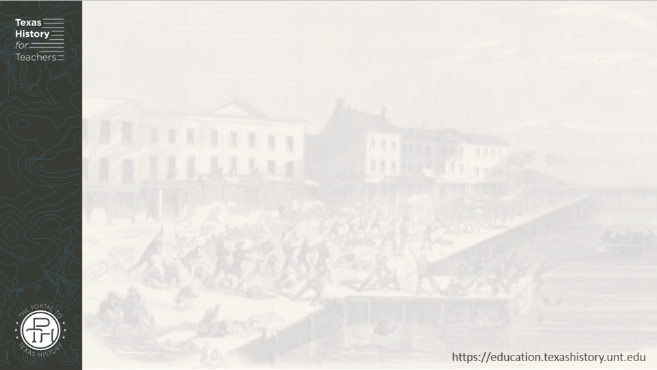
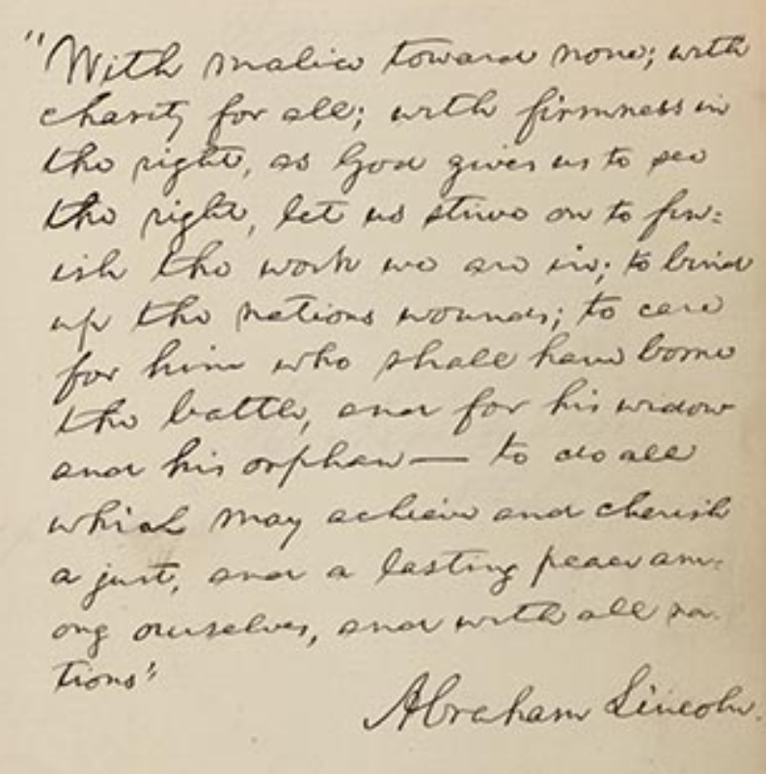
“With Malice Toward None”
Lincoln wrote a portion of his Second Inaugural Speech in an autograph book.
The Library of Congress
Notes:
With Malice Toward None: The Abraham Lincoln Bicentennial Exhibition, Healing the Nation’s Wounds. The Library of Congress. Accessed September 2, 2025. https://www.loc.gov/exhibits/lincoln/healing-the-nations-wounds.html

Slide 8
Exit Ticket
Follow the directions to complete your exit ticket
Imagine it: Read the scenario on your warm-up
Points of View to Consider: Choose one or both points of view, to record your response.
Discuss with a partner

Slide 9
Share with the class 2
A Southern Confederate would probably hope _____________
A newly freed Black Texan would probably hope ________

