Slide 1

Mind Map
Sub-topic
1
Additional information
Sub-topic
2
Main Topic
Additional information
Sub-topic
3
Additional information
Additional information
https://education.texashistory.unt.edu

Slide 2

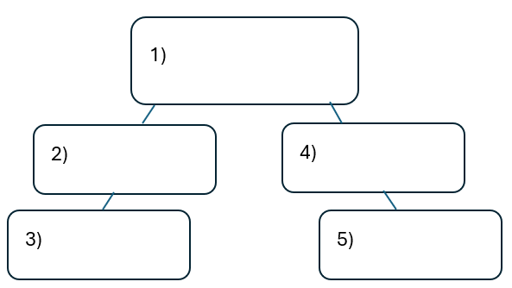


Warm-up: Follow the directions on your warm-up
Use the word bank provided to fill in the small mind map on your warm-up.
Place each term where you think it fits best in your mind map.
Discuss with a partner.
https://education.texashistory.unt.edu

Slide 3
Share with the class
I think the primary topic in box number one is _______
I think the subtopic in box number two is ____, and box number three is ____
I think the subtopic in box number four is ____, and box number five is ____
https://education.texashistory.unt.edu

Slide 4
Essential Question
How do the key terms and concepts from Unit 8: Civil War connect to each other?
https://education.texashistory.unt.edu

Slide 5
In today’s lesson…
We will make connections between key terms and concepts within all of Unit 8: Civil War.
I will create a Mind Map using terms and concepts from the class slides presentation.
https://education.texashistory.unt.edu

Slide 6
Unit Topic & Subtopics
Choose the box below that represents the topic of our unit. Write it in the middle of your mind map.
The remaining topics are subtopics in the unit. Write them evenly spaced around the main topic.
Civil War
Causes
Events
Union
Confederacy
https://education.texashistory.unt.edu

Slide 7
Make Connections
Connect each item below to the topic on your Mind Map.
Some items will connect directly to the main topic. Some will connect to other items from this slide.
Free States
Plantation Agriculture
Battle of Galveston
Rio Grande Trade
Slavery
Battle of Sabine Pass
https://education.texashistory.unt.edu

Slide 8
Make Connections 2
Connect each item below to the topic on your Mind Map.
Some items will connect directly to the main topic. Some will connect to other items from this slide or previous slides.
Some items could be placed in more than one location on your map.
Safe haven for refugees
Slave states
Kansas-Nebraska Act
Compromise of 1850
Emancipation Proclamation
Northern states
https://education.texashistory.unt.edu

Slide 9
Make Connections 3
Connect each item below to the topic on your Mind Map.
Some items will connect directly to the main topic. Some will connect to other items from this slide or previous slides.
Some items could be placed in more than one location on your map.
Western states
Battle of Palmito Ranch
Southern States
Election of 1860
Juneteenth
Smaller farms
https://education.texashistory.unt.edu

Slide 10
Make Connections 4
Connect each item below to the topic on your Mind Map.
Some items will connect directly to the main topic. Some will connect to other items from this slide or previous slides.
Some items could be placed in more than one location on your map.
Business and Manufacturing
Cotton
Abraham Lincoln
Secession
Plantation Agriculture
Freedom for enslaved people
https://education.texashistory.unt.edu

Slide 11
Make Connections 5
Connect each item below to the topic on your Mind Map.
Some items will connect directly to the main topic. Some will connect to other items from this slide or previous slides.
Some items could be placed in more than one location on your map.
Blockade
Increased population
Final battle of Civil War
Decreased size of Texas
Northern Republican
Border states
https://education.texashistory.unt.edu

Slide 12

Create Connections 6
Now take a few minutes to add any information you can think of to your Mind Map.
You can add facts, descriptions, explanations, cultural information, or anything else you can think of.
https://education.texashistory.unt.edu

Slide 13
Exit Ticket
Complete the sentence summarizing the main idea from our unit.
Discuss with a partner.
https://education.texashistory.unt.edu

Slide 14
Share your response
The (1)____________ is primarily characterized the by (2)_______________
https://education.texashistory.unt.edu

