Slide 1
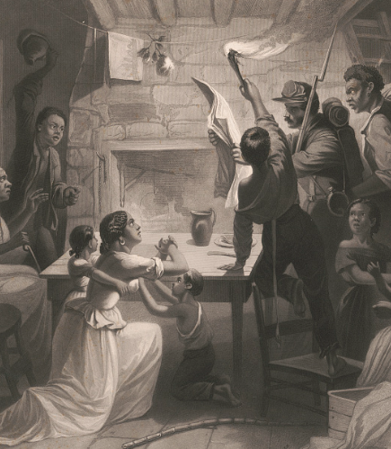
Unit 8: Civil War
Review Lesson:
Study Guide and Flash Cards
Reading the Emancipation Proclamation
The Library of Congress
Notes:
Watts, James W., Henry Walker Herrick, and Lucius Stebbins. Reading the Emancipation Proclamation / H.W. Herrick, del., J.W. Watts, SC. ca. 1864. Steel engraving. Library of Congress Prints and Photographs Division. https://www.loc.gov/item/2003678043/

Slide 2
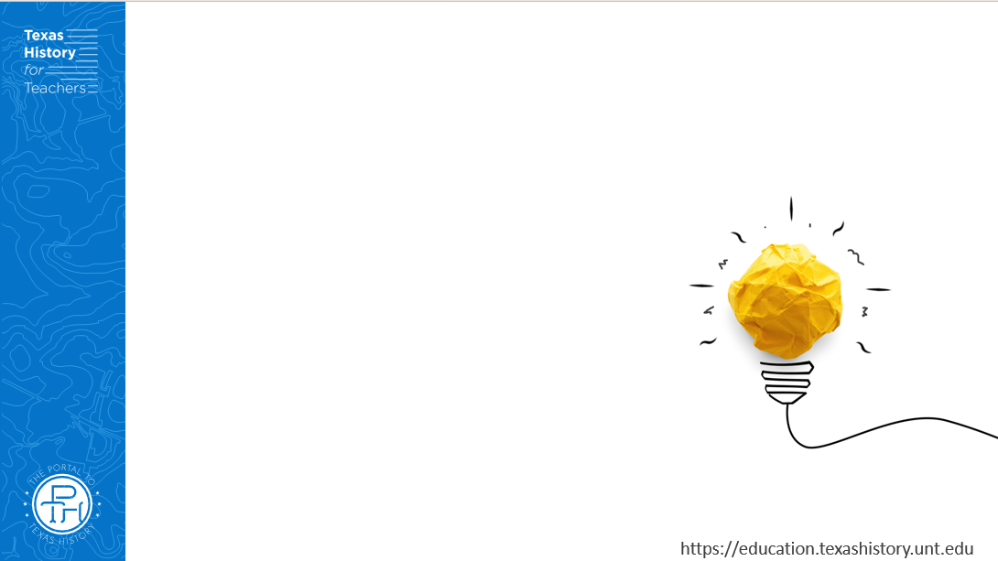



Warm-up: Follow the directions to complete your warm-up
Read each statement in the graphic organizer.
Circle or highlight each topic that you think we are likely to see on the Unit 8 test.
Share with a partner.

Slide 3
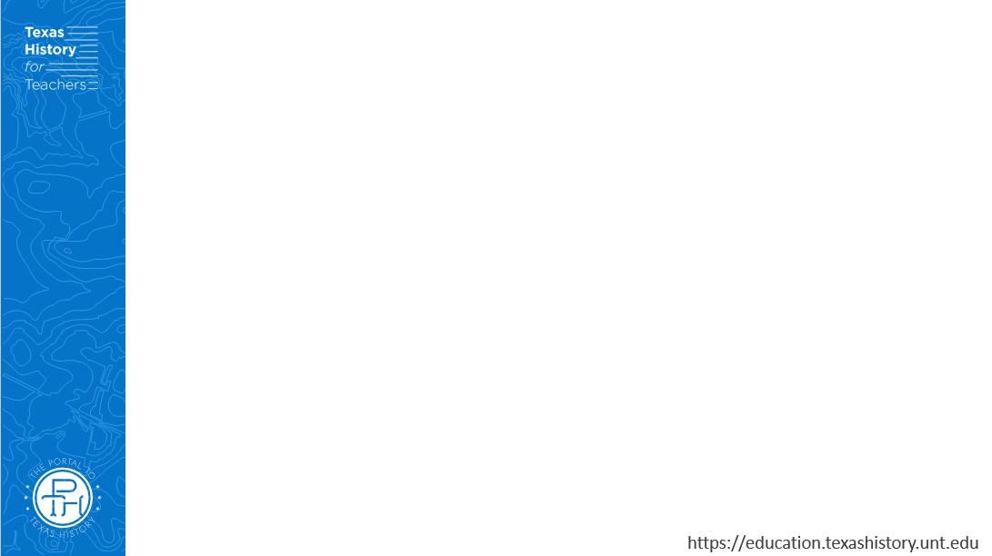
Share with the class
One topic I expect to see on the Unit 8 test is ______

Slide 4
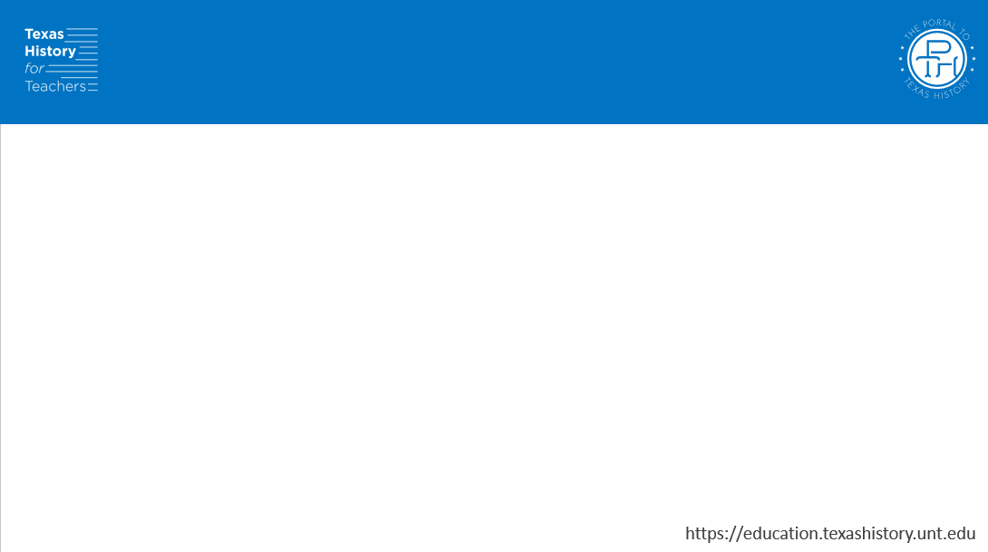
Essential Question
What are the key topics, themes, events, people, and terms that we need to know to be successful on the Unit 8 test?

Slide 5
In today’s lesson…
We will identify and review significant information for our upcoming test.
I will use my previous work and notes to complete my study guide. I will identify key terms and concepts, match cause and effect relationships, create short answer responses, and answer practice test questions.

Slide 6
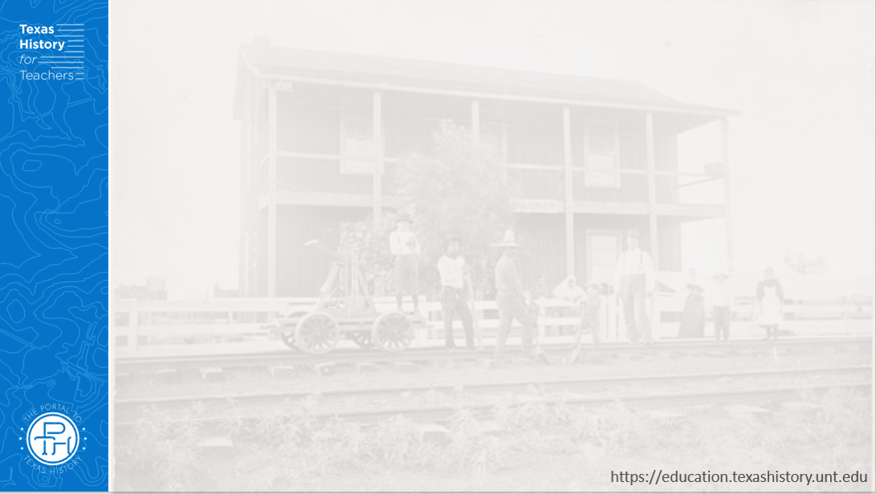
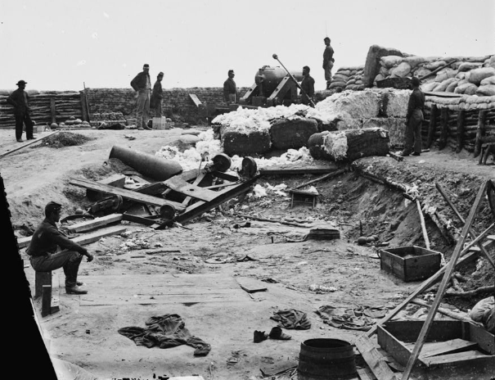
Part I: Significant Terms
Confederate fortifications reinforced with bales of cotton
The Library of Congress
Notes:
Yorktown, Virginia vicinity. Confederate fortifications reinforced with bales of cotton. 1862. Photograph. Library of Congress Prints and Photographs Division. https://www.loc.gov/item/2018670684/

Slide 7
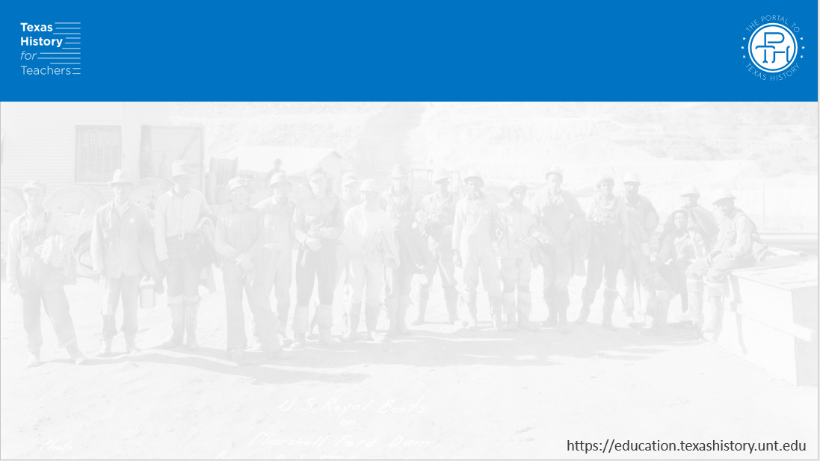
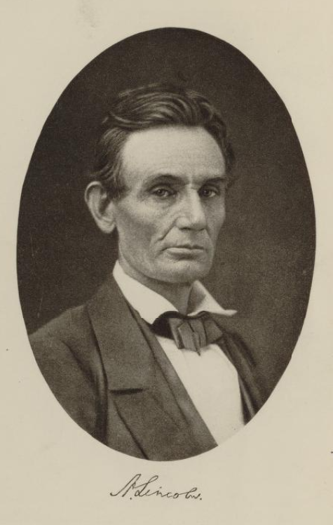
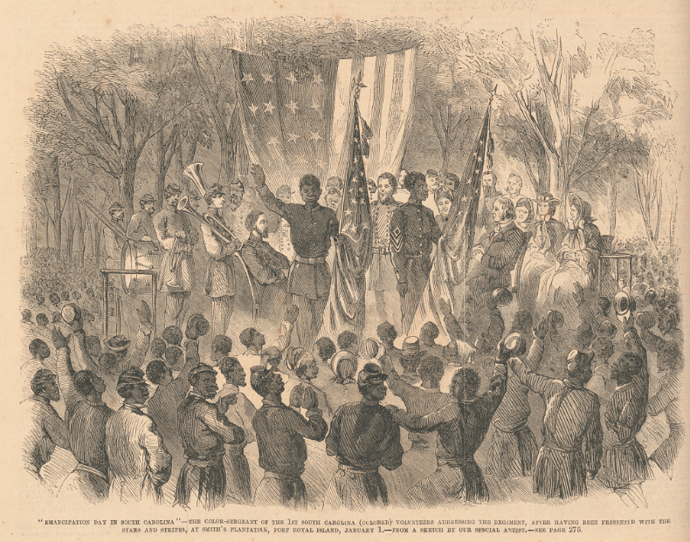
Part II: Cause and Effect Matching
Celebration of Emancipation
The Library of Congress
Abraham Lincoln
The Library of Congress
Notes:
Richards, John T, and Alfred Whital Stern Collection Of Lincolniana. Abraham Lincoln, the lawyer-statesman. Boston ; New York ; Houghton Mifflin, 1916. Image. https://www.loc.gov/item/16008365/.
"Emancipation Day in South Carolina" - the Color-Sergeant of the 1st South Carolina Colored Volunteers addressing the regiment, after having been presented with the Stars and Stripes, at Smith's plantation, Port Royal Island, January 1 / From a sketch by our special artist. 1863. Wood engraving. Library of Congress Prints and Photographs. https://www.loc.gov/item/99614128/

Slide 8
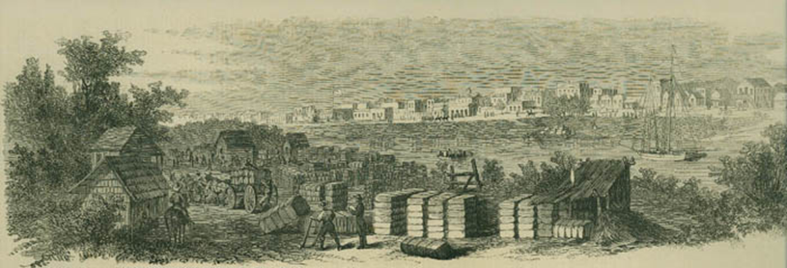
Part III: Practice Test Questions
View of Brownsville during the Civil War
The Texas States Library and Archives Commission
Notes:
View of Brownsville during the Civil War. From Frank Leslie's Illustrated Newspaper. Prints and Photographs Collection, 1980/10-4. Accessed September 2, 2025. https://www.tsl.texas.gov/exhibits/civilwar/1862_2.html

Slide 9
Exit Ticket: Follow the directions to complete your exit ticket
Complete the prompts in the graphic organizer to assess your preparedness for our test
Share with a partner.

Slide 10
Share with the class 2
Share one of your responses from your exit ticket

