Slide 1
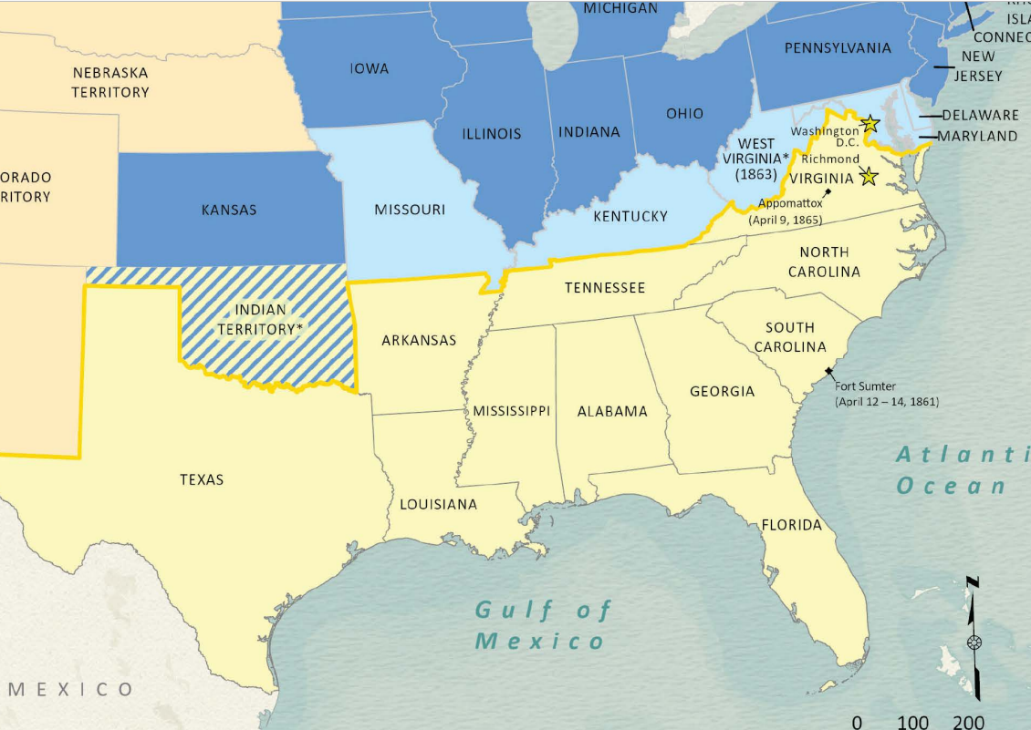
Unit 8: Civil War
Extension Lesson:
Texas & Secession
Notes:
Wang, Thomas, Lila Rakoczy, and James Harkins. American Civil War Political Loyalties. 2022. Texas General Land Office, GIS Educational Maps. Map Database and Store. https://historictexasmaps.com/object/97091

Slide 2





Warm-up Follow the directions below to complete your warm-up
Read the primary source excerpt.
Paraphrase the main idea of the material. (Write it in your own words)
Share with a partner

Slide 3

Share with the class:
In my own words, this source is saying that ___________________

Slide 4

Essential Question
What event caused the Southern states to secede from the Union, and what reasons did Texas give for seceding?

Slide 5

In Today’s Lesson
We will analyze excerpts from Texas’ Declaration of the Causes of Secession to determine why most Texans voted in favor of secession from the United States.
I will match primary source excerpt cards to their modern-day translation cards, then use the information in the cards to answer comprehension questions about Texas’ reasons for secession.

Slide 6
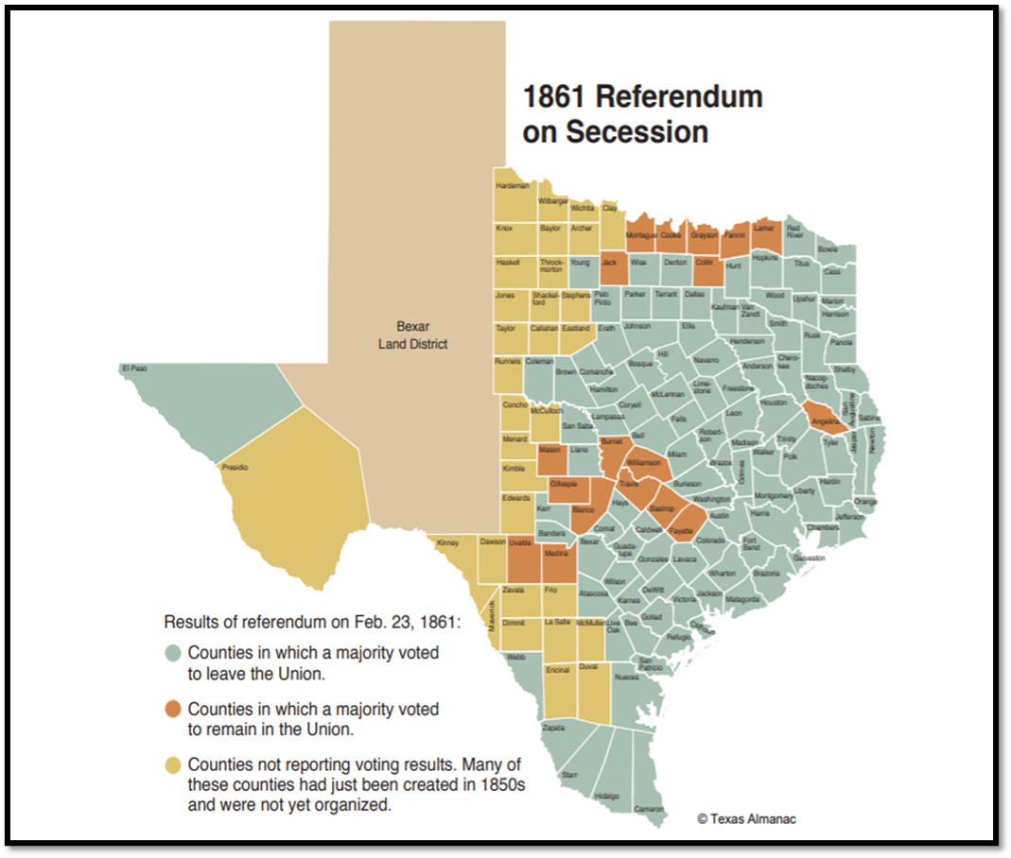
A Timeline of Secession
Read the timeline and answer the question(s)
This map shows how the majority of each county voted on secession.
The Texas Almanac
Notes:
Timeline: Texas Secession and Civil War (1861–1865) Accessed August 26, 2025. https://www.texasalmanac.com/articles/secession

Slide 7

Primary Source Matching Activity

Slide 8

Primary Source Cards
There are FOUR primary source excerpt cards with portions of the document, ““A Declaration of the causes which impel the State of Texas to secede from the Federal Union.” The cards are lettered A – D.
Primary Source Excerpt A
“Primary source quotes”
Primary Source Excerpt D
“Primary source quotes”
Primary Source Excerpt C
“Primary source quotes”
Primary Source Excerpt B
“Primary source quotes”

Slide 9
Translation Cards
There are FOUR translation cards that paraphrase the information in the excerpt cards in modern language. The Translation cards are numbered 1 - 4. You will match the translation with its correct excerpt. Translation cards are NOT in the correct order.
Translation card 1
Modern day translation
Translation Card 4
Modern day translation
Translation Card 3
Modern day translation
Translation Card 2
Modern day translation

Slide 10

Use the excerpt and translation to answer the questions on your worksheet

Slide 11
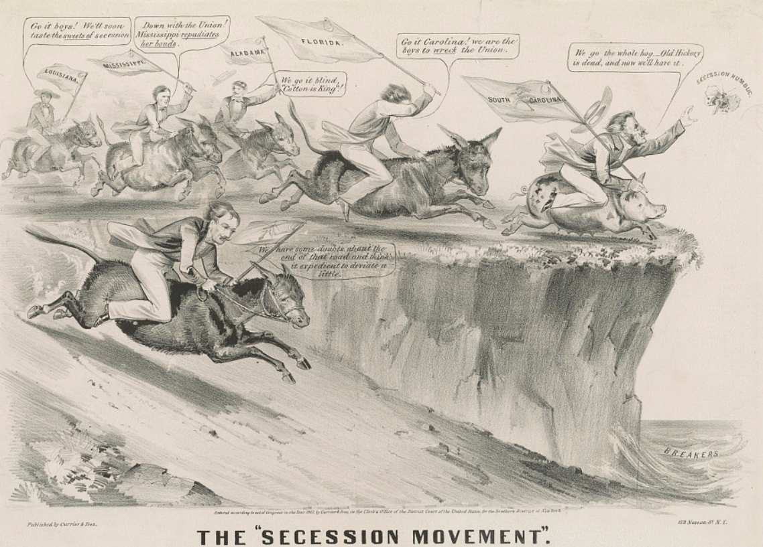
Exit Ticket
Use the image to complete your exit ticket
Notes:
Currier & Ives. The "Secession Movement". , ca. 1861. New York: Published by Currier & Ives. Photograph. https://www.loc.gov/item/2003674576/.

Slide 12
Share with the class: 2
I think the illustrator supported / opposed secession because _____________

