Slide 1
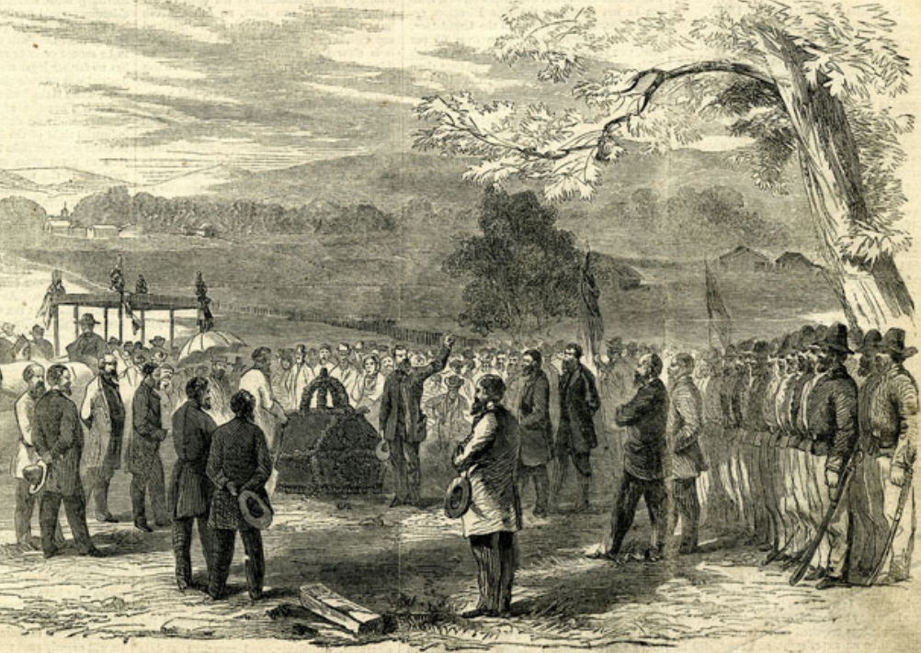
Unit 8:
Civil War
Lesson 7:
Texas & the Civil War
Funeral of the German patriots at Comfort, Texas
Texas State Library and Archives Commission
Notes:
Prints & Photographs #1992/75-1-1 Harper’s Weekly – A Journal of Civilization, January 20, 1866. Funeral of the German Patriots at Comfort, Texas, August 20, 1865. Texas State Library and Archives Commission. Accessed Aug. 27, 2025. https://www.tsl.texas.gov/highlights/2012_10/lobby-exhibits-3c.html

Slide 2

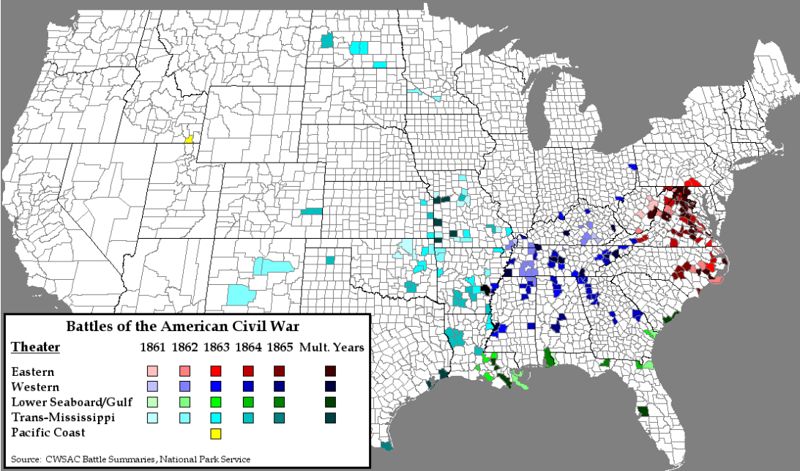
Warm-up
Use the map to complete your warm-up

Slide 3


Share with the class
One inference I can make about how the war affected Texas and Texans based on this map is ___________

Slide 4

Essential Question
In what way was Texas’ experience in the Civil War different from other Southern states, and how did this unique role affect Texas and Texans during the war?

Slide 5

In today’s lesson…
We will examine Texas’ experience during the war by focusing on the significant battles fought in Texas, life on the home front, and the Texas economy.
I will use information presented at different stations to identify the key information and significance of each topic and record my responses on my worksheet.

Slide 6
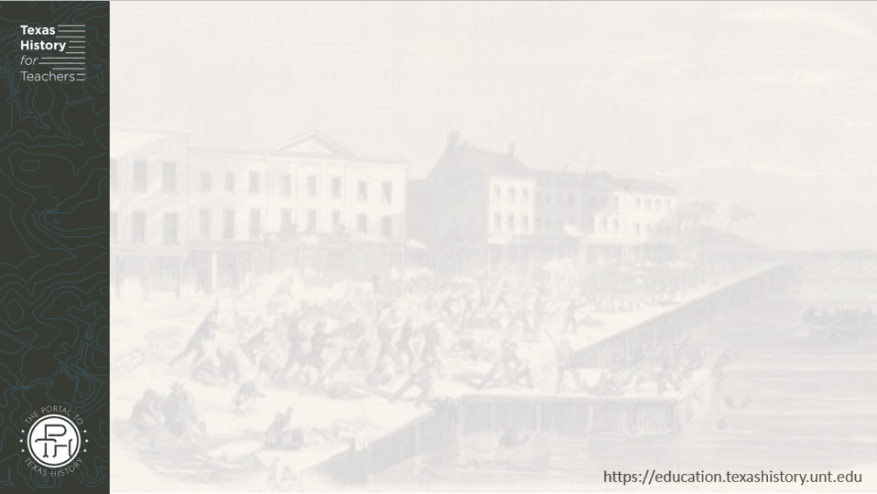
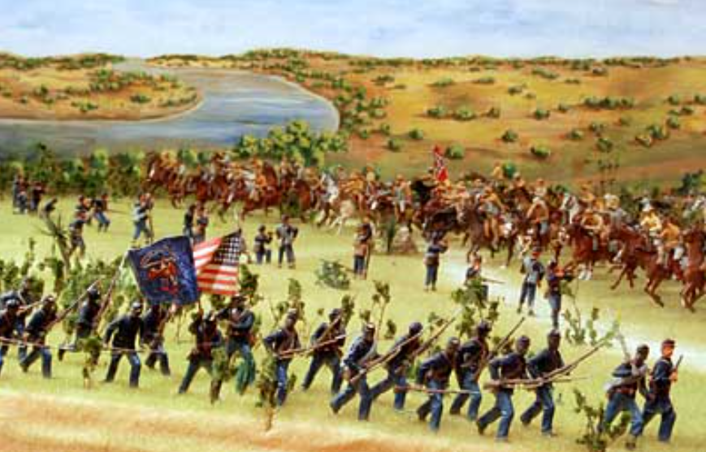
Civil War Battles in Texas
The Battle of Palmito Ranch
Texas Military Forces Museum
Notes:
The Battle of Palmetto Ranch Diorama, Used with permission of the Texas Military Forces Museum at Camp Mabry, Austin, Texas. Accessed August 22, 2025. https://www.texasmilitaryforcesmuseum.org/articles/palmetto/palmetto.htm

Slide 7
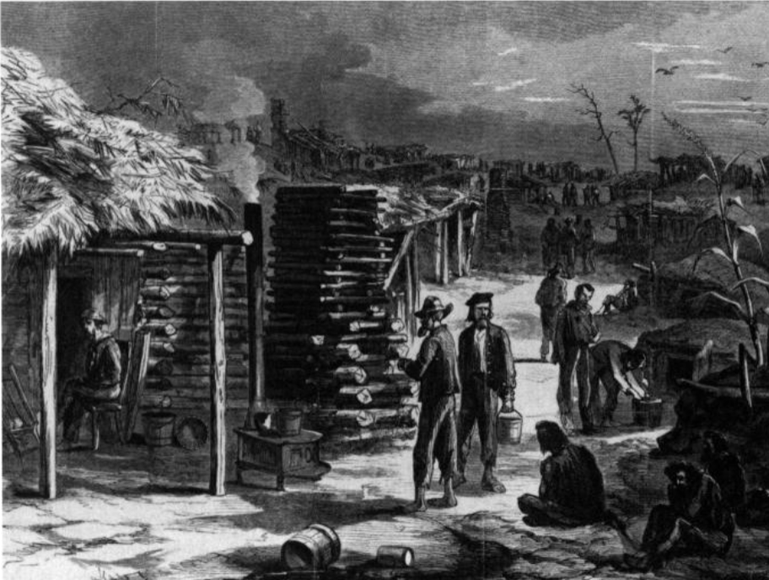
Texans on the Home Front
The harsh conditions at Camp Ford. The Portal to Texas History.
Notes:
Texas Historical Foundation. Heritage, Volume 14, Number 3, Summer 1996, periodical, Summer 1996; Austin, Texas. (https://texashistory.unt.edu/ark:/67531/metapth45405/: accessed August 22, 2025), University of North Texas Libraries, The Portal to Texas

Slide 8
Texas’ Economic Advantages During the War
American Civil War Battles by Theater
Notes:
American Civil War Battles by Theater, Year. his work has been released into the public domain by its author, Brian0918 at English Wikipedia. This applies worldwide. Accessed August 22, 2025. https://commons.wikimedia.org/wiki/File:American_Civil_War_Battles_by_Theater,_Year.png#filelinks

Slide 9
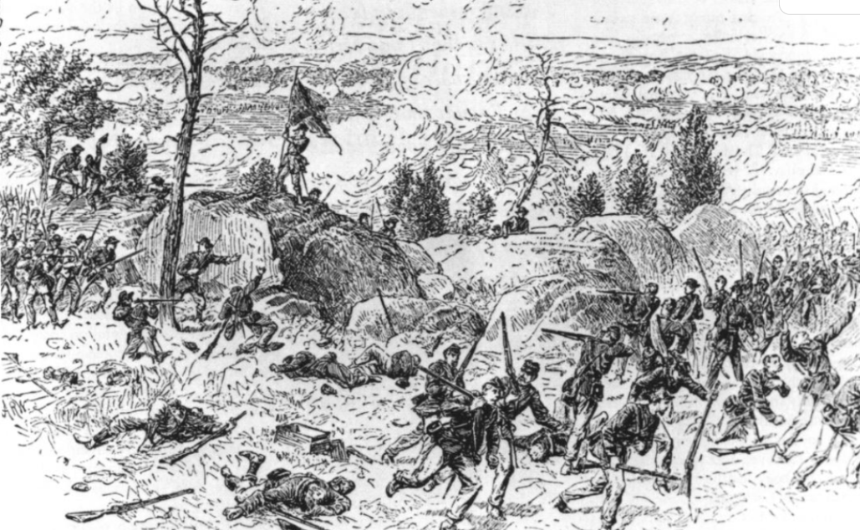
Texans at War
Hood's Brigade fighting at the Devil's Den, the Battle of Gettysburg.
The Portal to Texas History
Notes:
Texas Historical Foundation. Heritage, Volume 14, Number 3, Summer 1996, periodical, Summer 1996; Austin, Texas. (https://texashistory.unt.edu/ark:/67531/metapth45405/: accessed August 22, 2025), University of North Texas Libraries, The Portal to Texas History, https://texashistory.unt.edu; crediting Texas Historical Foundation.

Slide 10


Exit Ticket
Follow the directions to complete your exit ticket
Complete the sentence stems in each part of the graphic organizer.
Share with a partner

Slide 11
Share with the class 2
Texas role in the Confederacy during the Civil War was unique because ________
One example of this unique role was _______
A second example was _________

