Slide 1
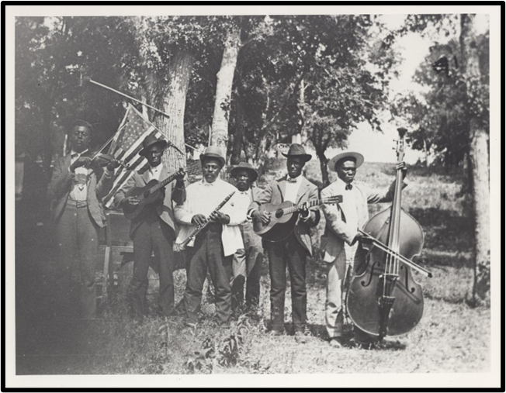
Unit 8: Civil War
Lesson 10:
Texas Today
Emancipation Day Celebration Band
The Portal to Texas History
Notes:
Stephenson, Mrs. Charles (Grace Murray). [Emancipation Day Celebration band, June 19, 1900], photograph, June 19, 1900; (https://texashistory.unt.edu/ark:/67531/metapth124054/: accessed January 10, 2023), University of North Texas Libraries, The Portal to Texas History, https://texashistory.unt.edu; crediting Austin History Center, Austin Public Library

Slide 2
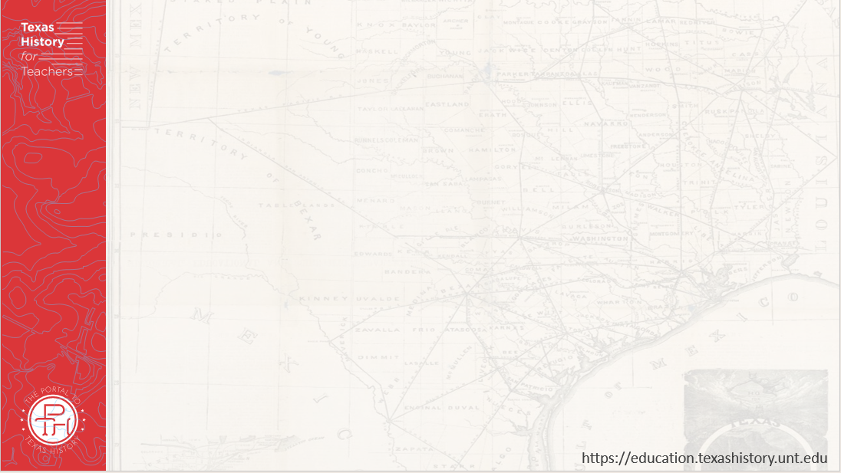
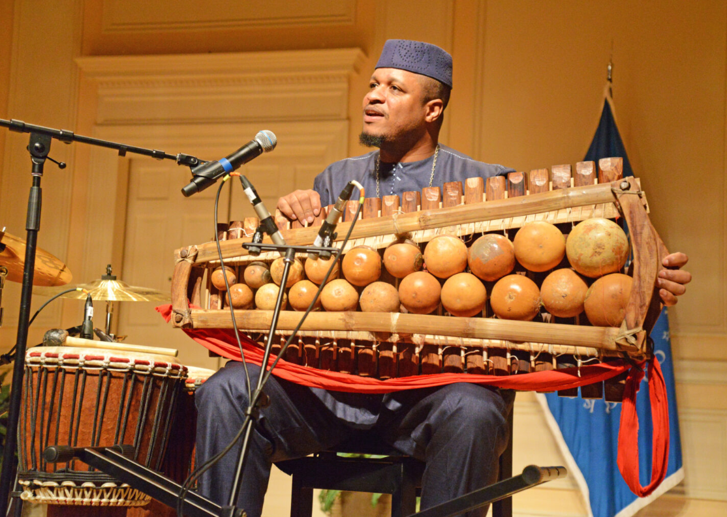
Warm-up Use the image to complete your warm-up
Notes:
African American musician, Uasuf Gueye with his traditional bala instrument. Folk Life Today: American Folk Life Center and Veterans History Project. Library of Congress Blogs. Accessed 9/3/2025. https://blogs.loc.gov/folklife/2023/08/homegrown-plus-christylez-bacons-progressive-hip-hop

Slide 3
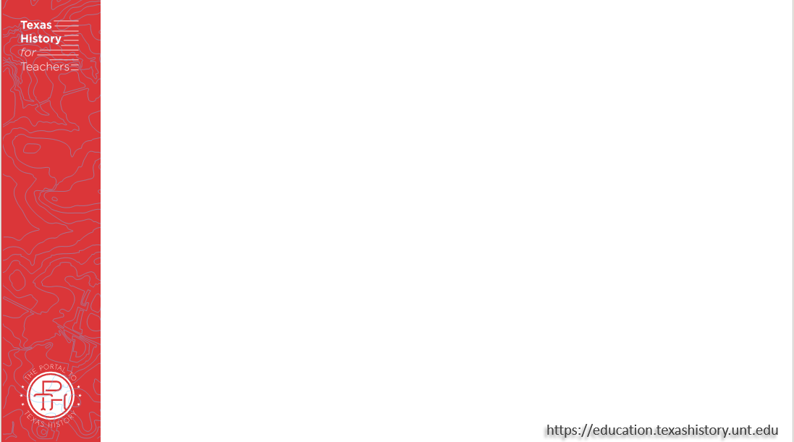

Share with the class:
One observation / inference I can make about the image is ______
I think this image relates to the Civil War and Texas Today because _____

Slide 4
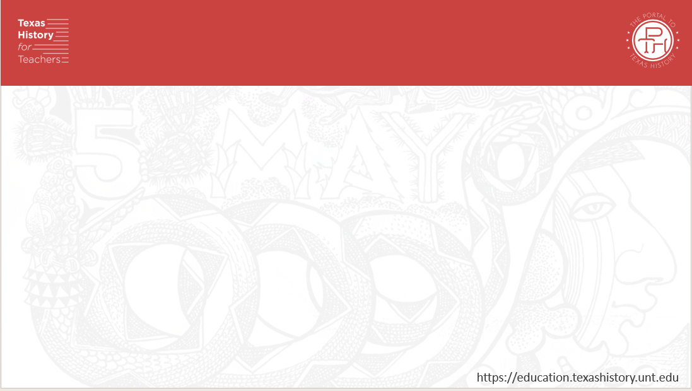
Essential Question
What is Juneteenth, why is it celebrated, and how has it evolved over time into the holiday that it is today?

Slide 5
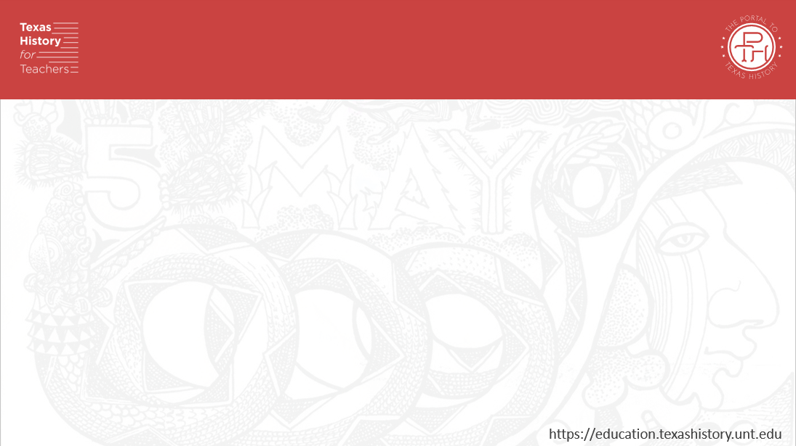
In Today’s Lesson
We will examine the history and significance of Juneteenth, celebrating the day the news of emancipation arrived in Texas.
I will analyze the text of General Order Number 3 announcing freedom for the enslaved people and examine the history and significance of Juneteenth in Texas and the United States.

Slide 6
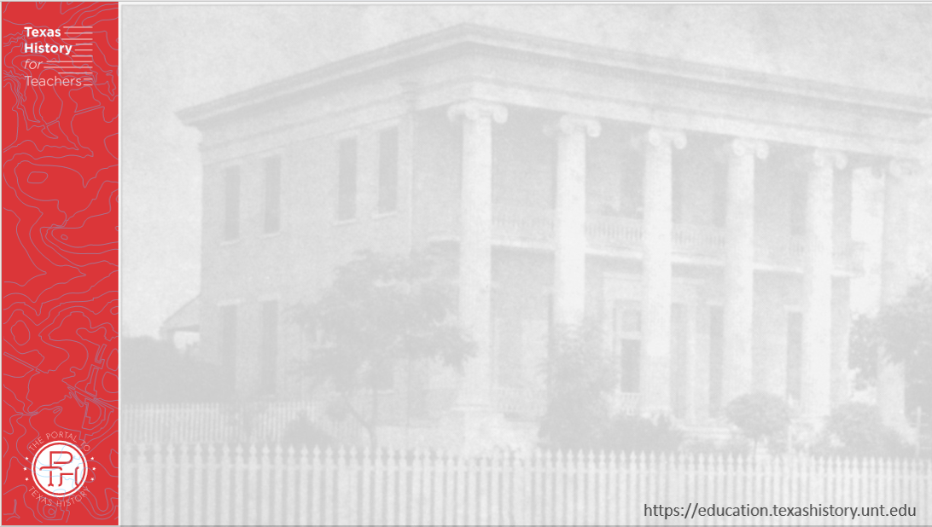
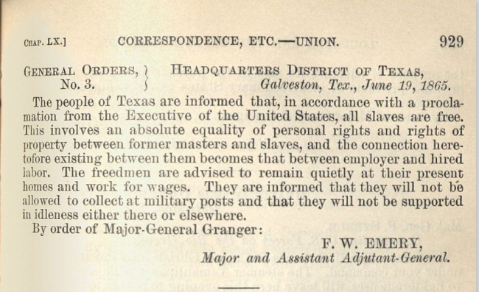
Part I: Emancipation & the Legacy of Juneteenth
Notes:
“The War of the Rebellion: A Compilation of Official Records of the Union and Confederate Armies. Texas State Library and Archives Commission. Accessed Sept. 3, 2025. https://www.tsl.texas.gov/outofthestacks/wp-content/uploads/2018/06/GeneralOrders3_Juneteenth.pdf

Slide 7
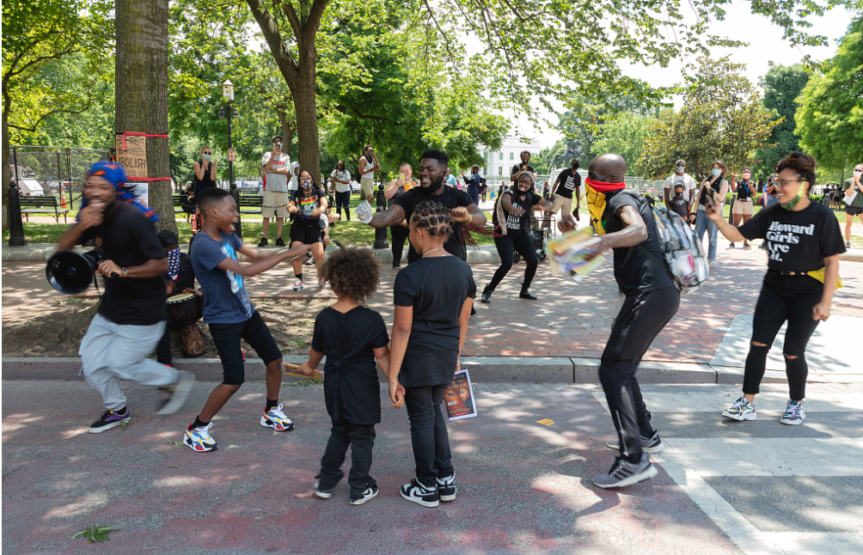
Part II: Juneteenth Today
Dancers and marchers visit the 2020 Juneteenth Celebration on Black Lives Matter Plaza in front of the White House. The Library of Congress
Notes:
Highsmith, Carol M, photographer. Dancers and marchers visit the Juneteenth Celebration on Black Lives Matter Plaza in front of the White House. Washington D.C. United States District of Columbia Washington D.C, 2020. -06-19. Photograph. https://www.loc.gov/item/2020720140/.

Slide 8


Exit Ticket Follow the instructions to complete your exit ticket.
Read each characteristic in the graphic organizer.
Choose 4 that best characterize Juneteenth.
Share with a partner.

Slide 9
Share with the class: 2
One observation / inference I can make about the image is ______
I think this image relates to the Civil War and Texas Today because _____

