Slide 1
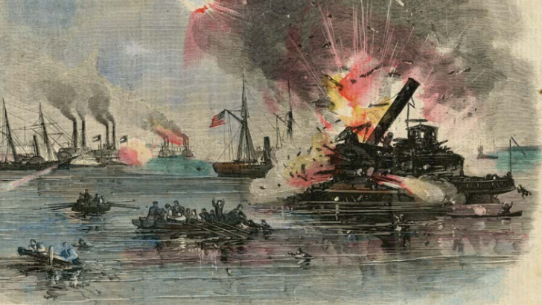
Unit 8: Civil War
Lesson 1:
The Big Picture
The Battle of Galveston, Jan. 1, 1863
Texas State Library and Archives Commission
Notes:
Prints & Photographs # 1965/36-7 Harper’s Weekly, January 31, 1863, “Attack of the Rebels Upon Our Gun Boat Flotilla at Galveston, TX, January 1, 1863. Texas State Library and Archives Commission. American Civil War in Texas: The Texas Coast | Texas State Library

Slide 2
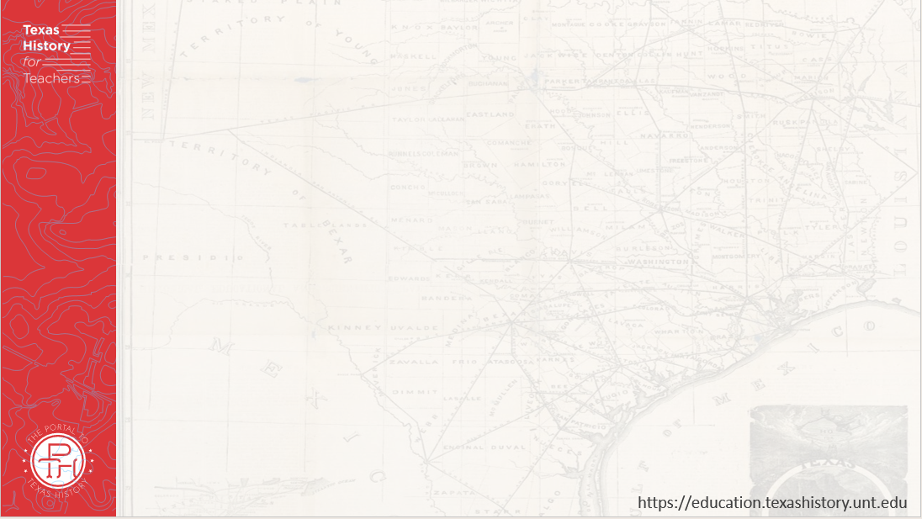



Warm-up Follow the directions below to complete your warm-up
Consider the events of our last unit: Early Statehood.
Circle or highlight each item in the answer bank that you think is true for Texas and the United States as we begin this new unit.
Share with a partner.

Slide 3

Share with the class:
One thing that I think was true for Texas and the U.S. as we begin this new unit is _________

Slide 4

Essential Question
What are the key events, major themes, and defining characteristics of the Civil War era of Texas history?

Slide 5

In Today’s Lesson
We will identify the main ideas, themes, key events, and defining characteristics of the Civil War era of Texas history.
I will analyze a primary source image, then use a reading passage to identify major themes and significant information related to this era. I will answer comprehension questions about the passage.

Slide 6
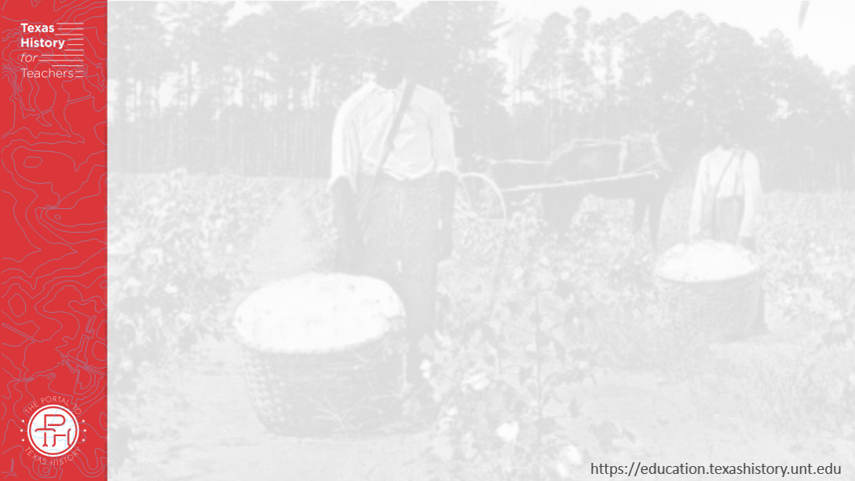
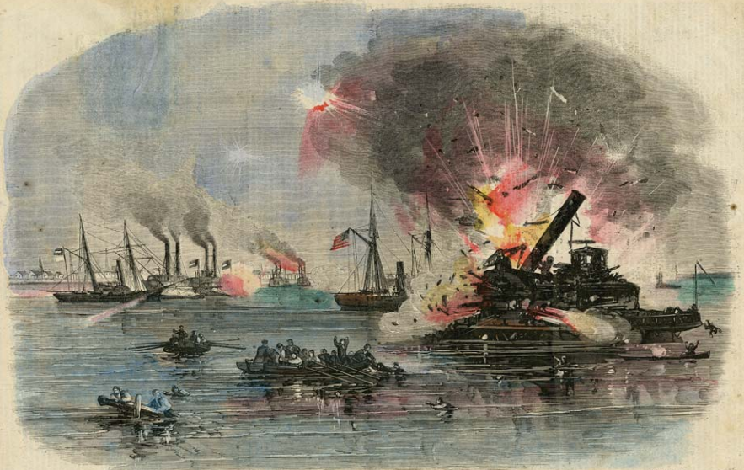
Part I: Analyze an Image
Harper’s Weekly, January 31, 1863, “Attack of the Rebels Upon Our Gun Boat Flotilla at Galveston. Texas State Library and Archives Commission

Slide 7
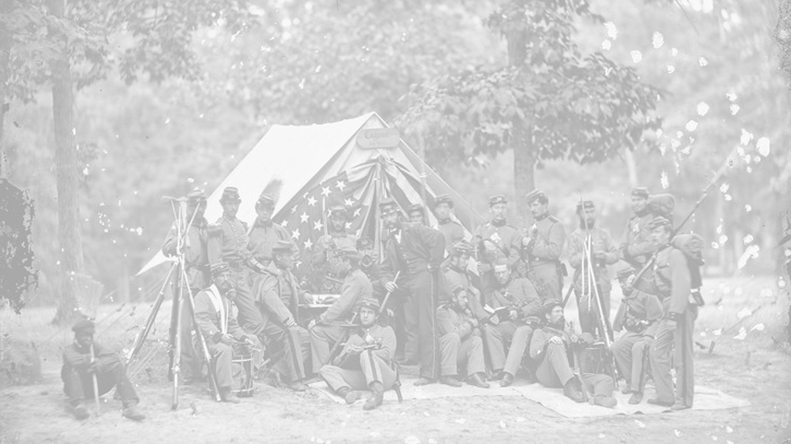


Part II: Essential Ideas Reading Passage
https://education.texashistory.unt.edu
Notes:
Source: https://catalog.archives.gov/id/524918

Slide 8
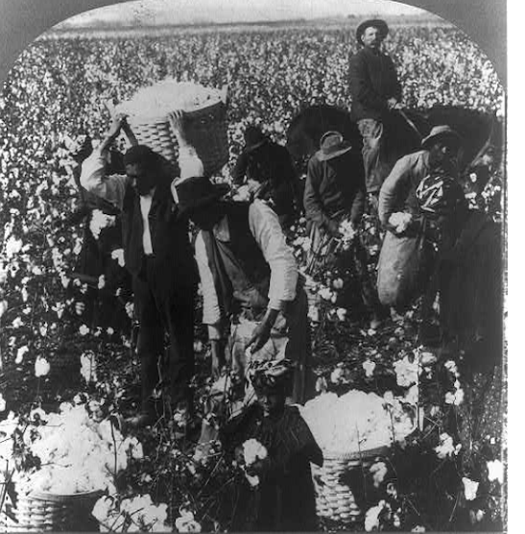

Paragraph 1: Looking Back at Early Statehood
In the domain of “King Cotton”, near Dallas, Texas.
Library of Congress
Notes:
Berry, Kelley & Chadwick. In the domain of King Cotton, near Dallas, Texas. 1907. Photograph. The Library of Congress. https://www.loc.gov/item/00652640/

Slide 9
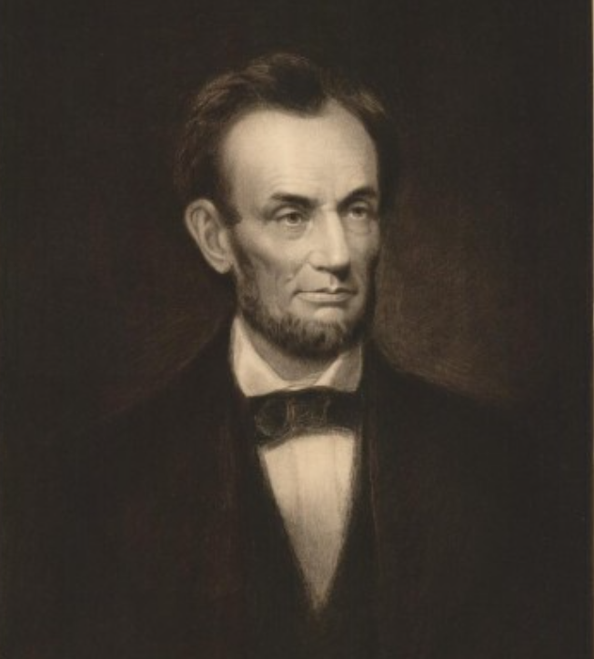
Paragraph 2: The Election of 1860
A Portrait of Abraham Lincoln
The Portal to Texas History
Notes:
Carpenter, F. B. Engraved print of Abraham Lincoln, artwork, 1864; (https://texashistory.unt.edu/ark:/67531/metapth31111/: accessed August 15, 2025), University of North Texas Libraries, The Portal to Texas History, https://texashistory.unt.edu; crediting Star of the Republic Museum.

Slide 10
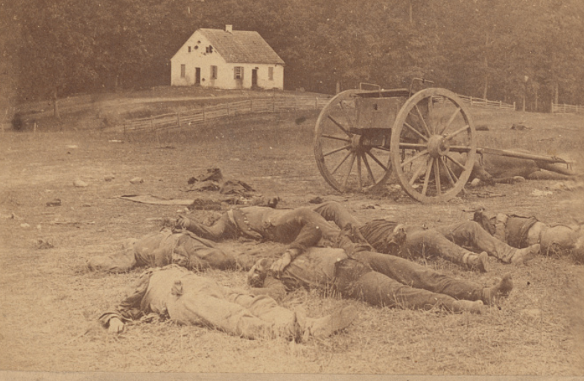
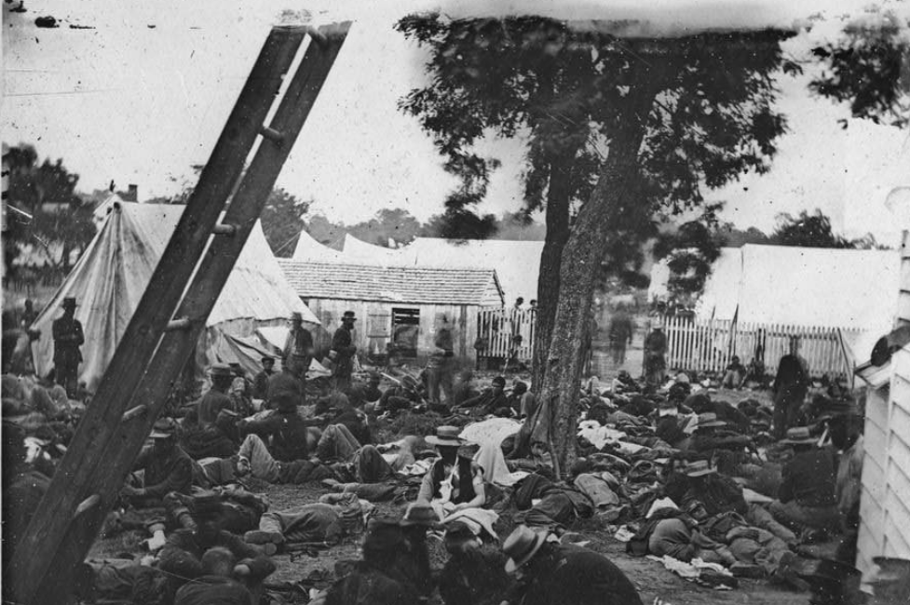
Paragraph 3: The Deadliest War in American History
Left: Casualties of the Battle of Antietam, the single bloodiest day of the Civil War, Sept. 17, 1862. Library of Congress
Right: A field hospital set up at the Battle of Savage Station, Virginia, June 29, 1862. Library of Congress
Notes:
Gibson, James F, photographer. Savage Station, Va. Field hospital after the battle of June 27. United States Virginia Savage Station, 1862. Photograph. https://www.loc.gov/item/2018666198/
Gardner, Alexander, Copyright Claimant, Gardner, Alexander, photographer. Completely silenced! Dead Confederate artillery men, as they lay around their battery after the Battle of Antietam / Brady's Album Gallery. Maryland United States Antietam, 1862. [Washington, D.C.: Brady's National Photographic Portrait Galleries] Photograph. https://www.loc.gov/item/2021644156/.

Slide 11
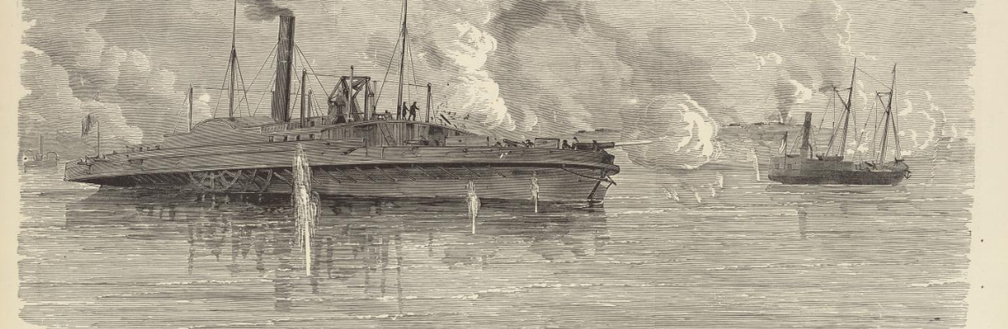
Paragraph 4: Texas’ Role in the Civil War
The Battle of Sabine Pass on the Sabine River in east Texas
The Portal to Texas History
Notes:
“‘Disabling and Capture of the Federal Gunboats 'Sachem' and 'Clifton' in the Attack on Sabine Pass, Texas, September 8th, 1863.’” The Portal to Texas History, January 18, 2008. https://texashistory.unt.edu/ark:/67531/metapth32903/

Slide 12
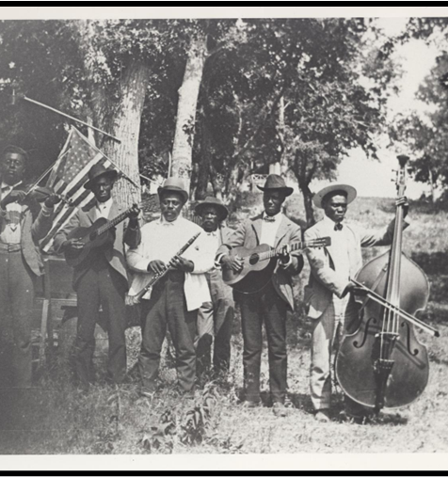
Paragraph 5: The End of the War
A celebration of Juneteenth
The Portal to Texas History
Notes:
Stephenson, Mrs. Charles (Grace Murray). [Emancipation Day Celebration band, June 19, 1900], photograph, June 19, 1900; (https://texashistory.unt.edu/ark:/67531/metapth124054/: accessed January 10, 2023), University of North Texas Libraries, The Portal to Texas History, https://texashistory.unt.edu; crediting Austin History Center, Austin Public Library.

Slide 13
Comprehension Questions
https://education.texashistory.unt.edu
Notes:
Source: https://catalog.archives.gov/id/524918

Slide 14
Exit Ticket Follow the directions below to complete your exit ticket
Choose the THREE most accurate explanations of the significance of Texas’ role in the Civil War.
Share with a partner.

Slide 15
Share with the class: 2
One statement that exemplifies Texas’ role in the Civil War is that _______

