Slide 1
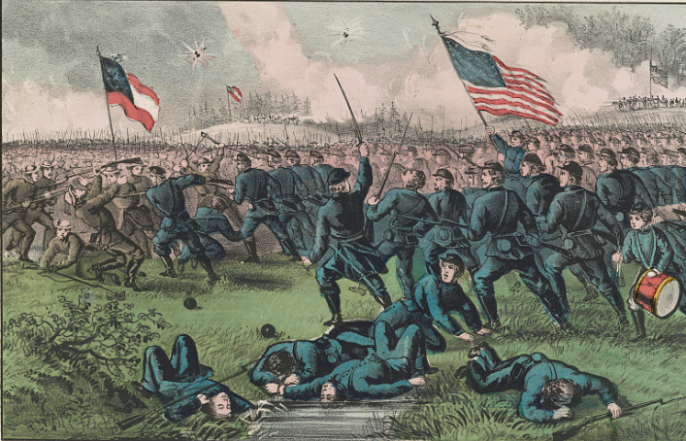
Unit 8: Civil War
Lesson 3:
Vocabulary
Notes:
Currier & Ives. Battle of Corinth, Miss. Oct. 4th 1862. ca. 1862. Lithograph. Library of Congress. https://www.loc.gov/item/90709052/

Slide 2




Warm-up: Follow the directions to complete your warm-up
Read the 4 new vocabulary terms you will see in this lesson.
Self Assess: How familiar are you with each word? Fill in the chart.
Share with a partner.

Slide 3

Share with the class
(Now, choose ONE word to share with the class. Share your level of familiarity with the word. For example:
I chose the word casualties. I have heard of this word. I think it’s related to war.

Slide 4

Essential Question
What are the key terms we need to know to be successful in the Civil war unit?

Slide 5
In today’s lesson…
We will identify, define, and exemplify the key terms of the Civil War era.
I will use the information and context of several short passages to identify and record the definition of each term and provide examples of the term in the context of our unit.

Slide 6
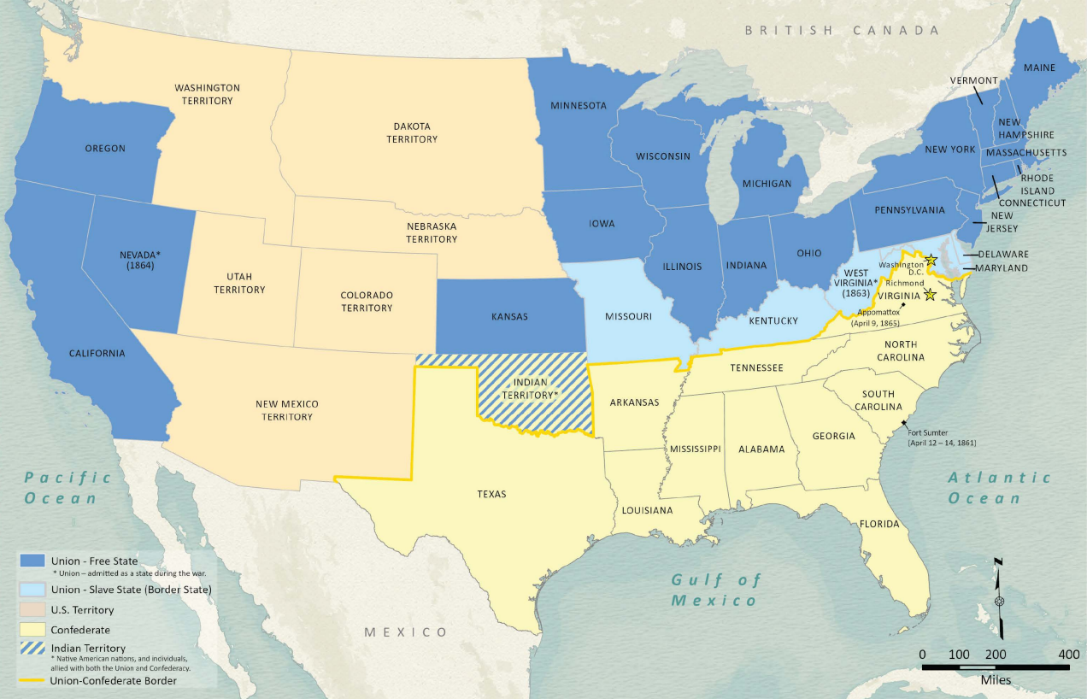
Secede (v)
The presidential election of 1860 divided the United States between Southerners who supported the expansion of slavery and Northerners who opposed it. When a Northern, anti-slavery man named Abraham Lincoln was elected president, many in Southern states were deeply unhappy.
On December 20, 1860, South Carolina became the first Southern state to secede or officially separate from the United States of America. Ten other states, including Texas, also seceded. The secession of these Southern states led to the Civil War between the North and the South that changed the country forever.
The American Civil War Political Loyalties Map
The Texas General Land Office
Notes:
Wang, Thomas, Lila Rakoczy, and James Harkins. American Civil War Political Loyalties. 2022. Texas GLO Map Database and Store. https://historictexasmaps.com/collection/search-results/97091-american-civil-war-political-loyalties-gis-educational-maps.

Slide 7
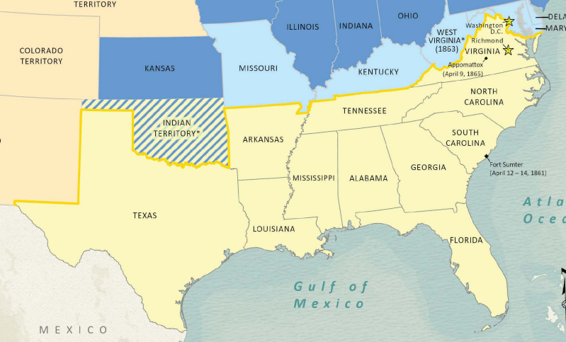
The Confederacy (n)
A confederacy is a general term that means a loose partnership between different groups like states or countries. In unit 1 (if you can remember that long ago!) we talked about the Caddo Confederacy – a group of different Caddo tribes working together.
In this unit, the Southern states that seceded from the United States formed their own country called the Confederate States of America. Many simply referred to it as the Confederacy. In this unit, when we refer to the Confederacy, we are talking about the specific partnership between the Southern states during the Civil War.
The Confederate States of America
Texas General Land Office
Notes:
Wang, Thomas, Lila Rakoczy, and James Harkins. American Civil War Political Loyalties. 2022. Texas GLO Map Database and Store. https://historictexasmaps.com/collection/search-results/97091-american-civil-war-political-loyalties-gis-educational-maps.

Slide 8
The Union (n)
Prior to the Civil War, the United States of America was often referred to simply as “the Union.” This term referred to all the states united under one federal government.
By 1861, eleven Southern states had seceded from the Union and formed the Confederacy. During the Civil War, from 1861 to 1865, the Union referred to the Northern states of the U.S. as they fought against the Southern states of the Confederacy.
The Texas General Land Office
Notes:
Wang, Thomas, Lila Rakoczy, and James Harkins. American Civil War Political Loyalties. 2022. Texas GLO Map Database and Store. https://historictexasmaps.com/collection/search-results/97091-american-civil-war-political-loyalties-gis-educational-maps.

Slide 9
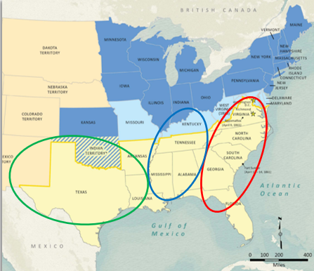
Theater (n)
In most wars, battles take place in many different locations. When discussing the different locations of fighting, we often use the term theater to talk about areas where action took place during the war.
In the Civil War there were three primary theaters of the war. Most of the fighting took place in the eastern theater in states like Virginia and Pennsylvania. Some Texans served in the eastern theater; however, most Texans were involved in the other theaters of war.
Many Texans served in the western theater in states like Tennessee, Kentucky, and Mississippi. Texans also served in the Trans-Mississippi theater in states like Louisiana, Arkansas, and Texas.
The Texas General Land Office
Notes:
Wang, Thomas, Lila Rakoczy, and James Harkins. Circles have been added to identify the three primary theaters of the war. American Civil War Political Loyalties. 2022. Texas GLO Map Database and Store. https://historictexasmaps.com/collection/search-results/97091-american-civil-war-political-loyalties-gis-educational-maps.

Slide 10
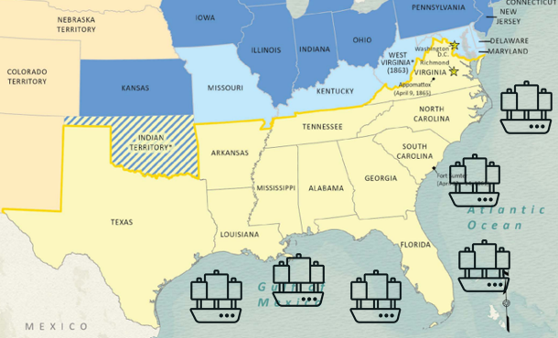
Blockade (n, v)
During the Civil War, the Union navy blockaded the South, placing Union ships along the Southern coast to prevent any goods from entering or exiting Southern ports. This meant that most of the South was unable to receive supplies by sea or take part in international trade.
The Union also blockaded Texas ports; however, Texas had an advantage that other Southern states did not: Texas shared a border with Mexico. The Union could not blockade Mexican ports without harming its relationship with Mexico. This allowed Texans to get around the Union blockade by moving their goods across the Rio Grande and then shipping them from Mexican ports.
The Texas General Land Office
Notes:
Wang, Thomas, Lila Rakoczy, and James Harkins. Ship icons have been placed along the Southern coast to represent the Union blockade of Southern ports. American Civil War Political Loyalties. 2022. Texas GLO Map Database and Store. https://historictexasmaps.com/collection/search-results/97091-american-civil-war-political-loyalties-gis-educational-maps.
Ship icons added to the map from Toicon-icon-feather-discover. Icon from the collection "getting-around“. Shannon E Thomas/toicon.com. http://www.toicon.com/. This file is licensed under the Creative Commons Attribution 4.0 International license. Accessed on August 13, 2025. https://commons.wikimedia.org/wiki/File:Toicon-icon-feather-discover.svg

Slide 11
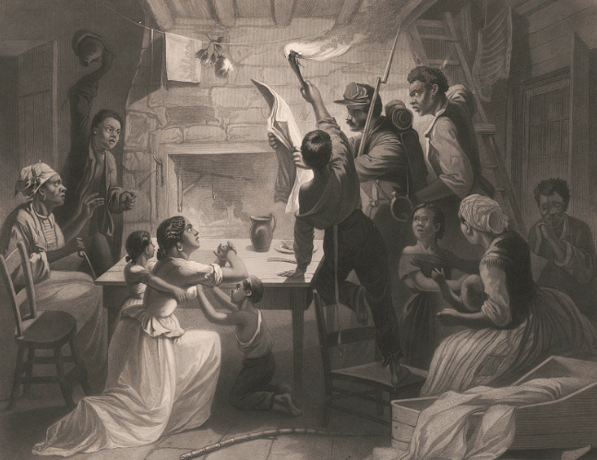
Emancipation (n)
On January 1, 1863, President Abraham Lincoln issued the Emancipation Proclamation. This was a law that stated all slaves in rebelling states were emancipated, or freed.
The Emancipation Proclamation did not promise freedom to slaves in states that were not in rebellion. There were some slave states on the border between the North and South, like Missouri, Kentucky, and Maryland, who had remained part of the Union when the rest of the Southern slave states seceded. According to the Emancipation Proclamation, these border states would be allowed to maintain slavery.
Lincoln hoped the Emancipation Proclamation would either persuade Southern states to rejoin the Union in order to keep slavery or weaken those states in their fight against the Union.
Reading the Emancipation Proclamation
Library of Congress
Notes:
Watts, James W., Henry Walker Herrick, and Lucius Stebbins. Reading the Emancipation Proclamation / H.W. Herrick, del., J.W. Watts, SC. ca. 1864. Steel engraving. Library of Congress Prints and Photographs Division. https://www.loc.gov/item/2003678043/

Slide 12
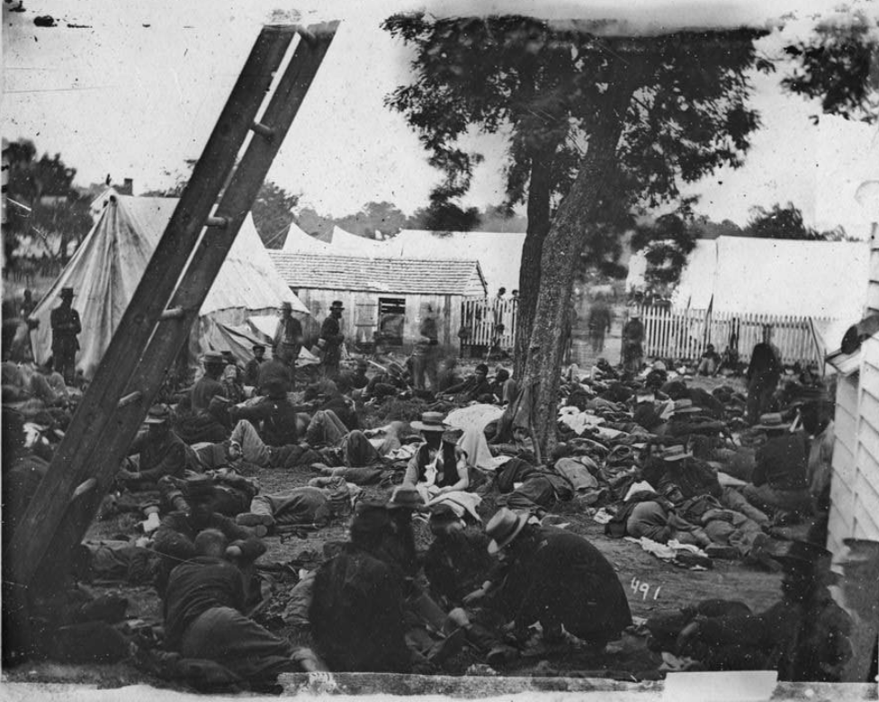
Casualties (n)
The Civil War was the deadliest war in American history. There were more than 750,000 total casualties, or people killed or injured in the war. There were more American casualties in the Civil War than in all other wars in American history combined.
Approximately 60,000 – 70,000 Texans served in the Civil War, primarily on the side of the South. Texan casualties numbered about 12,000 – 15,000 killed. Half of the casualties were caused by the battles themselves, while the other half were caused by disease.
Savage Station, VA. Field Hospital
Library of Congress
Notes:
Gibson, James F, photographer. Savage Station, Va. Field hospital after the battle of June 27. United States Virginia Savage Station, 1862. Photograph. https://www.loc.gov/item/2018666198/

Slide 13
Exit Ticket: Follow the directions to complete your exit ticket
Read the terms in the graphic organizer chart.
Choose THREE to FIVE terms that you think BEST connect to this unit. Use the sentence stem to explain.
Share with a partner.

Slide 14
Share with the class 2
One term I chose was __________. I think this term best relates to our unit because ______________.

