Slide 1
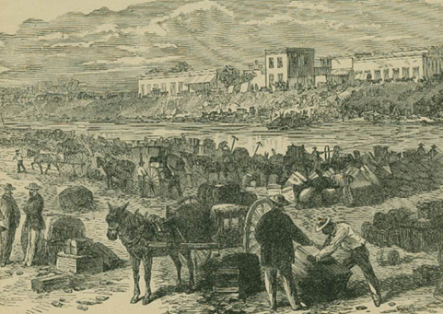




Unit 8: Civil War
Lesson 4:
What’s the story?
The Confederate Evacuation of Brownsville
Notes:
The Confederate evacuation of Brownsville. From Harper's Pictorial History of the Civil War. Prints and Photographs Collection, 1980/10-11.1863: The Tide Turns | Texas State Library

Slide 2

Warm-up Follow the directions to complete your warm-up
Read the primary source excerpt.
Record your observations about the source. What can we learn about this era from the source?
Discuss with a partner

Slide 3

Share with the class
One thing we can learn from the excerpt is ___________

Slide 4

Essential Question
What are the defining characteristics and most significant events of the Civil War era of Texas history?

Slide 5

In today’s lesson…
We will examine a chronology of the significant events that took place during the Civil War and identify their significance to Texas history.
I will read short passages about each event, identify key information, explain cause and effect relationships, and determine how the event is significant to Texas history.

Slide 6
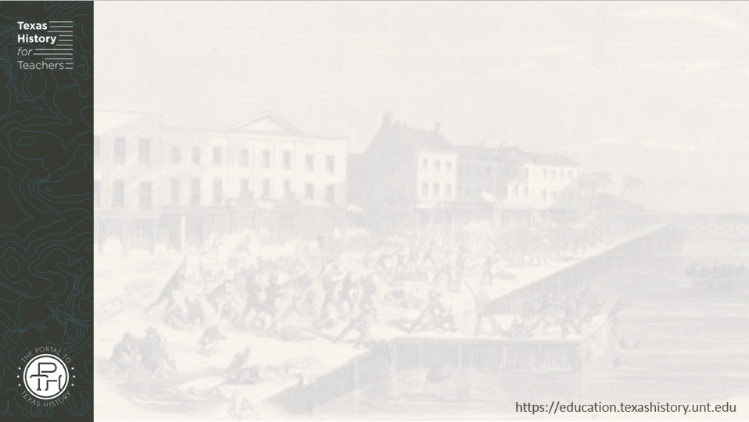
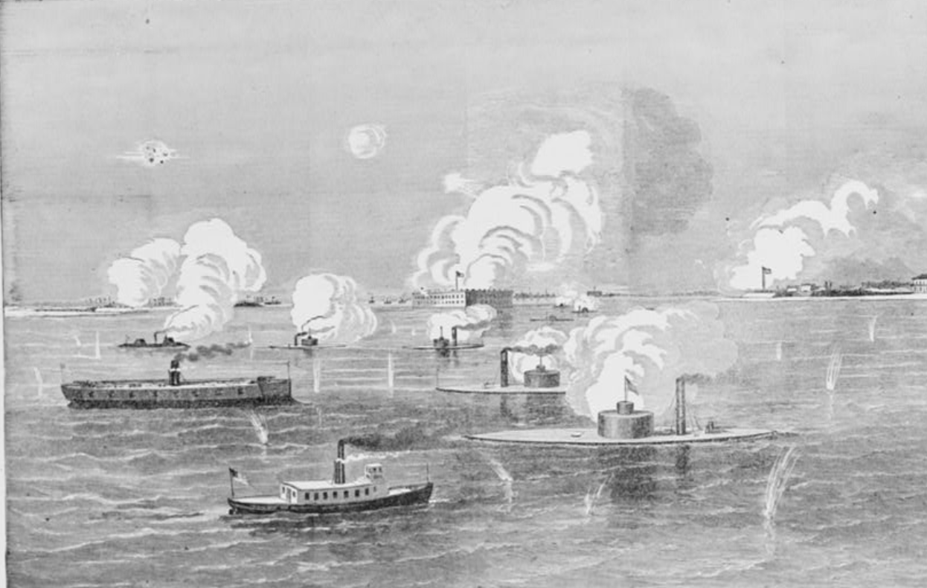
1. The North, the South, Slavery, & Sectionalism
The Confederate bombardment of Union troops at Fort Sumter, South Carolina
Library of Congress
Notes:
Bombardment of Fort Sumter. United States Fort Sumter Charleston South Carolina, ca. 1894. Photograph. https://www.loc.gov/item/97516939/

Slide 7
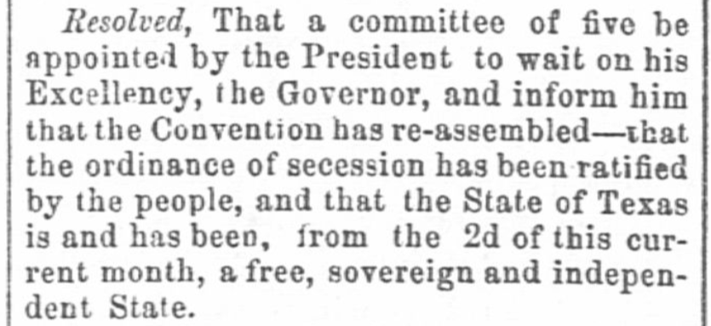
2. Secession & the Confederate States of America
The Weekly Telegraph, Houston, Texas. Tuesday, March 12, 1861
The Portal to Texas History
Notes:
The Weekly Telegraph (Houston, Tex.), Vol. 26, No. 52, Ed. 1 Tuesday, March 12, 1861, newspaper, March 12, 1861; Houston, Texas. (https://texashistory.unt.edu/ark:/67531/metapth236136/: accessed August 21, 2025), University of North Texas Libraries, The Portal to Texas History, https://texashistory.unt.edu; crediting The Dolph Briscoe Center for American History.

Slide 8
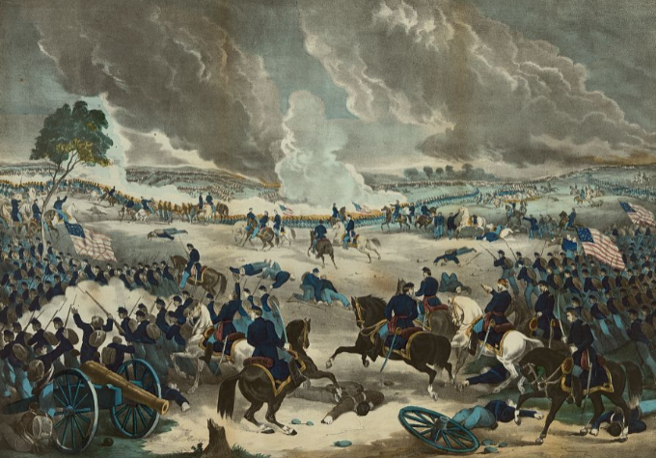
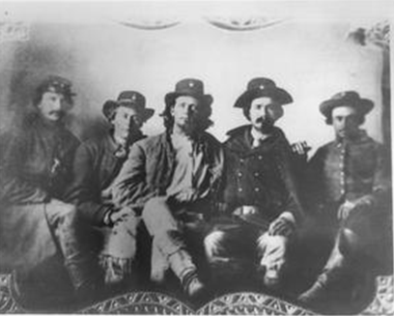
3. The Civil War Across the United States
The Battle of Gettysburg, PA.
Library of Congress
Some of Terry’s Texas Rangers
The Portal to Texas History
Notes:
Kelly, Thomas, Active , Publisher. The battle of Gettysburg. Pennsylvania United States Gettysburg, ca. 1867. N.Y.: Published by Thomas Kelly, 264 Third Avenue, between 22nd & 23rd St. Photograph. https://www.loc.gov/item/2006681070/
Image Citation: [Terry's Texas Rangers, c. 1863], photograph, 1863; (https://texashistory.unt.edu/ark:/67531/metapth799/m1/1/?q=Civil%20War: accessed November 3, 2023), University of North Texas Libraries, The Portal to Texas History, https://texashistory.unt.edu; crediting Fort Bend Museum

Slide 9
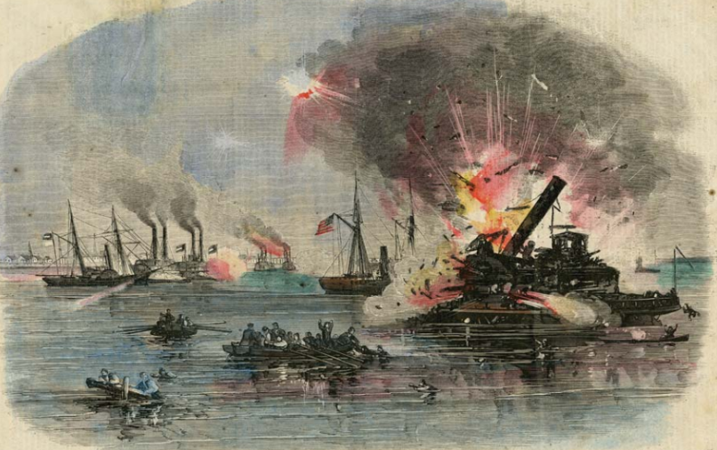
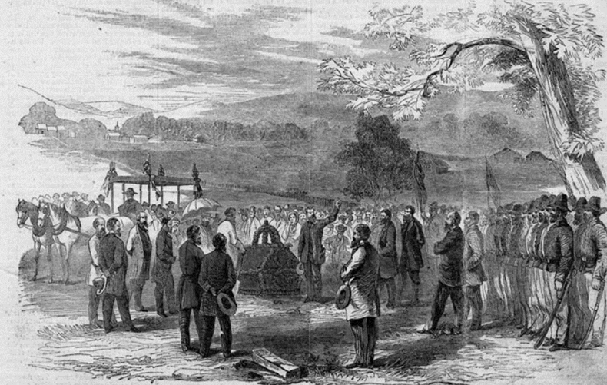
4. The Civil War Across in Texas
The Battle of Galveston
Texas State Library and Archives Commission
The funeral of German Unionists massacred by Confederates in Comfort, Texas
Texas State Library and Archives Commission
Notes:
Prints & Photographs # 1965/36-7 Harper’s Weekly, January 31, 1863, “Attack of the Rebels Upon Our Gun Boat Flotilla at Galveston, TX, January 1, 1863. Texas State Library and Archives Commission. American Civil War in Texas: The Texas Coast | Texas State Library
Prints & Photographs #1992/75-1-1 Harper’s Weekly – A Journal of Civilization, January 20, 1866 Funeral of the German Patriots at Comfort, Texas, August 20, 1865. https://www.tsl.texas.gov/highlights/2012_10/lobby-exhibits-3c.html

Slide 10
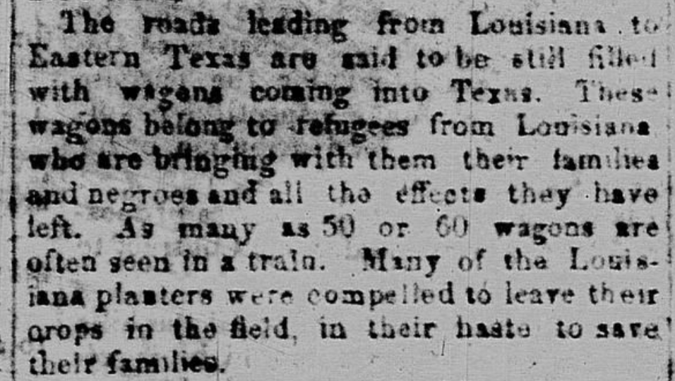
5. The Texas Homefront
The Semi-Weekly News, San Antonio. Monday, December 22, 1862.
The Portal to Texas History
Notes:
“The Semi-Weekly News. (San Antonio, Tex.), Vol. 2, No. 114, Ed. 1 Monday, December 22, 1862.” The Portal to Texas History. R. Finck, August 26, 2011. https://texashistory.unt.edu/ark:/67531/metapth179762/m1/1/

Slide 11
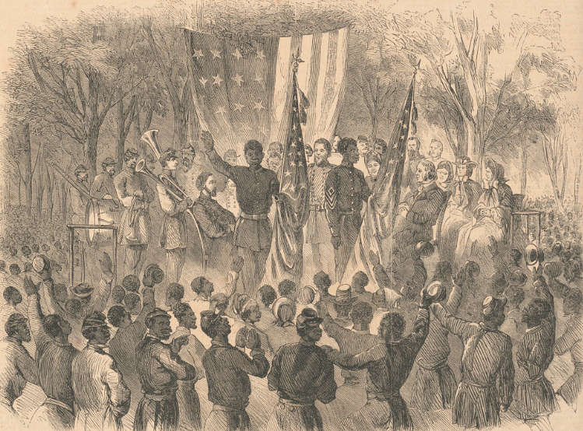
6. The End of the Civil War
“Emancipation Day in South Carolina”
The Library of Congress
Notes:
"Emancipation Day in South Carolina" - the Color-Sergeant of the 1st South Carolina Colored Volunteers addressing the regiment, after having been presented with the Stars and Stripes, at Smith's plantation, Port Royal Island, January 1 / From a sketch by our special artist. 1863. Wood engraving. Library of Congress Prints and Photographs. https://www.loc.gov/item/99614128/

Slide 12
Exit Ticket Follow the directions to complete your exit ticket
There are 5 events from the era that are listed OUT OF chronological order.
Put the events in the correct order by writing the number of each event in the space provided.
Discuss with a partner

Slide 13
Share with the class 2
The (first, second, third, etc.) event is that ___________.

