Slide 1
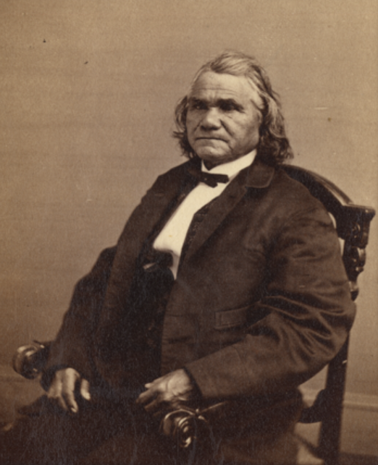
Unit 8: Civil War
Extension Lesson:
Who’s who of the Civil War
Cherokee leader Stand Watie
Library of Congress
Notes:
Gen. Stand Watie, C.S.A. National Archives. https://catalog.archives.gov/id/167250310

Slide 2




Warm-up: Follow the directions to complete your warm-up
Choose ONE point of view from the options in the graphic organizer.
Write a short journal entry (3 – 5 sentences) about your experience during the Civil War from that point of view.
Share with a partner.

Slide 3

Share with the class
The point of view I chose was ____________
A journal entry from this point of view during the Civil War might sound like this: ________

Slide 4

Essential Question
Who were some of the key people of the Civil War, and why were they significant to the era?

Slide 5
In today’s lesson…
We will study key people of the Civil War, identifying important information about their lives and their significance to the era.
I will use the reading or readings provided to record significant information about people from the Civil War era.

Slide 6
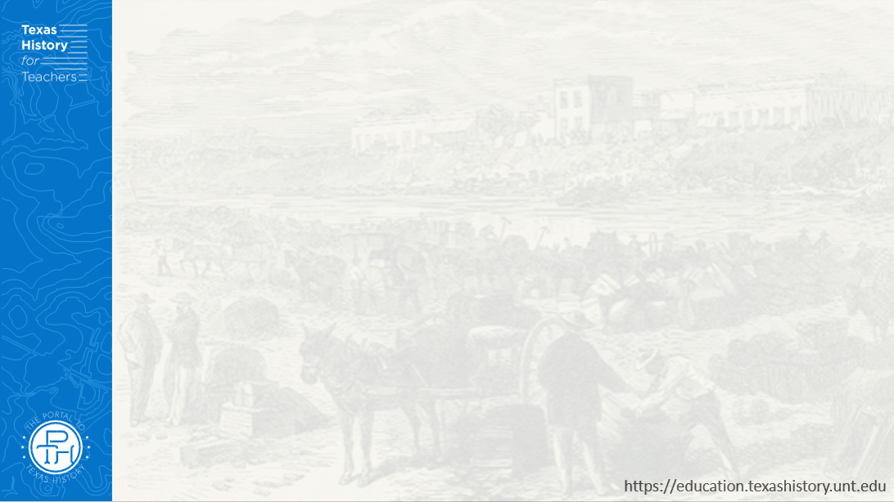
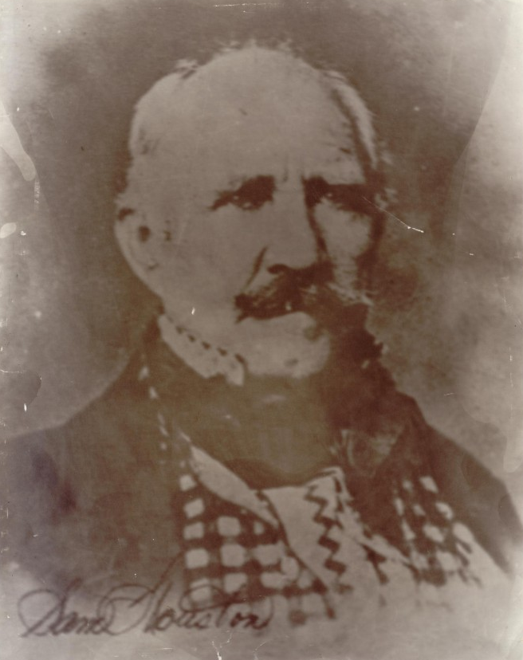
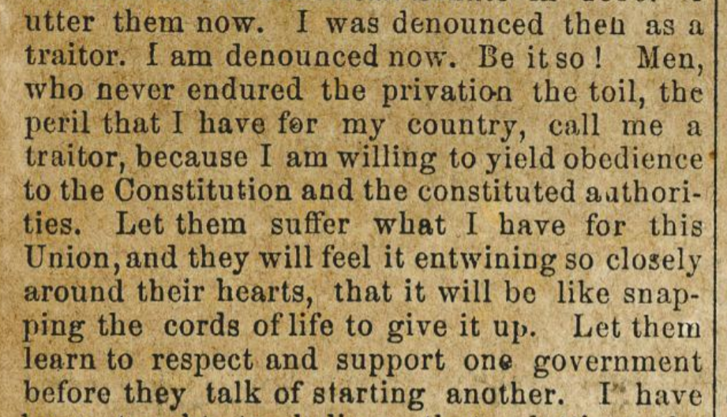
Sam Houston
A speech given by Governor Houston
The Portal to Texas History
The Portal to Texas History
Notes:
Photograph of Sam Houston, photograph, Date Unknown; (https://texashistory.unt.edu/ark:/67531/metapth30051/: accessed August 28, 2025), University of North Texas Libraries, The Portal to Texas History, https://texashistory.unt.edu; crediting Star of the Republic Museum.
Houston, Sam, 1793-1863. Address of Gen. Sam Houston, at the union mass meeting, Austin, Texas, on the 22nd of September, 1860., pamphlet, 1860; Austin, Texas. (https://texashistory.unt.edu/ark:/67531/metapth498755/: accessed August 28, 2025), University of North Texas Libraries, The Portal to Texas History, https://texashistory.unt.edu; crediting Schreiner University.

Slide 7
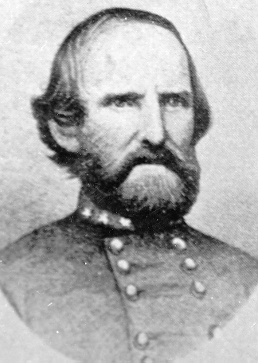
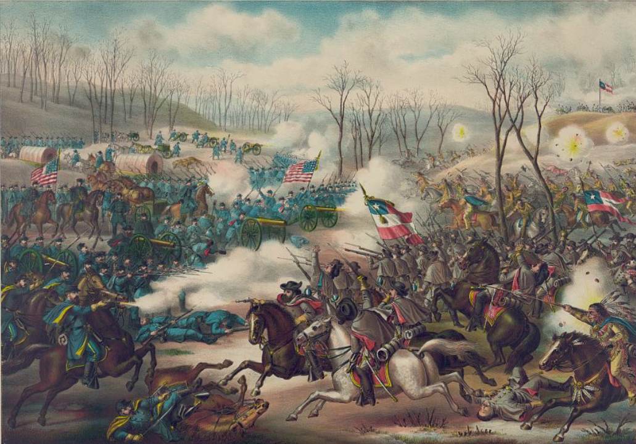
Ben McCulloch
The Battle of Pea Ridge
The Library of Congress
Texas State Cemetery Records
Notes:
Benjamin McCulloch. Texas State Cemetery. Accessed on July 18, 2025. Benjamin Mcculloch | Texas State Cemetery
Kurz & Allison, Publisher, and Copyright Claimant Kurz & Allison. Battle of Pea Ridge, Ark. Pea Ridge Arkansas United States, ca. 1889. Photograph. https://www.loc.gov/item/2013645343/

Slide 8
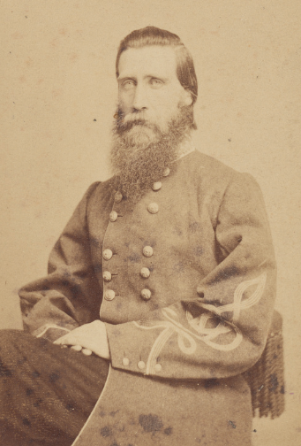
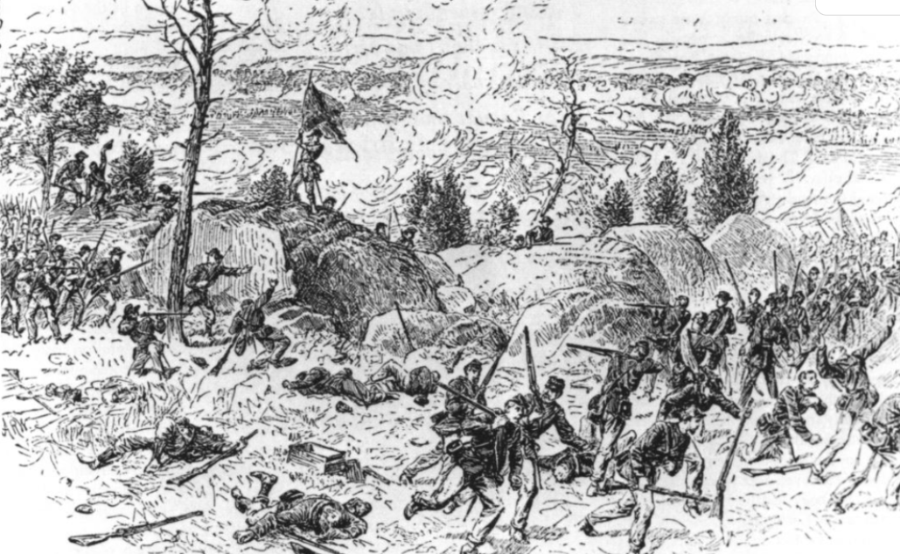
John Bell Hood
Artwork depicting Hood’s Texas Brigade fighting at “the Devil’s Den” at the Battle of Gettysburg.
The Portal to Texas History
The Library of Congress
Notes:
Sheldon, J. A. General John Bell Hood of the 3rd Virginia Cavalry Regiment, 4th Texas Infantry Regiment and Confederate States Infantry Regiment in uniform / J.A. Sheldon, photographer, 101 Canal St., New Orleans, La. ca. 1861-65. Photograph. Liljenquist Family collection, Library of Congress Prints and Photographs Division. https://www.loc.gov/item/2022630550/
Texas Historical Foundation. Heritage, Volume 14, Number 3, Summer 1996, periodical, Summer 1996; Austin, Texas. (https://texashistory.unt.edu/ark:/67531/metapth45405/: accessed August 22, 2025), University of North Texas Libraries, The Portal to Texas History, https://texashistory.unt.edu; crediting Texas Historical Foundation.

Slide 9
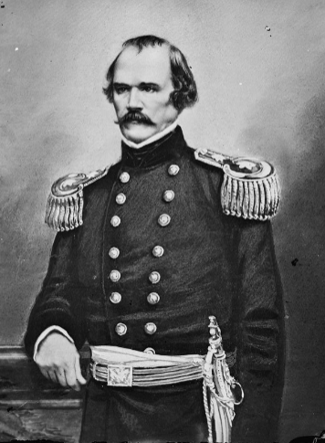
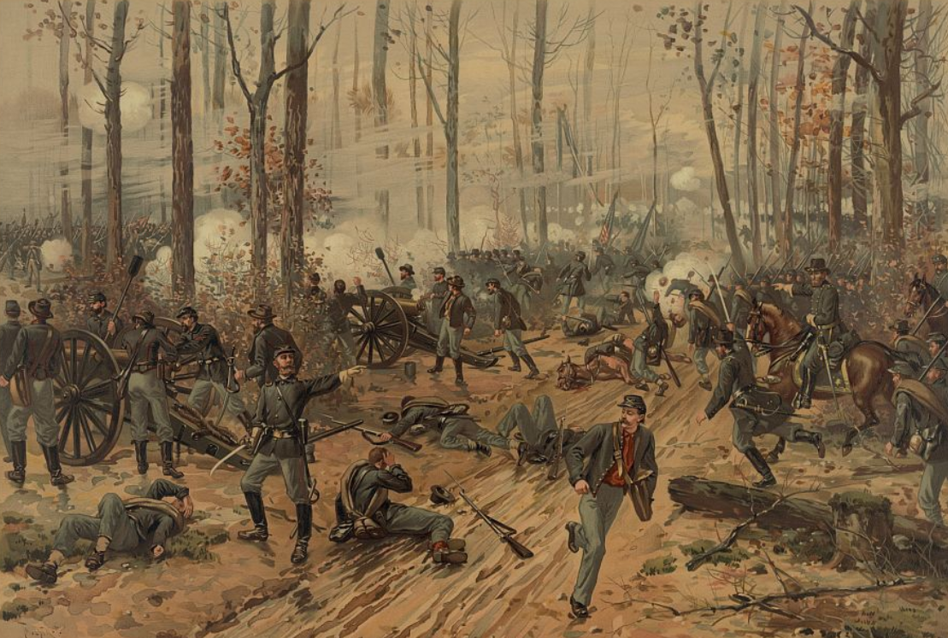
Albert Sidney Johnston
The Battle of Shiloh
The Library of Congress
The Library of Congress
Notes:
Albert Sidney Johnston. United States, None. [Between 1860 and 1862] Photograph. https://www.loc.gov/item/2018670318/
L. Prang & Co, and Thure De Thulstrup. Battle of Shiloh / Thulstrup. United States, ca. 1888. Photograph. https://www.loc.gov/item/92500191/

Slide 10
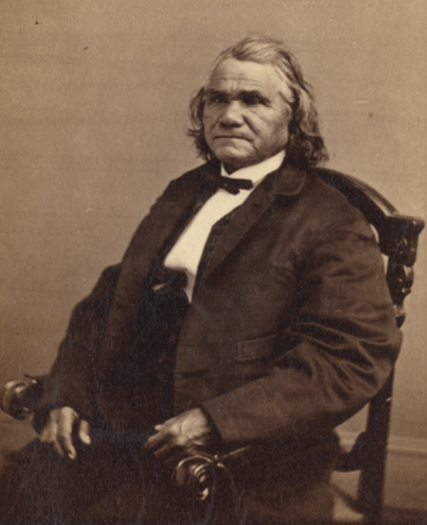
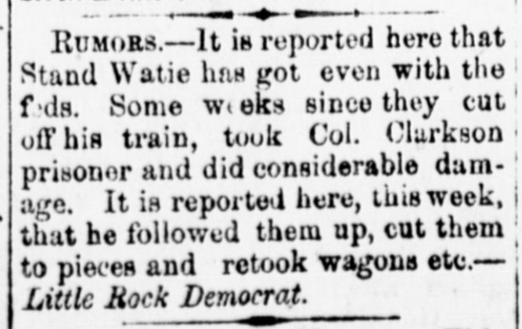
Stand Watie
The Dallas Herald, Saturday August 23, 1862
The Portal to Texas History
The National Archives
Notes:
Gen. Stand Watie, C.S.A. National Archives. https://catalog.archives.gov/id/167250310
Dallas Herald. (Dallas, Tex.), Vol. 10, No. 39, Ed. 1 Saturday, August 23, 1862, newspaper, August 23, 1862; Dallas, Texas. (https://texashistory.unt.edu/ark:/67531/metapth294217/: accessed August 28, 2025), University of North Texas Libraries, The Portal to Texas History, https://texashistory.unt.edu; .

Slide 11
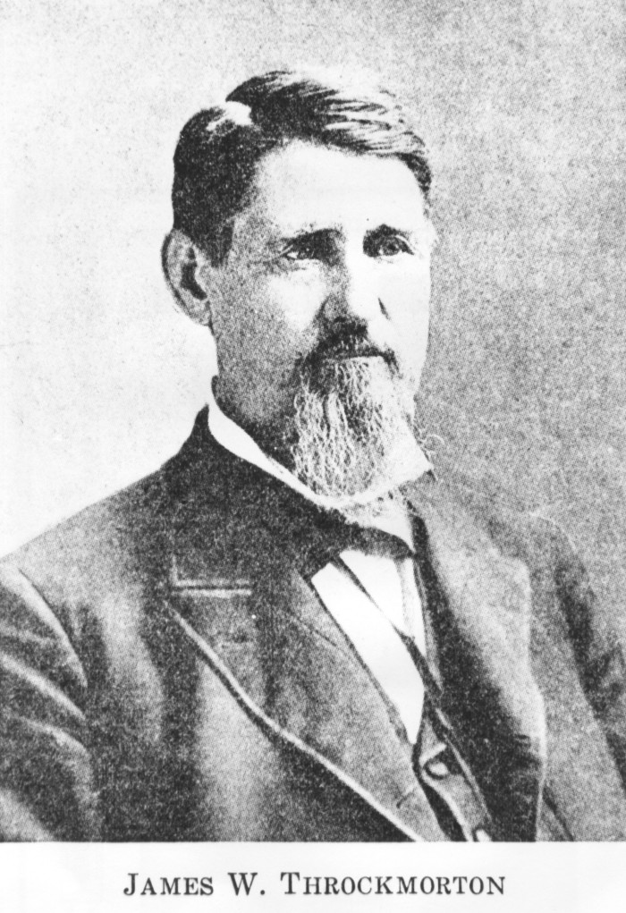
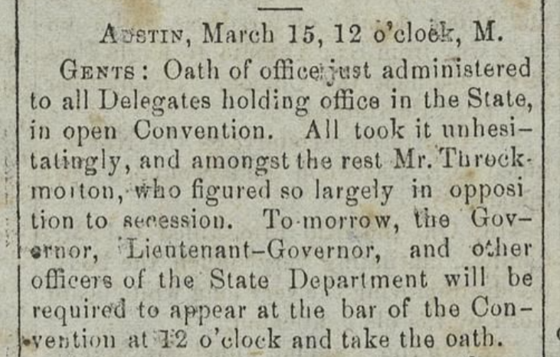
James Throckmorton
The Portal to Texas History
Notes:
James W. Throckmorton, photograph, Date Unknown; (https://texashistory.unt.edu/ark:/67531/metapth21108/: accessed August 28, 2025), University of North Texas Libraries, The Portal to Texas History, https://texashistory.unt.edu; crediting Tarrant County College NE, Heritage Room.
Baker, James D.; Baker, Ben M. & Baker, A. Hicks. The Colorado Citizen. (Columbus, Tex.), Vol. 4, No. 24, Ed. 1 Saturday, March 23, 1861, newspaper, March 23, 1861; Columbus, Texas. (https://texashistory.unt.edu/ark:/67531/metapth805664/: accessed August 28, 2025), University of North Texas Libraries, The Portal to Texas History, https://texashistory.unt.edu; crediting Nesbitt Memorial Library.

Slide 12
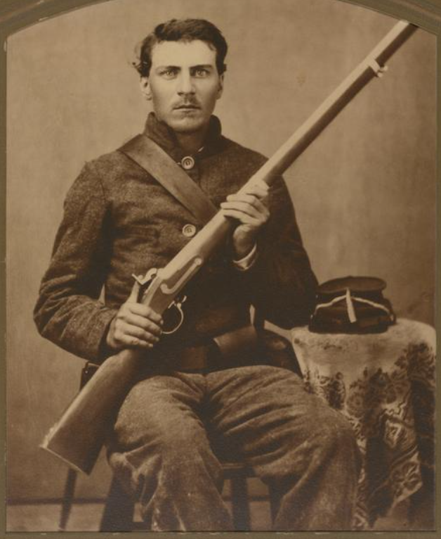
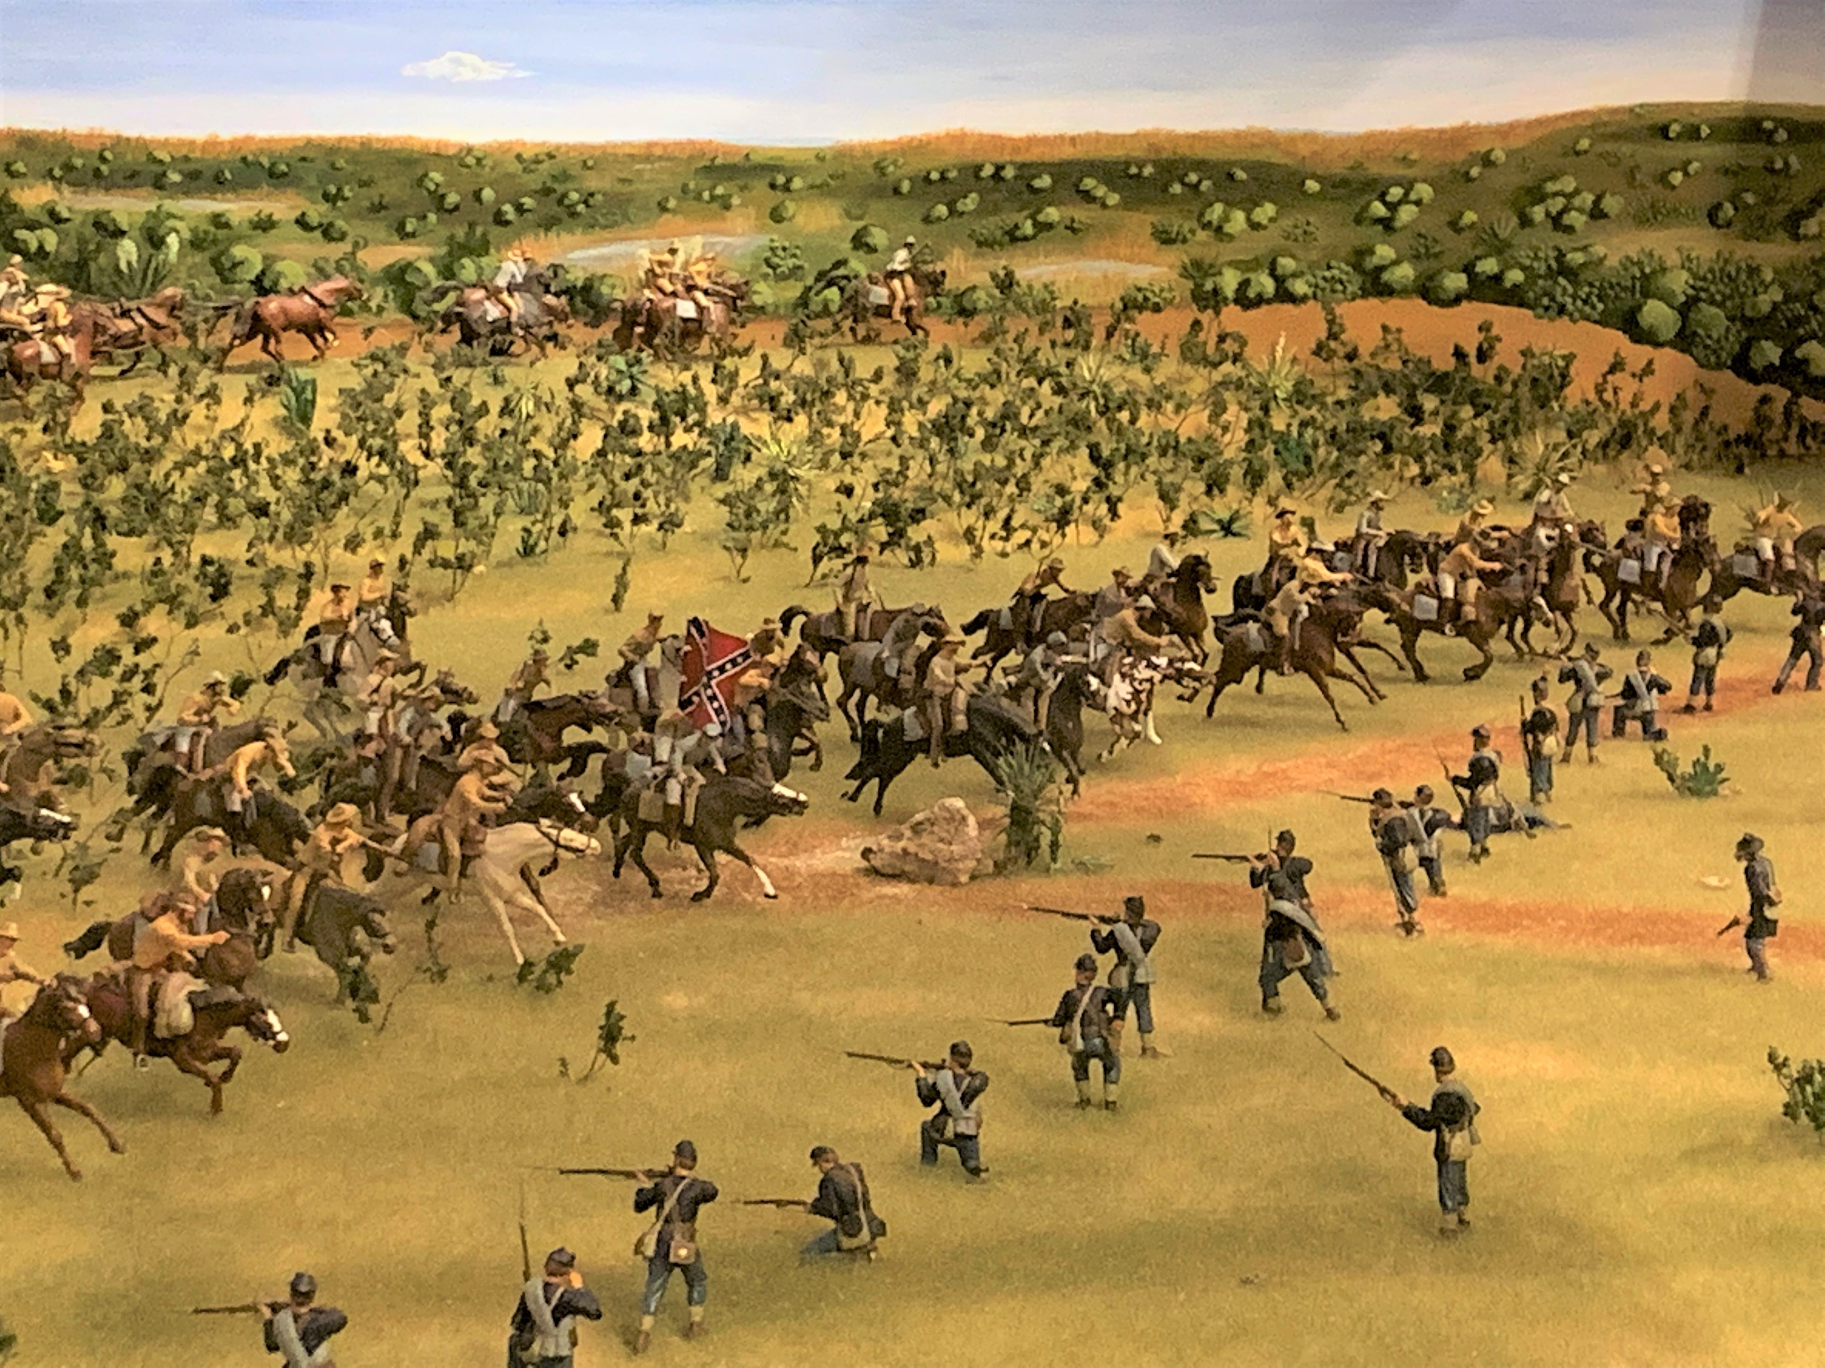
John Salmon “Rip” Ford
The Battle of Palmito Ranch
Texas Military Forces Museum, Camp Mabry, Austin
The Portal to Texas History
Notes:
Van Dyck Studio. [Portrait of John Salmon Ford], photograph, 190X/191X; (https://texashistory.unt.edu/ark:/67531/metapth1744355/: accessed August 28, 2025), University of North Texas Libraries, The Portal to Texas History, https://texashistory.unt.edu; crediting Private Collection of T. B. Willis.
The Battle of Palmito Ranch Diorama. The Texas Military Forces Museum, Camp Mabry, Austin, Texas. Accessed Aug. 28, 2025. https://www.texasmilitaryforcesmuseum.org/articles/palmetto/palmetto.htm

Slide 13
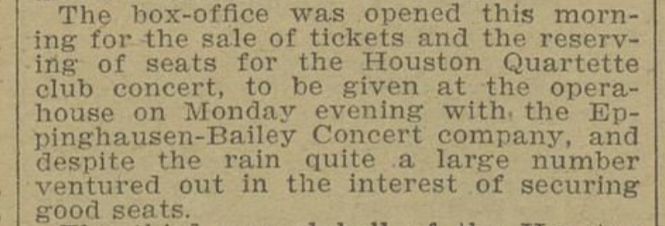

Mollie Arlene Kirkland Bailey
Click here to go to a 1939 recording of “The Old Gray Mare” at the Library of Congress
An advertisement in a 1890s newspaper for a performance of the Bailey Concert Company.
The Portal to Texas History
Notes:
Lomax, John A, Ruby T Lomax, and Elmo Newcomer. Old Gray Mare. near Pipe Creek, Texas, May 3, 1939. Audio. https://www.loc.gov/item/lomaxbib000160/.
Ousley, Clarence. Galveston Tribune. (Galveston, Tex.), Vol. 15, No. 301, Ed. 1 Sunday, November 10, 1895, newspaper, November 10, 1895; Galveston, Texas. (https://texashistory.unt.edu/ark:/67531/metapth1260631/: accessed August 28, 2025), University of North Texas Libraries, The Portal to Texas History, https://texashistory.unt.edu; crediting Rosenberg Library.

Slide 14
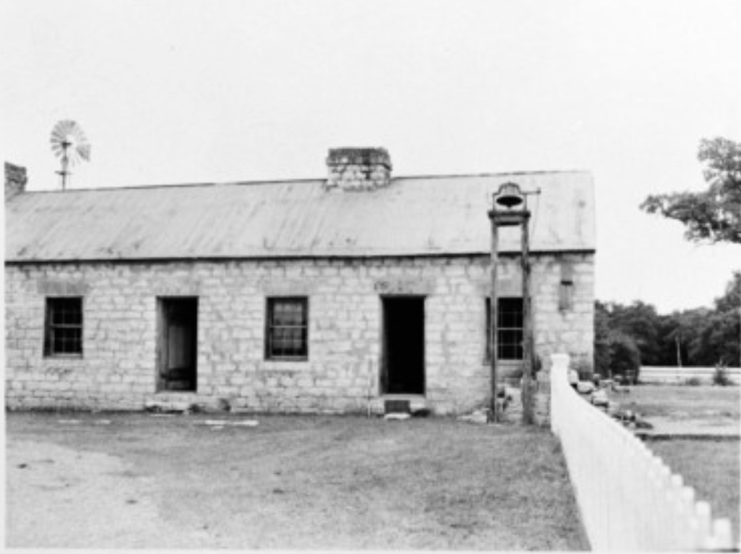
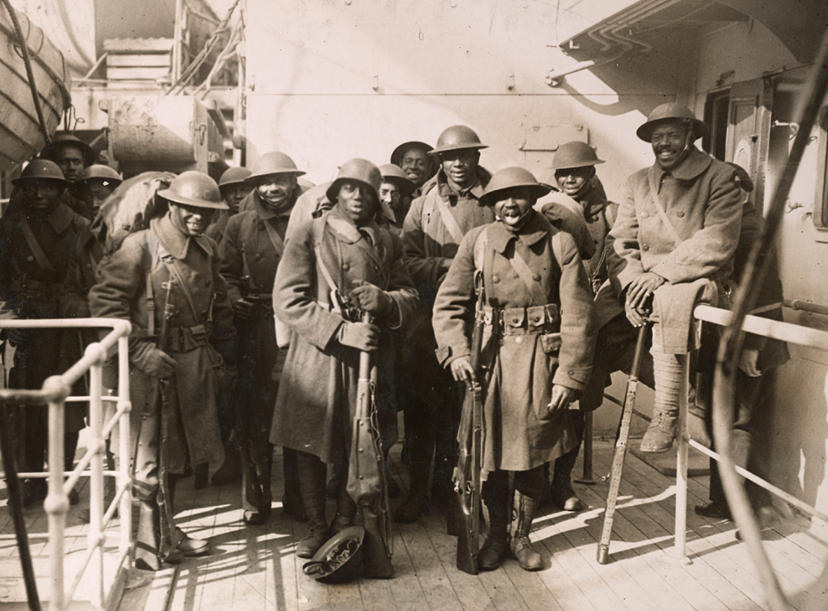
Harriet Glass Barrett
A 1970 photo of slave quarters that were preserved in Salado, Texas. This was not the plantation where Harriet was enslaved.
The Portal to Texas History
A photo of the all-Black Harlem Hellfighters unit during World War I. Harriet’s son served in this unit, though he is not pictured here.
The Portal to Texas History
Notes:
Texas Historical Commission. [Robertson Plantation Slave Quarters, (South elevation)], photograph, 1970; (https://texashistory.unt.edu/ark:/67531/metapth672324/: accessed August 28, 2025), University of North Texas Libraries, The Portal to Texas History, https://texashistory.unt.edu; crediting Texas Historical Commission.
The Harlem Hellfighters: The most storied Black combat unit of World War I. American Battle Monuments Commission. Accessed Aug. 28, 2025. https://www.abmc.gov/news-events/news/harlem-hellfighters-most-storied-african-american-combat-unit-world-war-i/

Slide 15
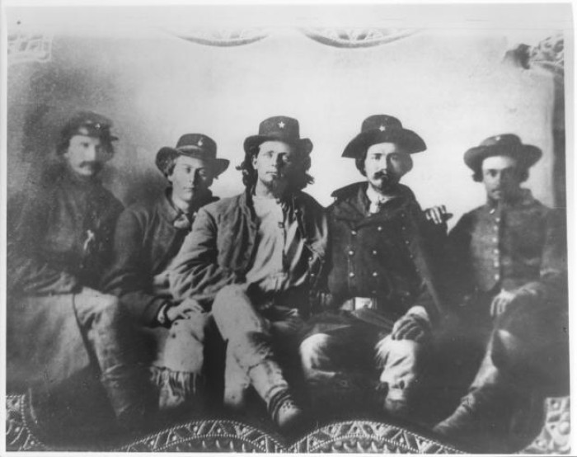
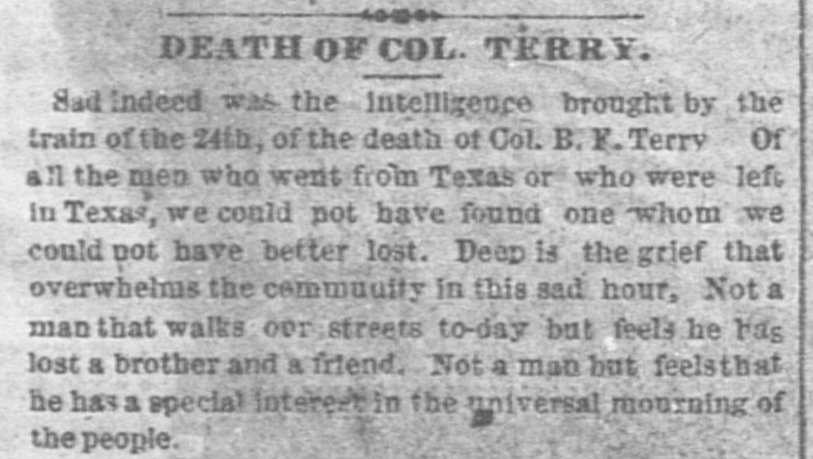
Benjamin Franklin Terry
Newspaper announcement of the death of Benjamin F. Terry.
The Portal to Texas History.
An 1863 photograph of Men who served in Terry’s Texas Rangers
The Portal to Texas History
Notes:
[Terry's Texas Rangers, c. 1863], photograph, 1863; (https://texashistory.unt.edu/ark:/67531/metapth799/: accessed August 28, 2025), University of North Texas Libraries, The Portal to Texas History, https://texashistory.unt.edu; crediting Fort Bend Museum.
Cushing, E. H. The Weekly Telegraph (Houston, Tex.), Vol. 27, No. 42, Ed. 1 Wednesday, January 1, 1862, newspaper, January 1, 1862; Houston, Texas. (https://texashistory.unt.edu/ark:/67531/metapth236175/: accessed August 28, 2025), University of North Texas Libraries, The Portal to Texas History, https://texashistory.unt.edu; crediting The Dolph Briscoe Center for American History.

Slide 16
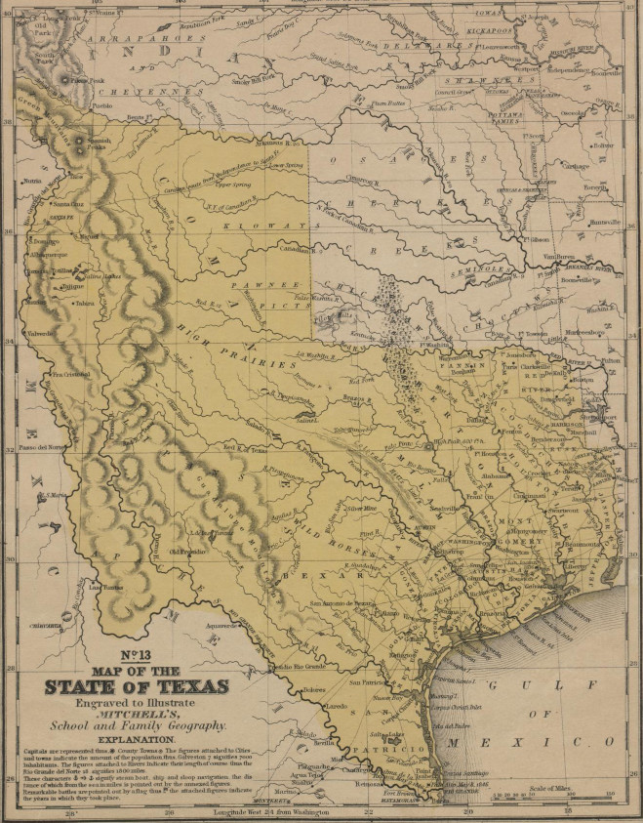
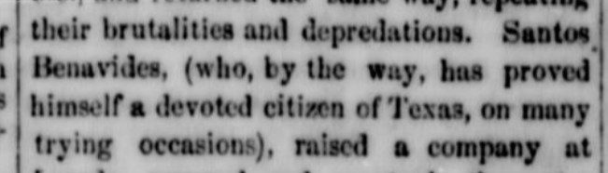
Santos Benavides
A newspaper article praises Benavides for defending Laredo from raiding American Indians.
The Portal to Texas History
A map of Texas from 1848. The location of Laredo is circled. The Portal to Texas History.
Notes:
Maltby, Henry A. & Maltby, William H. The Ranchero. (Corpus Christi, Tex.), Vol. 2, No. 22, Ed. 1 Saturday, March 16, 1861, newspaper, March 16, 1861; Corpus Christi, Texas. (https://texashistory.unt.edu/ark:/67531/metapth852559/: accessed August 28, 2025), University of North Texas Libraries, The Portal to Texas History, https://texashistory.unt.edu; .
Mitchell, S. Augustus (Samuel Augustus), 1792-1868. Map of the state of Texas., map, 1846; (https://texashistory.unt.edu/ark:/67531/metapth2484/: accessed July 18, 2025), University of North Texas Libraries, The Portal to Texas History, https://texashistory.unt.edu; crediting UNT Libraries Special Collections.

Slide 17
Exit Ticket: Follow the directions to complete your exit ticket.
Choose TWO people from the lesson.
Complete the sentence stems in the graphic organizer based on their similar or different points of view.
Share with a partner.

Slide 18
Share with the class 2
I think _______ and ________ would have been allies / opponents because _________

