Slide 1
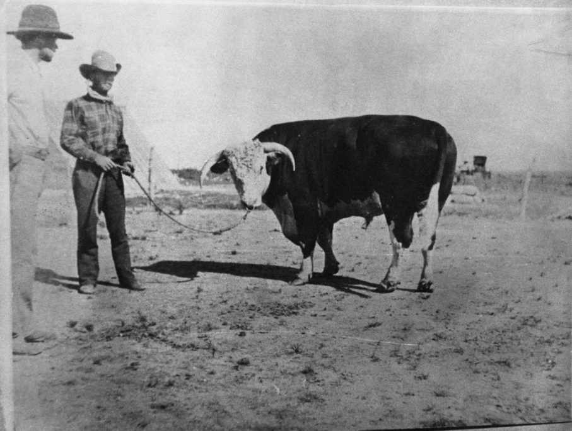
Unit 10: Cotton, Cattle, & Railroads
Lesson 7:
Cattle and Cowboys
A Hereford bull at C.C. Slaughter's Lazy "S" Ranch, photograph, 1900.
The Portal to Texas History
Notes:
Elvis E. Fleming. Sir Bredwell at C.C. Slaughter's Lazy "S" Ranch, photograph, 1900; (https://texashistory.unt.edu/ark:/67531/metapth43587/: accessed November 4, 2025), University of North Texas Libraries, The Portal to Texas History, https://texashistory.unt.edu; crediting Cattle Raisers Museum.

Slide 2




Warm-up: Follow the directions to complete your warm-up
Observe the image on your warm-up.
Respond to the questions based on your observations and inferences.
Share with a partner.

Slide 3

Share with the class
One thing I observe about this image is ______
What I think is happening in this picture is _______

Slide 4

Essential Question
What were some major topics, challenges, and developments that occurred during this era that affected cowboys in the cattle industry?

Slide 5
In today’s lesson…
We will examine various topics related to cowboys and cattle including Texas Fever, cattle trails, mega ranches, innovations, and some challenges of life as a cowboy.
I will use the information provided at six stations to identify, analyze, and summarize key topics related to cowboys and cattle in Texas.

Slide 6
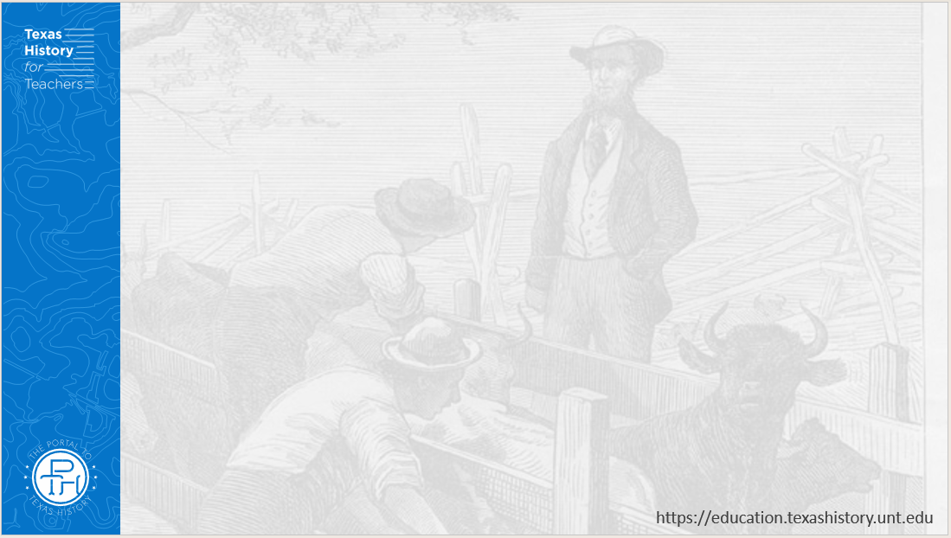
Station 1: The Rise of the Beef Industry
A Hereford bull at C.C. Slaughter's Lazy "S" Ranch, photograph, 1900.
The Portal to Texas History
Notes:
Elvis E. Fleming. Sir Bredwell at C.C. Slaughter's Lazy "S" Ranch, photograph, 1900; (https://texashistory.unt.edu/ark:/67531/metapth43587/: accessed November 4, 2025), University of North Texas Libraries, The Portal to Texas History, https://texashistory.unt.edu; crediting Cattle Raisers Museum.

Slide 7
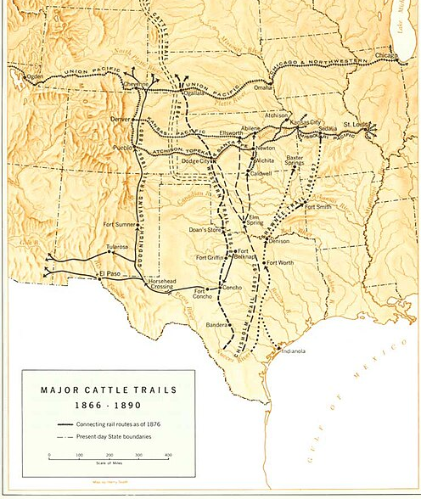
Station 2: Cattle Drive Trails
Historical map of cattle drives north from Texas.
National Park Services.
Notes:
Historical map of cattle drives north from Texas. National Park Service. Accessed at Wikimedia Commons on 11/11/25. https://commons.wikimedia.org/wiki/File:Cattle-trails.jpg

Slide 8
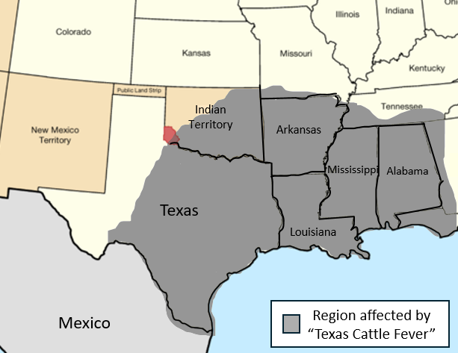
Station 3: Texas Cattle Fever
Notes:
United States Central map, 1900. Map of the United States in central North America from November 8, 1889, to November 11, 1889. Edited to show the Southwest and to include the approximate region afflicted by Texas Fever. https://commons.wikimedia.org/wiki/File:United_States_Central_map_1889-11-08_to_1889-11-11.png

Slide 9
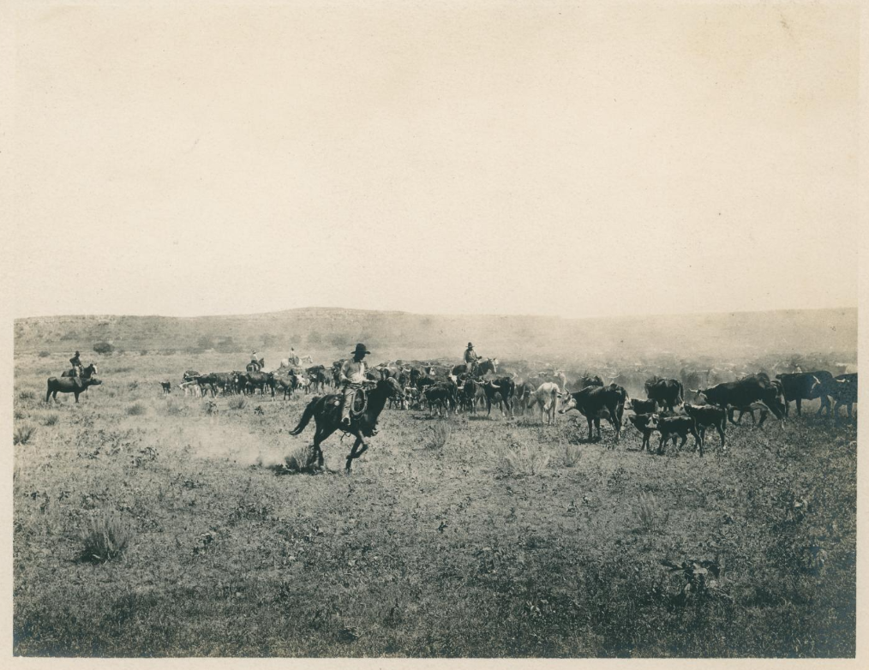
Station 4: Life as a Cowboy
Cowhands guiding a herd of cattle.
The Portal to Texas History.
Notes:
Smith, Erwin E. [Cowhands guiding a herd of cattle]. ca. 1910. Photograph. University of North Texas Libraries, The Portal to Texas History; crediting UNT Libraries Special Collections. https://texashistory.unt.edu/ark:/67531/metadc1151055/.

Slide 10
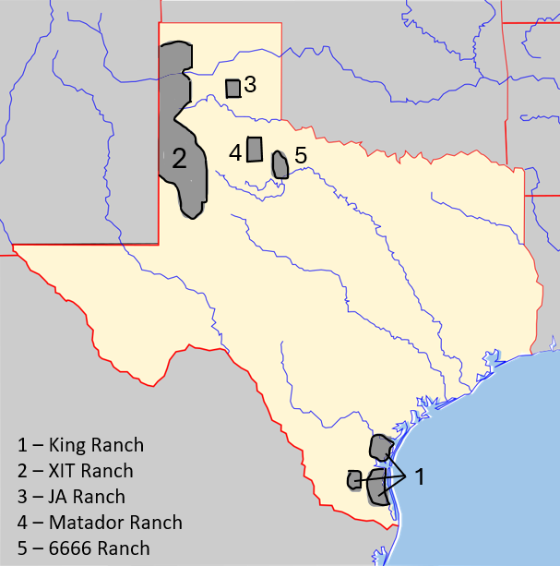
Station 5: Mega Ranches
Notes:
Texas Blank Map. Edited to include the locations of significant ranches during the age of Cotton, Cattle, and Railroads. This file is licensed under the Creative Commons Attribution-Share Alike 3.0 Unported license. Accessed 12/2/25. https://commons.wikimedia.org/wiki/File:Texas_blank_map.svg

Slide 11
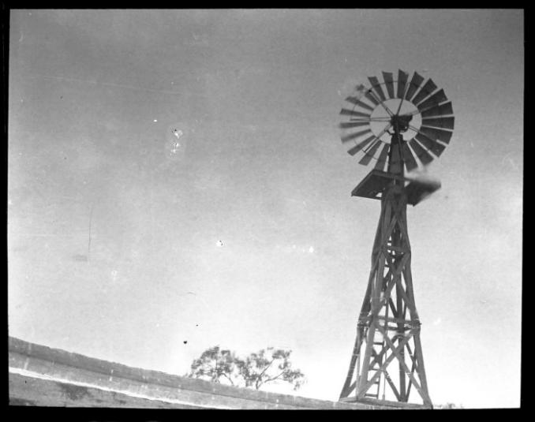
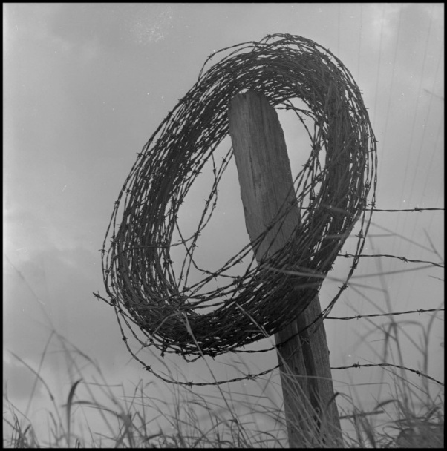
Station 6: Innovations
A windmill in Texas.
The Portal to Texas History
A coil of barbed wire on a fence post.
The Portal to Texas History
Notes:
[Photograph of Windmill], photograph, [1900..1929]; (https://texashistory.unt.edu/ark:/67531/metapth866241/: accessed November 5, 2025), University of North Texas Libraries, The Portal to Texas History, https://texashistory.unt.edu; crediting Howard Payne University Library.
Clark, Joe. [A coil of barbed wire], photograph, [1939..1989]; (https://texashistory.unt.edu/ark:/67531/metadc489800/: accessed November 13, 2025), University of North Texas Libraries, The Portal to Texas History, https://texashistory.unt.edu; crediting UNT Libraries Special Collections.

Slide 12
Exit Ticket: Follow the directions to complete your Exit Ticket
Read the primary source quote in the box.
Answer the question based on the quote.
Share with a partner.

Slide 13
Share with the class 2
The passage relates to the information about cattle and cowboys because __________

