Slide 1
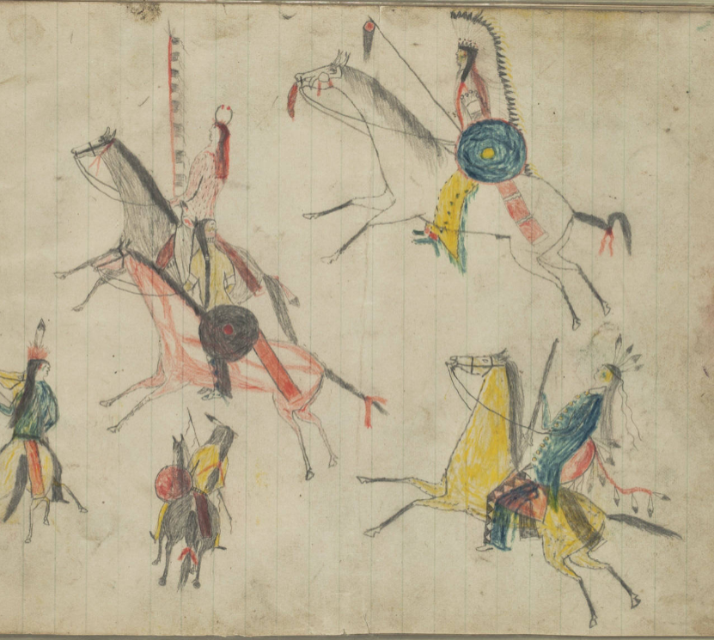
Unit 10: Cotton, Cattle, & Railroads
Lesson 6:
Frontier Wars
Kiowa Drawings, 1880-1890
Newberry Library
Notes:
Kiowa Ledger Drawings. Edward E. Ayer Digital Collection. Newberry Library. The Newberry makes its collections available for any lawful purpose, commercial or non-commercial, without licensing or permission fees to the library, subject to the following terms and conditions: https://www.newberry.org/rights-and-reproductions Accessed on 11/21/25 at https://collections.carli.illinois.edu/digital/collection/nby_eeayer/id/46856

Slide 2
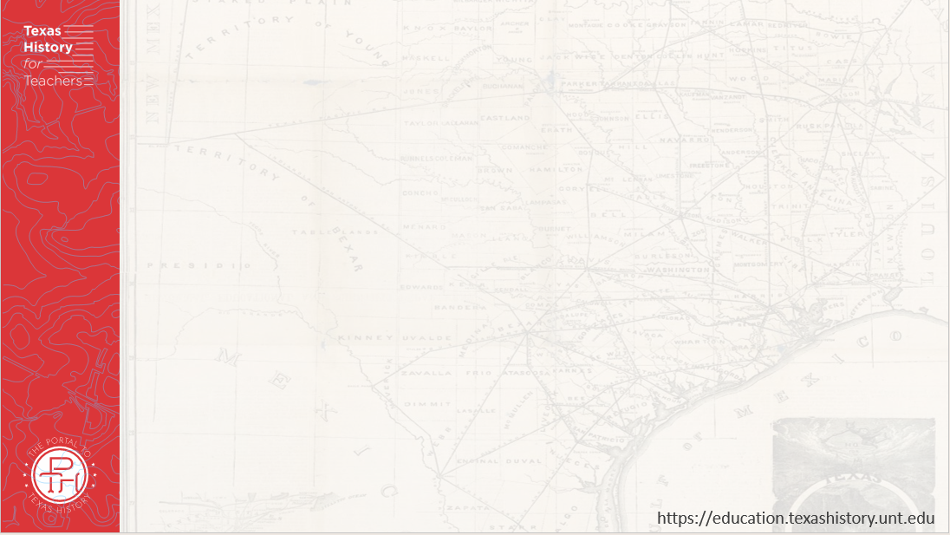
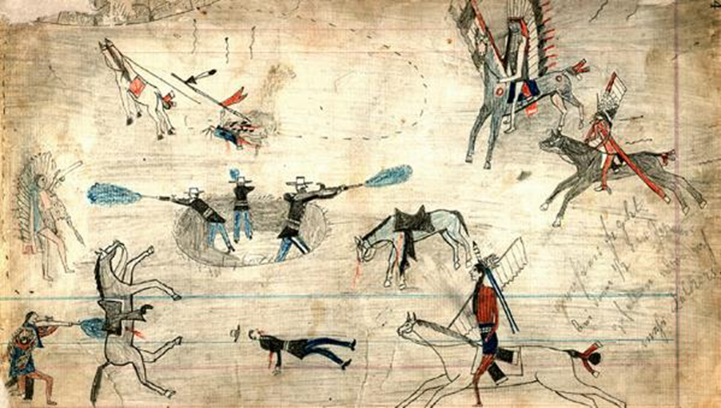
Warm-up Use the image to complete your warm-up
Notes:
Kiowa Ledger Drawings. Edward E. Ayer Digital Collection. Newberry Library. The Newberry makes its collections available for any lawful purpose, commercial or non-commercial, without licensing or permission fees to the library, subject to the following terms and conditions: https://www.newberry.org/rights-and-reproductions Accessed on 11/21/25 at https://collections.carli.illinois.edu/digital/collection/nby_eeayer/id/46856

Slide 3
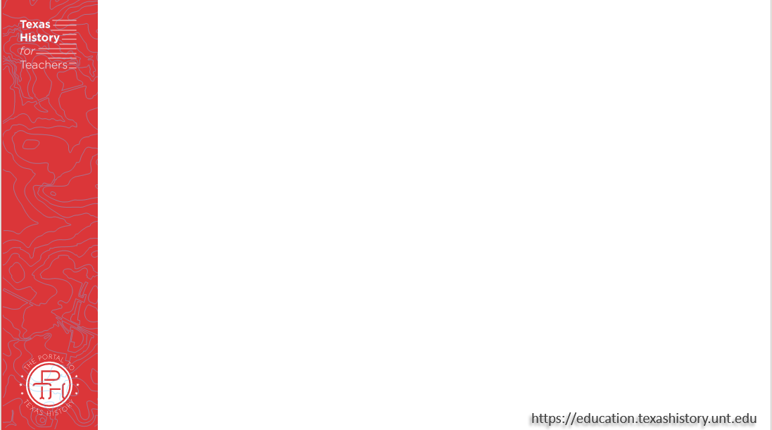

Share with the class:
One thing I observe about the image is _______
One thing I can infer about this lesson based on the image is ________

Slide 4
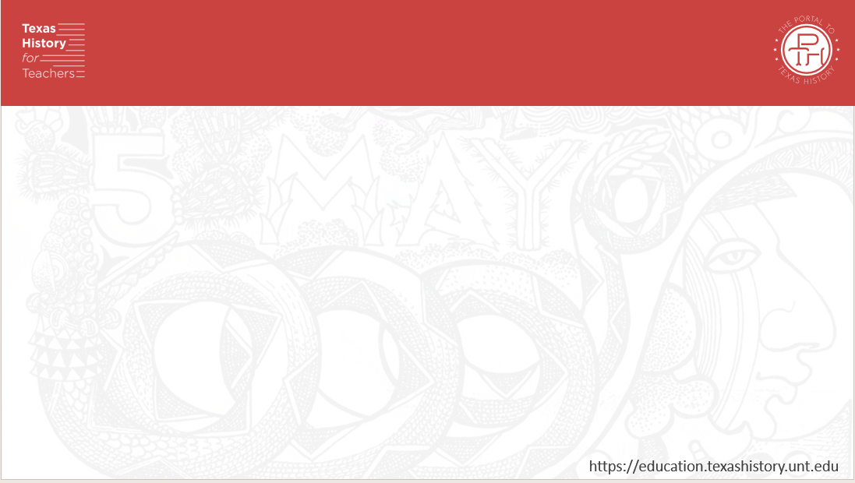
Essential Question
What were the causes, key events, outcome, and significance of the conflicts between Plains Indian tribes and Anglos on the west Texas frontier?

Slide 5
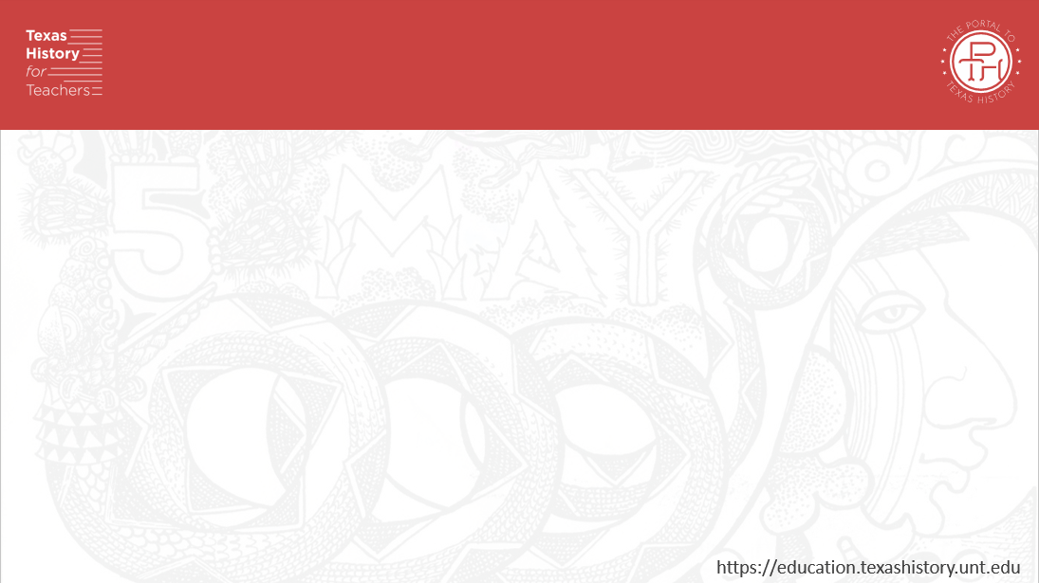
In Today’s Lesson
We will analyze the frontier wars, including their causes, key events, individuals involved, and their outcome and significance to Texas history.
I will read five short passages about different topics related to the frontier wars and answer comprehension questions about each topic.

Slide 6
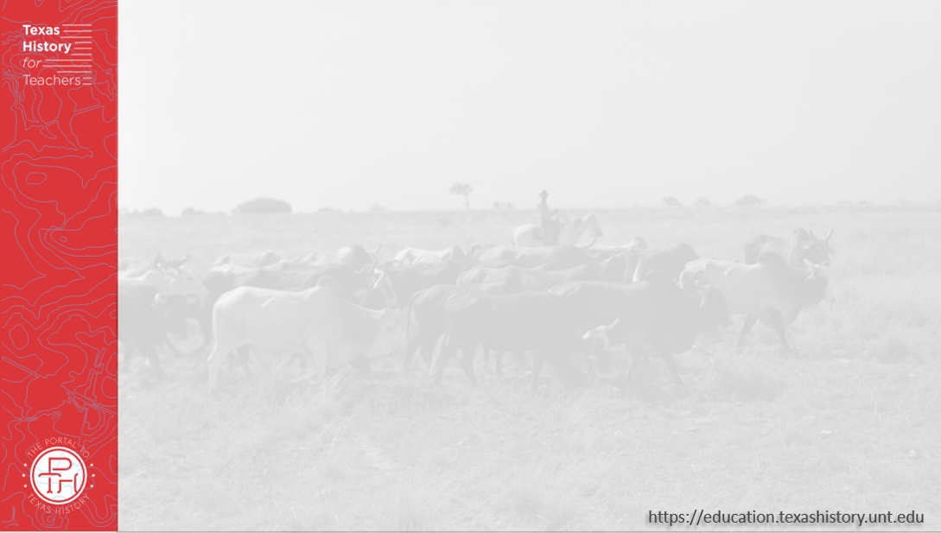
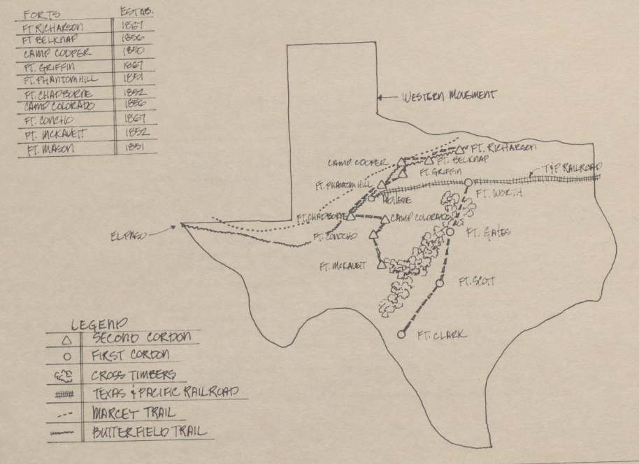
The Civil War and the West Texas Frontier
U.S. Army Forts Moving West
The Portal to Texas History
Notes:
Durham, Robert W., Jr. West Texas Historical Center: A Portrayal, report, 1977; (https://texashistory.unt.edu/ark:/67531/metapth1165548/: accessed November 26, 2025), University of North Texas Libraries, The Portal to Texas History, https://texashistory.unt.edu; crediting McMurry University Library.

Slide 7
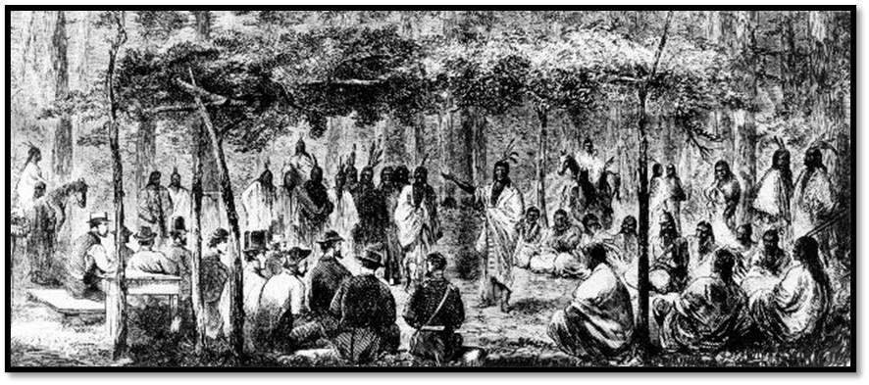
The Medicine Lodge Treaty
The Medicine Lodge Treaty
Oklahoma Historical Society
Notes:
Illustration depicting a meeting at Medicine Lodge, sketched by J. Howland. 19589.68.46, Alvin Rucker Collection, Oklahoma Historical Society. https://www.okhistory.org/publications/enc/entry?entry=ME005. Used under the terms of the Fair Use Policy as sited here 17 U.S. Code § 107 - Limitations on exclusive rights: Fair use | U.S. Code | US Law | LII / Legal Information Institute This media file is in the public domain in the United States. This applies to U.S. works where the copyright has expired, often because its first publication occurred prior to January 1, 1930, and if not then due to lack of notice or renewal. See this page for further explanation.

Slide 8
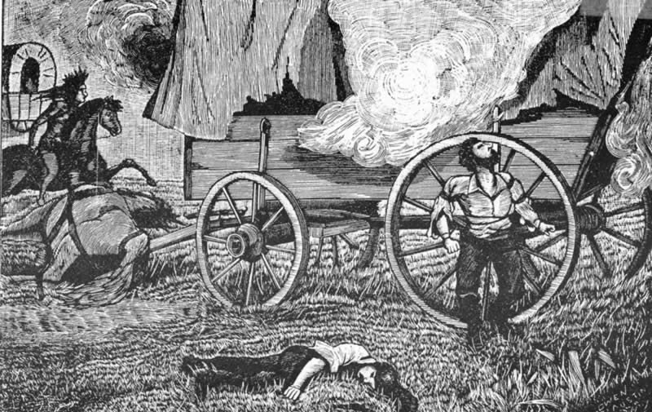
The Salt Creek Massacre
Sketch of the Warren Wagon Train Raid, 1871
Notes:
Warren Wagon Train Raid Sketch. May 22, 1871. This work is in the public domain in its country of origin and other countries and areas where the copyright term is the author's life plus 70 years or fewer. Accessed 11/26/25. https://commons.wikimedia.org/wiki/File:Warrensketch-lg.jpg

Slide 9
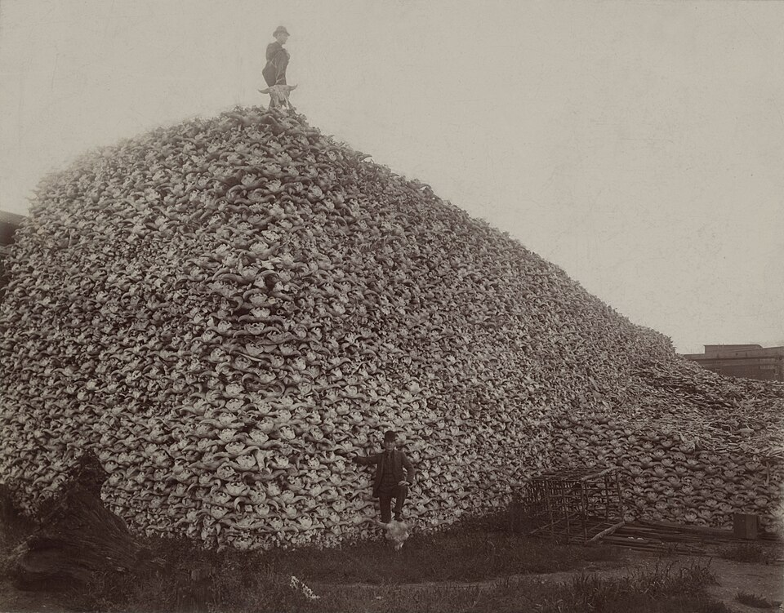
The Destruction of the American Buffalo
An enormous pile of bison skulls on the Plains, 1892.
Burton Historical Collection, Detroit Public Library.
Notes:
Photograph from 1892 of a pile of American bison skulls in Detroit (MI) waiting to be ground for fertilizer or charcoal. Original taken at Michigan Carbon Works, Rougeville, Michigan. 1892. Located in the Burton Historical Collection, Detroit Public Library. ^{[1]} Archive of jpeg at the Wayback Machine (archived 2024-06-06) This is a retouched picture, which means that it has been digitally altered from its original version. Modifications: reduced opacity of dirtiest and most scratched areas; slightly reduced saturation; some cloning; etc.. The original can be viewed here: Bison skull pile.jpg: . Modifications made by Chick Bowen. This media file is in the public domain in the United States. This applies to U.S. works where the copyright has expired, often because its first publication occurred prior to January 1, 1930, and if not then due to lack of notice or renewal. See this page for further explanation. Accessed 11/26/25. https://commons.wikimedia.org/wiki/File:Bison_skull_pile_edit.jpg

Slide 10
The Red River War
A drawing by a Kiowa tribe member representing a battle during the Red River War. The Newberry Library.
Notes:
Kiowa Ledger Drawings. Edward E. Ayer Digital Collection. Newberry Library. The Newberry makes its collections available for any lawful purpose, commercial or non-commercial, without licensing or permission fees to the library, subject to the following terms and conditions: https://www.newberry.org/rights-and-reproductions Accessed on 11/21/25 at https://collections.carli.illinois.edu/digital/collection/nby_eeayer/id/46856

Slide 11



Exit Ticket Follow the directions to complete your exit ticket
Read the writing prompt on your exit ticket.
Use the information from the lesson to complete the sentence stems to respond to the prompt.
Share with a partner.

Slide 12
Share with the class: 2
One major challenge related to the west Texas frontier during the era of Cotton, Cattle, and Railroads was _______
This challenge was one factor that led to conflict between the _________ and _________
One result of conflict between these groups, _____________

