Slide 1
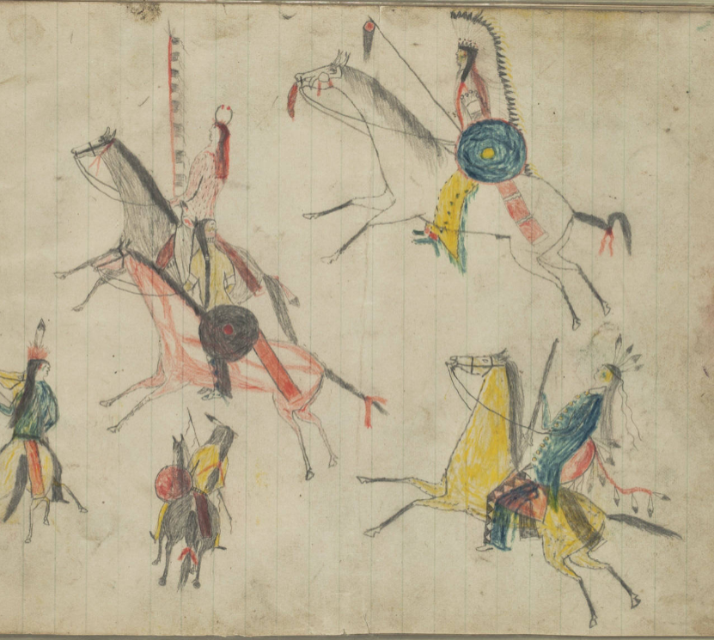
Unidad 10:
Algodón, ganado y ferrocarriles
Lección 6:
Guerras fronterizas
Kiowa Drawings, 1880-1890
Newberry Library
Notes:
Kiowa Ledger Drawings. Edward E. Ayer Digital Collection. Newberry Library. The Newberry makes its collections available for any lawful purpose, commercial or non-commercial, without licensing or permission fees to the library, subject to the following terms and conditions: https://www.newberry.org/rights-and-reproductions Accessed on 11/21/25 at https://collections.carli.illinois.edu/digital/collection/nby_eeayer/id/46856

Slide 2
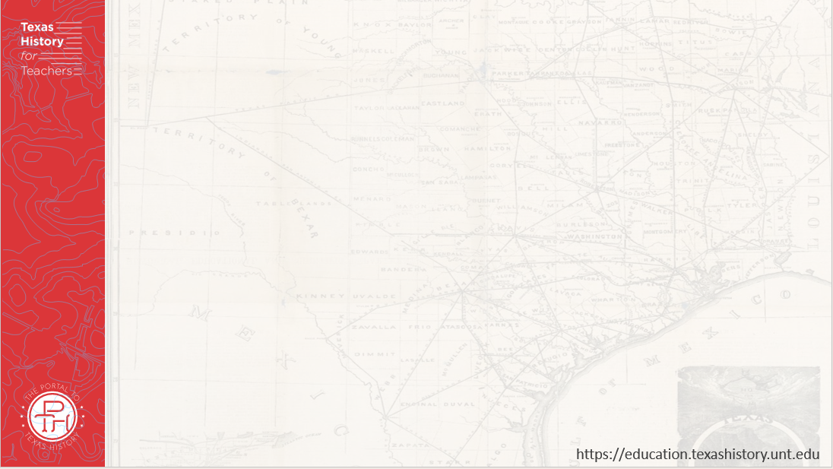
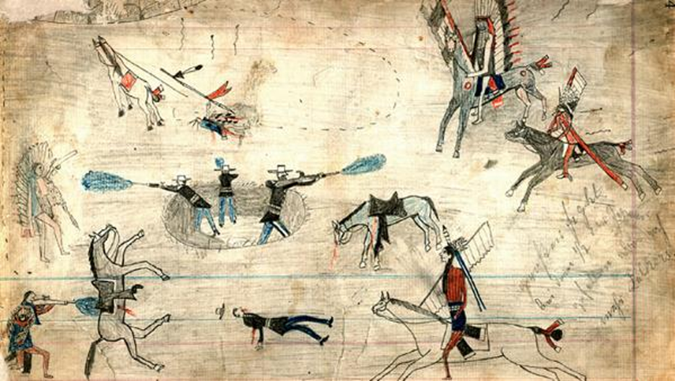
Calentamiento
Usa la imagen para completar tu calentamiento
Notes:
Kiowa Ledger Drawings. Edward E. Ayer Digital Collection. Newberry Library. The Newberry makes its collections available for any lawful purpose, commercial or non-commercial, without licensing or permission fees to the library, subject to the following terms and conditions: https://www.newberry.org/rights-and-reproductions Accessed on 11/21/25 at https://collections.carli.illinois.edu/digital/collection/nby_eeayer/id/46856

Slide 3
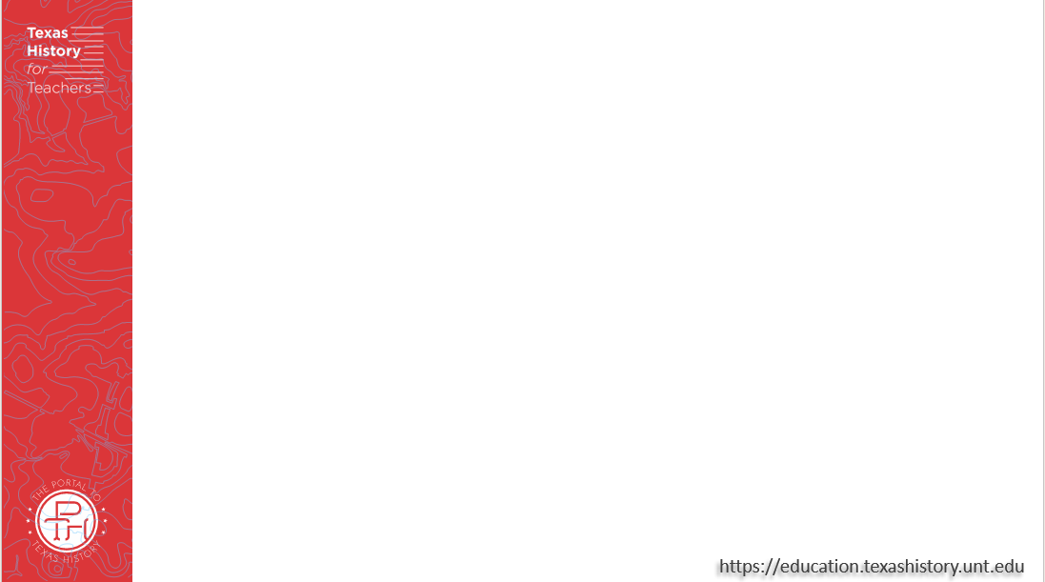
Comparte con la clase:
Una cosa que observo en la imagen es _______
Una cosa que puedo inferir de esta lección basándome en la imagen es ________

Slide 4
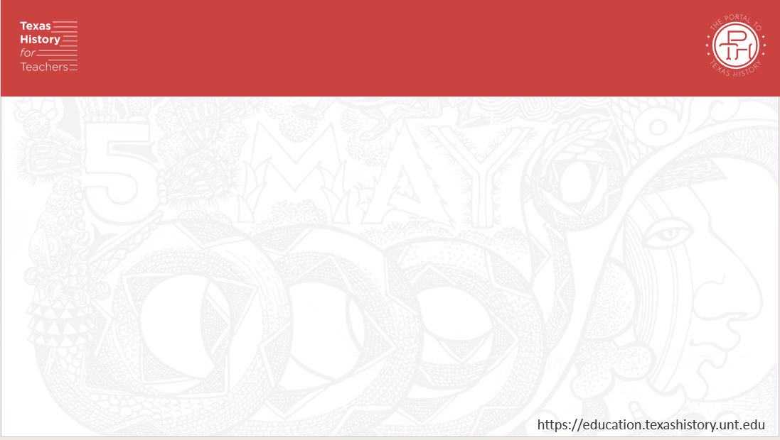
Pregunta esencial
Cuáles fueron las causas, los eventos clave, el resultado y la importancia de los conflictos entre las tribus indígenas de las llanuras y los anglosajones en la frontera oeste de Texas?

Slide 5
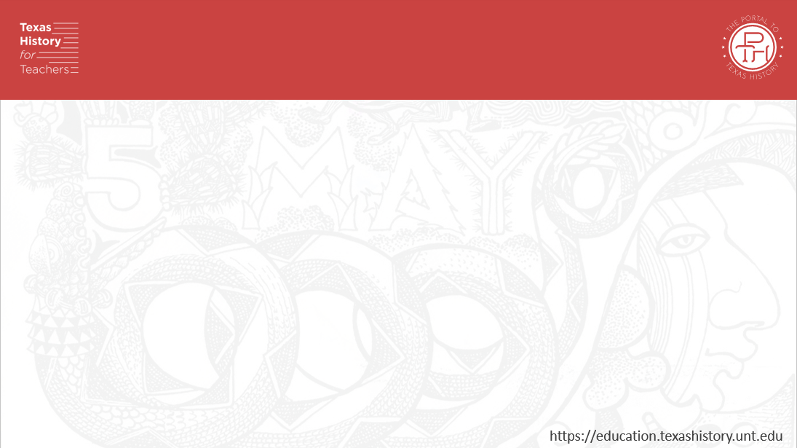
En la lección de hoy
Analizaremos las guerras fronterizas, incluyendo sus causas, eventos clave, individuos implicados y su resultado y importancia para la historia de Texas.
Leeré cinco breves pasajes sobre diferentes temas relacionados con las guerras fronterizas y responderé a preguntas de comprensión sobre cada tema.

Slide 6
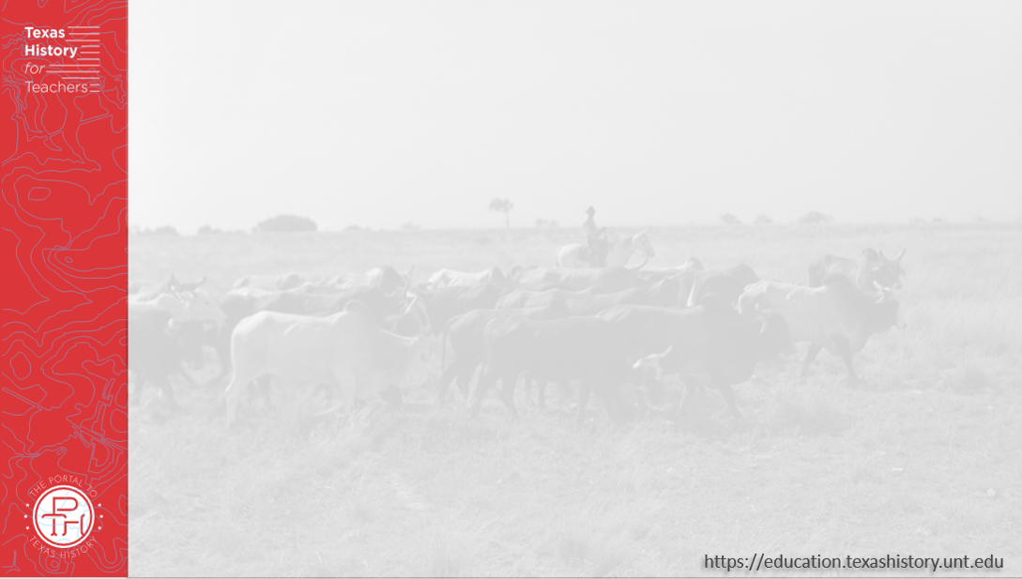
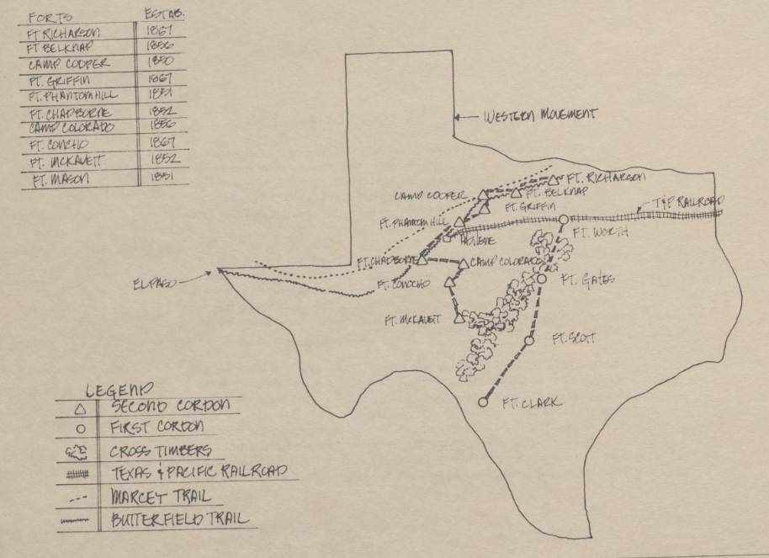
La Guerra Civil y la Frontera Occidental de Texas
Fuertes del Ejército de EE. UU. avanzando hacia el oeste
El portal a la historia de Texas
Notes:
Durham, Robert W., Jr. West Texas Historical Center: A Portrayal, report, 1977; (https://texashistory.unt.edu/ark:/67531/metapth1165548/: accessed November 26, 2025), University of North Texas Libraries, The Portal to Texas History, https://texashistory.unt.edu; crediting McMurry University Library.

Slide 7
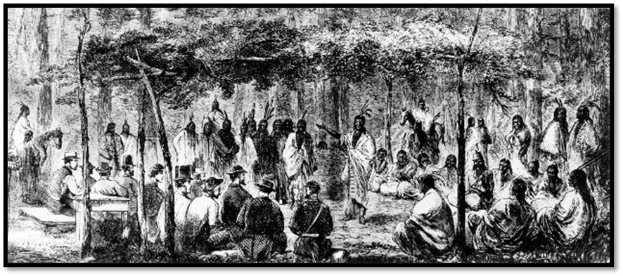
El Tratado de la Logia Medicinal
El Tratado de la Logia Medicinal
Sociedad Histórica de Oklahoma
Notes:
Illustration depicting a meeting at Medicine Lodge, sketched by J. Howland. 19589.68.46, Alvin Rucker Collection, Oklahoma Historical Society. https://www.okhistory.org/publications/enc/entry?entry=ME005. Used under the terms of the Fair Use Policy as sited here 17 U.S. Code § 107 - Limitations on exclusive rights: Fair use | U.S. Code | US Law | LII / Legal Information Institute This media file is in the public domain in the United States. This applies to U.S. works where the copyright has expired, often because its first publication occurred prior to January 1, 1930, and if not then due to lack of notice or renewal. See this page for further explanation.

Slide 8
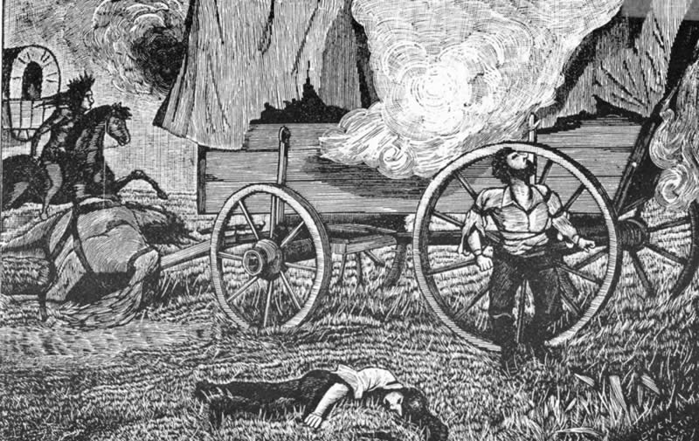
La masacre de Salt Creek
Esbozo de la incursión del tren de vagones de Warren, 1871
Notes:
Warren Wagon Train Raid Sketch. May 22, 1871. This work is in the public domain in its country of origin and other countries and areas where the copyright term is the author's life plus 70 years or fewer. Accessed 11/26/25. https://commons.wikimedia.org/wiki/File:Warrensketch-lg.jpg

Slide 9
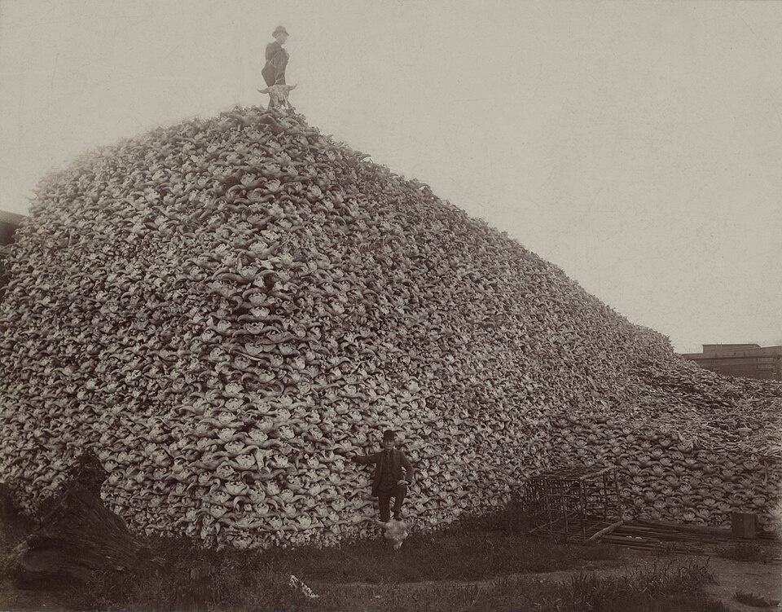
La destrucción del búfalo americano
Un enorme montón de cráneos de bisonte en las llanuras, 1892.
Colección Histórica Burton, Biblioteca Pública de Detroit.
Notes:
Photograph from 1892 of a pile of American bison skulls in Detroit (MI) waiting to be ground for fertilizer or charcoal. Original taken at Michigan Carbon Works, Rougeville, Michigan. 1892. Located in the Burton Historical Collection, Detroit Public Library. ^{[1]} Archive of jpeg at the Wayback Machine (archived 2024-06-06) This is a retouched picture, which means that it has been digitally altered from its original version. Modifications: reduced opacity of dirtiest and most scratched areas; slightly reduced saturation; some cloning; etc.. The original can be viewed here: Bison skull pile.jpg: . Modifications made by Chick Bowen. This media file is in the public domain in the United States. This applies to U.S. works where the copyright has expired, often because its first publication occurred prior to January 1, 1930, and if not then due to lack of notice or renewal. See this page for further explanation. Accessed 11/26/25. https://commons.wikimedia.org/wiki/File:Bison_skull_pile_edit.jpg

Slide 10
La Guerra del Río Rojo
Un dibujo de un miembro de la tribu Kiowa que representa una batalla durante la Guerra del Río Rojo. La Biblioteca Newberry.
Notes:
Kiowa Ledger Drawings. Edward E. Ayer Digital Collection. Newberry Library. The Newberry makes its collections available for any lawful purpose, commercial or non-commercial, without licensing or permission fees to the library, subject to the following terms and conditions: https://www.newberry.org/rights-and-reproductions Accessed on 11/21/25 at https://collections.carli.illinois.edu/digital/collection/nby_eeayer/id/46856

Slide 11
Billete de salida
Sigue las instrucciones para completar tu ticket de salida
Lee la consigna de escritura en tu ticket de salida.
Utiliza la información de la lección para completar los talones de las frases y responder al prompt.
Comparte con una pareja.

Slide 12
Comparte con la clase: 2
Uno de los principales desafíos relacionados con la frontera occidental de Texas durante la era del algodón, el ganado y los ferrocarriles fue _______
Este desafío fue uno de los factores que condujeron al conflicto entre la _________ y la _________
Una consecuencia del conflicto entre estos grupos, _____________

