Slide 1
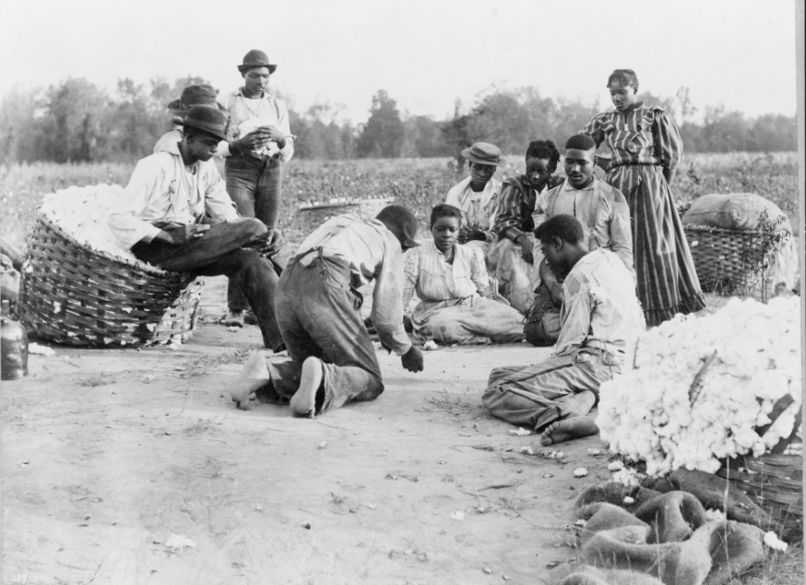
Unit 10:
Cotton, Cattle, & Railroads
Lesson 2:
How do we know what we know?
Cotton farmers taking a break to shoot dice in the field, 1900.
Library of Congress
Notes:
African Americans resting and shooting dice at edge of cotton field. 1900. Photograph. https://www.loc.gov/item/97507242/.

Slide 2





Warm-up
Follow the directions below to complete your warm-up
Read the primary source excerpt on your warm-up
Answer the two questions about the excerpt.
Share with a partner.

Slide 3

Share with the class:
The primary topic of this excerpt is __________
The best summary of this excerpt is that ___________

Slide 4

Essential Question
What are the key topics and major themes of Cotton, Cattle, and Railroads, and how were these topics recorded and discussed in the primary source materials of the era?

Slide 5

In Today’s Lesson
We will examine the major events and topics of the era of Cotton, Cattle, and Railroads by analyzing a set of primary source materials.
I will choose from the sources available and record information about the author, topic, and main idea for each of my chosen sources.

Slide 6
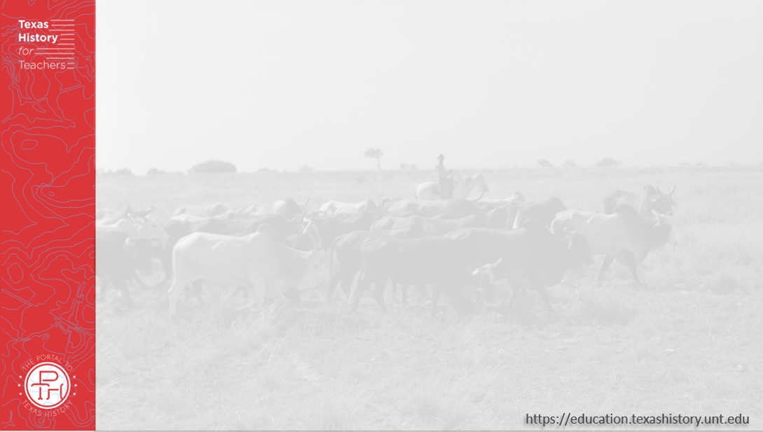
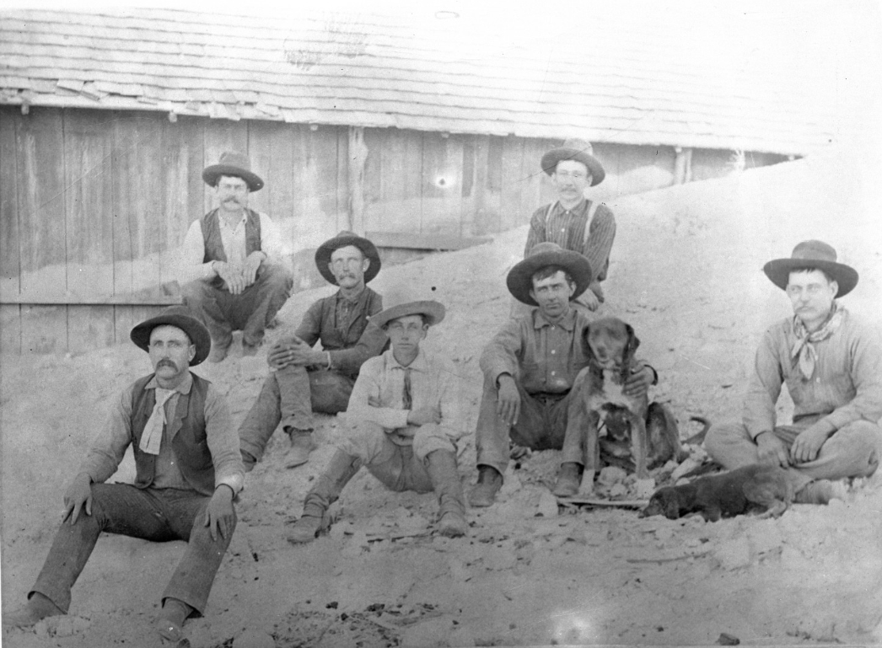
Part I: Texas at the End of the 20th Century
Cowboys outside the Escarbada bunk house at the XIT ranch, 1891.
The Portal to Texas History
Notes:
[Cowboys at Escarbada Bunk House], photograph, Date Unknown; (https://texashistory.unt.edu/ark:/67531/metapth13563/: accessed November 19, 2025), University of North Texas Libraries, The Portal to Texas History, https://texashistory.unt.edu; crediting Deaf Smith County Library.

Slide 7

Part II:
Primary Source Analysis

Slide 8

Exit Ticket
Follow the directions below to complete your exit ticket
Read the writing prompt in your exit ticket.
Answer the prompt by completing the sentence stems provided.
Share with a partner.

Slide 9
Share with the class: 2
One of the primary topics or major themes of this unit is _______
Evidence of this topic appeared in one primary source excerpt which discussed ______________

