Slide 1
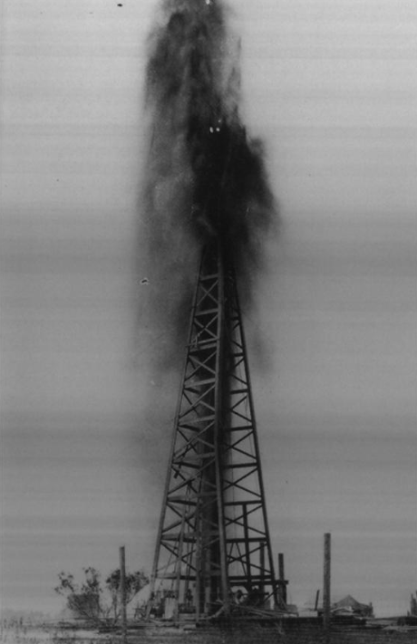
Unit 10:
Cotton, Cattle, & Railroads
Lesson 10:
Looking Ahead
Corpus Christi oil rig blow out, 1922
The Portal to Texas History
Notes:
Graham, Joe S. El Rancho in South Texas: Continuity and Change From 1750, book, 1994; Denton, Texas. (https://texashistory.unt.edu/ark:/67531/metadc28328/: accessed December 9, 2025), University of North Texas Libraries, The Portal to Texas History, https://texashistory.unt.edu; crediting UNT Press.

Slide 2

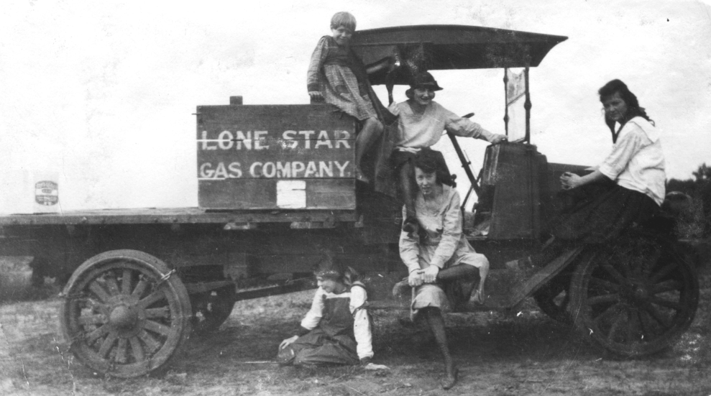
Warm-up
Use the image to complete your warm-up
Notes:
[Lone Star Gas Co Truck]. ca. 1910. Photograph. University of North Texas Libraries, The Portal to Texas History; crediting Clay County Historical Society. https://texashistory.unt.edu/ark:/67531/metapth16974/.

Slide 3


Share with the class
One thing I observe about the image is _____________
One thing I predict about this unit based on the image is __________

Slide 4

Essential Question
What significant event occurred at Spindletop in 1901, and how did this event shape Texas history during the Age of Oil?

Slide 5

In today’s lesson…
We will examine the events of the Spindletop oil discovery in 1901 and its significance in the history of Texas, the U.S., and the world.
I will identify the key events and significant effects of the discovery of oil at Spindletop in 1901 and write a paragraph summarizing three of these effects.

Slide 6

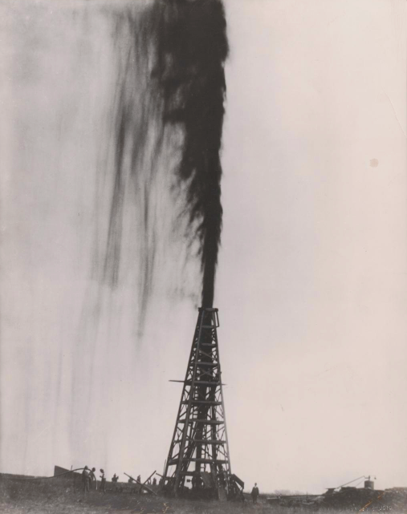
Part I:
Oil at Spindletop
The Lucas Gusher at Spindletop near Beaumont, Texas, 1901.
The Portal to Texas History
Notes:
The Lucas Gusher, 1901. 1901. Photograph. University of North Texas Libraries, The Portal to Texas History; crediting University of Texas at Arlington Library. https://texashistory.unt.edu/ark:/67531/metapth41398/.

Slide 7
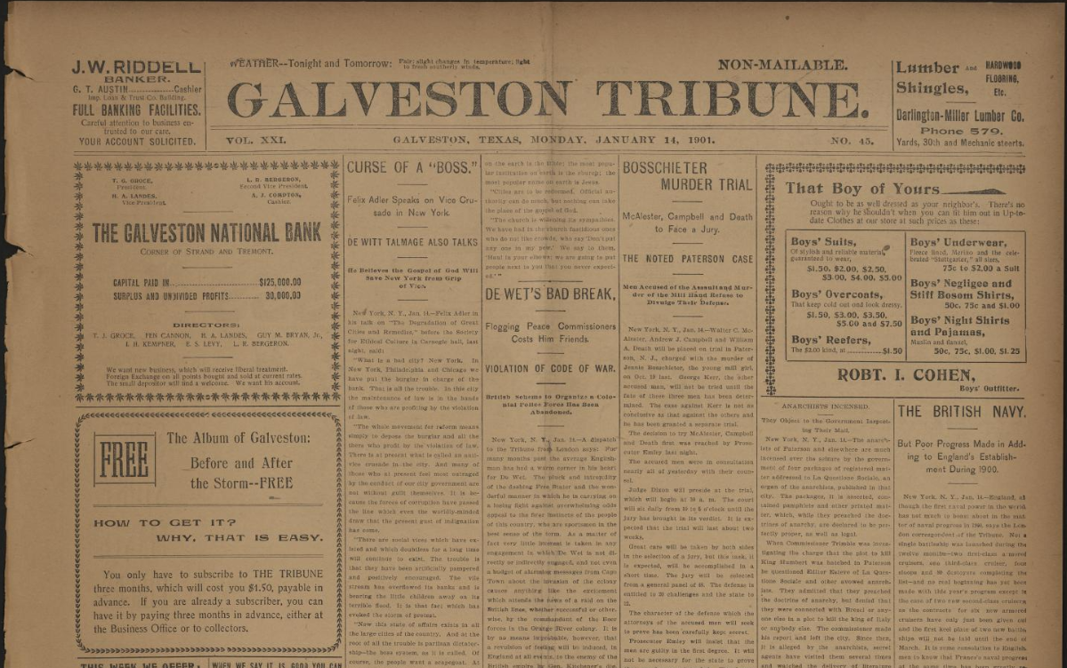
Primary Source Excerpt #1:
The Galveston Tribune, Jan. 14, 1901
The Portal to Texas History
Notes:
“Galveston Tribune. (Galveston, Tex.), Vol. 21, No. 45, Ed. 1 Monday, January 14, 1901.” The Portal to Texas History, January 26, 2020. https://texashistory.unt.edu/ark:/67531/metapth1218593/m1/4/

Slide 8
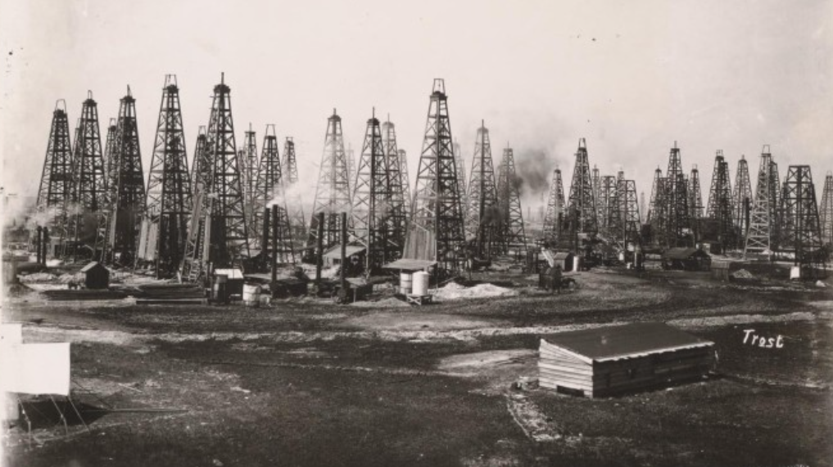
Part II: Texas in the Age of Oil
Beaumont, Texas, months after Spindletop, 1901.
The Portal to Texas History
Notes:
Trost Studio. Oil Field in Beaumont, Texas, 1901, photograph, 1901; (https://texashistory.unt.edu/ark:/67531/metapth41397/: accessed December 11, 2025), University of North Texas Libraries, The Portal to Texas History, https://texashistory.unt.edu; crediting University of Texas at Arlington Library.

Slide 9


Exit Ticket
Follow the directions to complete your exit ticket
Read the question and choose the answer that best describes the significance of oil in Texas history.
Discuss with a partner

Slide 10
Share with the class 2
The most accurate summary of one of the key defining characteristics of our next unit, the Age of Oil, is that ____________________________

