Slide 1

Mind Map
Sub-topic
1
Additional information
Sub-topic
2
Main Topic
Additional information
Sub-topic
3
Additional information
Additional information
https://education.texashistory.unt.edu

Slide 2

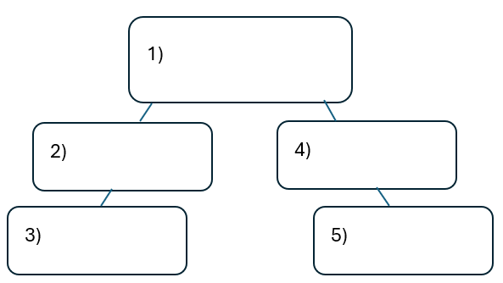


Warm-up: Follow the directions on your warm-up
Use the word bank provided to fill in the small mind map on your warm-up.
Place each term where you think it fits best in your mind map.
Discuss with a partner.
https://education.texashistory.unt.edu

Slide 3
Share with the class
I think the primary topic in box number one is _______
I think the subtopic in box number two is ____, and box number three is ____
I think the subtopic in box number four is ____, and box number five is ____
https://education.texashistory.unt.edu

Slide 4
Essential Question
How do the key terms and concepts from Unit 10: Cotton, Cattle, & Railroads connect to each other?
https://education.texashistory.unt.edu

Slide 5
In today’s lesson…
We will make connections between key terms and concepts within all of Unit 10: Cotton, Cattle, & Railroads.
I will create a Mind Map using terms and concepts from the class slides presentation and demonstrating how each term is connected to the overall unit.
https://education.texashistory.unt.edu

Slide 6
Unit Topic & Subtopics
Which of the titles in the boxes below is the main topic of our unit?
Draw a circle in the middle of your Mind Map and write the main topic inside.
Agriculture
The Texas Frontier
Legislation & Reform
Cotton, Cattle, & Railroads
Cattle Industry
https://education.texashistory.unt.edu

Slide 7
Make Connections
Connect each item below to the topic on your Mind Map.
Some items will connect directly to the main topic. Some will connect to other items from this slide.
Jim Crow
Westward migration
Falling cotton prices
Northern demand for beef
Overhunting bison
Trails
https://education.texashistory.unt.edu

Slide 8
Make Connections 2
Connect each item below to the topic on your Mind Map.
Some items will connect directly to the main topic. Some will connect to other items from this slide or previous slides.
Some items could be placed in more than one location on your map.
Goodnight-Loving
Cowboys
Debt
Salt Creek Massacre
Tenant Farming
Chisholm
https://education.texashistory.unt.edu

Slide 9
Make Connections 3
Connect each item below to the topic on your Mind Map.
Some items will connect directly to the main topic. Some will connect to other items from this slide or previous slides.
Some items could be placed in more than one location on your map.
Texas Fever
Railroad Commission
The Grange
Cowboy Culture
Open / Free range
Ranches
https://education.texashistory.unt.edu

Slide 10
Make Connections 4
Connect each item below to the topic on your Mind Map.
Some items will connect directly to the main topic. Some will connect to other items from this slide or previous slides.
Some items could be placed in more than one location on your map.
Buffalo Soldiers
Barbed wire
Comanches
Separate railroad cars
Farmer’s Alliance
Investors
https://education.texashistory.unt.edu

Slide 11
Make Connections 5
Connect each item below to the topic on your Mind Map.
Some items will connect directly to the main topic. Some will connect to other items from this slide or previous slides.
Some items could be placed in more than one location on your map.
Regulations
King
Populist Party
XIT
Poll Taxes
Quanah Parker
https://education.texashistory.unt.edu

Slide 12
Make Connections 6
Connect each item below to the topic on your Mind Map.
Some items will connect directly to the main topic. Some will connect to other items from this slide or previous slides.
Some items could be placed in more than one location on your map.
Abolish gold standard
Adobe Walls
Nearly 50%
Red River War
Subtreasury Plan
Windmills
https://education.texashistory.unt.edu

Slide 13
Make Connections 20 6
Connect each item below to the topic on your Mind Map.
Some items will connect directly to the main topic. Some will connect to other items from this slide or previous slides.
Some items could be placed in more than one location on your map.
Lampasas, TX
High railroad rates
Vaqueros
Income Tax
Oklahoma Reservations
Capitol Building
https://education.texashistory.unt.edu

Slide 14

Create Connections 6
Now take a few minutes to add any information you can think of to your Mind Map.
You can add facts, descriptions, explanations, cultural information, or anything else you can think of.
https://education.texashistory.unt.edu

Slide 15

Exit Ticket
Complete the sentence summarizing the main idea from our unit.
Discuss with a partner.
https://education.texashistory.unt.edu

Slide 16
Share your response
The (1)____________ is primarily characterized the by (2)_______________
https://education.texashistory.unt.edu

