Slide 1
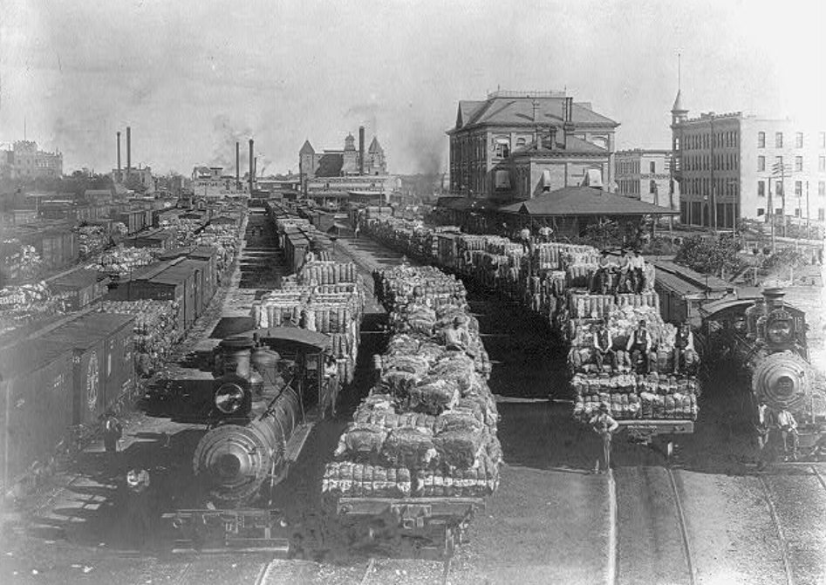
Unit 10:
Cotton, Cattle, & Railroads
Lesson 9:
Texas Today
Cotton transport on the Houston and Texas Central Railway
Library of Congress
Notes:
History of the Houston and Texas Central Railway. Texas State Historical Society. Original location Library of Congress. Accessed 12/4/2025. Image included in accordance with Title 17 U.S.C. Section 107. https://tile.loc.gov/storage-services/service/pnp/cph/3a30000/3a30000/3a30100/3a30145r.jpg

Slide 2
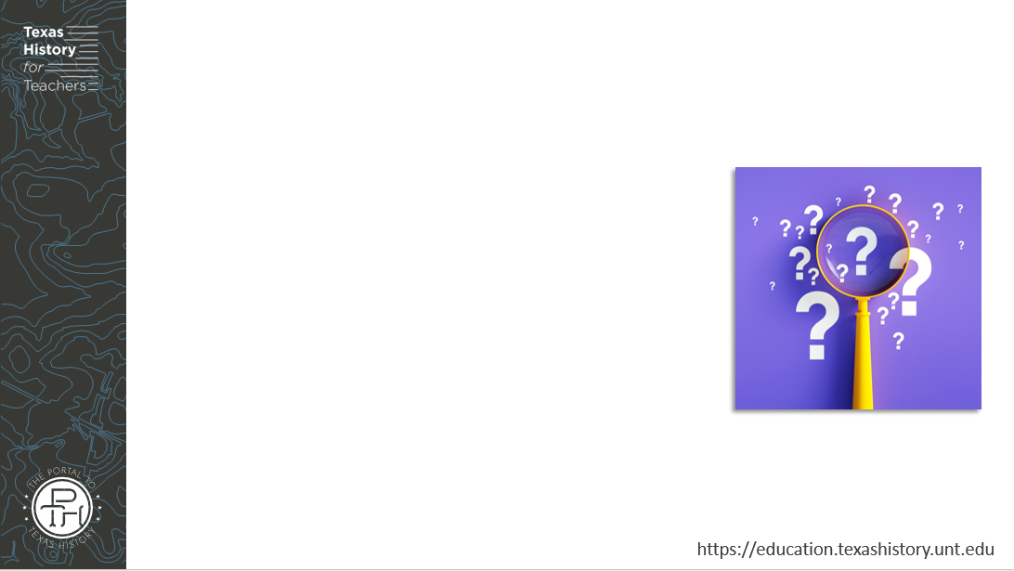



Warm-up
Follow the directions to complete your warm-up
Read the scenario provided.
Respond to the questions that follow.
Discuss with a partner

Slide 3
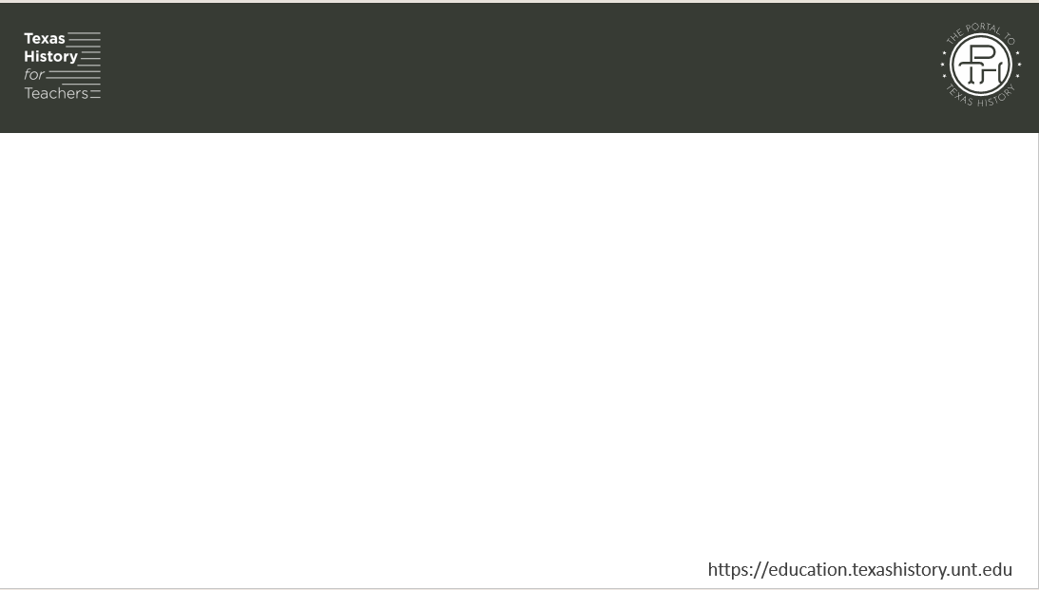
Share with the class
One way this would affect my business is _________
One thing that could fix this problem is __________

Slide 4

Essential Question
What is the Texas Railroad Commission, why was it established, and how have its responsibilities evolved over time?

Slide 5

In today’s lesson…
We will examine the origins, purpose, and development of the Texas Railroad Commission and its significance to Texas and U.S. history.
I will read a passage, identify key information, summarize main ideas, explain cause-and-effect relationships and the significance of topics in the reading.

Slide 6

Part I: The Texas
Railroad Commission

Slide 7
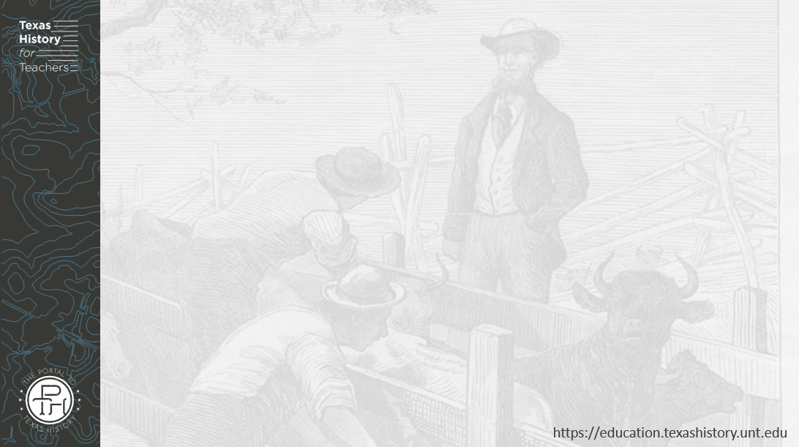
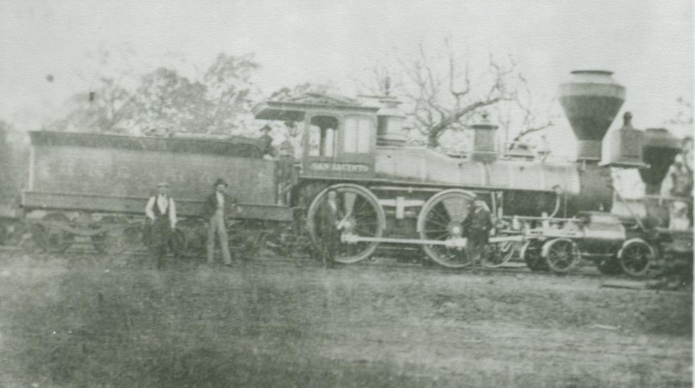
Origins of the Railroad Commission
A railroad in Longview, Texas. 1870.
The Portal to Texas History.
Notes:
[Railroads in Longview], photograph, 1870~; (https://texashistory.unt.edu/ark:/67531/metapth191279/: accessed November 14, 2025), University of North Texas Libraries, The Portal to Texas History, https://texashistory.unt.edu; crediting Longview Public Library.

Slide 8
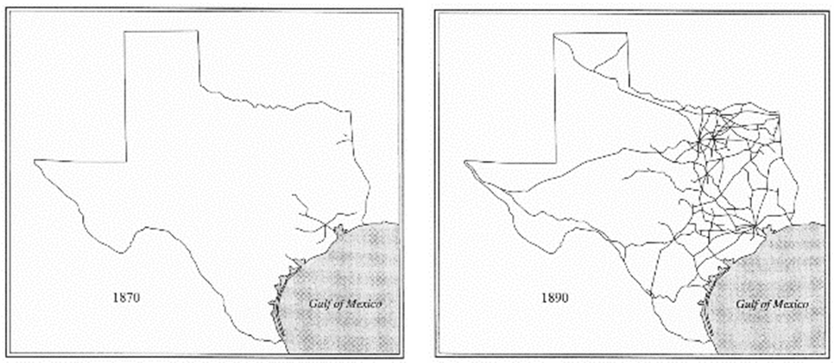
The Growth of Railroads in Texas
Notes:
Taken from Texas History for Teachers legacy materials.

Slide 9
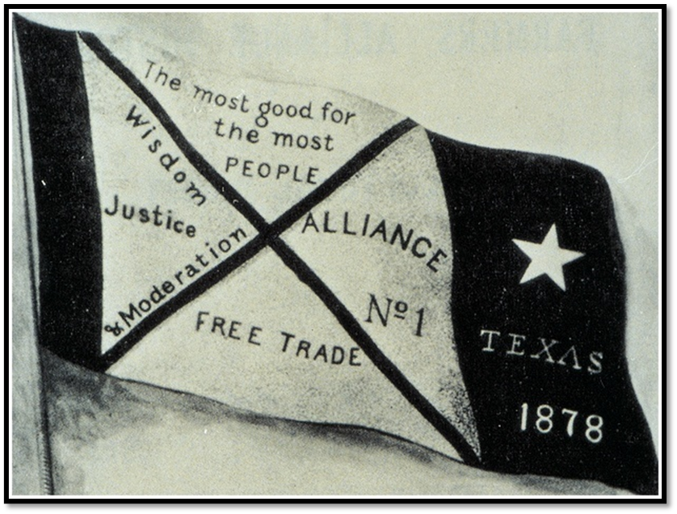
Farmers Organize and Get Involved
The Farmers Alliance Banner
Notes:
First flag of the Farmer’s Alliance. From Dunning (ed.), Farmers' Alliance History and Agricultural Digest. (Washington, DC: Alliance Publishing Co., 1891); pg. iv.; Digitally edited for Wikipedia by Tim Davenport ("Carrite"), no copyright claimed, file released to the public domain without restriction. https://en.wikipedia.org/wiki/File%3AFarmers-Alliance-Banner.jpg

Slide 10
Part II: Comprehension Questions

Slide 11
Exit Ticket
Follow the directions to complete your exit ticket
Read and answer each True or False statement.
Correct the wrong information in the False statements.
Discuss with a partner

Slide 12
Share with the class 2
(Choose one statement and read it) This statement is True / False.
I corrected the false information in this statement by writing _______

