Slide 1
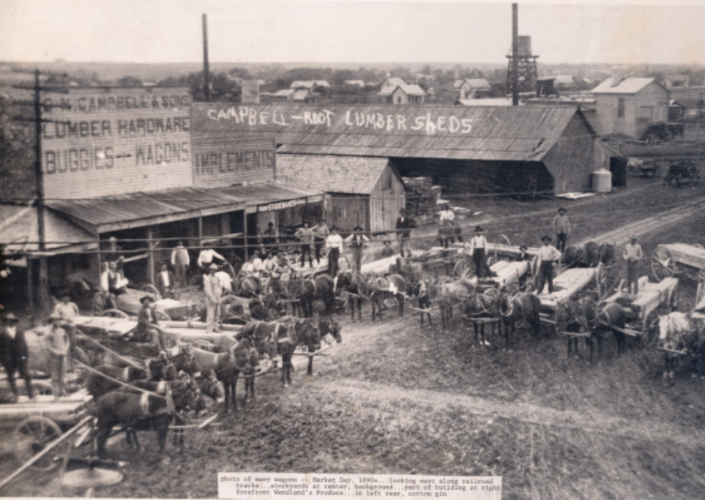
Unit 10: Cotton, Cattle, & Railroads
Lesson 1:
The Big Picture
Market day in Killeen, TX. 1890s
The Portal to Texas History
Notes:
[Many wagons on a market day in Killeen], photograph, 1890~/1899~; (https://texashistory.unt.edu/ark:/67531/metapth12939/: accessed November 5, 2025), University of North Texas Libraries, The Portal to Texas History, https://texashistory.unt.edu; crediting Killeen City Library System.

Slide 2




Warm-up Follow the directions to complete your warm-up
Consider the events of our last unit.
Circle or highlight UP TO 6 statements that you think are probably true as we begin this new unit.
Discuss with a partner

Slide 3

Share with the class
One thing that I think was probably true for Texas and the U.S. as we begin this unit is that ______________

Slide 4

Essential Question
What were the major events and defining characteristics of the Cotton, Cattle, and Railroads era of Texas history?

Slide 5

In today’s lesson…
We will examine the major events and defining characteristics of the era of Cotton, Cattle, and Railroads.
I will analyze a primary source image, read a passage presenting the main ideas of the unit, and explain the causes and effects of four key events that occurred during this era.

Slide 6
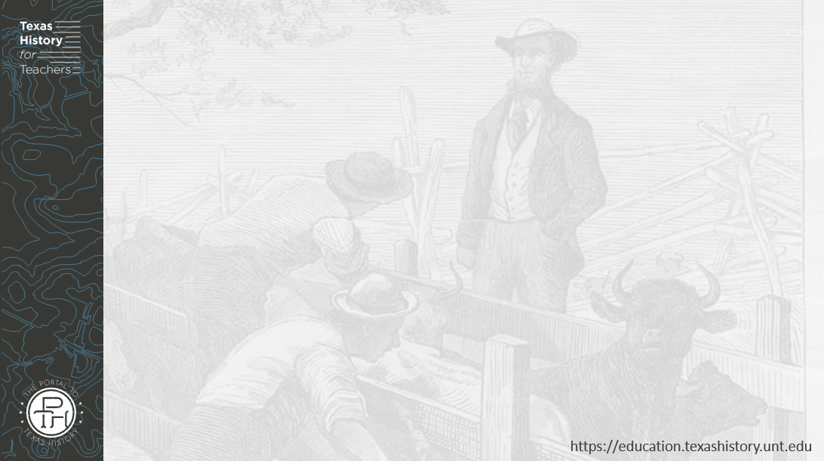
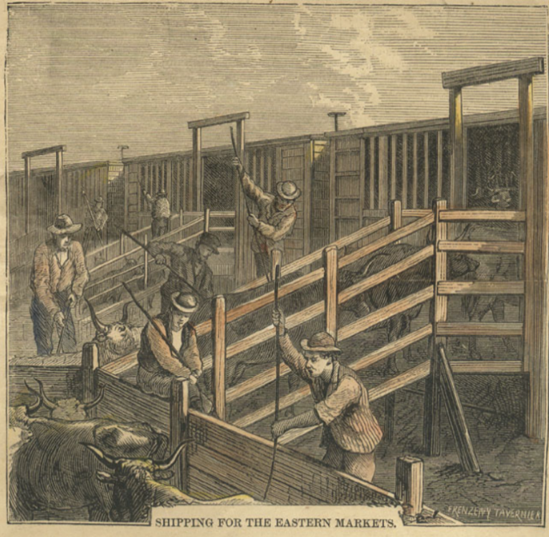
Part I: Analyze an Image
"The Texas Cattle Trade" Harper's Weekly, May 2, 1874.
The Portal to Texas History
Notes:
[Print from Harper's Weekly, May 2, 1874. "The Texas Cattle Trade"], artwork, May 2, 1874; (https://texashistory.unt.edu/ark:/67531/metapth7161/: accessed November 4, 2025), University of North Texas Libraries, The Portal to Texas History, https://texashistory.unt.edu; crediting George Ranch Historical Park.

Slide 7

Part II: Essential Ideas Reading Passage

Slide 8
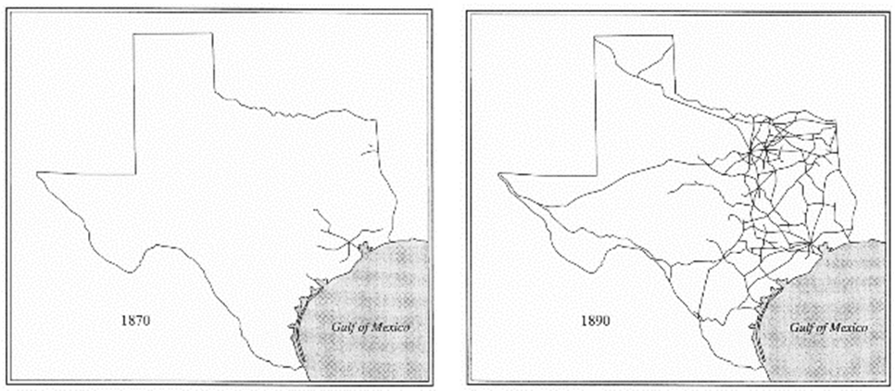
Paragraph I: The Population of Texas Grew
The expansion of railroads in Texas from 1870 to 1890

Slide 9
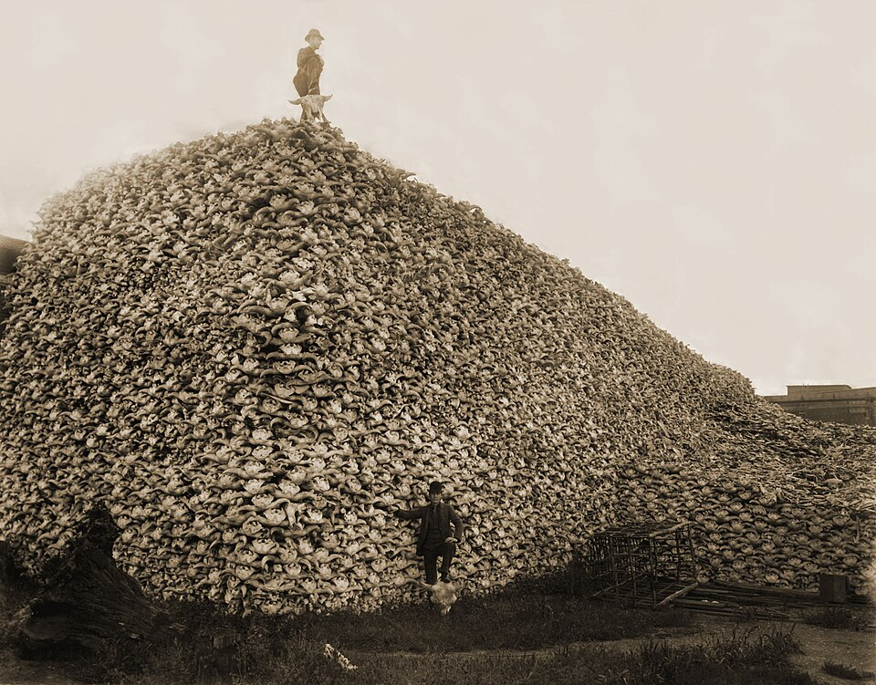
Paragraph 2: The Texas Plains
An enormous pile of buffalo skulls due to the overhunting of buffalo on the Plains, 1892.
Burton Historical Collection, Detroit Public Library
Notes:
Photograph 1892 of a pile of American bison skulls waiting to be ground for fertilizer. 1892. Burton Historical Collection, Detroit Public Library. This is a retouched picture, which means that it has been digitally altered from its original version. Modifications: restored. The original can be viewed here: Bison skull pile.jpg: . Modifications made by PawełMM. This media file is in the public domain in the United States. This applies to U.S. works where the copyright has expired, often because its first publication occurred prior to January 1, 1930, and if not then due to lack of notice or renewal. See this page for further explanation. https://commons.wikimedia.org/wiki/File:Bison_skull_pile-restored.jpg

Slide 10
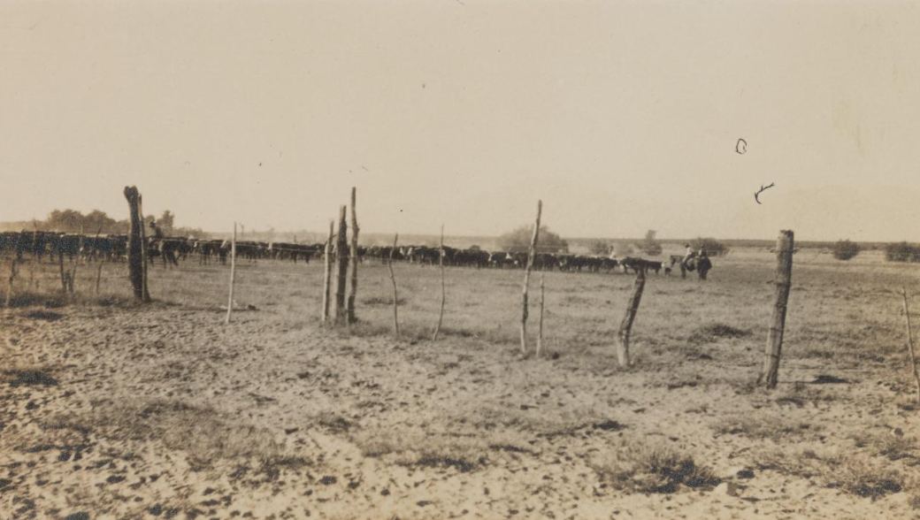
Paragraph 3: The Cattle Industry
A large herd of cattle on a west Texas ranch fenced in with barbed wire, 1918. The Portal to Texas History
Notes:
[Cattle Drive On Ranch, 1918], photograph, 1918; (https://texashistory.unt.edu/ark:/67531/metapth1125927/: accessed November 4, 2025), University of North Texas Libraries, The Portal to Texas History, https://texashistory.unt.edu; crediting Hardin-Simmons University Library.

Slide 11
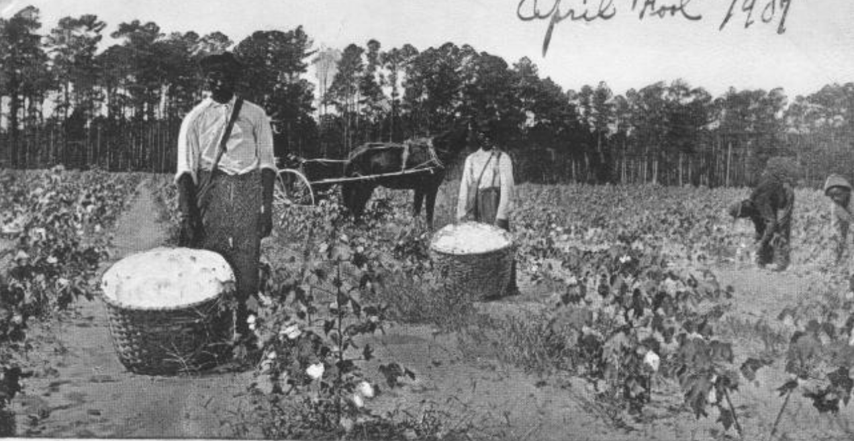
Paragraph 4: Cotton Farming in Texas
Cotton farmers near Galveston, 1907.
The Portal to Texas History
Notes:
[Men in a Cotton Field], postcard, April 1, 1907; (https://texashistory.unt.edu/ark:/67531/metapth784/: accessed November 19, 2025), University of North Texas Libraries, The Portal to Texas History, https://texashistory.unt.edu; crediting Fort Bend Museum.

Slide 12
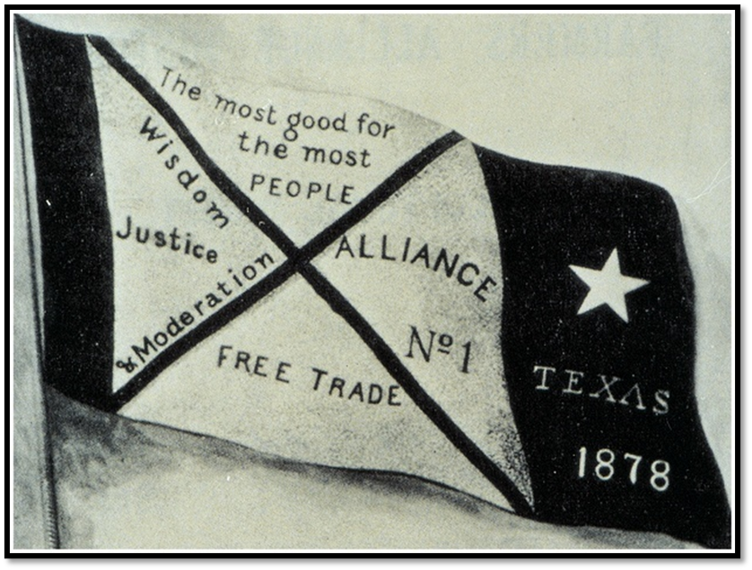
Paragraph 5: Farmers Organize
Farmer’s Alliance Banner
Notes:
Farmer’s Alliance Banner. From Dunning (ed.), Farmers' Alliance History and Agricultural Digest. (Washington, DC: Alliance Publishing Co., 1891); pg. iv.; Digitally edited for Wikipedia by Tim Davenport ("Carrite"), no copyright claimed, file released to the public domain without restriction. Accessed on 11/18/25. File:Farmers-Alliance-Banner.jpg - Wikipedia

Slide 13
Part III: Cause and Effect

Slide 14
Exit Ticket Follow the directions to complete your exit ticket
Answer the question by choosing THREE answer options that best demonstrate key defining characteristics of this era.
Discuss with a partner

Slide 15
Share with the class 2
One of the defining characteristics of the age of Cotton, Cattle, and Railroads is ___________

