Slide 1
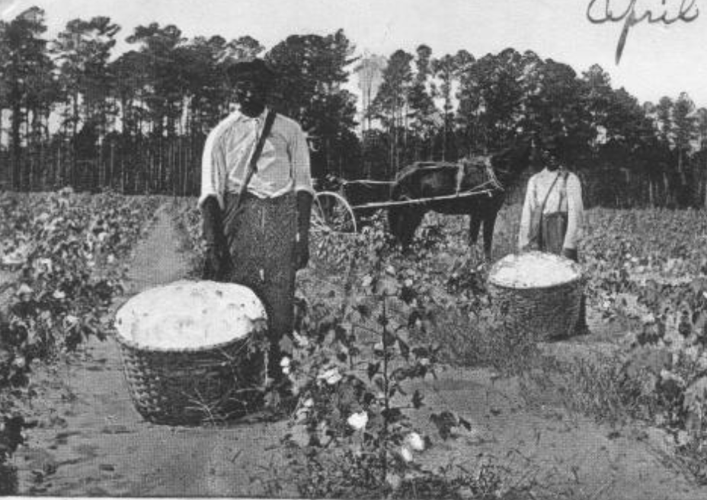
Unit 10: Cotton, Cattle & Railroads
Lesson 8:
The Problem with Cotton
Men on a cotton farm
The Portal to Texas History
Notes:
[Men in a Cotton Field], postcard, April 1, 1907; (https://texashistory.unt.edu/ark:/67531/metapth784/: accessed November 13, 2025), University of North Texas Libraries, The Portal to Texas History, https://texashistory.unt.edu; crediting Fort Bend Museum.

Slide 2




Warm-up Follow the directions to complete your warm-up
Read the primary source excerpt on your warm-up.
Respond to the question based on the excerpt.
Discuss with a partner

Slide 3

Share with the class
The author’s opinion of farmers and their role in the government is that ____________

Slide 4

Essential Question
What were the primary challenges facing farmers in Texas, and how did farmers work to address their concerns?

Slide 5

In today’s lesson…
We will identify the key challenges facing farmers in Texas in the late 19th century and examine how farmers attempted to address their concerns.
I will complete my guided notes worksheet, responding to questions about each topic.

Slide 6

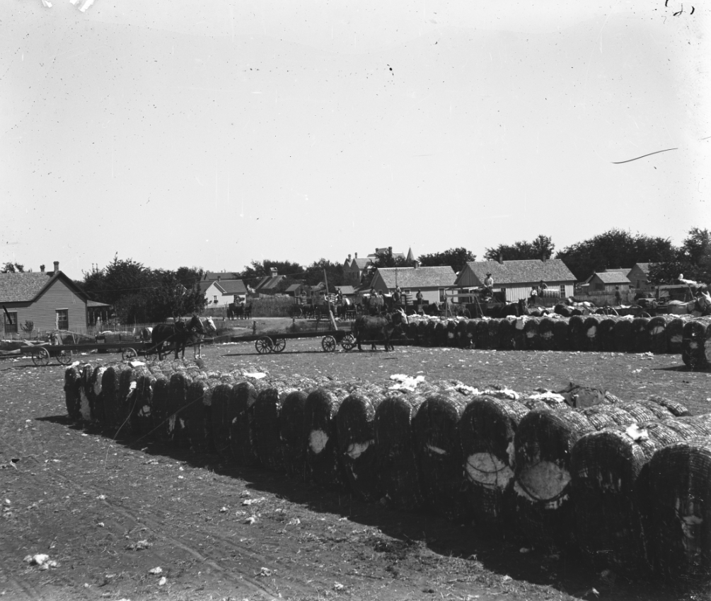
The Problem with Cotton, 1870 - 1900
Cotton prices fell steadily
Farmers received less money for their crop.
Farmers grew MUCH MORE cotton to try to make up for lost profits.
Too much cotton flooded the market, causing prices to drop lower.
Cotton bales in Bosque County,
south of Fort Worth.
The Portal to Texas History.
Notes:
[Cotton bales]. 1900-10. Photograph. University of North Texas Libraries, The Portal to Texas History; crediting Bosque County Historical Commission. https://texashistory.unt.edu/ark:/67531/metapth26999/.

Slide 7
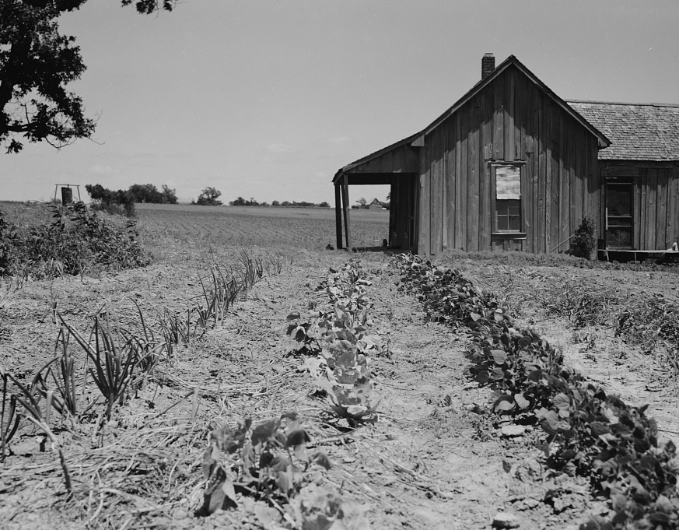
Effects of Falling Cotton Prices
Many farmers could not afford supplies, equipment, shipping, or property costs.
Farmers often borrowed to pay for expenses, causing many to go into debt.
30,000 farmers turned to tenant farming during this period.
By 1890, 42% of all Texas farms worked by tenants.
Tenant farmer house in Ellis County Texas
The Library of Congress
Notes:
Lange, Dorothea, photographer. House of ex-tenant farmer now on relief. Ellis County, Texas. Ellis County Texas United States, 1937. June. Photograph. https://www.loc.gov/item/2017770114/.

Slide 8

Farmers Organize

Slide 9
The Grange
What:
Platform:
Established 1867 by the U.S. Dept. of Agriculture to support struggling farmers.
1873 – First Texas chapter established in Salado.
Limit government spending and taxes.
Government regulation of railroad rates
Establish non-profit cooperative groups to sell crops for farmers without a fee.

Slide 10
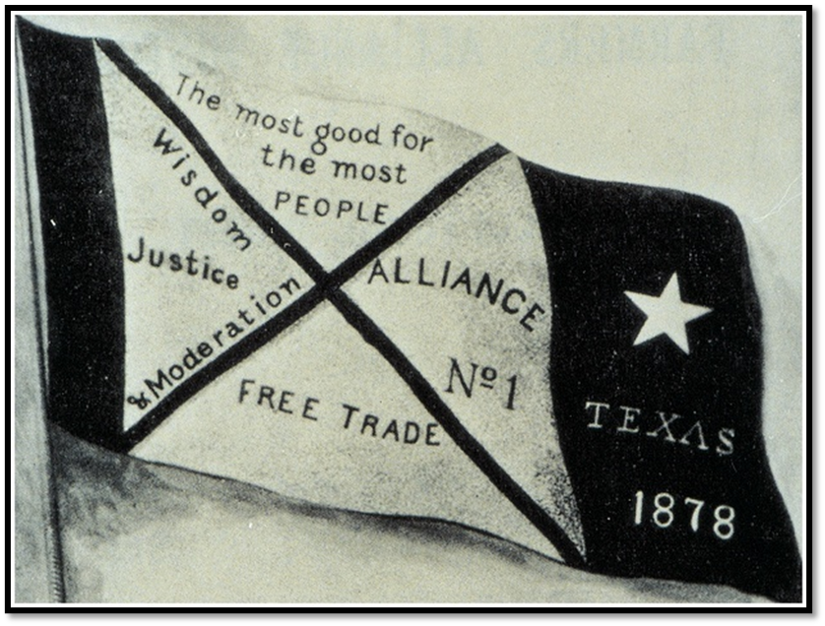
The Farmer’s Alliance
What:
Established 1876 in Lampasas, TX to support struggling farmers.
The Farmer’s Alliance Banner
Notes:
From Dunning (ed.), Farmers' Alliance History and Agricultural Digest. (Washington, DC: Alliance Publishing Co., 1891); pg. iv.; Digitally edited for Wikipedia by Tim Davenport ("Carrite"), no copyright claimed, file released to the public domain without restriction. https://en.wikipedia.org/wiki/File:Farmers-Alliance-Banner.jpg#file

Slide 11
The Farmer’s Alliance Platform
Establish non-profit cooperative groups to sell crops for farmers without a fee.
Government regulation of railroad rates
Abandon the gold standard and include “Free Silver” to expand the money supply.
Subtreasury Plan: Government should establish warehouses to store surplus cotton to prevent flooding the market.
Notes:
From Dunning (ed.), Farmers' Alliance History and Agricultural Digest. (Washington, DC: Alliance Publishing Co., 1891); pg. iv.; Digitally edited for Wikipedia by Tim Davenport ("Carrite"), no copyright claimed, file released to the public domain without restriction. https://en.wikipedia.org/wiki/File:Farmers-Alliance-Banner.jpg#file

Slide 12
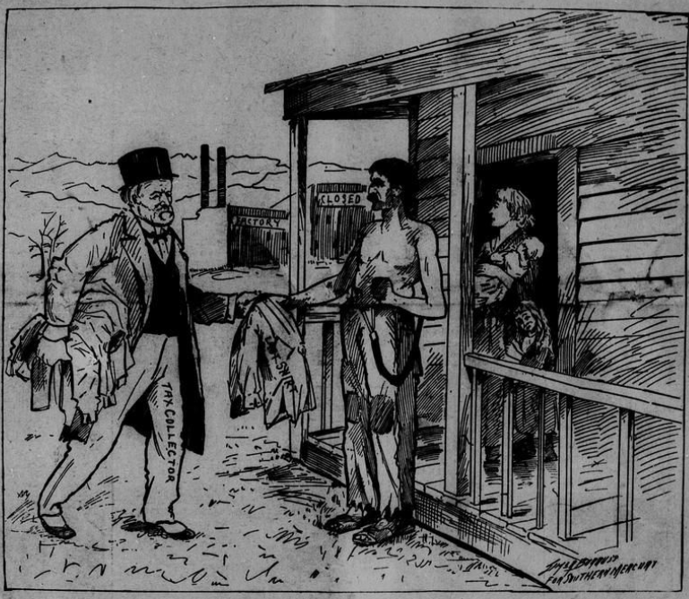
The Populist Party
Officially established in Omaha, Nebraska, 1892.
“The People’s Party”
Formed to support laborers across the U.S.
“Taking the last shirt off the back of the laboring man.”
The Southern Mercury, July 9, 1896.
The Portal to Texas History.
Notes:
Park, Milton. The Southern Mercury. (Dallas, Tex.), Vol. 15, No. 28, Ed. 1 Thursday, July 9, 1896, newspaper, July 9, 1896; Dallas, Texas. (https://texashistory.unt.edu/ark:/67531/metapth185667/: accessed November 13, 2025), University of North Texas Libraries, The Portal to Texas History, https://texashistory.unt.edu; .

Slide 13
The Populist Party Platform
Abolish national banks
Establish an income tax which taxes wealthier people at a higher rate than poorer people.
Direct election of senators.
Government control of transportation and communication companies.
“Free Silver” – abandon gold standard.
Government regulation of the economy.

Slide 14

Effects of Labor Organizing
Labor organizations were short-lived and never as strong as existing political parties, BUT . . .
They highlighted issues important to farmers and laborers
They encouraged the creation of the Texas Railroad Commission to regulate railroads.
“The Gift of the Grangers”
The Library of Congress
Notes:
Strobridge & Co. Lith. Gift for the grangers / J. Hale Powers & Co. Fraternity & Fine Art Publishers, Cin'ti. ; Strobridge & Co. Lith. Cincinnati, O. , ca. 1873. Cincinnati, O.: J. Hale Powers & Co. Photograph. https://www.loc.gov/item/96512563/.

Slide 15
Exit Ticket Follow the directions to complete your exit ticket
Read the secondary source excerpt in your exit ticket.
Respond to the question based on the excerpt.
Discuss with a partner

Slide 16
Share with the class 2
One thing we can learn about the Populist Party based on the excerpt is _______________

