Slide 1
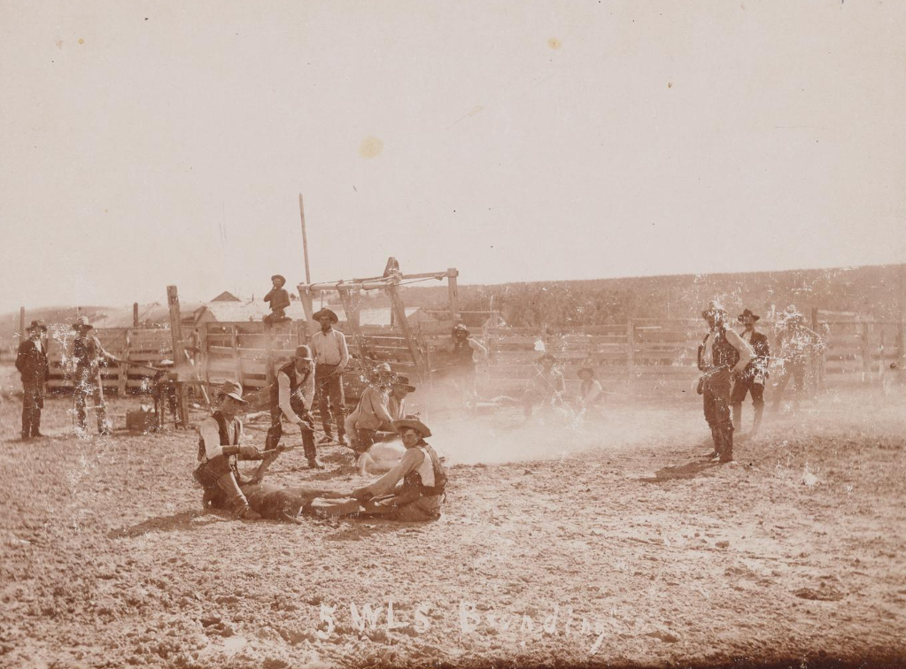
Unit 10:
Cotton, Cattle, & Railroads
Lesson 3:
Vocabulary
Cattle branding at the Five Wells Ranch. The Portal to Texas History
Notes:
[Cattle Branding at Five Wells], photograph, 1889; (https://texashistory.unt.edu/ark:/67531/metapth1637090/: accessed November 4, 2025), University of North Texas Libraries, The Portal to Texas History, https://texashistory.unt.edu; crediting Midland Historical Society.

Slide 2




Warm-up:
Follow the directions to complete your warm-up
Reach each term in the chart on your warm-up.
Complete the chart based on your prior knowledge of each term.
Share with a partner.

Slide 3

Share with the class
One vocabulary term we will learn in this unit is ______.
(Read your chosen response for this term)

Slide 4

Essential Question
What are the key terms we need to know to understand the era of Cotton, Cattle, and Railroads, and what is the meaning of these terms in the context of our unit?

Slide 5
In today’s lesson…
We will identify, define, and exemplify the key terms of the Cotton, Cattle, and Railroads era.
I will use the information and context of several short passages to identify and record the definition of each term and provide examples of the term in the context of our unit.

Slide 6
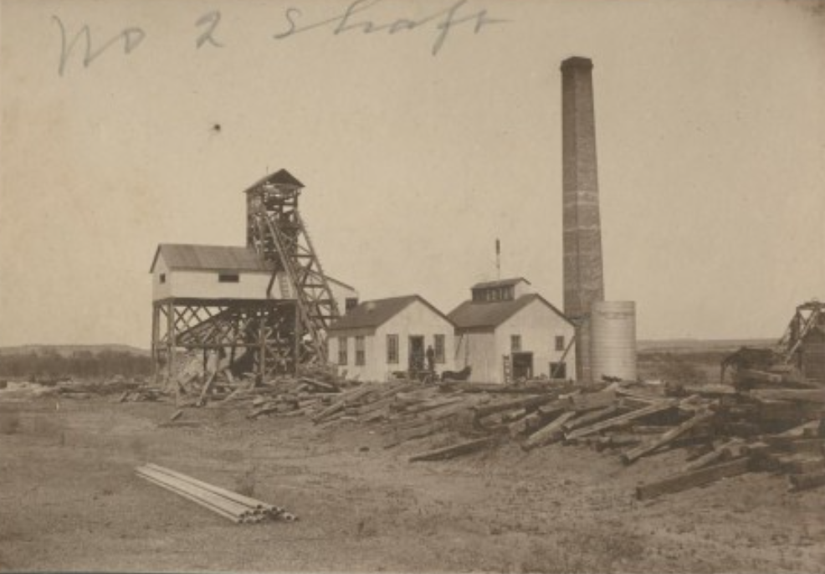
Industrialization (n)
The end of the 19th century was a period of rapid development and advancements throughout the United States. One significant development was an expansion of industry, or the processing of raw materials into manufactured goods.
When a country grows and develops its industries on a large scale, that is called industrialization. In Texas, for example, the forests of the eastern Piney Woods allowed for the growth of the lumber industry in the state. The vast grasslands of the Great Plains region and the abundance of cattle gave rise to the establishment of ranches for the beef industry. Texas’s industrial growth allowed the state to develop rapidly during this era.
A coal mine in Lyra, Texas, west of Fort Worth.
The Portal to Texas History
Notes:
[Number 2 Coal Shaft in Lyra, Texas], photograph, 1900~; (https://texashistory.unt.edu/ark:/67531/metapth427147/: accessed November 5, 2025), University of North Texas Libraries, The Portal to Texas History, https://texashistory.unt.edu; crediting Palo Pinto County Historical Association.

Slide 7
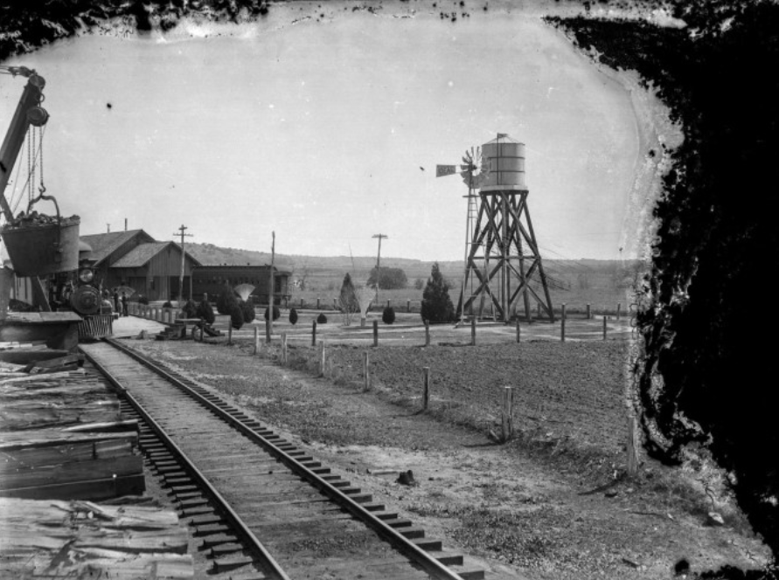
Innovation (n)
During the period of industrialization in the U.S., people created new inventions and made improvements on existing materials. People were creating and introducing many new ideas, methods for doing things, and products. This is known as innovation.
Innovations in transportation included the expansion of railroads which allowed people and goods to travel more quickly over long distances.
Innovations like windmills allowed farmers and ranchers in more arid regions like the Great Plains to pump water to their crops and livestock. Another innovation was barbed wire, which allowed ranchers to cheaply fence in their property to protect their land, livestock, and water resources.
A railroad depot with a water tower and windmill in the background.
The Portal to Texas History.
Notes:
Boone, Alanson D. [Fairland Depot], photograph, 1900~; (https://texashistory.unt.edu/ark:/67531/metapth1029570/: accessed November 5, 2025), University of North Texas Libraries, The Portal to Texas History, https://texashistory.unt.edu; crediting Austin History Center, Austin Public Library.

Slide 8
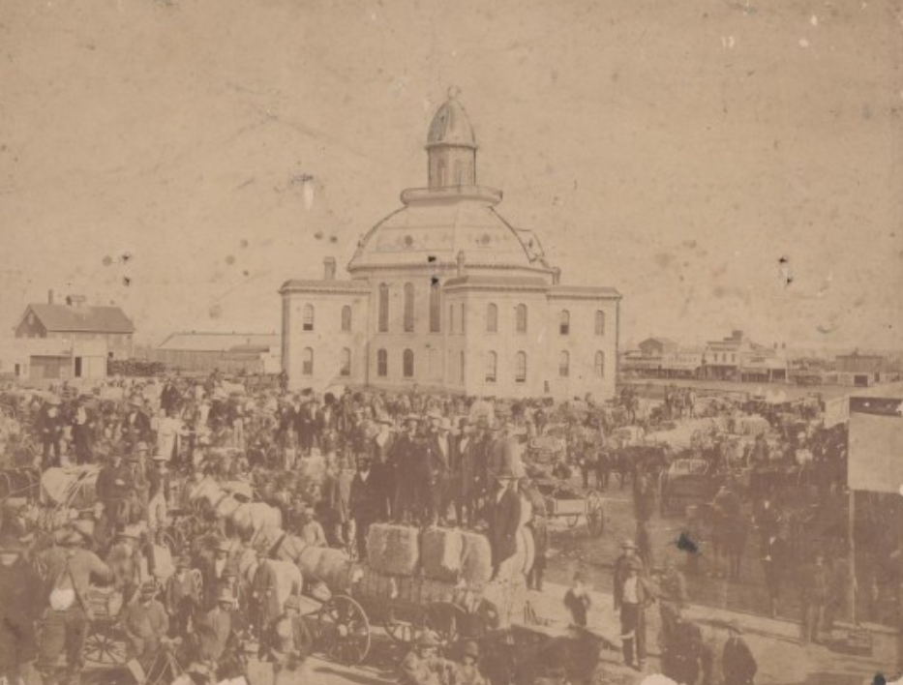
Urbanization (n)
Today, Texas has many large cities. Approximately 85% of Texans now live in urban areas, or cities. In fact, Houston is the fourth largest city in the whole United States!
This was not always the case. For most of Texas’s history, the majority of Texans lived in rural areas in the countryside. At the end of the 19th century, the population of Texas increased rapidly, and some people began moving from the countryside into the cities in a process called urbanization.
Although Texas was becoming urbanized, during this era 83% of Texans still lived in rural eras.
Tarrant County courthouse and public square, 1879.
The Portal to Texas History
Notes:
Tarrant County Courthouse and Public Square in 1879, photograph, 1879; (https://texashistory.unt.edu/ark:/67531/metapth41391/: accessed November 5, 2025), University of North Texas Libraries, The Portal to Texas History, https://texashistory.unt.edu; crediting University of Texas at Arlington Library.

Slide 9
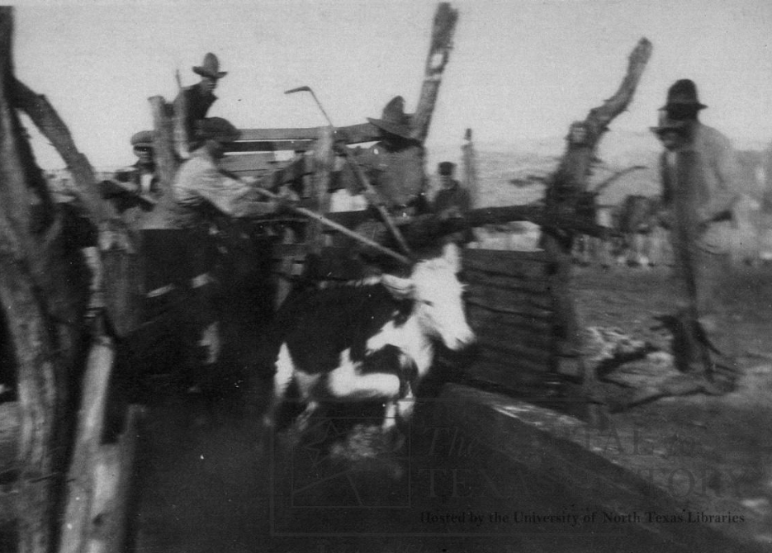
A ranch (n)
After the Civil War and Reconstruction, demand for beef was high in Northern states, where cattle were not as abundant. A cow bought in Texas for $4.00 could sell in New York for nearly $40.00!
As a result, the Texas cattle industry developed rapidly during this era. At first, cowboys drove herds of cattle to Northern states. Later, large ranches were established to raise cattle to then be transported by trains to Northern markets.
A ranch is a type of large farm where cattle and livestock are raised. Mega ranches like the XIT ranch and the King ranch came to dominate the cattle industry in Texas during this era.
Cowboys at the J.M. Keuhn Ranch treating cattle for ticks, which carried the “Texas Fever.”
The Portal to Texas History
Notes:
Ranching, photograph, 1900~; (https://texashistory.unt.edu/ark:/67531/metapth16517/: accessed November 4, 2025), University of North Texas Libraries, The Portal to Texas History, https://texashistory.unt.edu; crediting Clay County Historical Society.

Slide 10
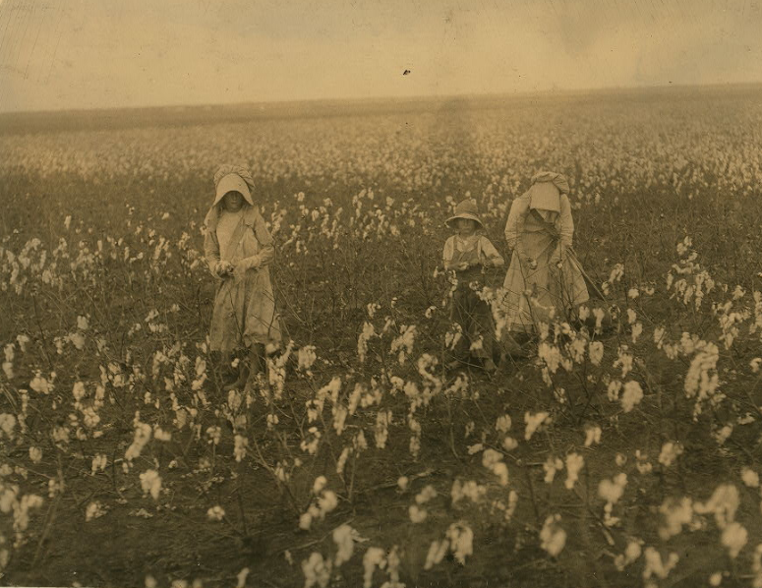
Tenant Farming (n, v)
Despite the growth of cities with urbanization and the rise in ranching, most Texans still lived in the countryside and worked as farmers. Poorer farmers who could not afford to buy their own land often became tenant farmers, or farmers who rented the land from a landowner and paid rent in cash or a portion of their crops.
Tenant farming is similar to sharecropping, however sharecroppers work other people’s land for a share of the crop profit and have very little control over their work.
Both tenant farming and sharecropping often led farmers into cycles of debt and poverty that left many farmers incredibly dissatisfied and eager to address the challenges they faced.
Young children of an immigrant family picking cotton near Houston.
Library of Congress
Notes:
Hine, Lewis Wickes. Eddie Marek a six year old cotton picker who picks fifty pounds a day. His sister eighteen years old picks one hundred pounds. Father and mother and some negroes also pick. A frugal Bohemian family. Own the farm of two hundred acres near Houston.Location: Houston vicinity, Texas. October 1913. Photograph. Library of Congress Prints and Photographs Division. https://www.loc.gov/item/2018677601/.

Slide 11
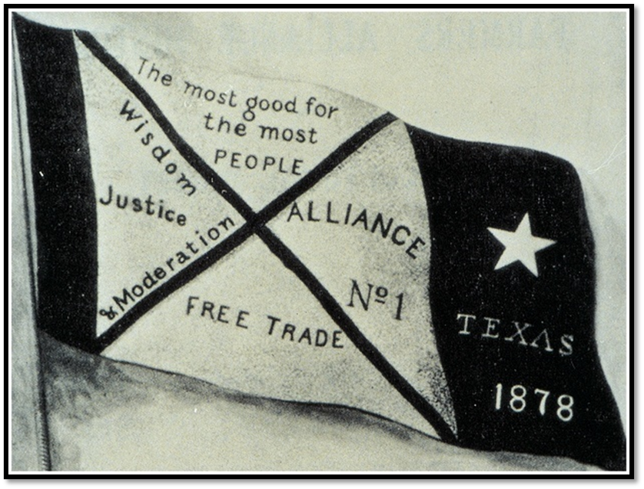
To reform (v)
The end of the 19th century was a difficult time for many farmers and other laborers. Falling cotton prices meant that cotton farmers received very little profit from the sale of their cotton. Often, this led cotton farmers into cycles of debt as tenant farmers or sharecroppers.
Farmers and other laborers who were frustrated with the economic challenges they faced began to form organizations to reform, or make changes to improve, their situation.
Organizations like the Farmer’s Alliance and a new political organization called the Populist Party wanted reforms in railroad pricing, banking, and taxes to improve the lives of farmers and laborers in the U.S.
The Populist Movement Banner
Notes:
The Populist Movement Banner. American Yawp. Located at: http://www.americanyawp.com/index.html. Project: American Yawp. License: CC BY-SA: Attribution-ShareAlike

Slide 12
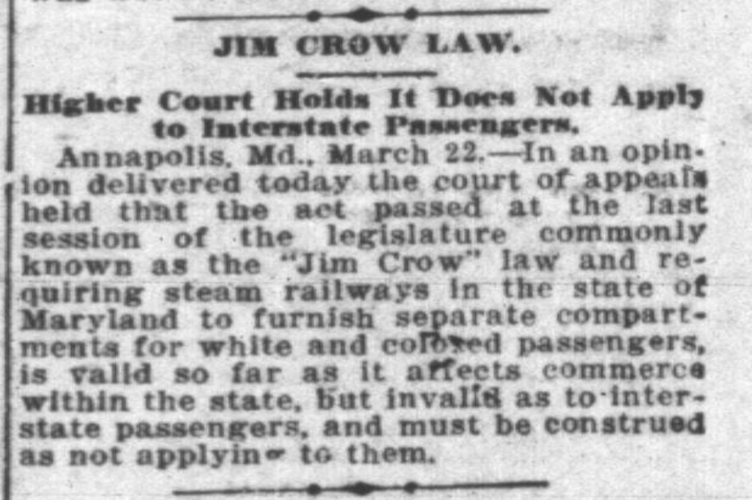
Segregation (n)
During this era, Southern state legislatures began to pass laws to restrict the rights and activities of Black Southerners. These laws were known as “Jim Crow Laws.”
Many of these laws called for the segregation of Black citizens. Segregation was a separation of white and Black people in public spaces. One law required segregated railroad cars, which meant Black citizens were prohibited from riding in cars with white passengers.
During this era, segregation due to “Jim Crow Laws” spread through the South.
The Fort Worth Record and Register, March 23, 1905.
The Portal to Texas History
Notes:
The Fort Worth Record and Register (Fort Worth, Tex.), Vol. 9, No. 159, Ed. 1 Thursday, March 23, 1905, newspaper, March 23, 1905; Fort Worth, Texas. (https://texashistory.unt.edu/ark:/67531/metapth1494494/: accessed November 7, 2025), University of North Texas Libraries, The Portal to Texas History, https://texashistory.unt.edu;

Slide 13

Exit Ticket:
Follow the directions to complete your exit ticket
Choose THREE terms from the graphic organizer that you think BEST relate to our unit.
Complete the sentence stem provided.
Share with a partner.

Slide 14
Share with the class 2
One term I chose was ___________.
I think this term relates to our unit because ______

