Slide 1
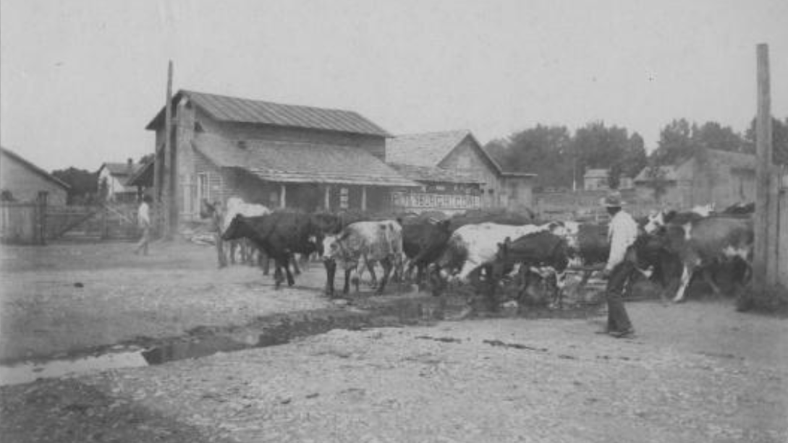
Unit 10:
Cotton, Cattle, & Railroads
Lesson 4:
What’s the story?
Two men herding cattle down a street, August 14, 1897
The Portal to Texas History
Notes:
[Two men herding cattle down a street], photograph, August 14, 1897; (https://texashistory.unt.edu/ark:/67531/metapth8867/: accessed November 4, 2025), University of North Texas Libraries, The Portal to Texas History, https://texashistory.unt.edu; crediting George Ranch Historical Park.

Slide 2




Warm-up:
Follow the directions to complete your warm-up
Read the three newspaper headlines in your graphic organizer.
Write at least ONE piece of information you would expect to find in each article based on its headline.
Share with a partner.

Slide 3

Share with the class
In the article titled, “________” I would expect to read ______

Slide 4

Essential Question
What were the most significant events of Cotton, Cattle, & Railroads? What were the details, causes, and effects of each event?

Slide 5
In today’s lesson…
We will examine six primary topics and themes in Cotton, Cattle, & Railroads to identify the major events that shaped the era in the United States and Texas.
I will read six short passages about key events to determine the dates, primary details, and significance of key events that occurred during Cotton, Cattle, & Railroads.

Slide 6
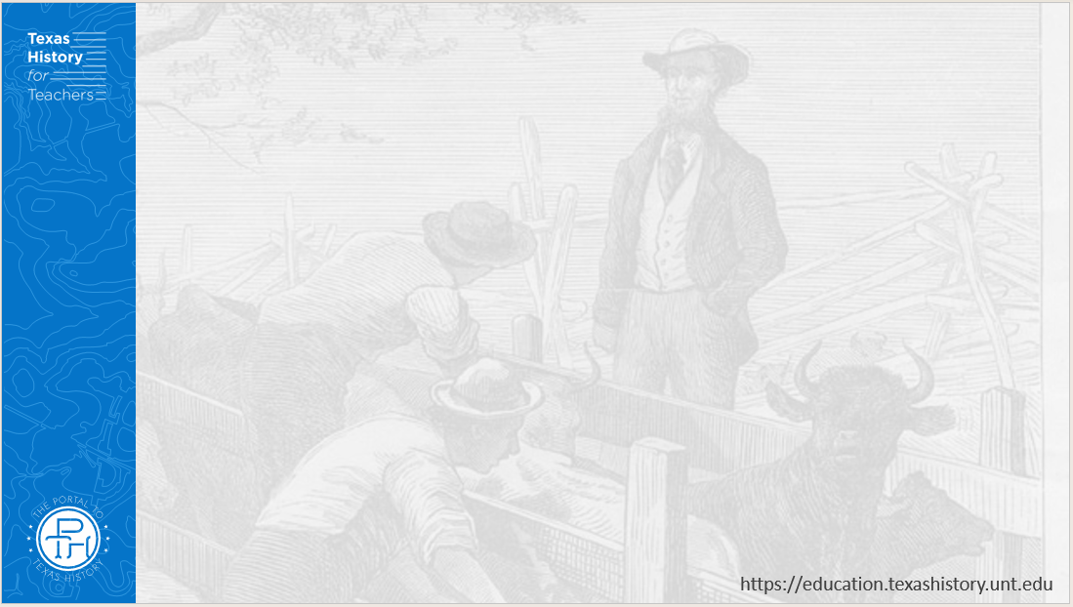
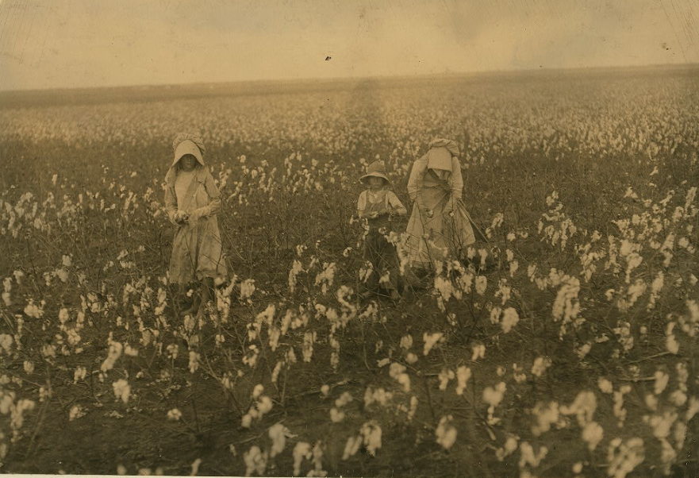
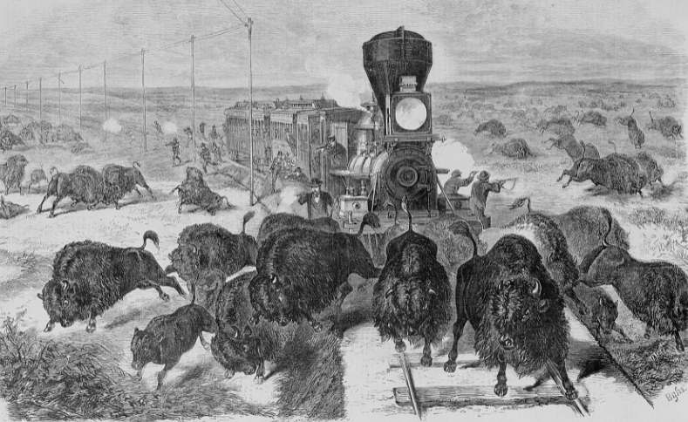
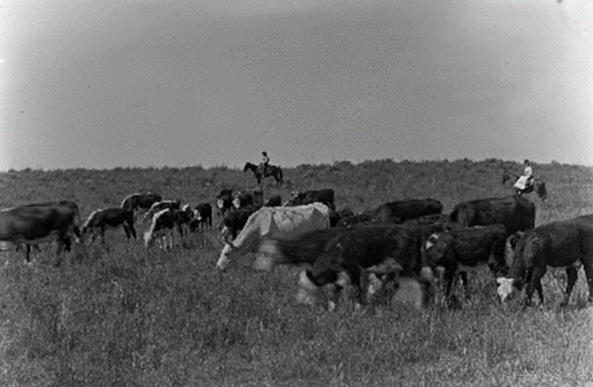
1) An Era of Growth and Change 1870 - 1900
Children picking cotton in a field near Houston.
The Library of Congress
Shooting Buffalo from a train
The Library of Congress
Cattle grazing
The Portal to Texas History
Notes:
Hine, Lewis Wickes, photographer. Eddie Marek a six year old cotton picker who picks fifty pounds a day. His sister eighteen years old picks one hundred pounds. Father and mother and some negroes also pick. A frugal Bohemian family. Own the farm of two hundred acres near Houston.Location: Houston vicinity, Texas. Texas Houston United States, 1913. October. Photograph. https://www.loc.gov/item/2018677601/.
Image Credit: Mugg, Kilo. [Cattle Grazing], photograph, Date Unknown; (https://texashistory.unt.edu/ark:/67531/metapth129765/: accessed April 28, 2024), University of North Texas Libraries, The Portal to Texas History, https://texashistory.unt.edu; crediting Wolf Creek Heritage Museum.
The far west - shooting buffalo on the line of the Kansas-Pacific Railroad / Bghs. Great Plains, 1871. Photograph. https://www.loc.gov/item/2004669992/.

Slide 7
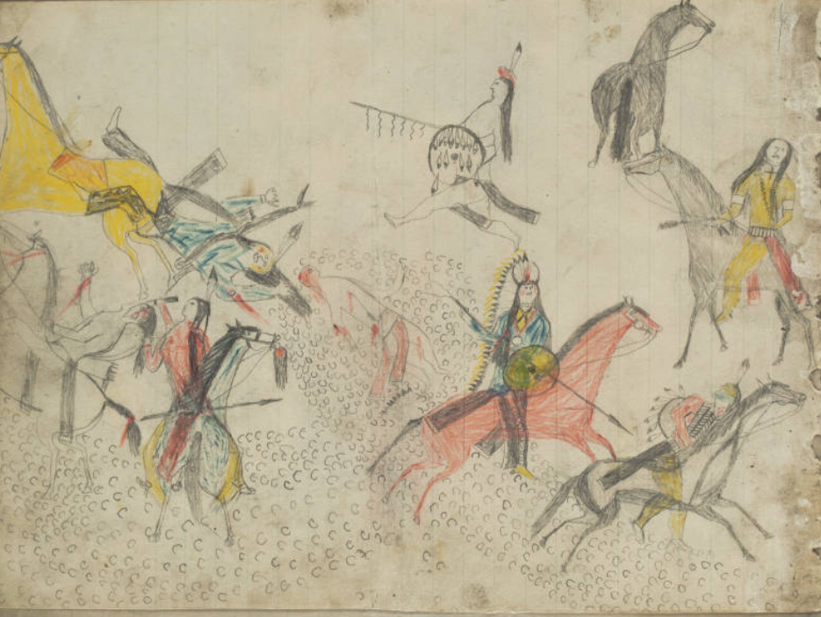
2) The End of Comanche Dominance of the Plains 1875
Kiowa drawings of conflicts on the Plains. 1880 – 1890
The Newberry Library
Notes:
Kiowa Ledger Drawings. Edward E. Ayer Digital Collection. Newberry Library. The Newberry makes its collections available for any lawful purpose, commercial or non-commercial, without licensing or permission fees to the library, subject to the following terms and conditions: https://www.newberry.org/rights-and-reproductions Accessed on 11/21/25 at https://collections.carli.illinois.edu/digital/collection/nby_eeayer/id/46856

Slide 8
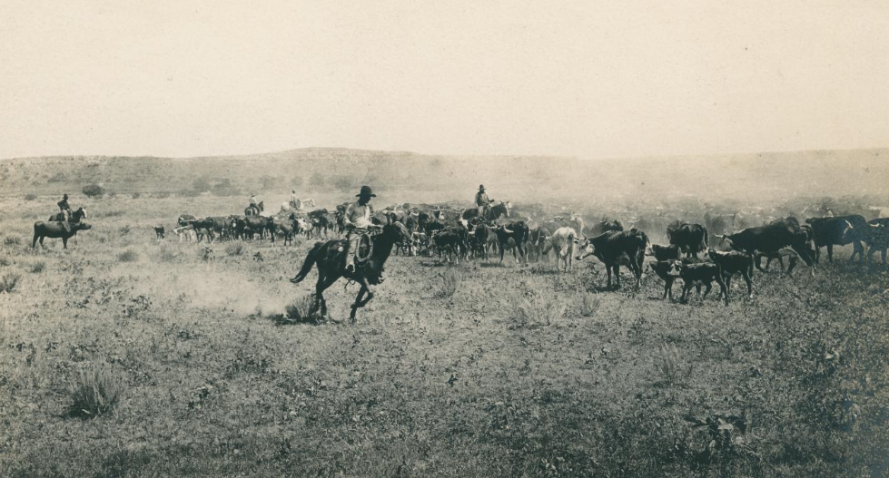
3) Cowboys and Cattle Drives 1860s - 1890
Cowboys herding cattle on a cattle drive, 1910.
The Portal to Texas History
Notes:
Smith, Erwin E. [Cowhands guiding a herd of cattle]. ca. 1910. Photograph. University of North Texas Libraries, The Portal to Texas History; crediting UNT Libraries Special Collections. https://texashistory.unt.edu/ark:/67531/metadc1151055/.

Slide 9
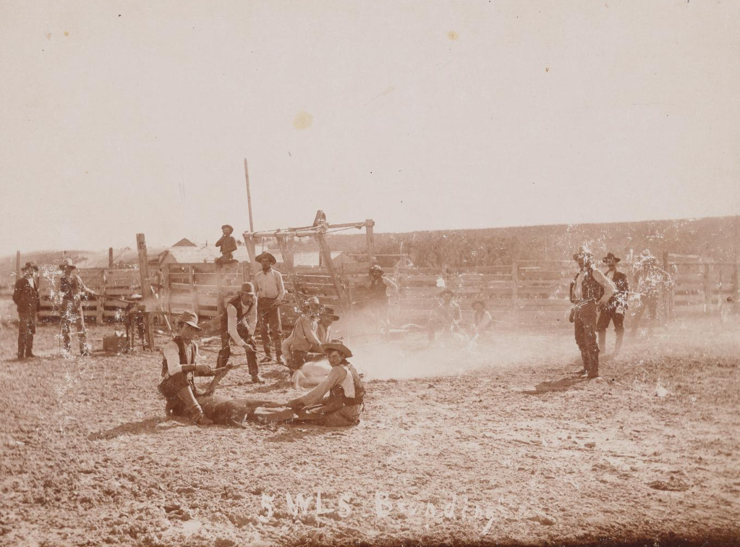
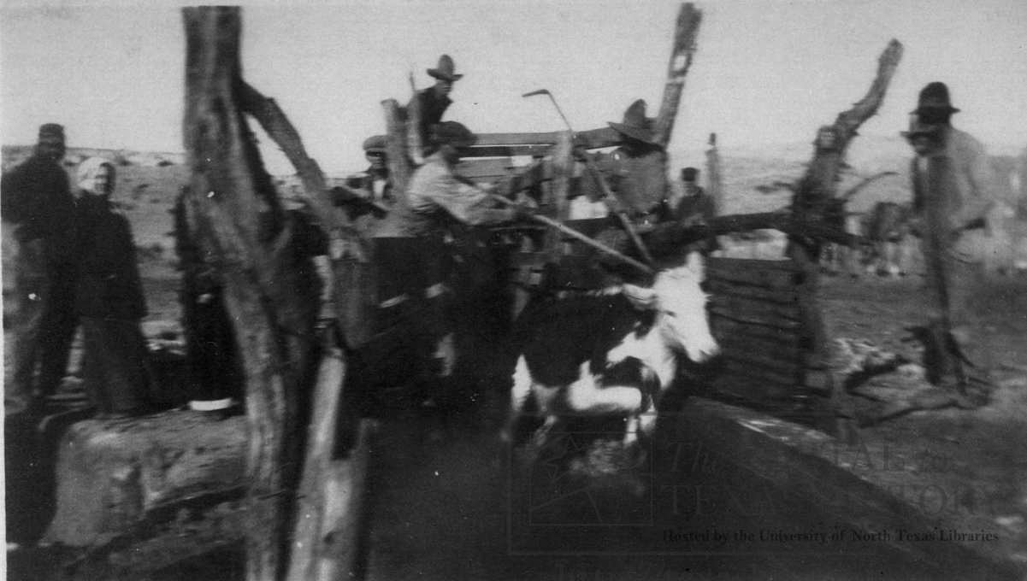
4) The Rise of Mega Ranches 1870s - 1900
Cowboys “dipping” cattle to treat them for disease at the J.M Keuhn ranch, 1900.
The Portal to Texas History
Cowboys branding cattle at the Five Wells ranch, 1889.
The Portal to Texas History
Notes:
[Cattle Branding at Five Wells], photograph, 1889; (https://texashistory.unt.edu/ark:/67531/metapth1637090/: accessed November 4, 2025), University of North Texas Libraries, The Portal to Texas History, https://texashistory.unt.edu; crediting Midland Historical Society.
Ranching, photograph, 1900~; (https://texashistory.unt.edu/ark:/67531/metapth16517/: accessed November 4, 2025), University of North Texas Libraries, The Portal to Texas History, https://texashistory.unt.edu; crediting Clay County Historical Society.

Slide 10
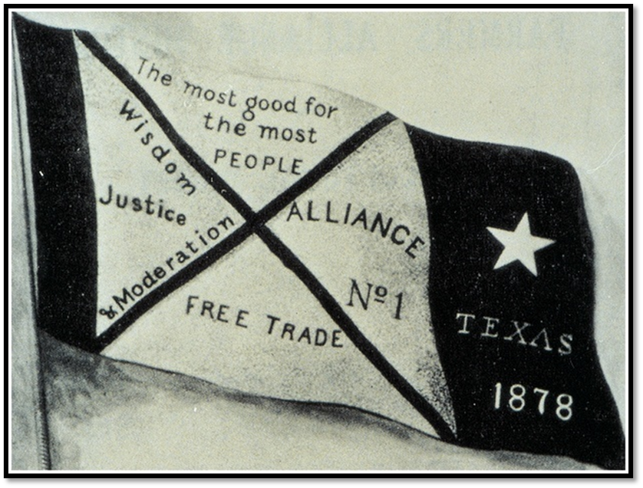
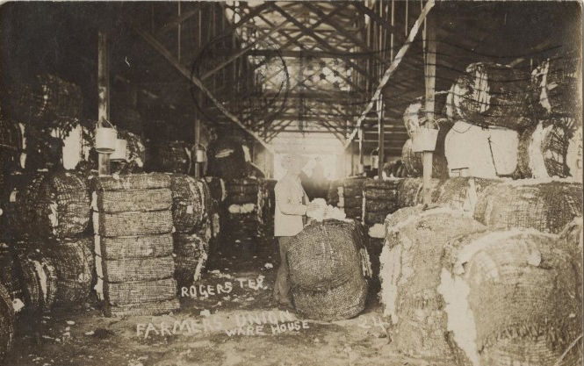
5) Farmers & Laborers Organize 1870s – 1890s
Banner of the Farmer’s Alliance
Farmer’s Union Warehouse, Rogers, TX 1907.
The Portal to Texas History
Notes:
Farmer’s Alliance Banner. From Dunning (ed.), Farmers' Alliance History and Agricultural Digest. (Washington, DC: Alliance Publishing Co., 1891); pg. iv.; Digitally edited for Wikipedia by Tim Davenport ("Carrite"), no copyright claimed, file released to the public domain without restriction. Accessed on 11/18/25. File:Farmers-Alliance-Banner.jpg - Wikipedia
[Postcard of Farmers Union Warehouse], postcard, January 24, 1907; (https://texashistory.unt.edu/ark:/67531/metapth743134/: accessed November 21, 2025), University of North Texas Libraries, The Portal to Texas History, https://texashistory.unt.edu; crediting Private Collection of T. B. Willis.

Slide 11
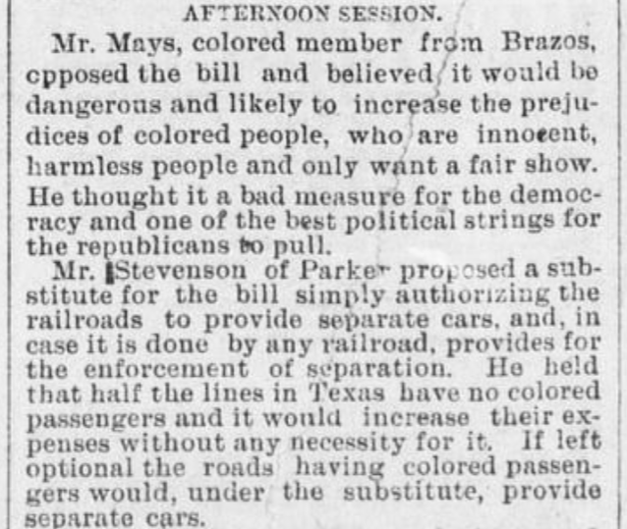
6) The Rise of Jim Crow in the South
1890s – 1960s
The Galveston Daily News. (Galveston, Tex.)
Tuesday, March 26, 1889, newspaper, March 26, 1889
The Portal to Texas History
Notes:
The Galveston Daily News. (Galveston, Tex.), Vol. 47, No. 333, Ed. 1 Tuesday, March 26, 1889, newspaper, March 26, 1889; Galveston, Texas. (https://texashistory.unt.edu/ark:/67531/metapth466971/: accessed November 21, 2025), University of North Texas Libraries, The Portal to Texas History, https://texashistory.unt.edu; crediting Abilene Library Consortium.

Slide 12
Exit Ticket:
Follow the directions to complete your exit ticket.
Choose ONE event from the list in the middle of your chart.
Write at least one cause and one effect of your event in the spaces provided.
Share with a partner.

Slide 13
Share with the class 2
I chose the event titled, “_______.”
One cause of this event was _______, while one effect of the event was ______

