Slide 1
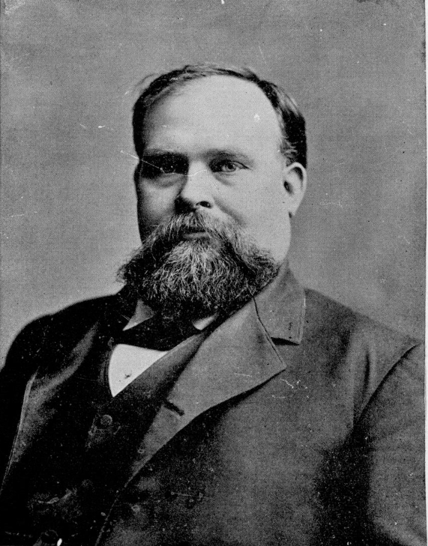
Unit 10: Cotton, Cattle, & Railroads
Lesson 5:
Who’s Who of Cotton, Cattle, & Railroads
Notes:
James S. Hogg, Governor, 1890. In History of Texas, from 1685 to 1892. Volume 2, by John Henry Brown, 496. St. Louis: Becktold & Co., 1893. University of North Texas Libraries, The Portal to Texas History. https://texashistory.unt.edu/ark:/67531/metapth91046/m1/514/.

Slide 2
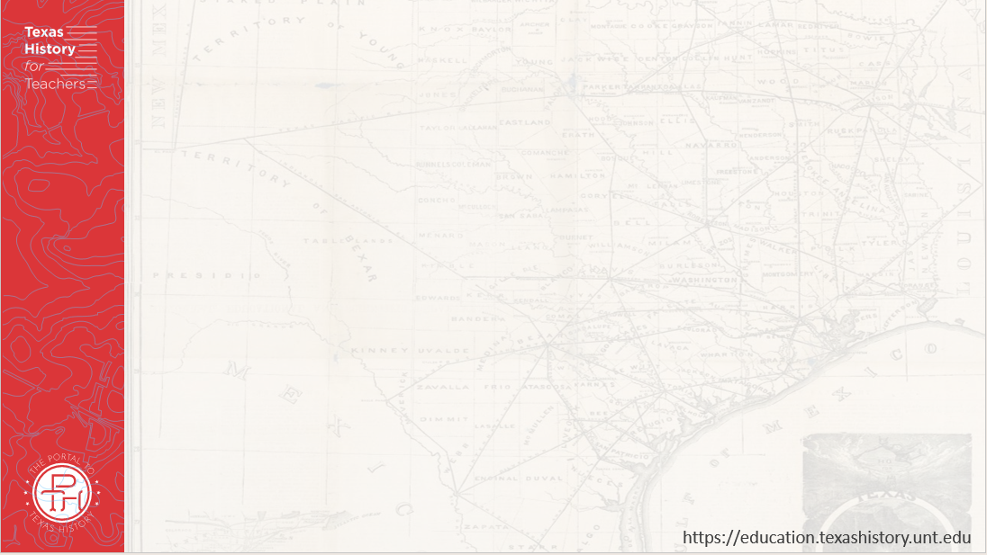




Warm-up Follow the directions below to complete your warm-up
Read the scenario on your warm-up.
Write your response in the space provided.
Share with a partner.

Slide 3
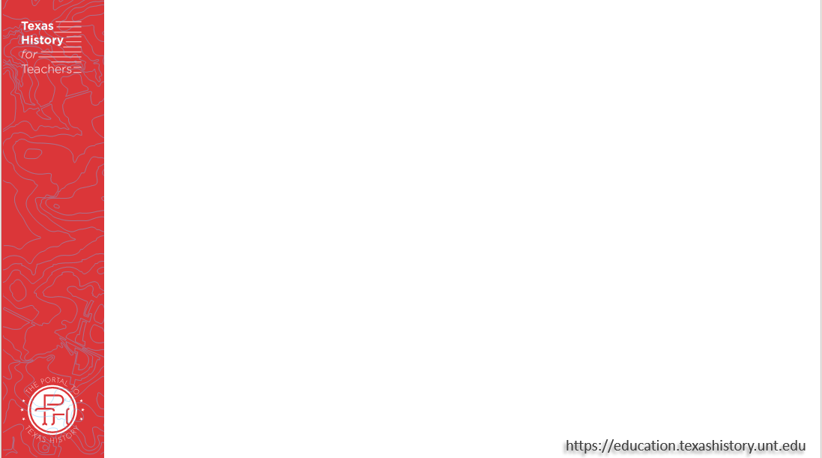
Share with the class:
One thing I would expect to find in a time capsule from the 1880s is _________

Slide 4
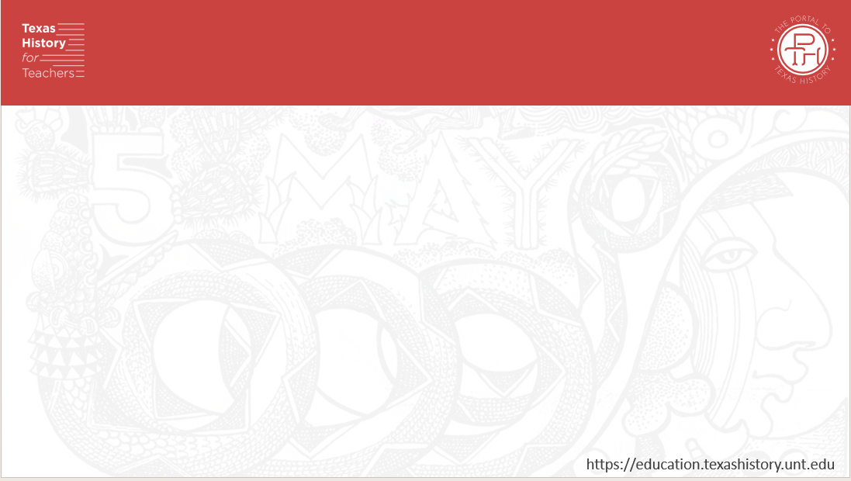
Essential Question
Who were some of the significant people during Cotton, Cattle, & Railroads, and how were they significant to the era?

Slide 5
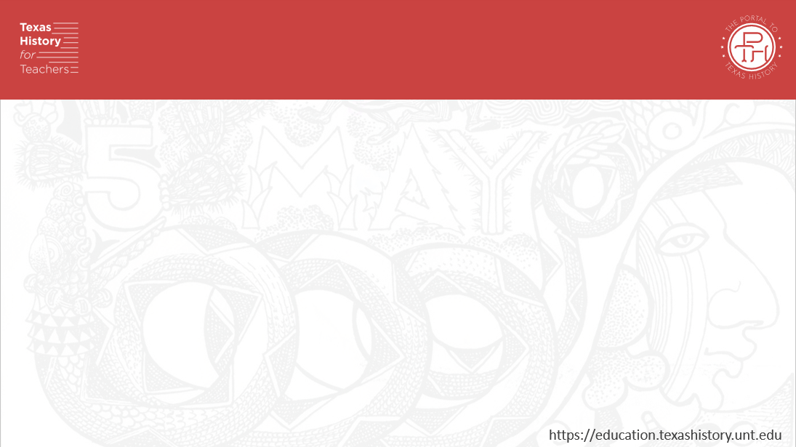
In Today’s Lesson
We will learn about some of the significant individuals of the Cotton, Cattle, & Railroads era.
I will research the assigned number of individuals and complete a worksheet recording information about each person’s background, achievements, and significance.

Slide 6
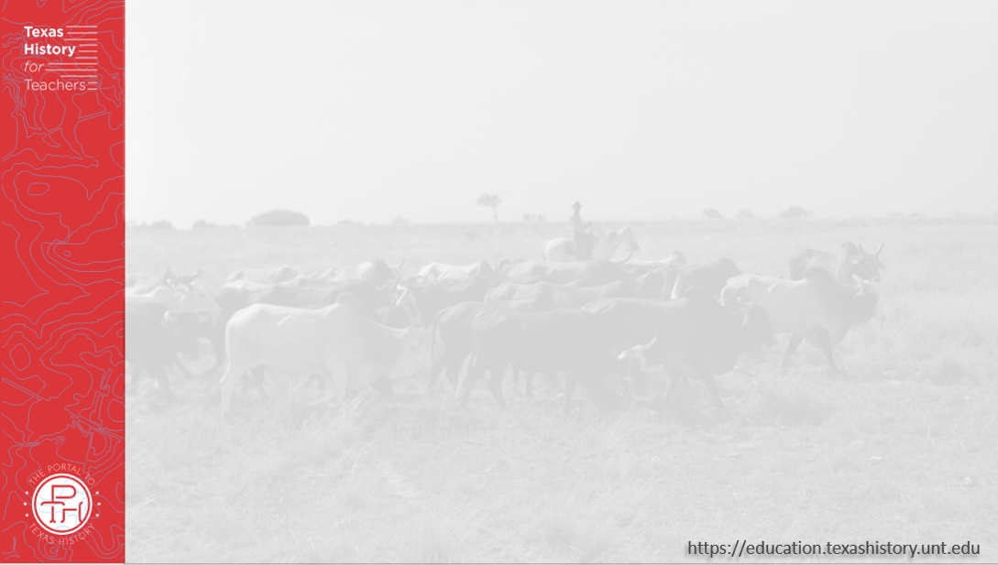
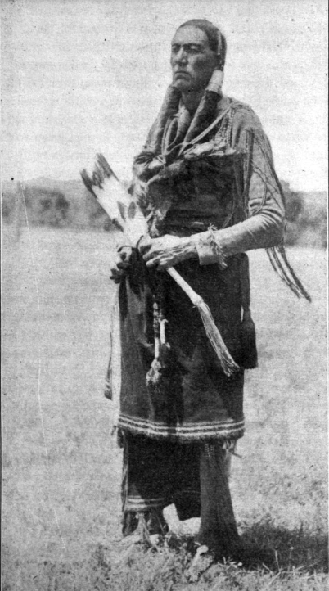
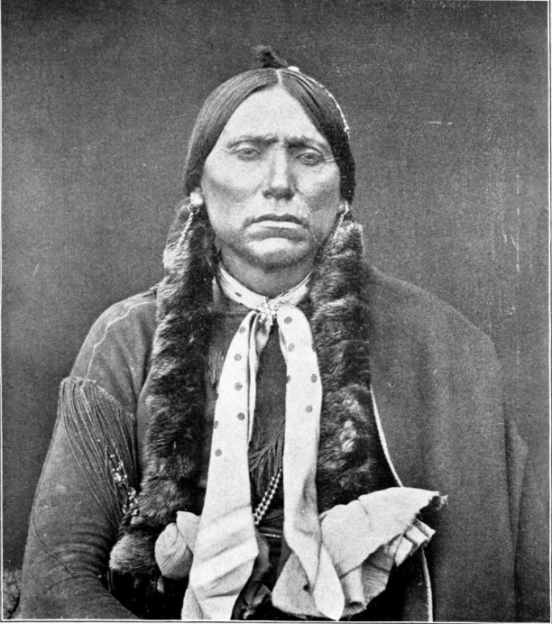
Quanah Parker
The Portal to Texas History
The Portal to Texas History
Notes:
Babb, T. A. (Theodore Adolphus), 1852-1936. In the Bosom of the Comanches: A Thrilling Tale of Savage Indian Life, Massacre and Captivity Truthfully Told by a Surviving Captive, book, 1923; Dallas, Texas. (https://texashistory.unt.edu/ark:/67531/metapth38118/: accessed November 26, 2025), University of North Texas Libraries, The Portal to Texas History, https://texashistory.unt.edu; crediting Austin History Center, Austin Public Library.
Brown, John Henry. Indian Wars and Pioneers of Texas, book, 1880~; Austin, Texas. (https://texashistory.unt.edu/ark:/67531/metapth6725/: accessed December 3, 2025), University of North Texas Libraries, The Portal to Texas History, https://texashistory.unt.edu; crediting UNT Libraries Special Collections.

Slide 7
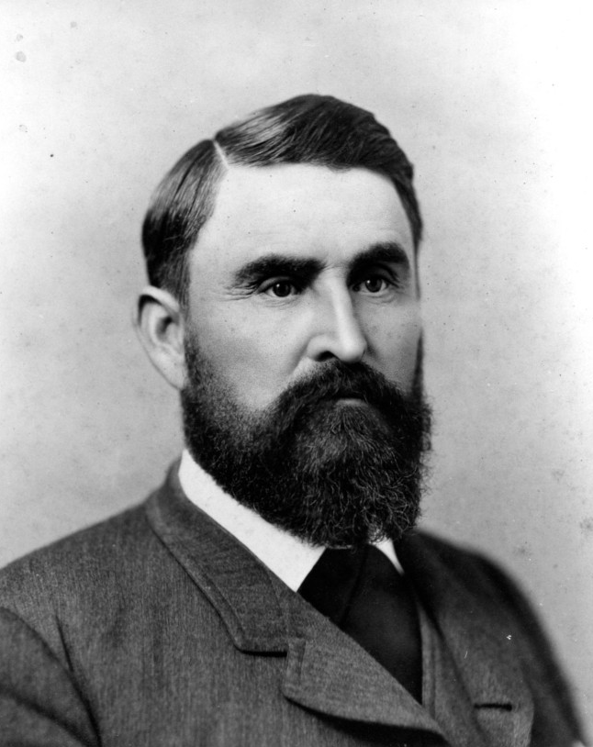
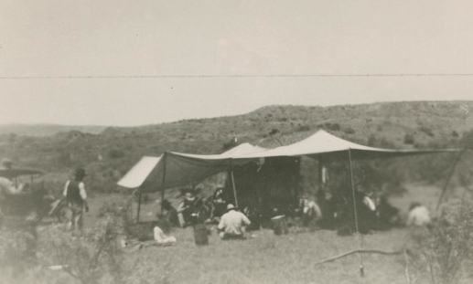
Charles Goodnight
Lunch time on the JA Ranch
The Portal to Texas History
The Portal to Texas History
Notes:
Charles Goodnight, photograph, Date Unknown; (https://texashistory.unt.edu/ark:/67531/metapth44851/: accessed December 9, 2025), University of North Texas Libraries, The Portal to Texas History, https://texashistory.unt.edu; crediting Cattle Raisers Museum.
[Lunchtime on JA Ranch], photograph, 1900~/1930~; (https://texashistory.unt.edu/ark:/67531/metapth1139376/: accessed December 9, 2025), University of North Texas Libraries, The Portal to Texas History, https://texashistory.unt.edu; crediting Cattle Raisers Museum.

Slide 8
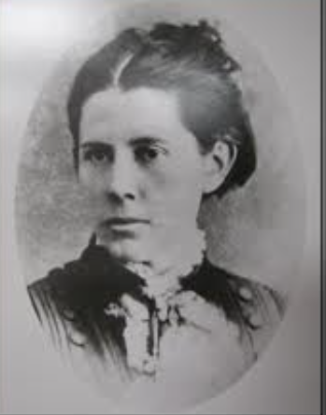
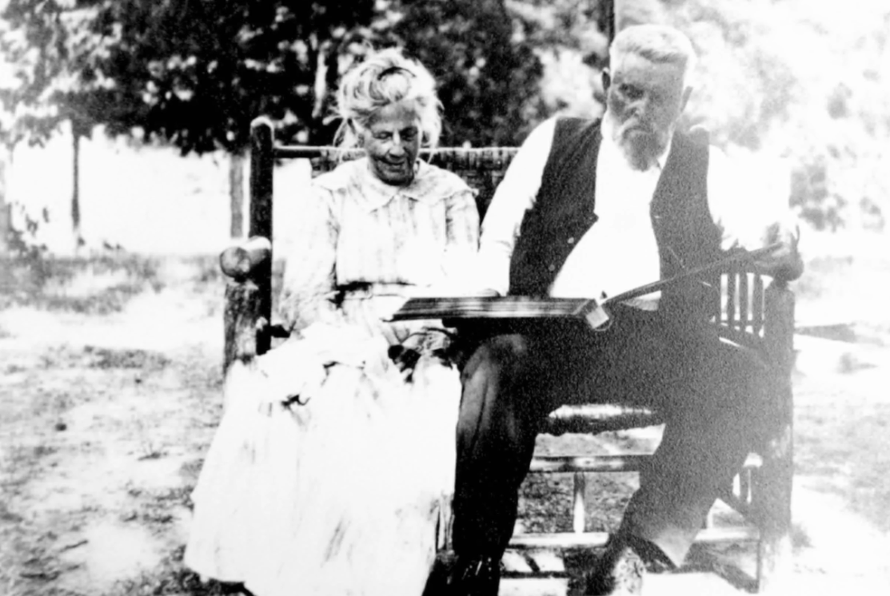
Mary Ann “Molly” Dyer Goodnight
Molly and her husband, Charles in their later years.
Texas State Historical Association.
Texas State Historical Association
Notes:
Mary Ann (Molly) Goodnight: The Mother of the Panhandle. Joyce Gibson Roach. Image available in accordance with Title 17 U.S.C. Section 107. Texas State Historical Association. Accessed 12/9/2025. https://www.tshaonline.org/handbook/entries/goodnight-mary-ann-dyer-molly

Slide 9
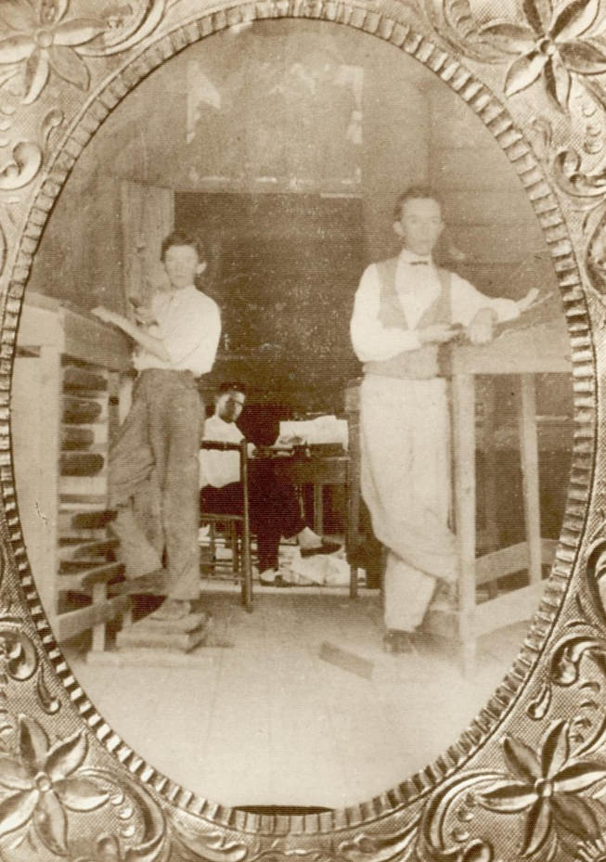
James “Jim” Hogg
Hogg and his employees in the print shop of the newspaper he founded in Longview, TX.
The Portal to Texas History
The Portal to Texas History
Notes:
Culpepper, Cody B. [James Stephen Hogg], photograph, 1871; (https://texashistory.unt.edu/ark:/67531/metapth403388/: accessed December 9, 2025), University of North Texas Libraries, The Portal to Texas History, https://texashistory.unt.edu; crediting Longview Public Library.
James S. Hogg, Governor, 1890. In History of Texas, from 1685 to 1892. Volume 2, by John Henry Brown, 496. St. Louis: Becktold & Co., 1893. University of North Texas Libraries, The Portal to Texas History. https://texashistory.unt.edu/ark:/67531/metapth91046/m1/514/.

Slide 10
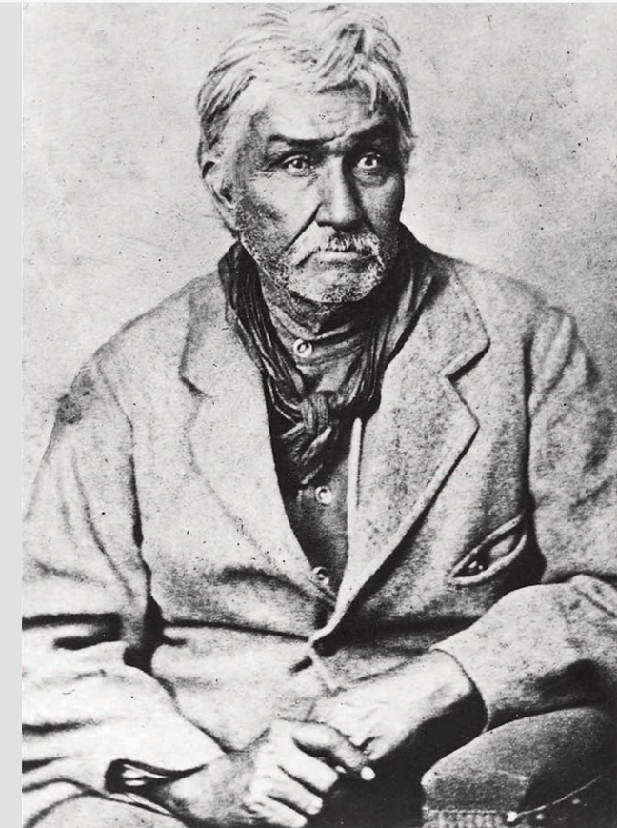
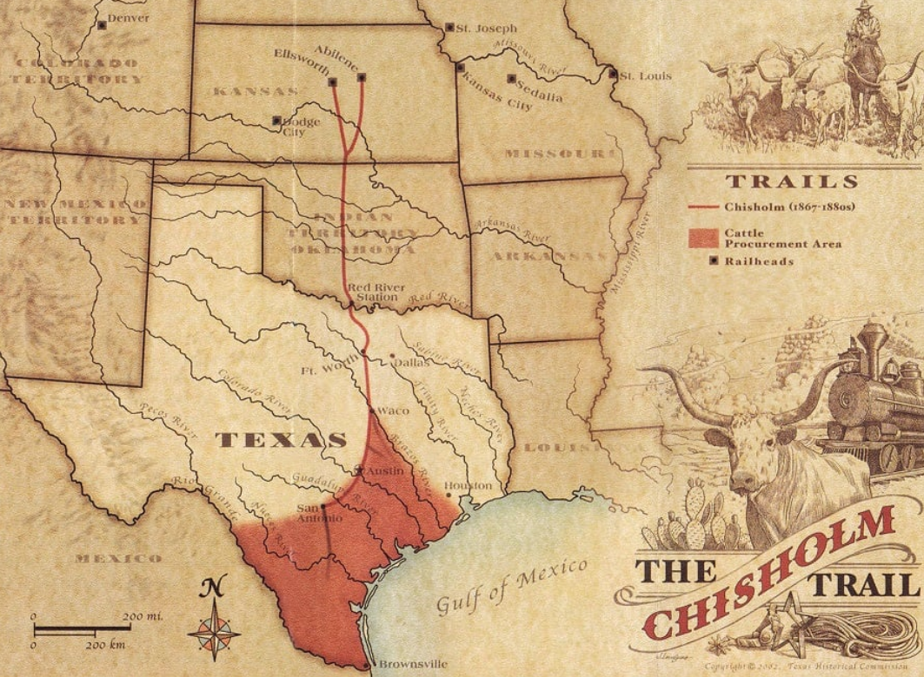
Jesse Chisholm
The Chisholm Trail
Texas State Historical Association
Texas State Historical Association
Notes:
Jesse Chisholm and the Chisholm Trail. Courtesy of the Kansas State Historical Society. Image available in accordance with Title 17 U.S.C. Section 107 at the Texas State Historical Association website accessed 12/9/2025, https://www.tshaonline.org/handbook/entries/chisholm-jesse

Slide 11
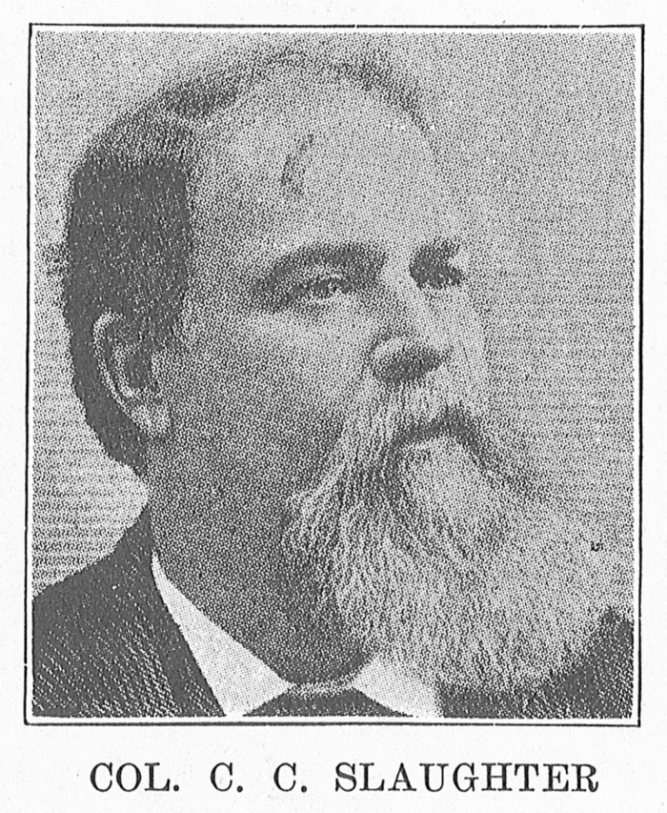
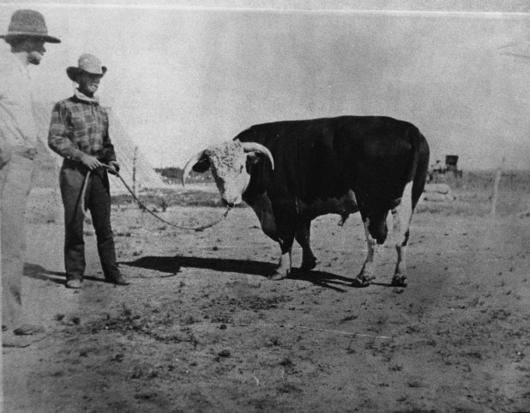
Christopher Columbus Slaughter
A Hereford bull at the Lazy S Ranch, 1900
The Portal to Texas History
The Portal to Texas History
Notes:
Christopher Columbus Slaughter, photograph, Date Unknown; (https://texashistory.unt.edu/ark:/67531/metapth19986/: accessed December 9, 2025), University of North Texas Libraries, The Portal to Texas History, https://texashistory.unt.edu; crediting Tarrant County College NE, Heritage Room.
Elvis E. Fleming. Sir Bredwell at C.C. Slaughter's Lazy "S" Ranch, photograph, 1900; (https://texashistory.unt.edu/ark:/67531/metapth43587/: accessed December 9, 2025), University of North Texas Libraries, The Portal to Texas History, https://texashistory.unt.edu; crediting Cattle Raisers Museum.

Slide 12
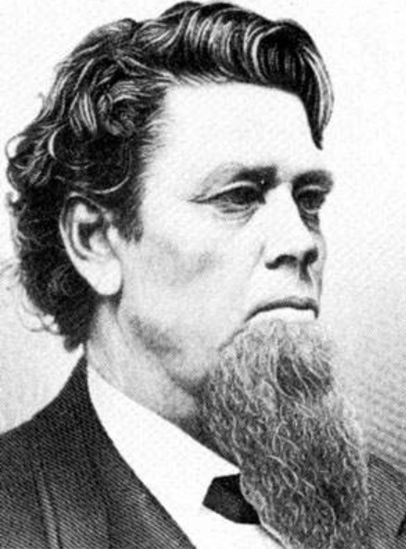
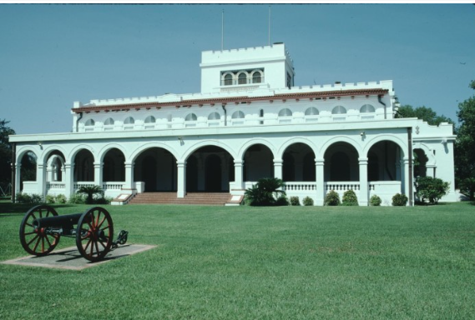
Richard King
An official building of the King Ranch today, Kingsville, TX.
The Portal to Texas History
Texas State Historical Association
Notes:
Richard King: Pioneer of the King Ranch and Steamboat Entrepreneur. Richard King, an early ranch owner who recruited vaqueros from Mexico in 1854. Courtesy of the Bullock Texas State History Museum. Image available on the Internet and included in accordance with Title 17 U.S.C. Section 107. Accessed 12/9/2025. https://www.thestoryoftexas.com/upload/images/characters/vaqueros/vaquero-king.jpg?1453143343
Texas Historical Commission. [King's Ranch], photograph, August 1, 1996; (https://texashistory.unt.edu/ark:/67531/metapth938232/: accessed December 9, 2025), University of North Texas Libraries, The Portal to Texas History, https://texashistory.unt.edu; crediting Texas Historical Commission.

Slide 13
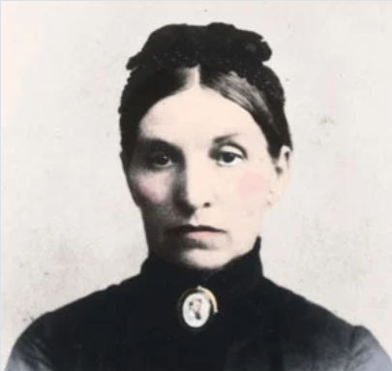
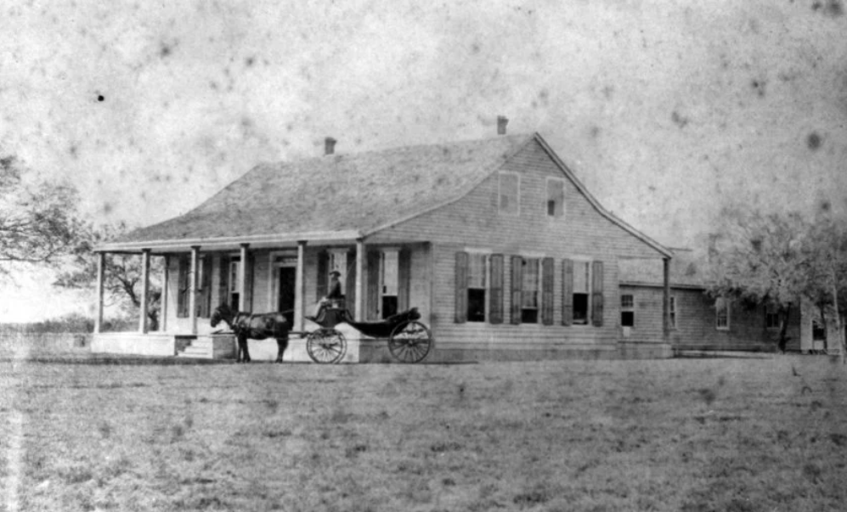
Henrietta Chamberlain King
The original King ranch house, before it was destroyed by fire in 1911.
Texas State Historical Association
Texas State Historical Association
Notes:
Henrietta Maria Morse Chamberlain King. Courtesy of Porter Feary, UTSA Institute of Texan Cultures. Image available on the Internet and included in accordance with Title 17 U.S.C. Section 107. Texas State Historical Association. Accessed 12/9/2025. https://www.tshaonline.org/handbook/entries/king-henrietta-chamberlain

Slide 14
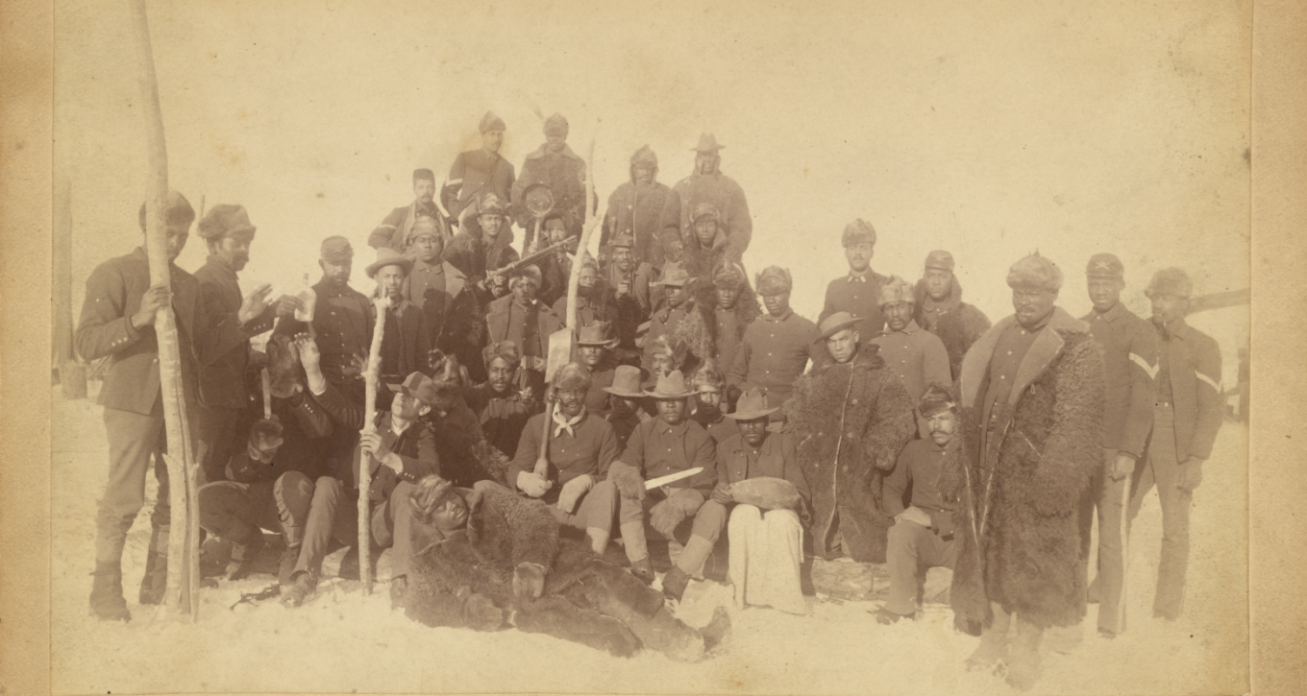
Buffalo Soldiers
Buffalo Soldiers of the 25th Infantry, 1890. The Library of Congress.
Notes:
Buffalo soldiers of the 25th Infantry, some wearing buffalo robes, Ft. Keogh, Montana / Chr. Barthelmess, photographer, Fort Keogh, Montana. 1890. Photograph. https://www.loc.gov/item/98501226/.

Slide 15
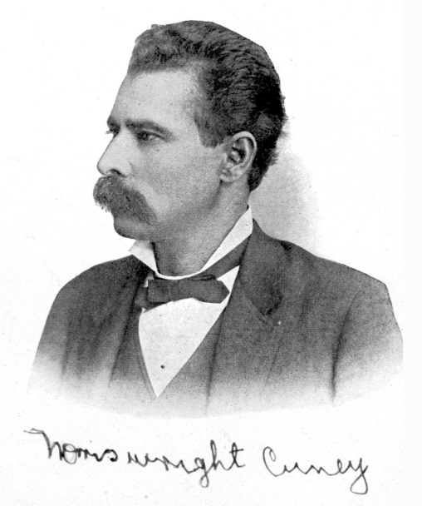
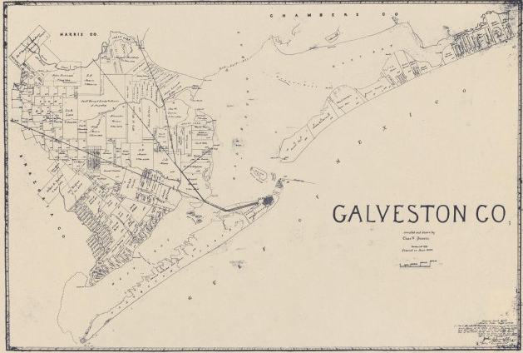
Norris Wright Cuney
Cuney’s Texas home city of Galveston, 1899.
The Portal to Texas History
The Portal to Texas History
Notes:
Norris Wright Cuney. In Norris Wright Cuney: A Tribune of the Black People, by Maud Cuney Hare, 2. New York: The Crisis Publishing Company, 1913. University of North Texas Libraries, The Portal to Texas History. https://texashistory.unt.edu/ark:/67531/metapth29401/m1/2/.
Pressler, Chas. W. Galveston Co., map, 1899; Austin, Texas. (https://texashistory.unt.edu/ark:/67531/metapth493223/: accessed December 9, 2025), University of North Texas Libraries, The Portal to Texas History, https://texashistory.unt.edu; crediting Hardin-Simmons University Library.

Slide 16
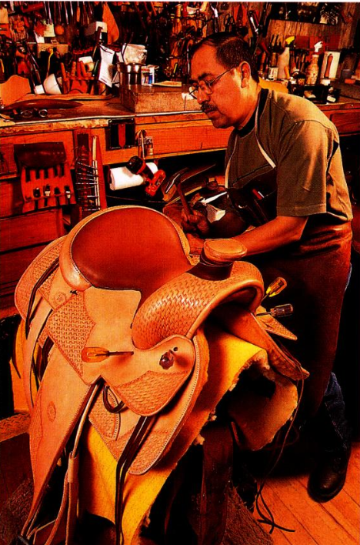
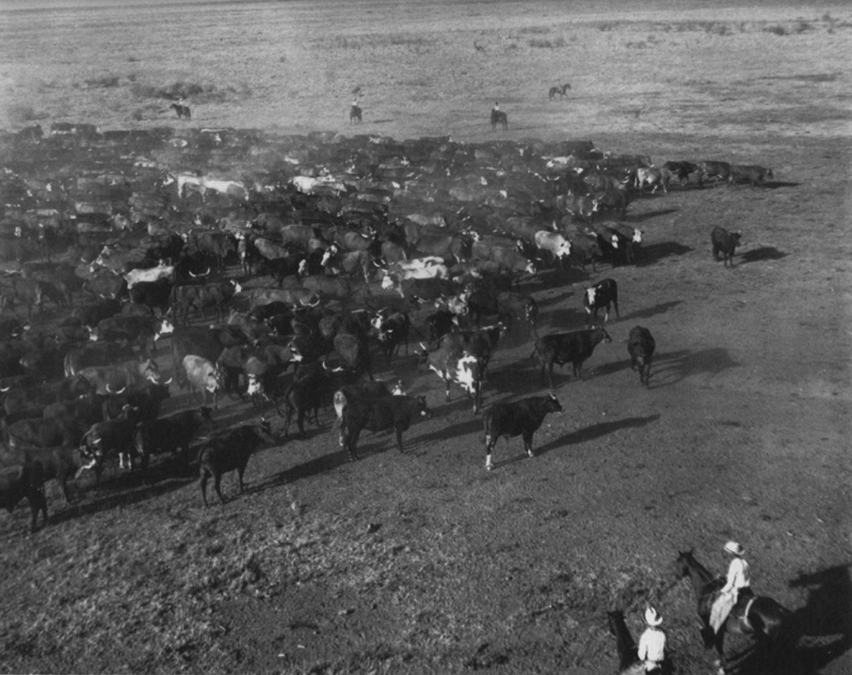
Los Kineños
Robert Salas, descendant of Los Kineños and master saddle maker in his workshop, 2002.
The Portal to Texas History
A typical roundup by Kineños on the King ranch, 1920s
The Portal to Texas History
Notes:
Texas. Department of Transportation. Texas Highways, Volume 49, Number 9, September 2002, periodical, September 2002; Austin, Texas. (https://texashistory.unt.edu/ark:/67531/metapth654460/: accessed December 9, 2025), University of North Texas Libraries, The Portal to Texas History, https://texashistory.unt.edu; crediting UNT Libraries Government Documents Department.
Graham, Joe S. El Rancho in South Texas: Continuity and Change From 1750, book, 1994; Denton, Texas. (https://texashistory.unt.edu/ark:/67531/metadc28328/: accessed December 9, 2025), University of North Texas Libraries, The Portal to Texas History, https://texashistory.unt.edu; crediting UNT Press.

Slide 17
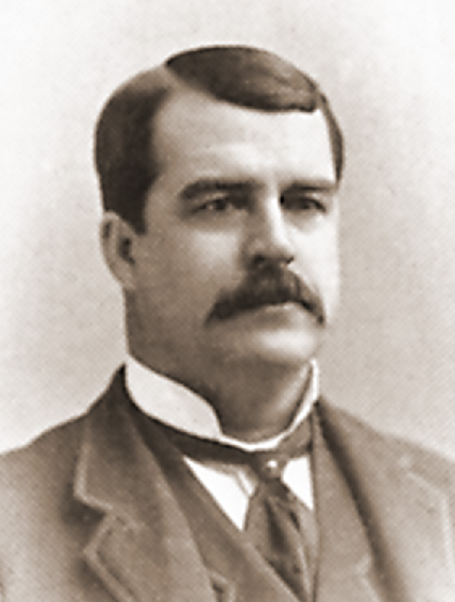
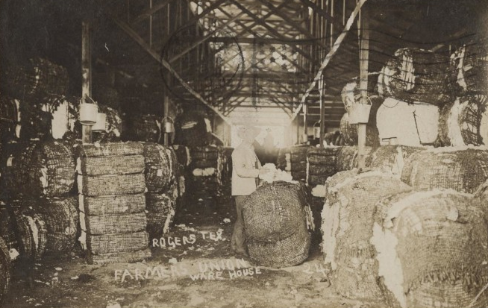
Charles William Macune
A Farmer’s Union warehouse for cotton storage, 1907.
The Portal to Texas History
The Farmers’ Alliance History and Agricultural Digest, 1891
Notes:
Published in Dunning (ed.), The Farmers' Alliance History and Agricultural Digest. (Washington, DC: Alliance Publishing Co., 1891), pg. 257.; Digital editing by Tim Davenport ("Carrite") for Wikipedia, no copyright claimed, file released to the public domain without restriction. Published in the USA prior to 1923, public domain. Accessed 12/92025. https://en.wikipedia.org/wiki/Charles_Macune#/media/File:Macune-C-W.jpg
[Postcard of Farmers Union Warehouse], postcard, January 24, 1907; (https://texashistory.unt.edu/ark:/67531/metapth743134/: accessed November 21, 2025), University of North Texas Libraries, The Portal to Texas History, https://texashistory.unt.edu; crediting Private Collection of T. B. Willis.

Slide 18
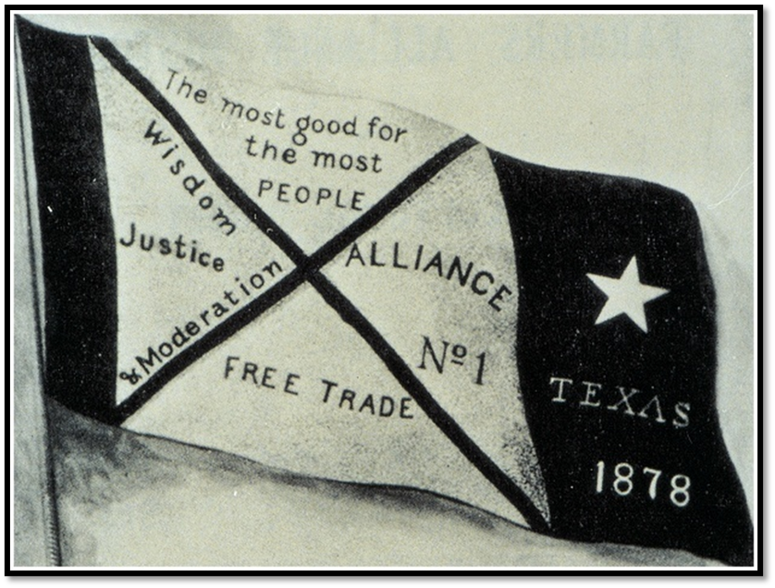
William Robert Lamb
The Farmer’s Alliance Banner
Notes:
From Dunning (ed.), Farmers' Alliance History and Agricultural Digest. (Washington, DC: Alliance Publishing Co., 1891); pg. iv.; Digitally edited for Wikipedia by Tim Davenport ("Carrite"), no copyright claimed, file released to the public domain without restriction. https://en.wikipedia.org/wiki/File:Farmers-Alliance-Banner.jpg#file

Slide 19
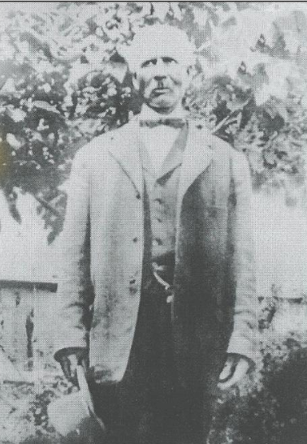
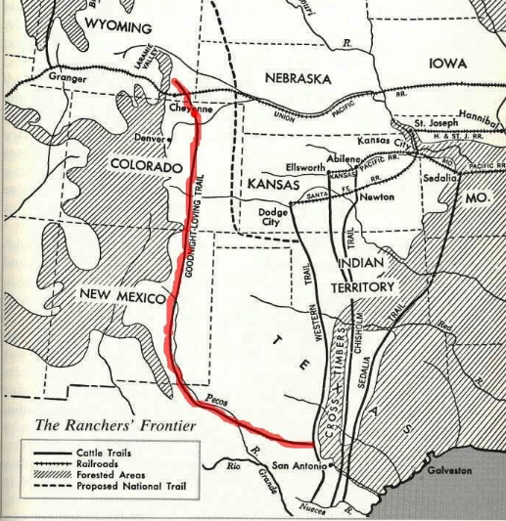
Bose Ikard
The Goodnight-Loving Trail
Texas State Historical Association
The Portal to Texas History
Notes:
The Swisher County News (Tulia, Tex.), Vol. 11, No. 21, Ed. 1 Thursday, May 16, 2019, newspaper, May 16, 2019; Tulia, Texas. (https://texashistory.unt.edu/ark:/67531/metapth1319034/: accessed December 9, 2025), University of North Texas Libraries, The Portal to Texas History, https://texashistory.unt.edu; crediting Swisher County Library.
The Goodnight-Loving Trail: A Historic Cattle Drive Route. The Handbook of Texas, Texas State Historical Association. The Goodnight-Loving Trail. Image available on the Internet and included in accordance with Title 17 U.S.C. Section 107. Accessed 12/9/2025. https://www.tshaonline.org/handbook/entries/goodnight-loving-trail

Slide 20

Exit Ticket Follow the directions below to complete your exit ticket
Choose ONE person you learned about in today’s lesson.
Answer the questions according to that person’s point of view.
Share with a partner.

Slide 21
Share with the class:2
Regarding Anglo expansion into west Texas, this person probably thought _______
Regarding the Anglo government’s role in society and the economy, this person probably thought _______
Regarding Anglo railroad operations, this person probably thought _______

