Slide 1
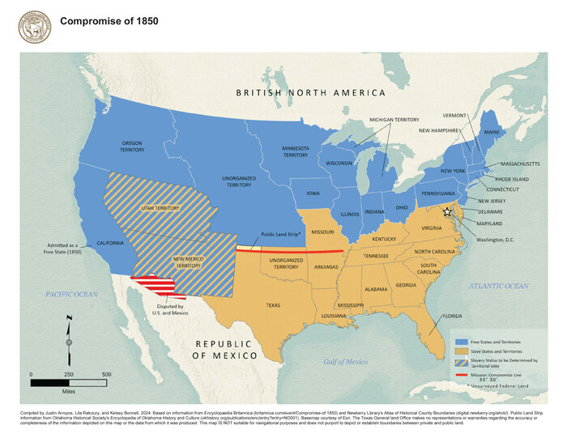
Unit 7: Early Statehood
Extension Lesson:
The Compromise of 1850
Notes:
The Compromise of 1850 Map. GIS Educational Maps, Texas General Land Office Map and Database Store. Justin Arroyos (Compiler), Lila Rakoczy (Compiler), Kelsey Bonnell (Compiler). Accessed on July 24, 2025. https://historictexasmaps.com/object/97358

Slide 2
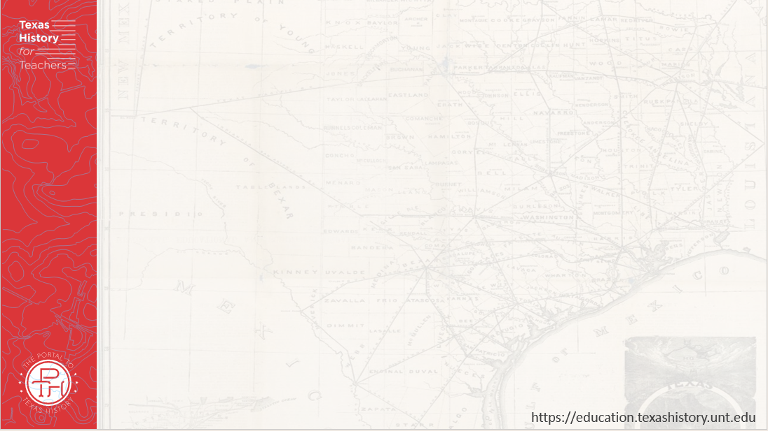





Warm-up Follow the directions below to complete your warm-up

Slide 3

Share with the class:
One thing I observe about this map is ________
One way this map might relate to slavery is _______

Slide 4

Essential Question
What were the events and issues that caused the United States Congress to make the Compromise of 1850, and what were the terms of the Compromise?

Slide 5

In Today’s Lesson
We will examine the events that caused the creation of the Compromise of 1850, identify the terms of the Compromise, and analyze how the terms affected the growing sectionalism in the United States.
I will identify the cause-and-effect relationships between significant events, summarize the significance of the events, and make conclusions about the effects of the Compromise of 1850 on the North and South.

Slide 6
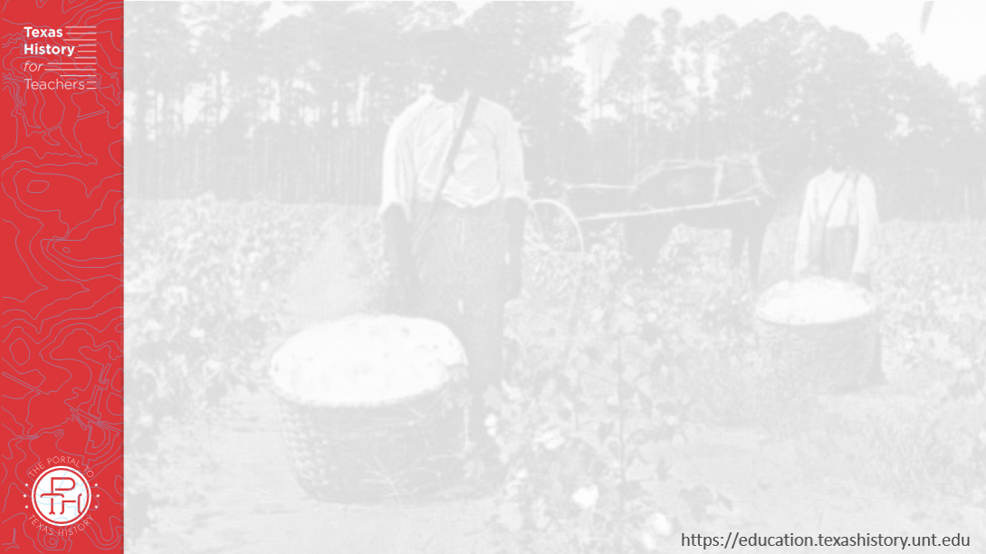
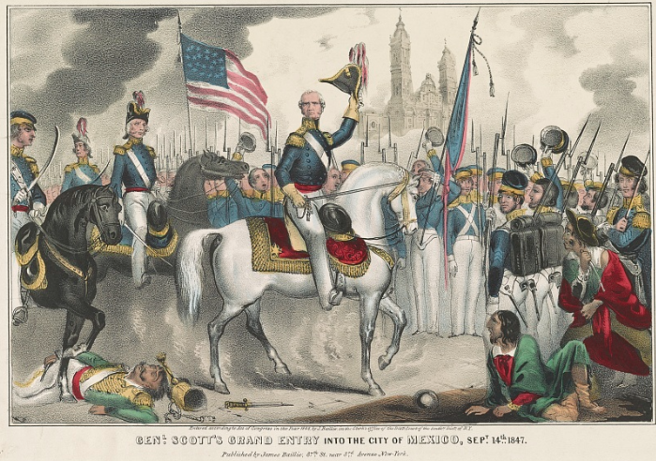
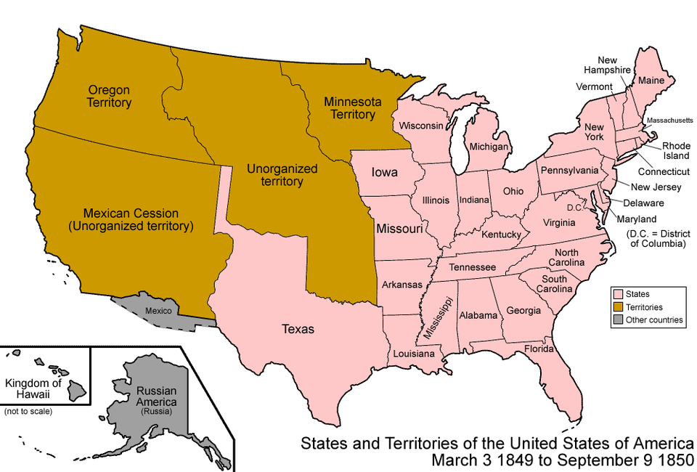
The Road to the Compromise of 1850 The U.S.-Mexico War
The U.S.-Mexico War
The Library of Congress
Map of the United States & Mexican Cession
Notes:
Baillie, James S. Genl. Scott's grand entry into the city of Mexico, Sept. 14th 1847. 1848. Lithograph. Library of Congress Prints and Photographs Division. https://www.loc.gov/item/2002719717/
Map of the states and territories of the United States as it was from 1849 to 1850. Made by User:Golbez. See Charles O. Paullin and John K. Wright's Atlas of the Historical Geography of the United States (1932) for PD maps which support these. I, the copyright holder of this work, hereby publish it under the following licenses:
Permission is granted to copy, distribute and/or modify this document under the terms of the GNU Free Documentation License, Version 1.2 or any later version published by the Free Software Foundation; with no Invariant Sections, no Front-Cover Texts, and no Back-Cover Texts. A copy of the license is included in the section entitled GNU Free Documentation License. This file is licensed under the Creative Commons Attribution-Share Alike 3.0 Unported license. Wikimedia Commons. Accessed on June 26, 2025. https://commons.wikimedia.org/wiki/File:United_States_1849-1850.png

Slide 7
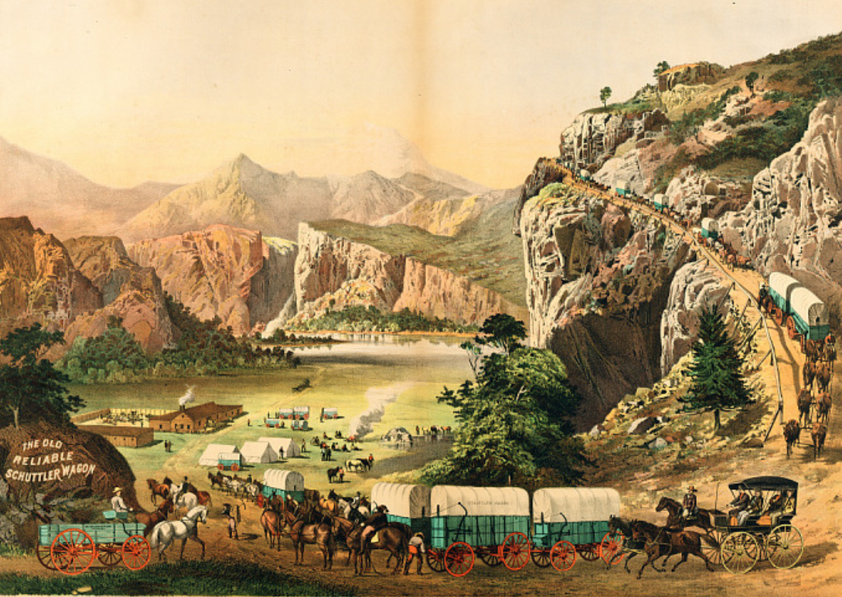
The Road to the Compromise of 1850 The California Gold Rush
A wagon train of pioneers migrating West during the Gold Rush
The Smithsonian Institute
Notes:
The Old Reliable Schuttler Wagon. Presented by Peter Schuttler, Chicago. Harry T. Peters "America on Stone" Lithography Collection, ca 1885. catalog number60.3753. Smithsonian Institute. Accessed on July 24, 2025. The Old Reliable Schuttler Wagon. Presented by Peter Schuttler, Chicago | National Museum of American History

Slide 8
The Compromise of 1850
The Political borders of the United States after the Compromise of 1850
The Texas General Land Office
Notes:
The Compromise of 1850 Map. GIS Educational Maps, Texas General Land Office Map and Database Store. Justin Arroyos (Compiler), Lila Rakoczy (Compiler), Kelsey Bonnell (Compiler). Accessed on July 24, 2025. https://historictexasmaps.com/object/97358

Slide 9
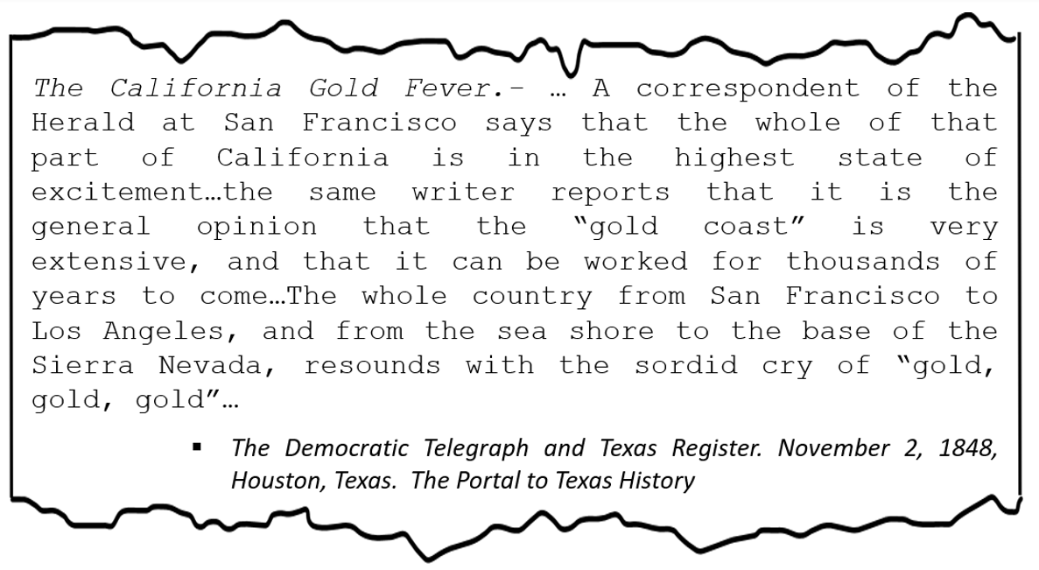
Advanced Short Answer Response
Notes:
Moore, Francis, Jr. Democratic Telegraph and Texas Register (Houston, Tex.), Vol. 13, No. 44, Ed. 1, Thursday, November 2, 1848, newspaper, November 2, 1848; Houston, Texas. (https://texashistory.unt.edu/ark:/67531/metapth48518/: accessed July 23, 2025), University of North Texas Libraries, The Portal to Texas History, https://texashistory.unt.edu; crediting The Dolph Briscoe Center for American History.

Slide 10

Exit Ticket Follow the directions below to complete your exit ticket
Read each of the five descriptions of key events from this lesson.
Write the letter of each description in the correct box under the appropriate event below.
Share with a classmate.

Slide 11
Share with the class: 2
One thing I observe about this map is ________
One way this map might relate to slavery is _______

