Slide 1
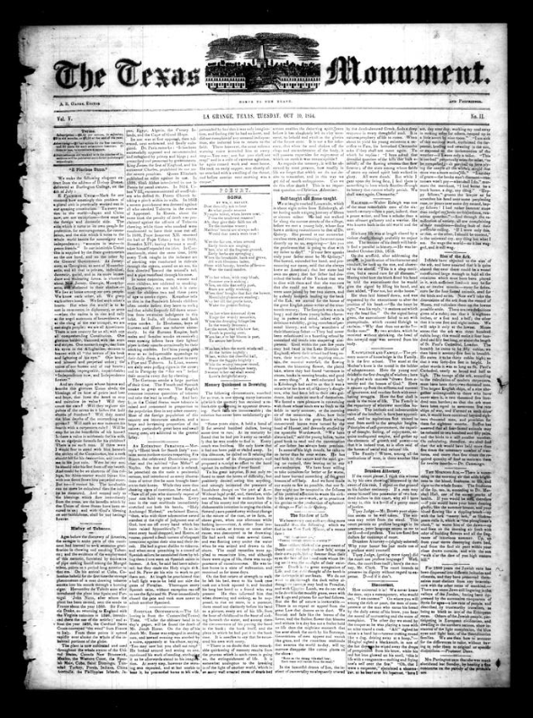
Unit 7:
Early Statehood
Lesson 2:
How do we know what we know?
Notes:
Gates, A. R. The Texas Monument. (La Grange, Tex.), Vol. 5, No. 11, Ed. 1 Tuesday, October 10, 1854, newspaper, October 10, 1854; (https://texashistory.unt.edu/ark:/67531/metapth1291421/: accessed July 2, 2025), University of North Texas Libraries, The Portal to Texas History, https://texashistory.unt.edu; crediting Fayette Public Library, Museum and Archives.

Slide 2




Warm-up:
Follow the directions to complete your warm-up
Read each statement in the column on the left.
Match each statement with the person who would be most likely to have that point of view.
Share with a partner.

Slide 3

Share with the class
The statement “____________” would have most likely been said by ____________.

Slide 4

Essential Question
What were the most significant events, topics, or themes of the Early Statehood era, and how were they represented or addressed in different primary source materials?

Slide 5
In today’s lesson…
We will examine the significant themes, topics, and events of the Early Statehood era by analyzing a variety of primary source materials.
I will record information about the primary source materials and determine how each is related to the themes of the unit.

Slide 6

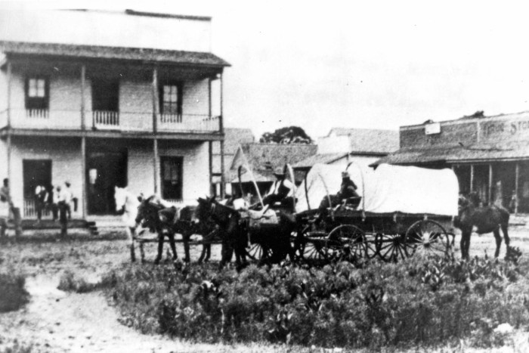
Part I: Texas, the 28th State in the United States of America
A covered wagon stopped for a rest in Round Rock, north of Austin, 1860.
The Portal to Texas History
Notes:
[A Wagon Train in Round Rock], photograph, 1860~; (https://texashistory.unt.edu/ark:/67531/metapth159983/: accessed July 2, 2025), University of North Texas Libraries, The Portal to Texas History, https://texashistory.unt.edu; crediting The Williamson Museum.

Slide 7
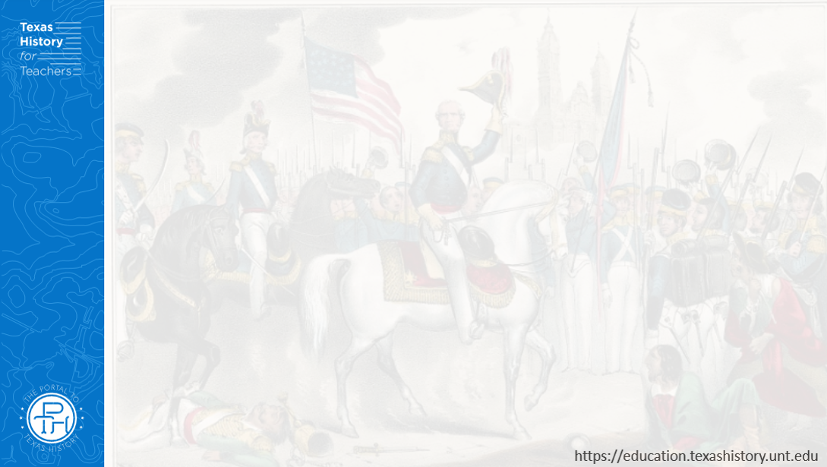
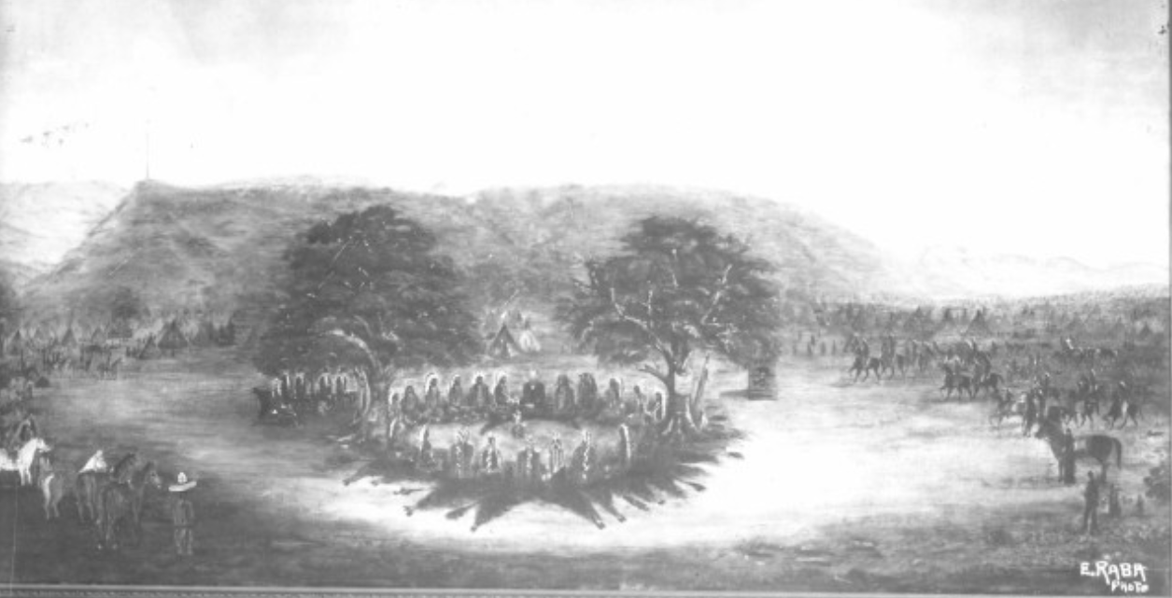
Part II: Primary Source Analysis
The Comanche-Meusebach Treaty of 1847
The Portal to Texas History
Notes:
Raba, Ernst Wilhelm, 1874-1951. [The Meusebach-Comanche Treaty], photograph, Date Unknown; (https://texashistory.unt.edu/ark:/67531/metapth460058/: accessed June 27, 2025), University of North Texas Libraries, The Portal to Texas History, https://texashistory.unt.edu; crediting San Antonio Conservation Society.

Slide 8
Exit Ticket:
Follow the directions to complete your exit ticket
Choose ONE key event from this unit in the left column.
In the right column, give an example from one primary source that relates to your chosen key event.
Share with a partner.

Slide 9
Share with the class 2
One significant event that happens during the Early Statehood era of Texas history is _____________.
One primary source I examined in this activity that provides evidence of this significant change was ________

