Slide 1
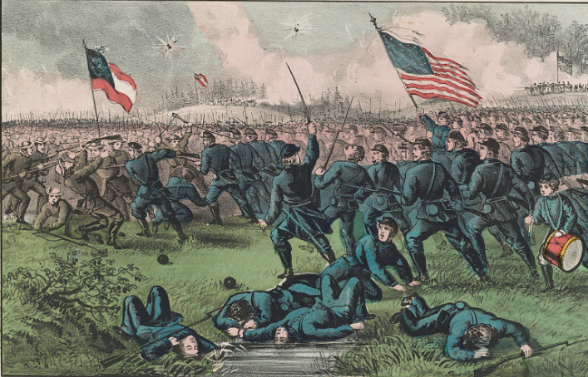
Unit 7:
Early Statehood
Lesson 11:
Looking Ahead
Notes:
Currier & Ives. Battle of Corinth, Miss. Oct. 4th 1862. ca. 1862. Lithograph. Library of Congress. https://www.loc.gov/item/90709052/

Slide 2

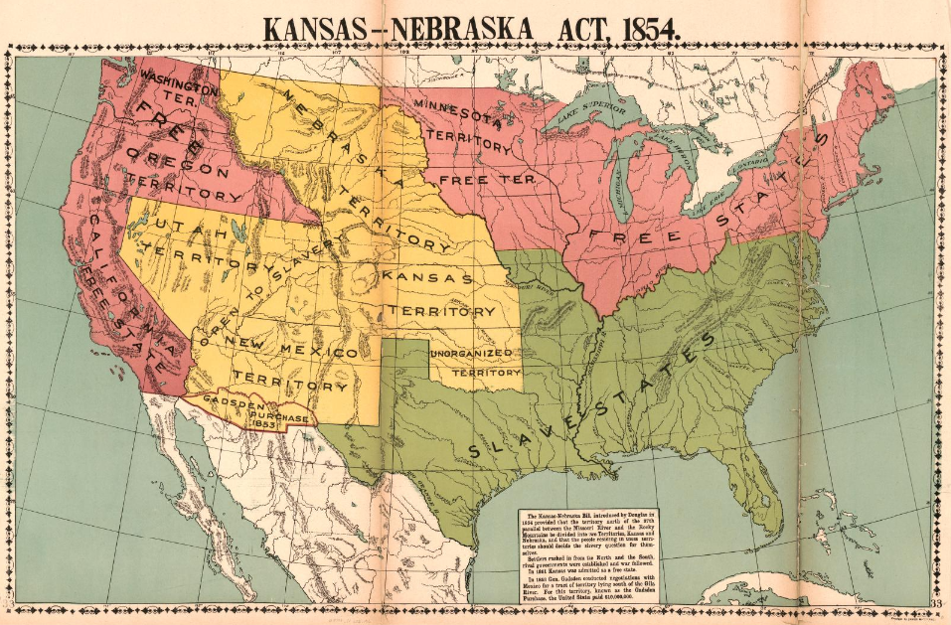
Warm-up:
Use the image to complete your warm-up

Slide 3


Share with the class
One thing the map can tell us about the United States during this era is ________.

Slide 4

Essential Question
What were some of the main arguments surrounding sectional issues like secession and abolition at the end of the Early Statehood era?

Slide 5
In today’s lesson…
We will analyze primary source excerpts from various Texas newspapers addressing sectional issues including secession, the union, slavery, and abolition to identify the major arguments related to these issues of the time.
I will analyze and record information about each article’s main idea and author’s point of view, providing textual evidence to support my analysis.

Slide 6
Sectionalism: A Nation Divided
Sectional Map of the United States, 1854. The Library of Congress
Notes:
Mcconnell Map Co, and James McConnell. Kansas-Nebraska Act, 1854. 1919. Library of Congress Geography and Map Division. https://www.loc.gov/item/2009581130/

Slide 7
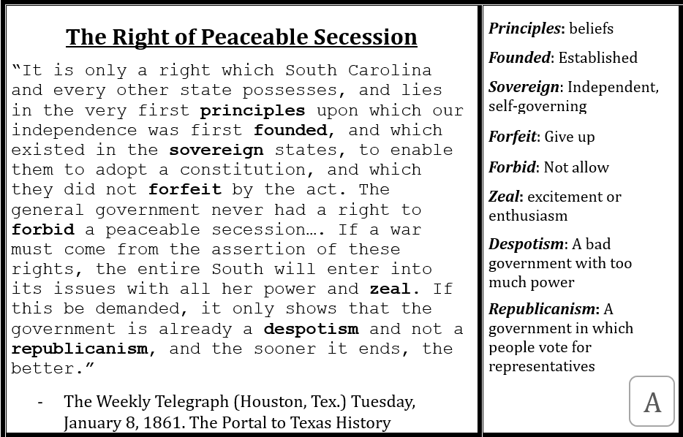
Let’s look at one primary source material together

Slide 8
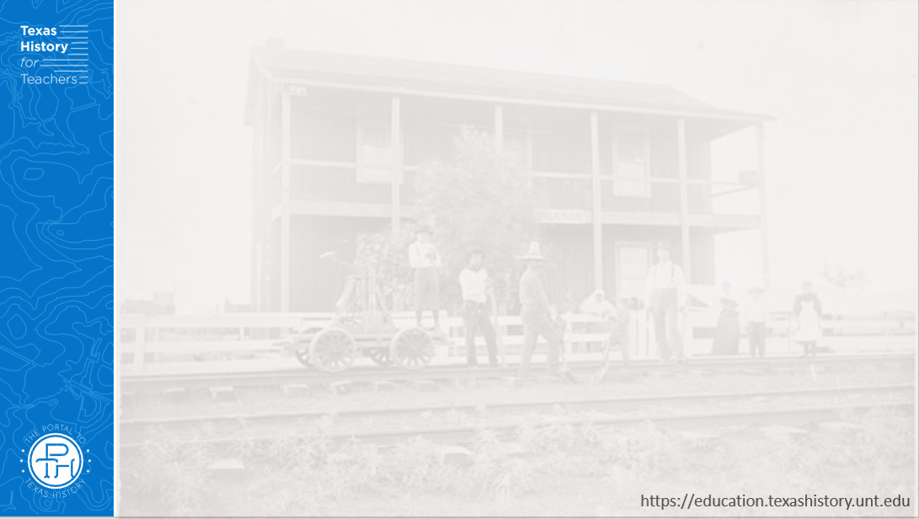
Primary Source Analysis
Remember: You do not need to understand the full text of the primary source. Focus on main ideas, author’s general point of view, and key words and phrases.

Slide 9
Share your findings
The primary source titled “________” talked about _____________.
The author’s point of view was that ______________________

Slide 10






Exit Ticket:
Follow the directions to complete your exit ticket
Complete the paragraph in the box by choosing a topic from the day’s lesson and giving two different points of view for the topic.
Share with a partner.

Slide 11
Share with the class 2
One of the topics presented in the primary source materials today was ________.
One point of view about this topic was _________,
while a different point of view on the topic was _________

