Slide 1
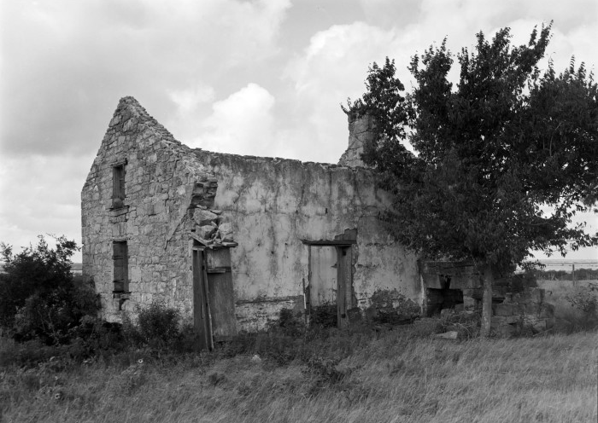




Unit 7:
Early Statehood
Extension Lesson:
Population & Settlement
A house that belonged to the Moczygemba family who immigrated to Texas from Poland in the 1850s.
The Portal to Texas History
Notes:
Texas Historical Commission. [Alfred Moczygemba House], photograph, Date Unknown; (https://texashistory.unt.edu/ark:/67531/metapth663133/: accessed July 24, 2025), University of North Texas Libraries, The Portal to Texas History, https://texashistory.unt.edu; crediting Texas Historical Commission.

Slide 2

Warm-up
Follow the directions to complete your warm-up
Read the primary source excerpt in the box.
What can you learn about Early Texas statehood based on the excerpt?
Discuss with a partner

Slide 3

Share with the class
One thing we can learn from this excerpt is ____________.
I think this is true, because in the excerpt, it says __________

Slide 4

Essential Question
What significant changes or developments occurred in Texas from 1845 to 1860 as a result of migration and immigration to the state?

Slide 5

In today’s lesson…
We will analyze primary and secondary source materials including maps, graphs, charts, and artifacts to draw conclusions about the effects of population and settlement developments in Texas from 1845 to 1860.
I will complete a stations activity, using materials at seven stations to answer questions about developments in Texas’ population during the Early Statehood era.

Slide 6
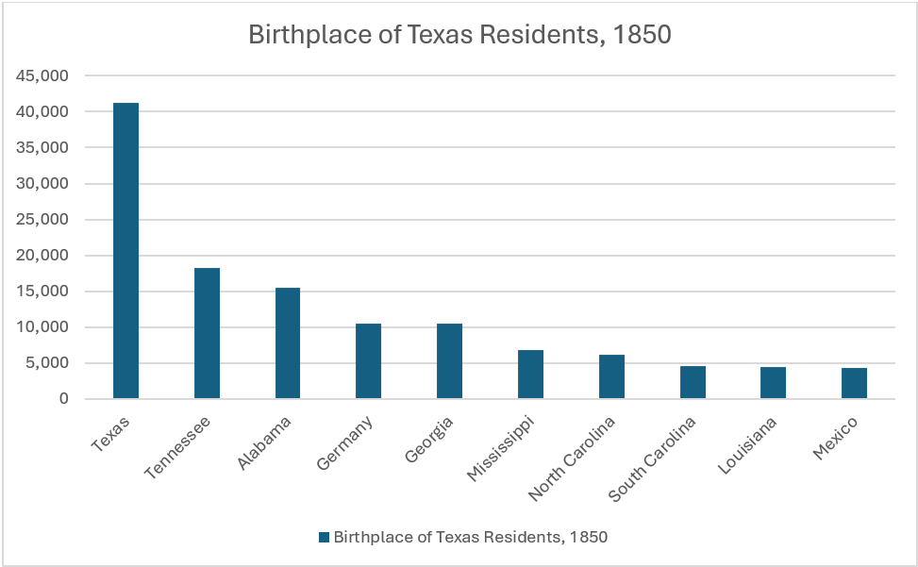
Station 1:
https://education.texashistory.unt.edu
Notes:
A chart made based on information from the following source: Birthplace of Texas residents 1850-2022. Texas Migration History 1850-2022. America’s Great Migration Project. University of Washington. Accessed on July 22, 2025. TexasMigration History 1850-2022 - America's Great Migrations

Slide 7
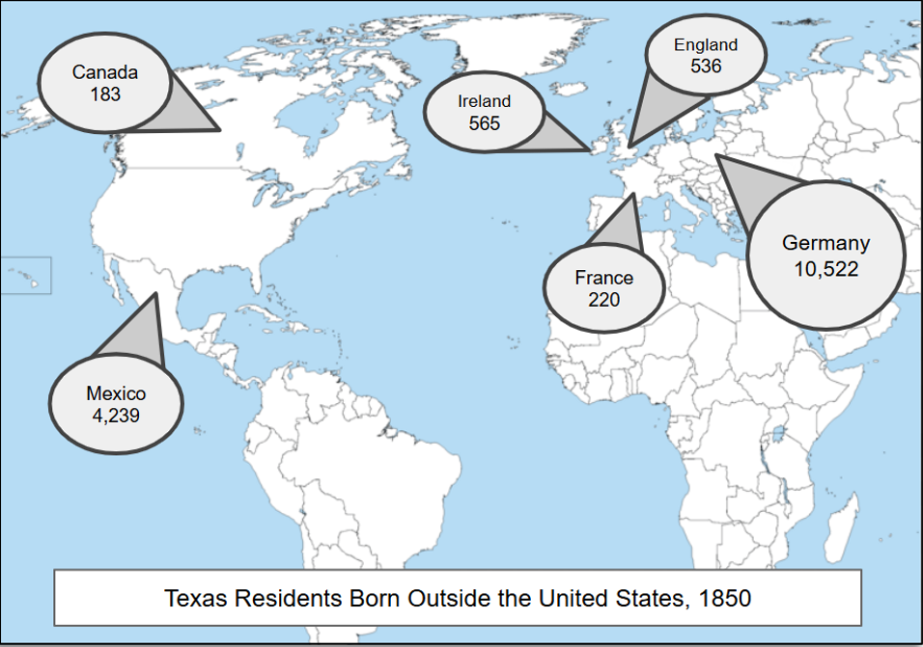
Station 2:
https://education.texashistory.unt.edu
Notes:
An infographic made using information from the following source: Birthplace of Texas Residents, 1850. Texas Migration History 1850-2022. America’s Great Migration Project. University of Washington. Accessed on July 22, 2025. TexasMigration History 1850-2022 - America's Great Migrations. Data placed on a map from Wikimedia Commons: A large blank world map with oceans marked in blue. Accessed on July 22, 2025. https://commons.wikimedia.org/wiki/File:20230519193449!A_large_blank_world_map_with_oceans_marked_in_blue_(1).png

Slide 8
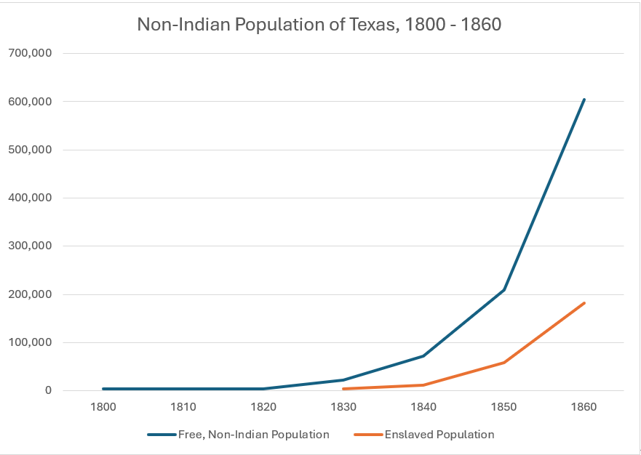
Station 3:
https://education.texashistory.unt.edu
Notes:
An infographic using information from the following source: Population Growth from Early Texas Settlers, 1800 – 1850. Accessed on July 22, 2025. Population Growth from Early Texas Settlers - Texas Proud

Slide 9
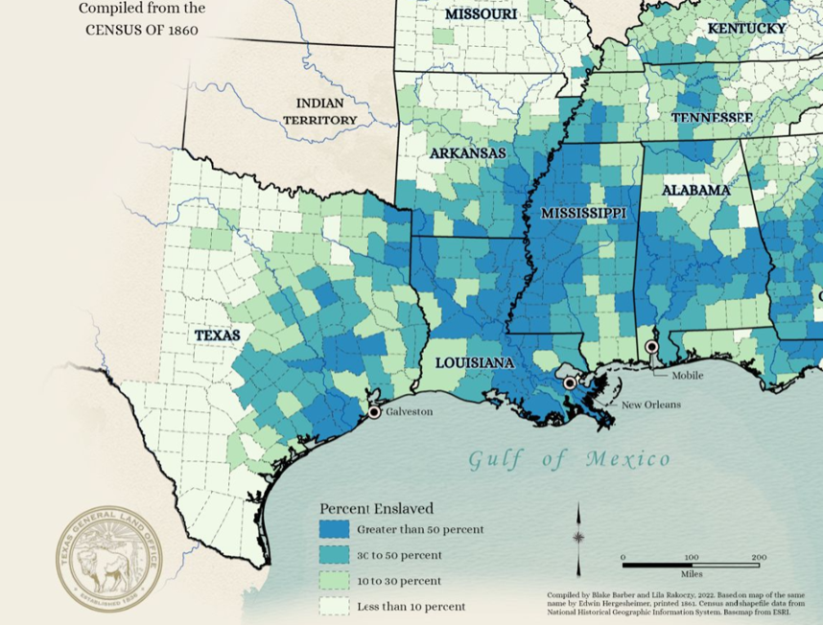
Station 4:
https://education.texashistory.unt.edu
Notes:
Map Showing the Distribution of the Slave Population of the Southern States of the United States. Compiled from the Census of 1860. GIS Educational Maps. Texas General Land Office. Accessed on July 22, 2025. https://historictexasmaps.com/object/96677

Slide 10

Station 5:
https://education.texashistory.unt.edu
Notes:
German-Texan Heritage Society. German-Texan Heritage Society, The Journal, Volume 36, Number 3, Fall 2014, periodical, Autumn 2014; Austin, Texas. (https://texashistory.unt.edu/ark:/67531/metapth1507496/: accessed July 22, 2025), University of North Texas Libraries, The Portal to Texas History, https://texashistory.unt.edu; crediting German-Texan Heritage Society.

Slide 11
Exit Ticket
Follow the directions to complete your exit ticket
Read the six statements in the graphic organizer.
Which THREE statements are most accurate about Texas population from 1845 to 1860.
Discuss with a partner

Slide 12
Share with the class 2
One true statement about changes that occurred in Texas from 1845 to 1860 was that _______________

