Slide 1

Mind Map Review
Sub-topic
1
Additional information
Main Topic
Sub-topic
2
Sub-topic
3
Additional information
Additional information
Additional information
https://education.texashistory.unt.edu

Slide 2

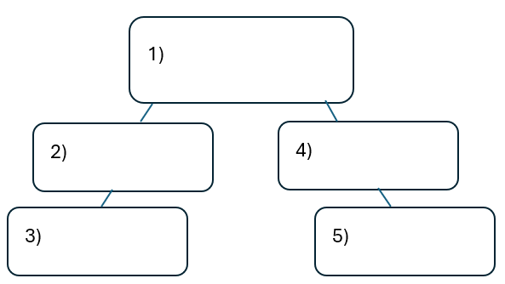


Warm-up:
Follow the directions on your warm-up
Use the word bank provided to fill in the small mind map on your warm-up.
Place each term where you think it fits best in your mind map.
Discuss with a partner.
https://education.texashistory.unt.edu

Slide 3
Share with the class
I think the primary topic in box number one is _______
I think the subtopic in box number two is ____, and box number three is ____
I think the subtopic in box number four is ____, and box number five is ____
https://education.texashistory.unt.edu

Slide 4
Essential Question
How do the key terms and concepts from Unit 7: Early Statehood connect to each other?
https://education.texashistory.unt.edu

Slide 5
In today’s lesson…
We will make connections between key terms and concepts within all of Unit 7: Early Statehood.
I will create a Mind Map using terms and concepts from the class slides presentation.
https://education.texashistory.unt.edu

Slide 6
Unit Topic & Subtopics
Which of the titles in the boxes below is the main topic of our unit?
Draw a circle in the middle of your Mind Map and write the main topic inside.
Write the remaining topics around the main topic. Connect each sub-topic to the main topic with a line.
Texas Developments
U.S.-Mexico War
Early Statehood
Sectionalism
https://education.texashistory.unt.edu

Slide 7
Make Connections 1
Connect each item below to the topic on your Mind Map.
Some items will connect directly to the main topic. Some will connect to other items from this slide. Some items can go in more than one place.
South
Rio Grande
Texas annexation to the U.S.
North
Population Growth
Border Disputes
https://education.texashistory.unt.edu

Slide 8
Make Connections 2
Connect each item below to the topic on your Mind Map.
Some items will connect directly to the main topic. Some will connect to other items from this slide. Some items can go in more than one place.
Treaty of Guadalupe Hidalgo
Pro-Slavery
Plantation agriculture
Manufacturing
Immigration
Anti-Slavery
https://education.texashistory.unt.edu

Slide 9
Make Connections 3
Connect each item below to the topic on your Mind Map.
Some items will connect directly to the main topic. Some will connect to other items from this slide. Some items can go in more than one place.
Germans
Mexico ceded land to U.S.
Texas Rangers
U.S. paid Mexico $15 million
The west Texas frontier
Migration
https://education.texashistory.unt.edu

Slide 10
Make Connections 4
Connect each item below to the topic on your Mind Map.
Some items will connect directly to the main topic. Some will connect to other items from this slide. Some items can go in more than one place.
Mexican Cession
Statehood
Gold Rush
Compromise of 1850
Conflict with Indians
Debates over slavery
https://education.texashistory.unt.edu

Slide 11
Make Connections 5
Connect each item below to the topic on your Mind Map.
Some items will connect directly to the main topic. Some will connect to other items from this slide. Some items can go in more than one place.
California joins as free state
John Coffee Hays
Comanches
Popular Sovereignty
Fugitive Slave Law
U.S. Army
https://education.texashistory.unt.edu

Slide 12
Make Connections 6
Connect each item below to the topic on your Mind Map.
Some items will connect directly to the main topic. Some will connect to other items from this slide. Some items can go in more than one place.
Manifest Destiny
Reservations
Texas ceded its western land to U.S.
$10 million
Removal to present-day Oklahoma
Westward expansion
https://education.texashistory.unt.edu

Slide 13

Create Connections 6
Now take a few minutes to add any information you can think of to your Mind Map.
You can add facts, descriptions, explanations, caused, effects, or anything else you can think of.
https://education.texashistory.unt.edu

Slide 14
Exit Ticket
Complete the sentence summarizing the main idea from our unit.
Discuss with a partner.
https://education.texashistory.unt.edu

Slide 15
Share your response
The (1)____________ is primarily characterized by (2)_______________
https://education.texashistory.unt.edu

