Slide 1
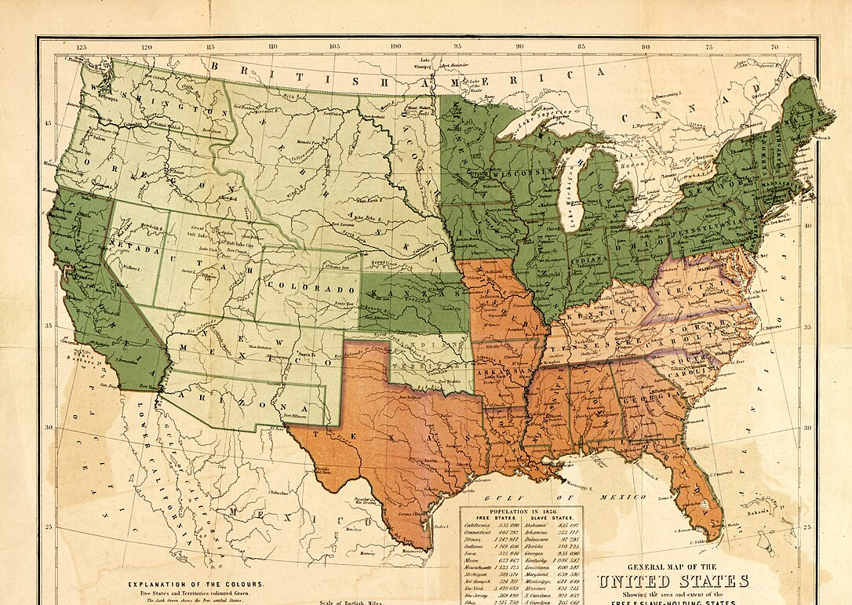




Unit 7:
Early Statehood
Review Lesson:
Flashcards and Study Guide
Notes:
Rogers, Henry D, W. & A.K. Johnston Limited, and Edward Stanford Ltd. General map of the United States, showing the area and extent of the free & slave-holding states, and the territories of the Union: also the boundary of the seceding states. [London: E. Stanford ; Edinburgh: W. & A.K. Johnston, 1857] Map. https://www.loc.gov/item/97682063/.

Slide 2
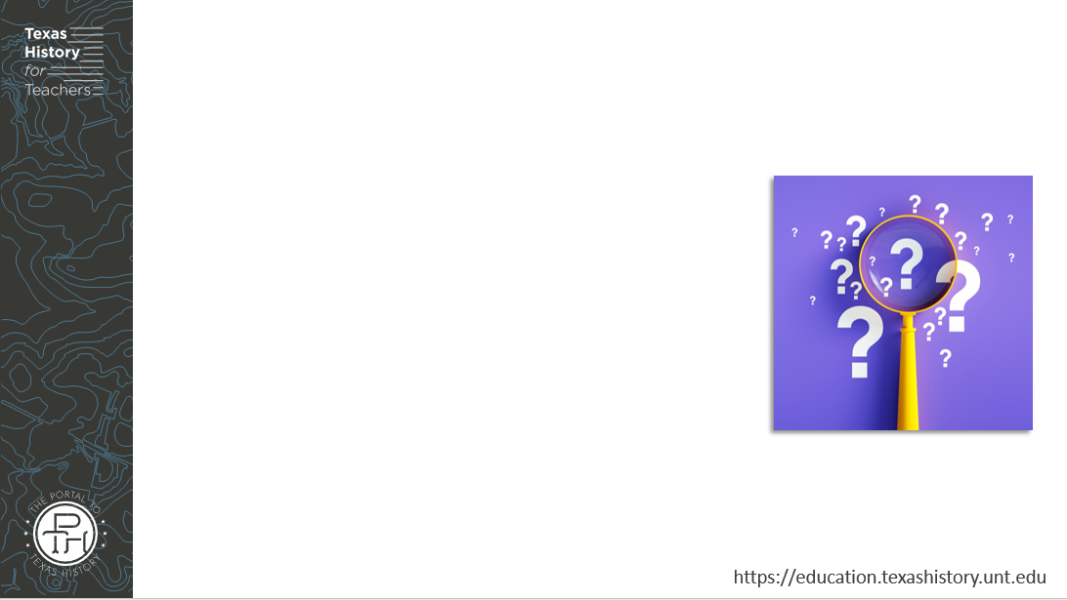
Warm-up
Follow the directions to complete your warm-up
Circle or highlight any and all topics that you expect to see on the unit 7 test based on what we have learned and discussed in class.
Share with a partner

Slide 3
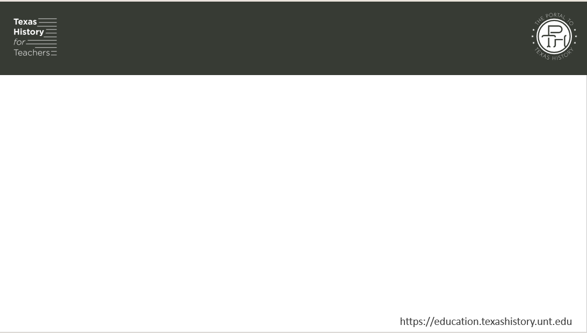
Share with the class
One topic that we will probably see on the Unit 7 test is _______

Slide 4

Essential Question
What significant information do we need to know to be successful on the unit 7 test: Early Statehood?

Slide 5

In today’s lesson…
We will identify and review significant information for our upcoming test.
I will use my previous work and notes to complete my study guide. I will identify key terms and concepts, match cause and effect relationships, create short answer responses, and answer practice test questions.

Slide 6
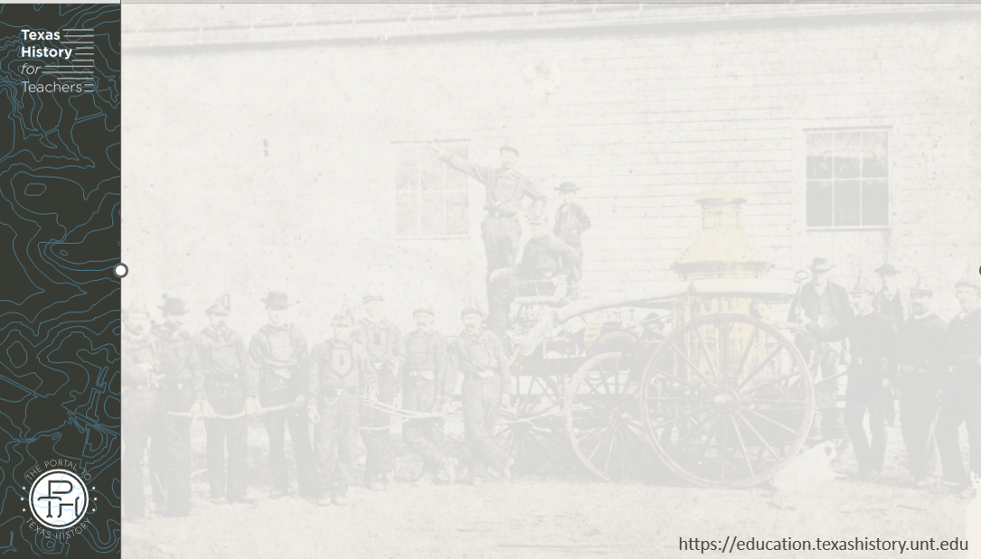
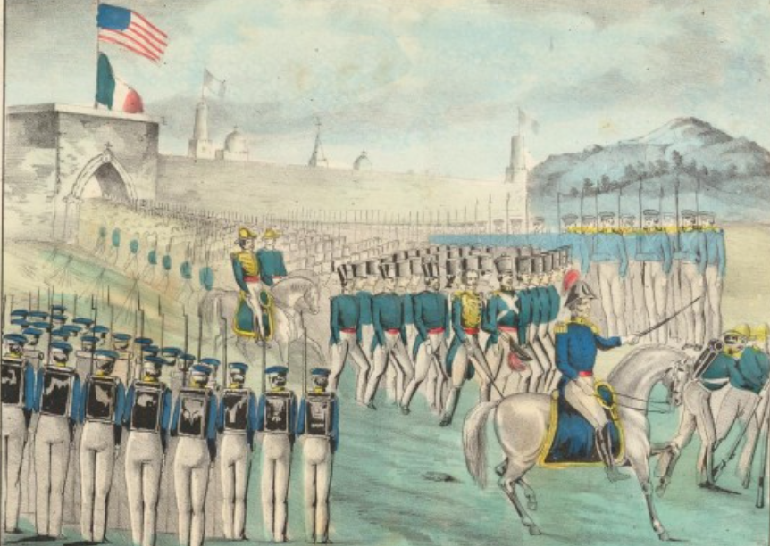
Part I: Significant Terms
The U.S. army takes Veracruz in the U.S.-Mexico War
The Portal to Texas History
Notes:
"Capitulation of Vera Cruz: The Mexican Soldiers Marching Out and Surrendering their Arms to General Scott, March 29, 1847.", image, Date Unknown; (https://texashistory.unt.edu/ark:/67531/metapth31824/: accessed June 3, 2025), University of North Texas Libraries, The Portal to Texas History, https://texashistory.unt.edu; crediting Star of the Republic Museum.

Slide 7
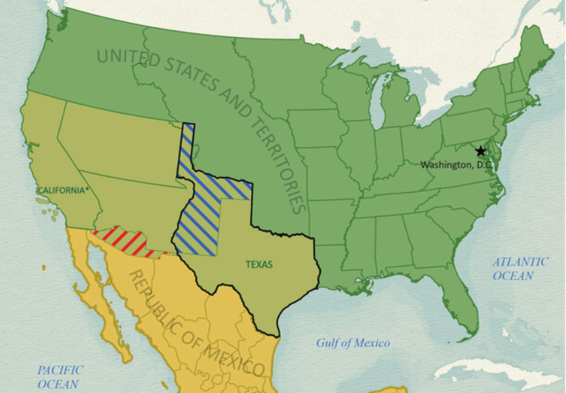
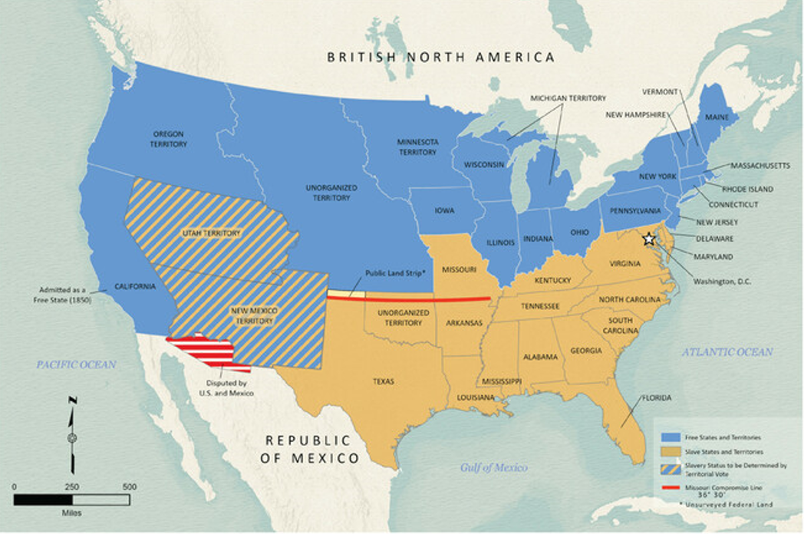
Part II: Cause-and-Effect Matching
1848 Borders of the United States
Texas General Land Office
1850 Borders of the United States
Texas General Land Office
Notes:
Disputed Territory Between Mexico and the United States, 1845-1854. GIS Educational Maps. Ben Snider (Compiler) Lila Rakoczy (Compiler) Kelsey Bonnell (Compiler) "Disputed Territory Between Mexico and the United States, 1845 - 1848" (97129) and “Northern Mexico Campaign of the U.S.-Mexico War, 1846 – 1847” (97152)
https://historictexasmaps.com/object/97251
Map of the Compromise of 1850. Justin Arroyos (Compiler), Lila Rakoczy (Compiler), Kelsey Bonnell (Compiler), GIS Educational Maps, Texas General Land Office. Accessed July 30, 2025. https://historictexasmaps.com/object/97358

Slide 8
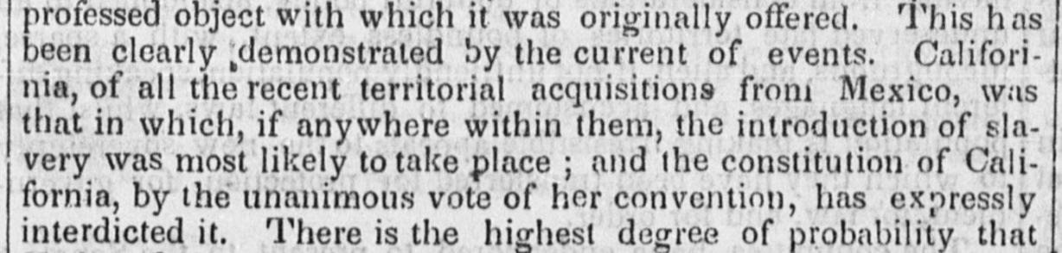
Part III: Practice Test Questions
The Texas State Gazette, Austin, Texas. Saturday, June 8, 1850
The Portal to Texas History
Notes:
Texas State Gazette. (Austin, Tex.), Vol. 1, No. 42, Ed. 1, Saturday, June 8, 1850, newspaper, June 8, 1850; Austin, Texas. (https://texashistory.unt.edu/ark:/67531/metapth80932/: accessed July 30, 2025), University of North Texas Libraries, The Portal to Texas History, https://texashistory.unt.edu; crediting The Dolph Briscoe Center for American History.

Slide 9
Exit Ticket
Follow the directions to complete your exit ticket
Complete the graphic organizer assessing your knowledge and readiness for our unit 6 test.
Share with a partner

Slide 10
Share with the class 2
(Choose one thing to share from your exit ticket)

