Slide 1
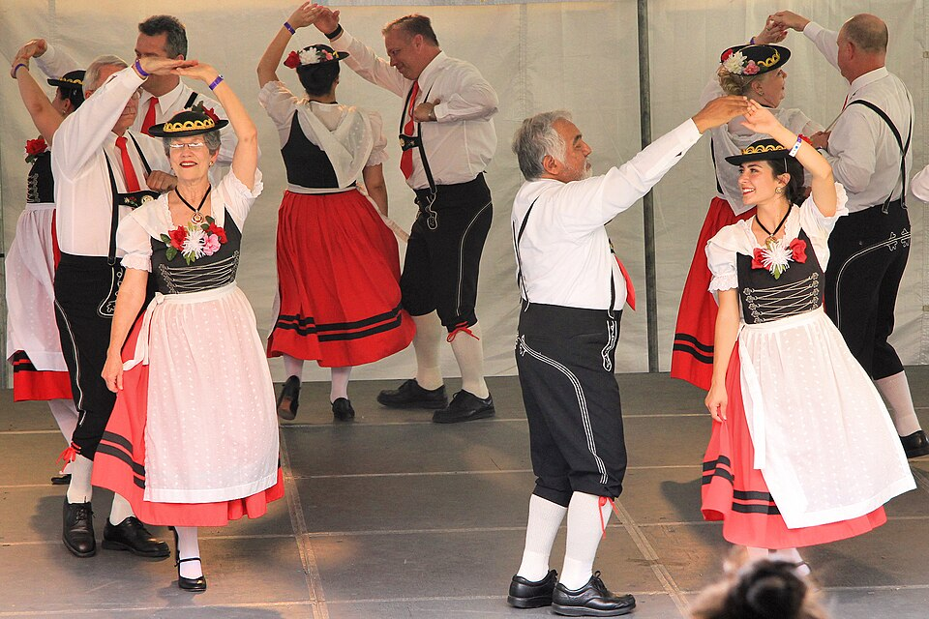
Unit 7:
Early Statehood
Lesson 10:
Texas Today
Notes:
Texas German folklife festival, 2013. The German Folk dancers of San Antonio perform at the 42nd Texas Folklife Festival in San Antonio, Texas, United States. © 2013 Larry D. Moore. Licensed under CC BY 4.0.
Attribution Specification: Reuse without attribution is a violation of the license. The photographer's name and the link to the license are required. A link back to this source is requested. Example: Larry D. Moore, CC BY 4.0, Wikimedia Commons. This file is licensed under the Creative Commons Attribution 4.0 International license. Accessed July 31, 2025. https://commons.wikimedia.org/wiki/File:Texas_folklife_festival_german1_2013.jpg

Slide 2

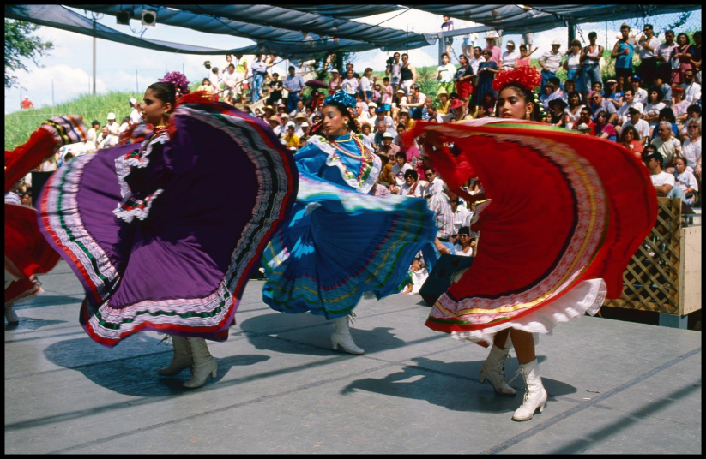
Warm-up
Follow the directions to complete your warm-up

Slide 3


Share with the class
One observation I can you make about how people preserve their culture based on the image is __________________
One other way people can preserve their culture is _____________

Slide 4

Essential Question
How do different groups of people in Texas preserve their unique cultures and heritage today?

Slide 5

In today’s lesson…
We will examine how different cultural groups in Texas including Tejanos, American Indians, and those with German and Polish ancestry work to preserve their unique cultures and heritage today.
I will use a reading to research and record information about one cultural group. I will teach my classmates about my chosen group and learn about theirs.

Slide 6
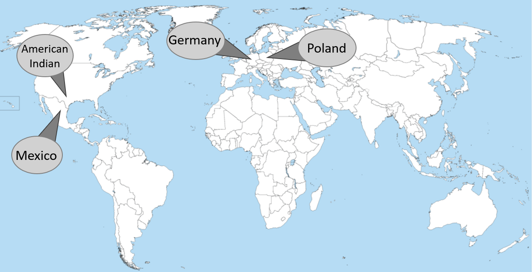
Preserving Cultural Heritage in Texas Today
Notes:
A large blank world map with oceans marked in blue. Edited to identify Germany, Poland, Mexico, and the location of American Indians in Texas. This file is licensed under the Creative Commons Attribution-Share Alike 4.0 International license. Accessed Aug. 4, 2025. https://commons.wikimedia.org/wiki/File:20230519193449!A_large_blank_world_map_with_oceans_marked_in_blue_(1).png

Slide 7

Choose one People Group to Learn About . . .

Slide 8
Preserving German Culture and Heritage
Notes:
Texas German folklife festival, 2013. The German Folk dancers of San Antonio perform at the 42nd Texas Folklife Festival in San Antonio, Texas, United States. © 2013 Larry D. Moore. Licensed under CC BY 4.0.
Attribution Specification: Reuse without attribution is a violation of the license. The photographer's name and the link to the license are required. A link back to this source is requested. Example: Larry D. Moore, CC BY 4.0, Wikimedia Commons. This file is licensed under the Creative Commons Attribution 4.0 International license. Accessed July 31, 2025. https://commons.wikimedia.org/wiki/File:Texas_folklife_festival_german1_2013.jpg

Slide 9
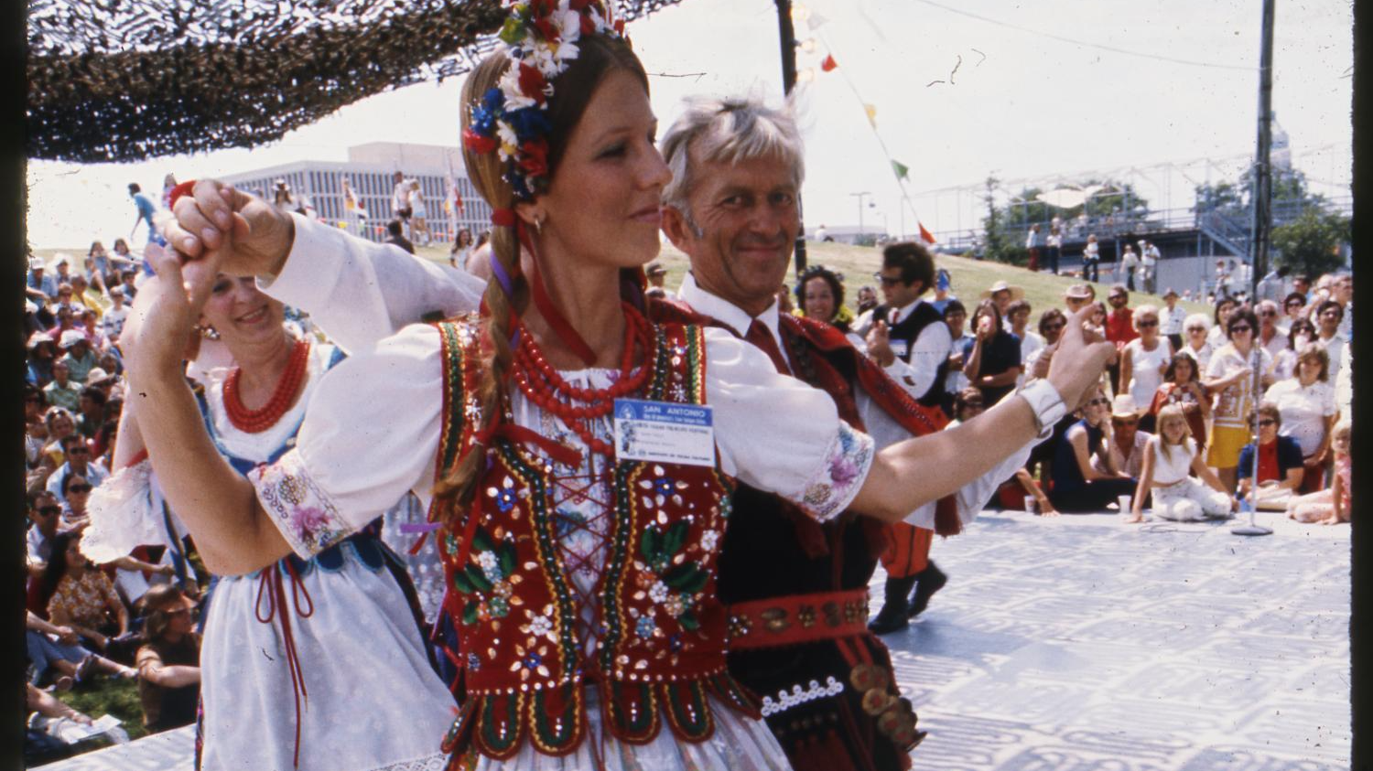
Preserving Polish Culture and Heritage
Notes:
[Austin Polish Folk Dance Performance at the Texas Folklife Festival - August 1975], photograph, [1975-08-07..1975-08-10]; (https://texashistory.unt.edu/ark:/67531/metapth227967/: accessed July 31, 2025), University of North Texas Libraries, The Portal to Texas History, https://texashistory.unt.edu; crediting UT San Antonio Libraries Special Collections.

Slide 10

Preserving Mexican Culture and Heritage
Notes:
Informedia. [Ballet Folklorico Dancers], photograph, [1990-08-02..1990-08-05]; (https://texashistory.unt.edu/ark:/67531/metapth300827/: accessed August 4, 2025), University of North Texas Libraries, The Portal to Texas History, https://texashistory.unt.edu; crediting UT San Antonio Libraries Special Collections.

Slide 11
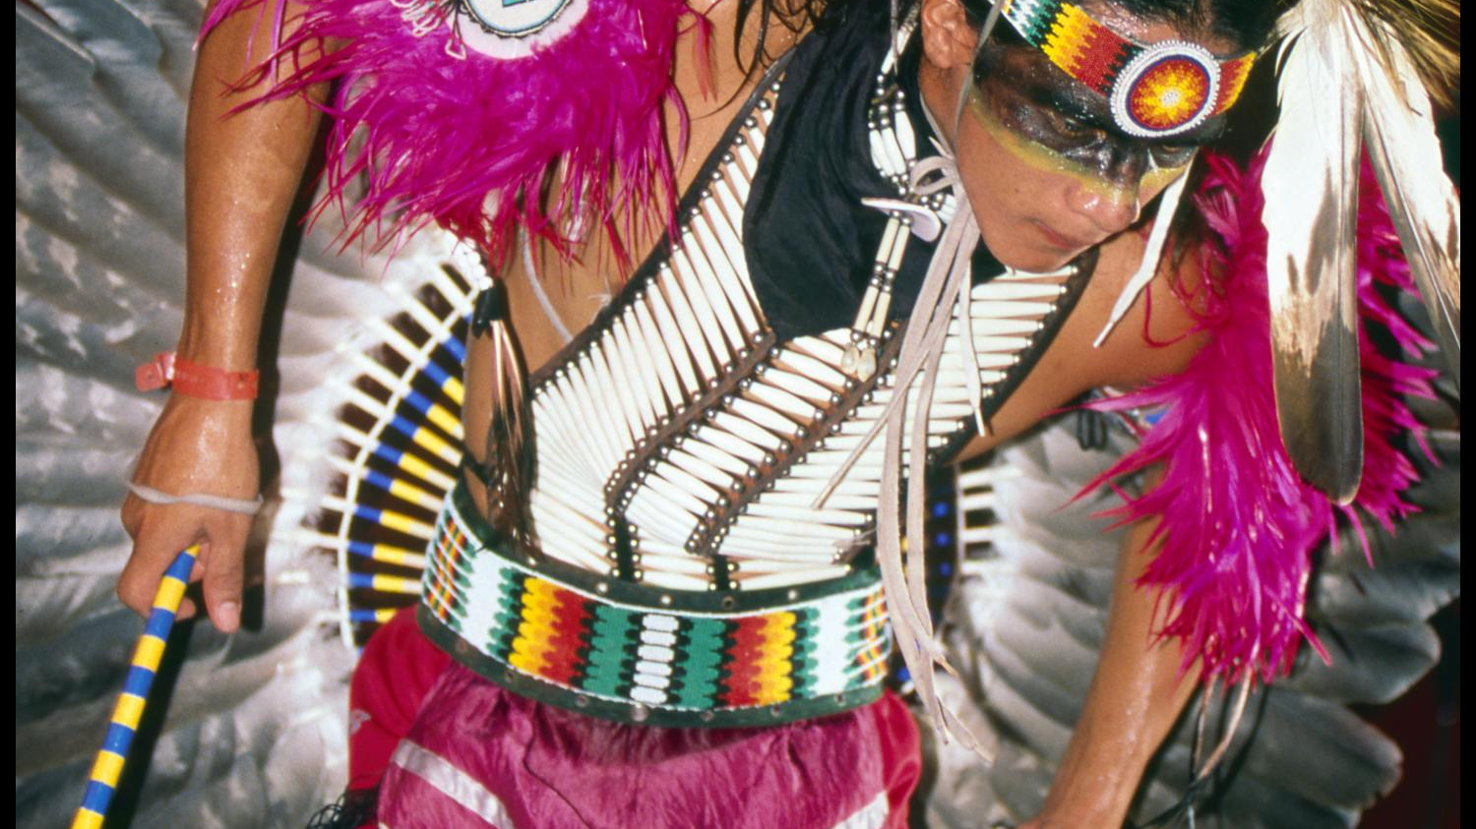
Preserving American Indian Culture and Heritage
Notes:
Informedia. [Alabama-Coushatta Dancing Demonstration], photograph, [1990-08-02..1990-08-05]; (https://texashistory.unt.edu/ark:/67531/metapth300787/: accessed August 4, 2025), University of North Texas Libraries, The Portal to Texas History, https://texashistory.unt.edu; crediting UT San Antonio Libraries Special Collections.

Slide 12
Teach & Learn from your classmates . . .

Slide 13
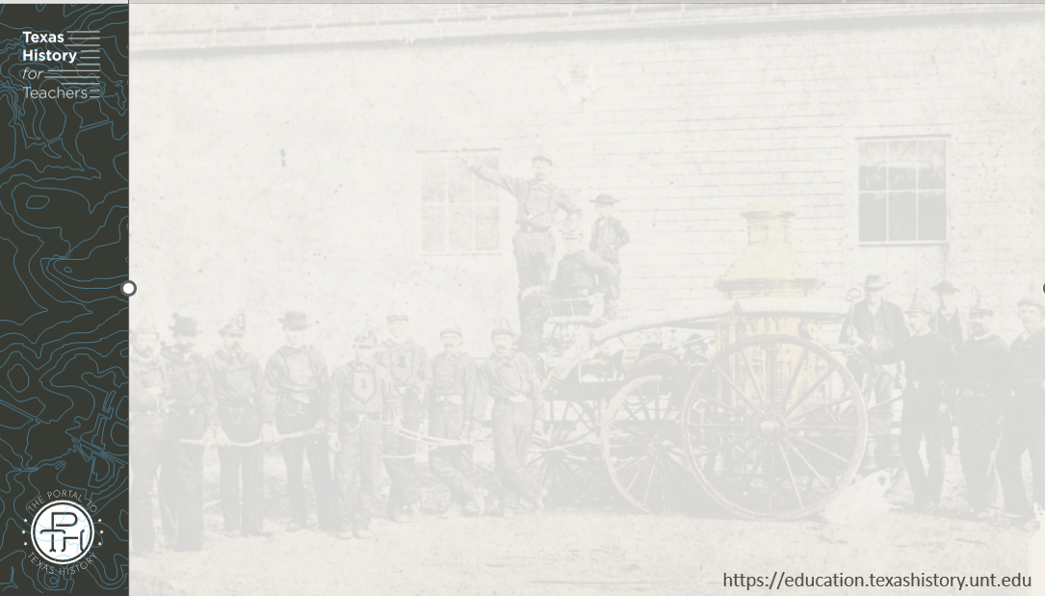
Share what you learned
One thing I learned about / German / Polish / Tejano / American Indian culture in Texas today is that _________

Slide 14


Exit Ticket
Follow the directions to complete your exit ticket
Complete the paragraph by filling in the blanks and circling or highlighting information from given options.
Share with a partner.

Slide 15
Share with the class 2
People from various cultural groups in Texas today work to preserve their cultures and heritage in a number of ways, like __________
For example, many / German / Polish / Tejano / American Indian people preserve their culture by _______________________

