Slide 1
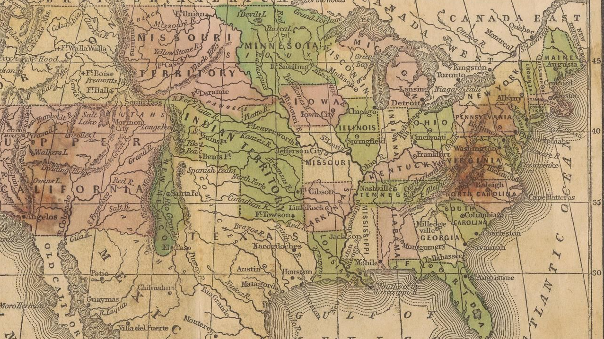
Unit 7:
Early Statehood
Lesson 1:
The Big Picture
Notes:
Ensigns & Thayer. Map of the United States and Mexico, including Oregon, Texas and the Californias. 1848. University of North Texas Libraries, The Portal to Texas History; crediting University of Texas at Arlington Library. Accessed on July 1, 2025. (https://texashistory.unt.edu/ark:/67531/metapth298378

Slide 2
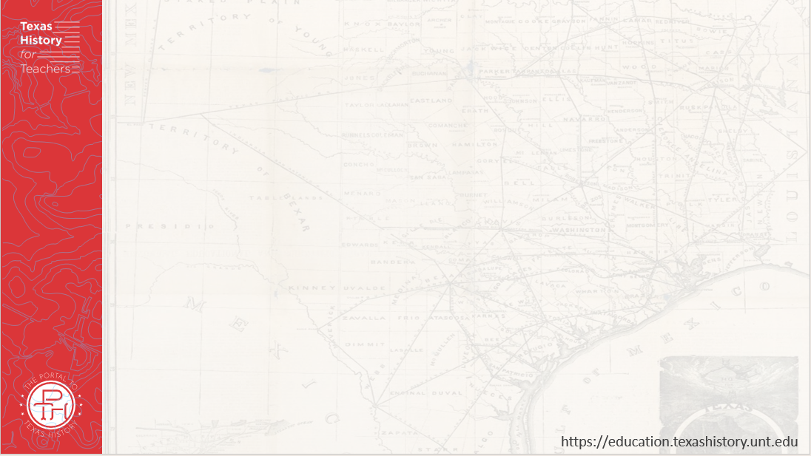





Warm-up
Follow the directions below to complete your warm-up
Consider the events of our last unit: The Republic of Texas.
Circle or highlight each item in the answer bank that you think is true for Texas as we begin this new unit.
Share with a partner.

Slide 3

Share with the class:
One thing that I think is true for Texas as we begin this new unit is _________

Slide 4

Essential Question
What are the key events, major themes, and defining characteristics of the Early Statehood era of Texas history?

Slide 5

In Today’s Lesson
We will identify the main ideas, themes, key events, and defining characteristics of the Early Statehood era of Texas history.
I will analyze a primary source image, identify major themes and significant information related to this era, and demonstrate the cause-and-effect relationships between significant events.

Slide 6

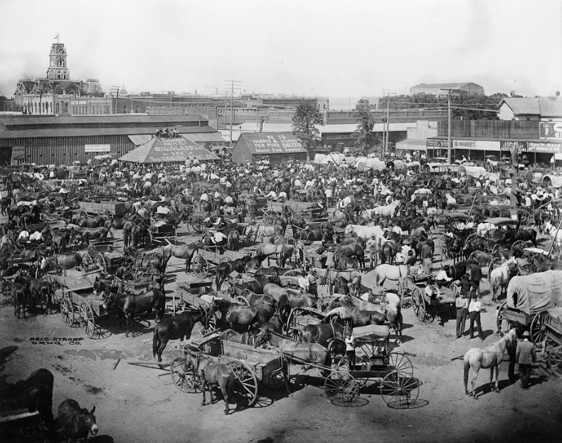
Part I: Analyze an Image
Notes:
Sturdevant, E. K. Market Square, Cleburne, Texas. 1850. Photograph. Library of Congress Prints and Photographs. Accessed on July 1, 2025. https://www.loc.gov/item/2006682448/

Slide 7

Part II: Essential Ideas Reading Passage

Slide 8
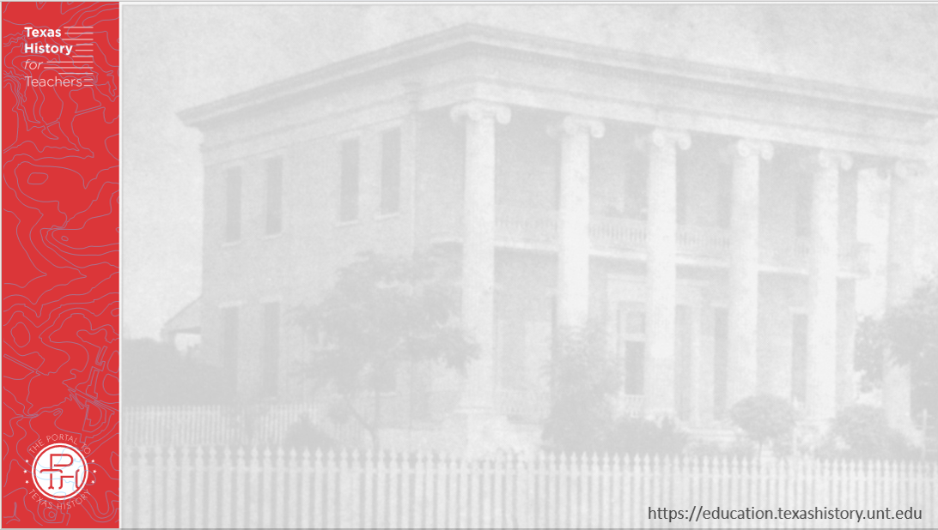
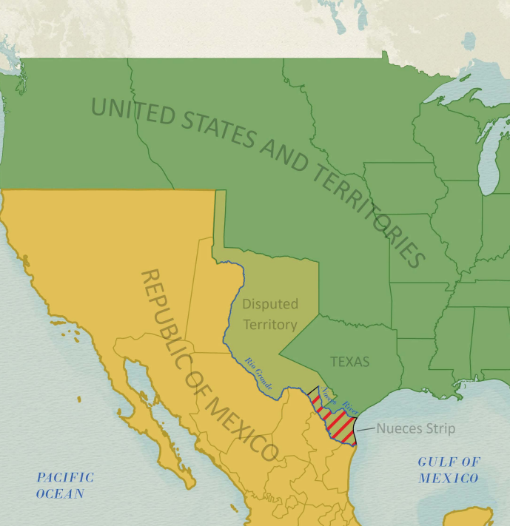
Paragraph 1:
The Annexation of Texas
The political borders of North America after Texas annexation in 1846.
The Texas General Land Office
Notes:
Disputed Territory Between Mexico and the United States. GIS Educational Maps. Kevin Greszler (Compiler) Lila Rakoczy (Compiler) James Harkins (Compiler)
"Northern Mexico Campaign of the U.S. - Mexico War, 1846-1847" (97152) and “Disputed Territory Between Mexico and the United States, 1845 – 1854” (97251) Texas General Land Office. Accessed on July 1, 2025. https://historictexasmaps.com/object/97129

Slide 9
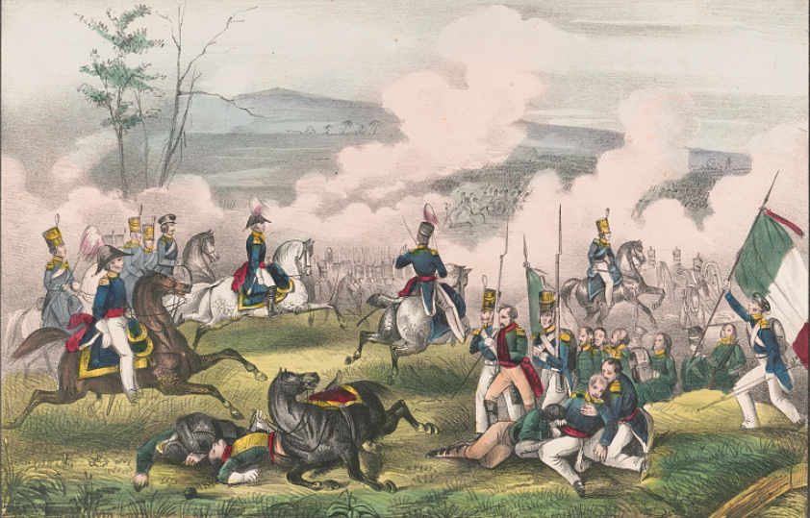
Paragraph 2: The U.S.-Mexico War
The Battle of Palo Alto: The first major battle of the U.S.-Mexico War
Library of Congress
Notes:
E.B. & E.C. Kellogg. Battle of Palo Alto--May 8th , between 2900 Americans, under Genl. Taylor, and 6000 Mexicans, commanded by Genl. Arista ... / E.B. & E.C. Kellogg, Hartford, Conn. ; D. Needham, Buffalo. 1846. Lithograph. Library of Congress Prints and Photographs Division. https://www.loc.gov/item/98513698/. "Northern Mexico Campaign of the U.S. - Mexico War, 1846-1847" (97152) and “Disputed Territory Between Mexico and the United States, 1845 – 1854” (97251) Texas General Land OfficeAccessed on July 1, 2025.. https://historictexasmaps.com/object/97129

Slide 10
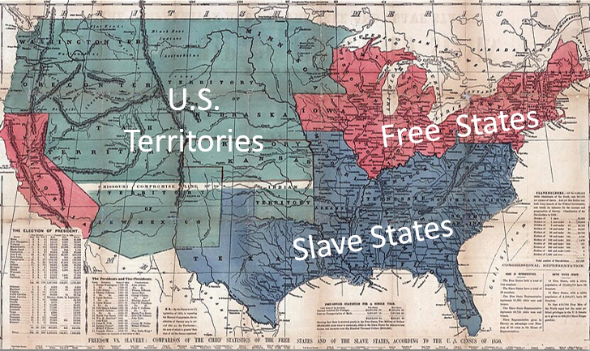
Paragraph 3: Westward Expansion
Notes:
Map of U.S. free and slave states, 1850s. This work is in the public domain in its country of origin and other countries and areas where the copyright term is the author's life plus 70 years or fewer. Accessed on July 1, 2025. https://commons.wikimedia.org/wiki/File:Map_of_U.S._free_and_slave_states,_1850s.jpg

Slide 11
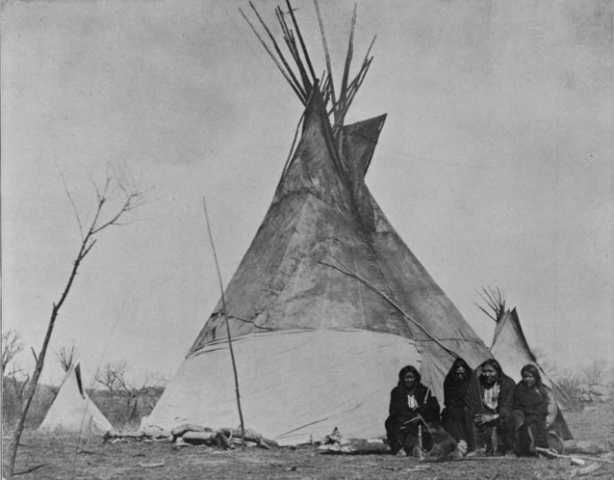
Paragraph 4: Population Growth in Texas
Comanche Indian camp, late 19th Century
Library of Congress
Notes:
Soule, William S. Comanche Indian camp. ca. 1890. Photograph. Library of Congress Prints and Photographs Division. Accessed on July 1, 2025. https://www.loc.gov/item/00650194/

Slide 12
Exit Ticket
Follow the directions below to complete your exit ticket
Match the CAUSE statement on the left with its correct EFFECT statement on the right.
Share with a partner.

Slide 13
Share with the class: 2
(Choose ONE statement on the left and read it here)
One effect of this event was that …
(Read the correct effect from the right)

