Slide 1
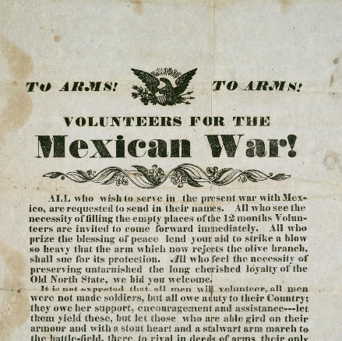




Unit 7:
Early Statehood
Lesson 5:
U.S.-Mexico War
Notes:
To Arms! To Arms! Volunteers for the Mexican War!. December 5, 1846. Poster. University of North Texas Libraries, The Portal to Texas History; crediting Star of the Republic Museum. https://texashistory.unt.edu/ark:/67531/metapth31112.

Slide 2

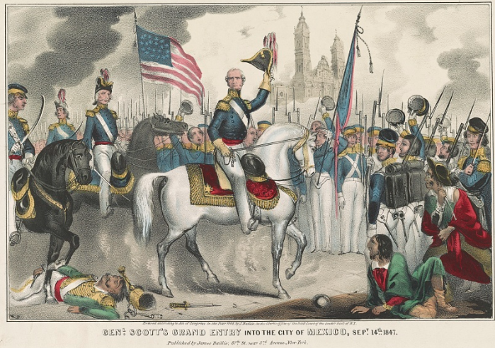
Warm-up
Use the image to complete your warm-up
Notes:
Baillie, James S. Genl. Scott's grand entry into the city of Mexico, Sept. 14th, 1847. 1848. Lithograph. Library of Congress Prints and Photographs Division. Accessed on July 17, 2025. https://www.loc.gov/item/2002719717/

Slide 3

Share with the class
One inference I can make about today’s lesson based on the title and image is that ______________

Slide 4

Essential Question
What were the causes, key events, and significance of the U.S.-Mexico War?

Slide 5

In today’s lesson…
We will identify and summarize the key causes, events, effects, and significance of the U.S.-Mexico War.
I will use my guided note-taking worksheet to record significant information about the U.S.-Mexico War.

Slide 6
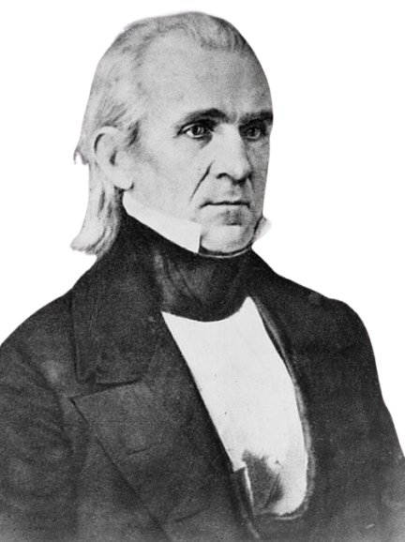
James K. Polk
U.S. President 1845 – 1849
Goal: Westward expansion of the U.S. to the Pacific Ocean.
Why?
  Better access to profitable markets with Asia
  “Manifest Destiny”
James K. Polk
The Library of Congress
Notes:
President James K. Polk, half-length portrait, seated, facing right. ca. 1855. Photograph. Library of Congress Prints and Photographs Division. Accessed on July 1, 2025. https://www.loc.gov/item/96522397/

Slide 7

The U.S.-Mexico War

Slide 8

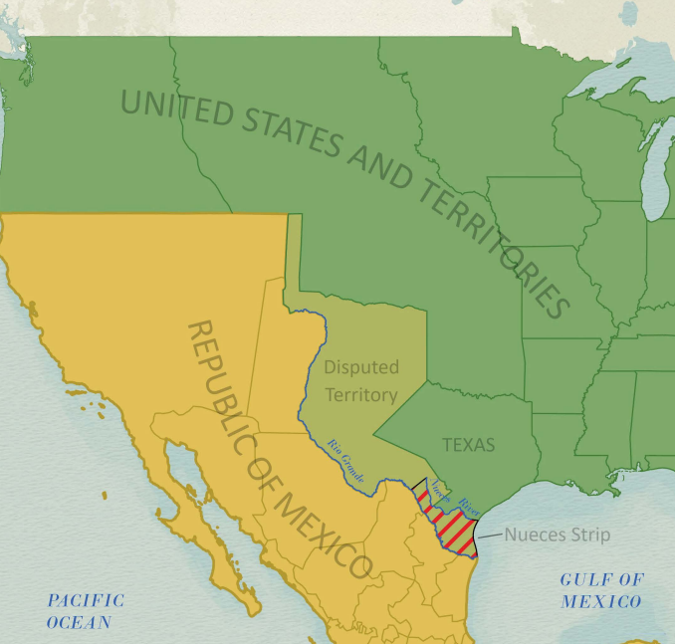
Causes of the U.S.-Mexico War
Mexico opposed the U.S. annexation of Texas
Disputes between the U.S. and Mexico over the southern border of Texas
Texas General Land Office
Notes:
Disputed Territory Between Mexico and the United States. GIS Educational Maps. Kevin Greszler (Compiler) Lila Rakoczy (Compiler) James Harkins (Compiler)
"Northern Mexico Campaign of the U.S. - Mexico War, 1846-1847" (97152) and “Disputed Territory Between Mexico and the United States, 1845 – 1854” (97251) Texas General Land Office. Accessed on July 1, 2025 https://historictexasmaps.com/object/97129

Slide 9
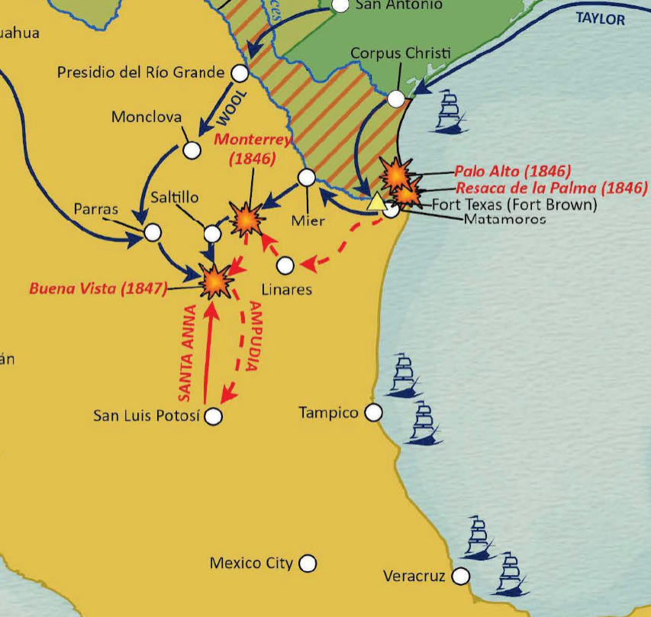
Notable Battles
Battle of Palo Alto: (May 1846) The first battle of the war
Battle of Buena Vista: (February 1847) American General Zachary Taylor defeated Santa Anna in one of the largest battles of the war.
Capture of Mexico City: (September 1847) Leads to the end of the war.
Texas General Land Office
Notes:
Northern Mexico Campaign of the U.S. - Mexico War, 1846 -1847. GIS Educational Maps. Ellyson Wong (Compiler) Lila Rakoczy (Compiler) "Disputed Territory Between Mexico and the United States" (97129) and “Disputed Territory Between Mexico and the United States, 1845 – 1854” (97251) Texas General Land Office. Accessed on July 1, 2025 https://historictexasmaps.com/object/97152

Slide 10
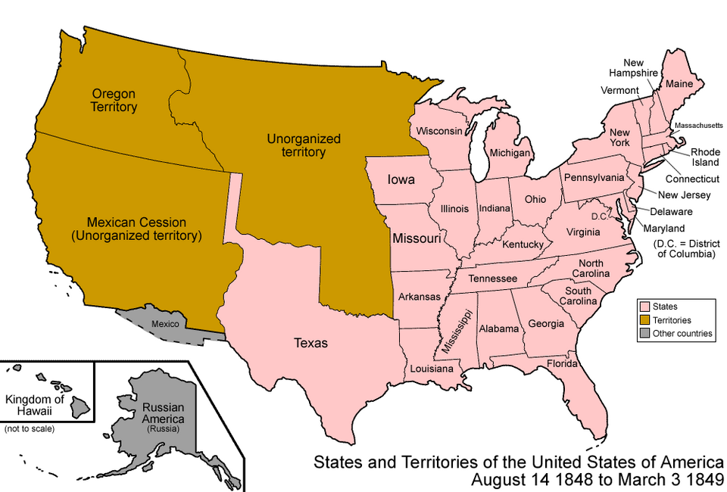
Treaty of Guadalupe Hidalgo
February 1848
Mexico ceded all its land from Texas west to California.
The U.S. paid Mexico $15 million for the land.
Mexican citizens in the ceded territory could automatically become U.S. citizens.
Notes:
States and Territories of the United States of America 1848 – 1849. Map of the states and territories of the United States as it was from August 1848 to 1849. On August 14 1848, Oregon Territory was organized. On March 3 1849, Minnesota Territory was organized. I, the copyright holder of this work, hereby publish it under the following licenses:
Permission is granted to copy, distribute and/or modify this document under the terms of the GNU Free Documentation License, Version 1.2 or any later version published by the Free Software Foundation; with no Invariant Sections, no Front-Cover Texts, and no Back-Cover Texts. A copy of the license is included in the section entitled GNU Free Documentation License. Accessed on July 1, 2025. https://commons.wikimedia.org/wiki/File:United_States_1848-08-1849.png

Slide 11
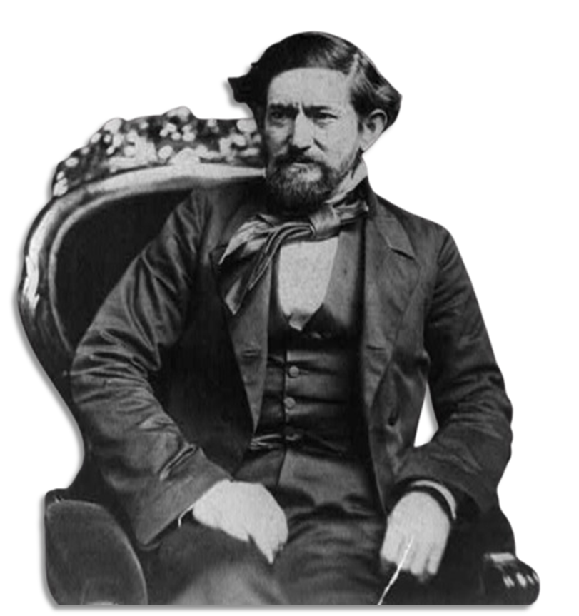
Texas & the U.S.-Mexico War
Approximately 8,000 Texans fought in the U.S.- Mexico War.
The Texas Rangers fought alongside the regular U.S. Army.
New army forts were built in Texas during the war.
John “Jack” Coffee Hays led a group of Rangers during the U.S.-Mexico War, taking part in the Battles of Monterrey and Buena Vista. The Library of Congress
Notes:
Brady, Mathew B. John Coffee Hays, 3/4-length portrait, seated in chair and facing left. ca. 1857. Photograph. Library of Congress Prints and Photographs Division. https://www.loc.gov/item/2002712549/

Slide 12
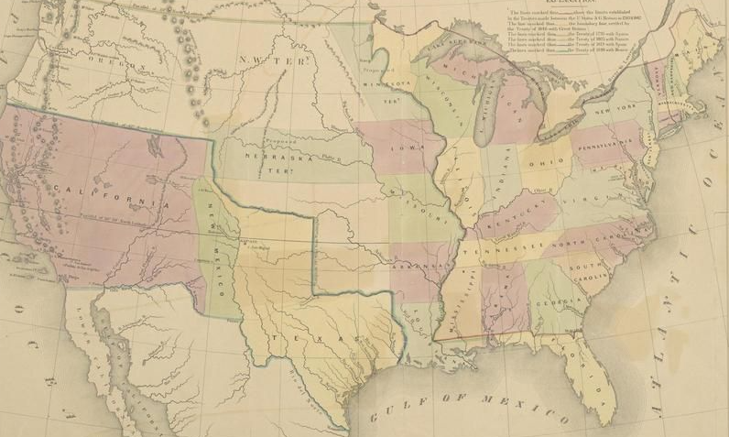
Significance of the U.S. – Mexico War
The Rio Grande is solidified as Texas’ southern border.
The U.S. now extends fully to the west coast.
The new lands of the Mexican Cession start new arguments about the expansion of slavery in the U.S.
Map of the United States 1848-54
The Portal to Texas History
Notes:
Gilman, E. [Map of the United States]. ca. 1848-54. University of North Texas Libraries, The Portal to Texas History; crediting University of Texas at Arlington Library. https://texashistory.unt.edu/ark:/67531/metapth193521

Slide 13

Exit Ticket
Use the image to complete your exit ticket
Write at least ONE cause and ONE effect of the U.S.-Mexico War based on the information in your notes.
Share with a partner

Slide 14
Share with the class 2
One cause / effect of the U.S.- Mexico War was ______________

