Slide 1
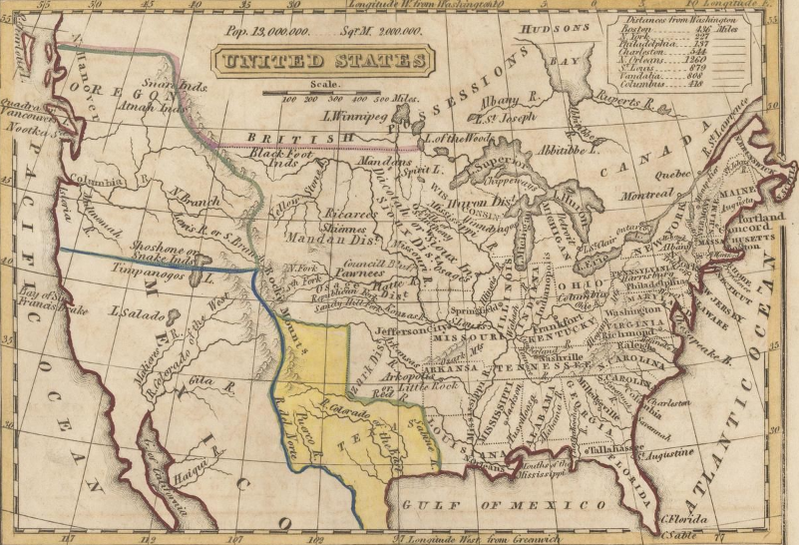
Unit 7:
Early Statehood
Lesson 3:
Vocabulary
Notes:
Boynton, George W. United States. ca. 1835-55. University of North Texas Libraries, The Portal to Texas History; crediting University of Texas at Arlington Library. https://texashistory.unt.edu/ark:/67531/metapth192700

Slide 2
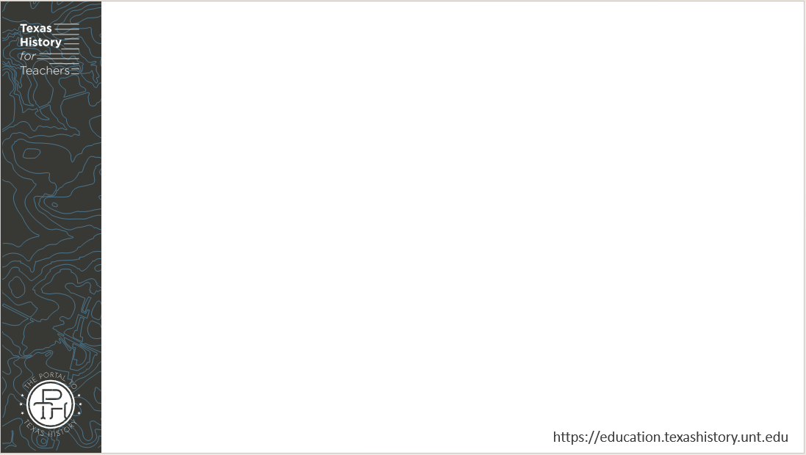




Warm-up
Follow the directions to complete your warm-up
Read the passage.
Use the context of the reading to answer questions about the term cede.
Share your responses with a partner

Slide 3

Share with the class
“Based on the context in the passage, I think the term cede . . .”

Slide 4
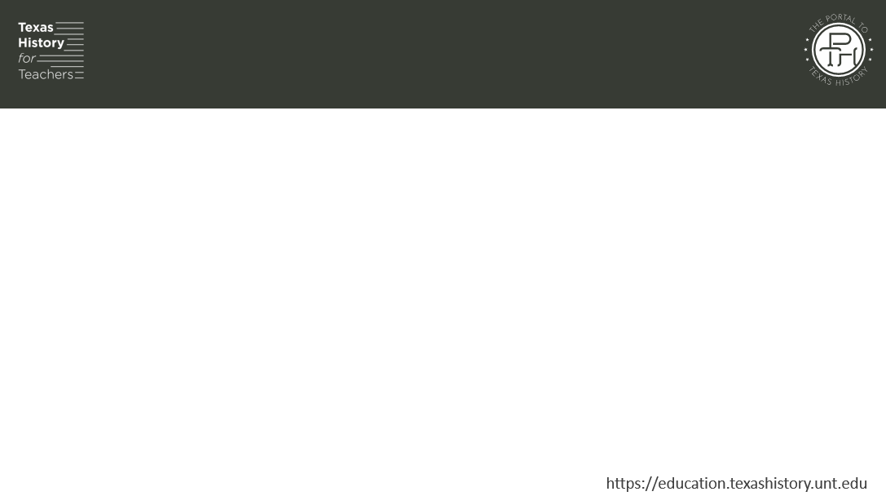
Essential Question
What are the key terms we need to know to be successful in the early Texas statehood unit?

Slide 5

In today’s lesson…
We will identify, define, and exemplify the key terms of Unit 7: Early Statehood.
I will use the information and context of several short passages to identify and record the definition of each term and provide examples of the term in the context of our unit.

Slide 6
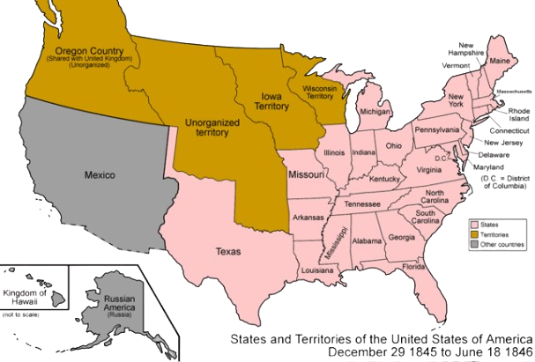
Manifest Destiny (n)
When Texas was officially annexed to the United States in 1845, the map of the U.S. looked very different from today. Much of the southwest belonged to Mexico, including the modern-day states of California, Arizona, Utah, and parts of New Mexico, Colorado, and Wyoming. Many Americans wanted the U.S. to expand into this territory all the way to the Pacific Ocean.
The primary reason Americans supported westward expansion was to gain easier access to profitable markets across the Pacific Ocean in Asia. Later, some would also make the claim that America was always meant to expand across the continent – that it was even destined by God. This belief is often referred to as Manifest Destiny.
Notes:
Map of the United States, 1845. Permission is granted to copy, distribute and/or modify this document under the terms of the GNU Free Documentation License, Version 1.2 or any later version published by the Free Software Foundation; with no Invariant Sections, no Front-Cover Texts, and no Back-Cover Texts. A copy of the license is included in the section entitled GNU Free Documentation License. This file is licensed under the Creative Commons Attribution-Share Alike 3.0 Unported license. Wikimedia Commons. Accessed on June 26, 2025. https://commons.wikimedia.org/wiki/File:United_States_1845-12-1846-06.png

Slide 7
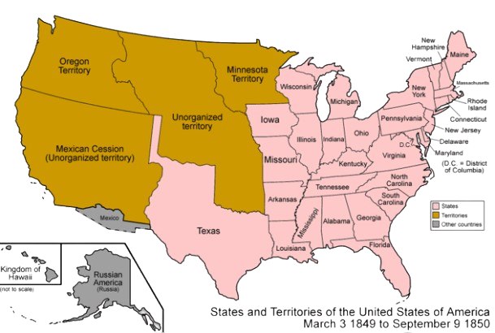
Cession (n)
After Texas was annexed to the United States, disputes over the border between Texas and Mexico led to a war between the United States and Mexico. The U.S. defeated Mexico, which was still struggling with its own ongoing civil war between centralists and federalists. The Treaty of Guadalupe-Hidalgo ended the U.S. – Mexico War in 1848 and set the terms for peace.
According to the Treaty of Guadalupe-Hidalgo, Mexico ceded, or gave up, all if its land west of Texas to the Pacific Ocean. This included the modern-day states of California, Utah, Arizona, parts of New Mexico, Colorado and Wyoming. This area of land was known as the Mexican Cession, or the land that was surrendered.
Notes:
Map of the states and territories of the United States as it was from 1849 to 1850. Made by User:Golbez. See Charles O. Paullin and John K. Wright's Atlas of the Historical Geography of the United States (1932) for PD maps which support these. I, the copyright holder of this work, hereby publish it under the following licenses:
Permission is granted to copy, distribute and/or modify this document under the terms of the GNU Free Documentation License, Version 1.2 or any later version published by the Free Software Foundation; with no Invariant Sections, no Front-Cover Texts, and no Back-Cover Texts. A copy of the license is included in the section entitled GNU Free Documentation License. This file is licensed under the Creative Commons Attribution-Share Alike 3.0 Unported license. Wikimedia Commons. Accessed on June 26, 2025. https://commons.wikimedia.org/wiki/File:United_States_1849-1850.png

Slide 8
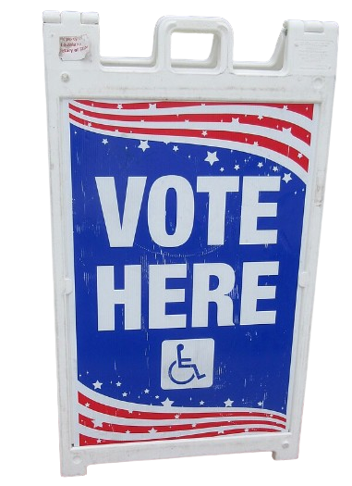
Popular Sovereignty (n)
The United States government was founded on several important principles, or beliefs. One of these principles is called popular sovereignty (sov – ren – ty). Popular sovereignty is the political principle that the people hold the power in the government. Not a king, not an emperor – the people. One of the primary ways the people can exercise their power is by voting.
When the United States gained the lands of the Mexican Cession, many Americans wondered if these new lands would allow slavery or not. Some believed that popular sovereignty should decide the issue of slavery. In other words, some people believed that the people of the new lands should decide for themselves by voting on whether to allow slavery or not.
Notes:
Vote Here sign, Louisiana. This file is licensed under the Creative Commons Attribution-Share Alike 2.0 Generic license.
This image was originally posted to Flickr by Infrogmation at https://flickr.com/photos/29350288@N06/54418146910. The background has been removed from the original image. It was reviewed on 29 March 2025 by FlickreviewR 2 and was confirmed to be licensed under the terms of the cc-by-sa-2.0. Wikimedia Commons. Accessed on June 26, 2025. https://commons.wikimedia.org/wiki/File:Vote_Here_sign,_Louisiana,_March_2029.jpg

Slide 9
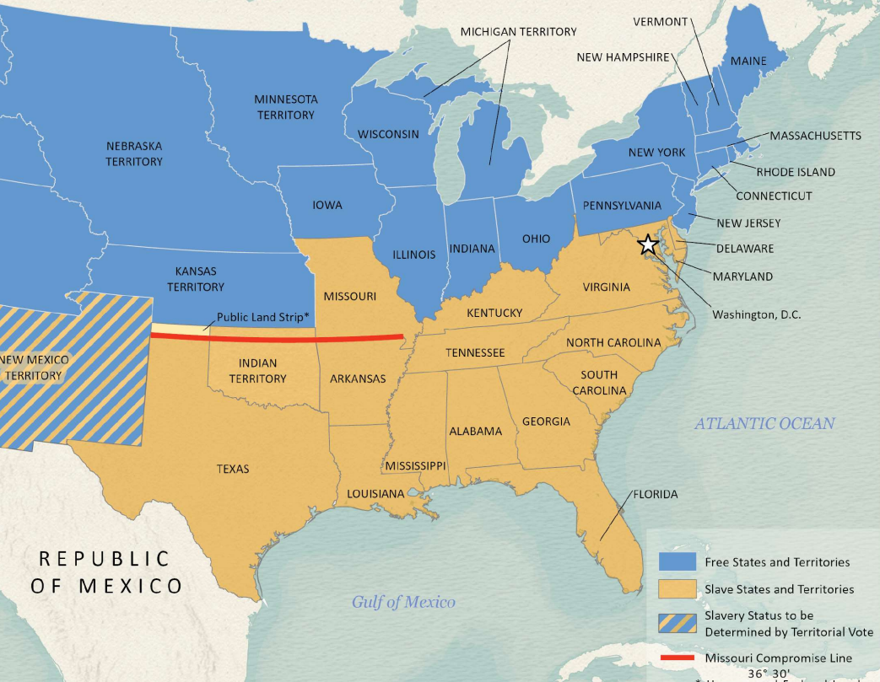
Sectionalism (n)
There were many significant differences between the northern and southern regions of the United States. The most significant difference was the issue of slavery. Southern states supported slavery because they believed their plantation-based economies depended on it. Northern states opposed slavery because they believed it lowered the value of northern labor.
The differences between the two regions caused sectionalism in the United States. Sectionalism meant that people in both regions had a strong loyalty to their own region, rather than the country as a whole.
When Texas entered the Union in 1845, it shared many of the same needs and concerns as the other southern agricultural states in the U.S. As a result, Texas would be firmly on the side of the South regarding sectionalism.
Texas General Land Office
Notes:
Kansas-Nebraska Act Map, 1854. Justin Arroyos (Compiler), Lila Rakoczy (Compiler), Kelsey Bonnell (Compiler). GIS Educational Maps. 2024. Accessed on June 26, 2025. Texas General Land Office. Kansas-Nebraska Act | 97359, Kansas-Nebraska Act, GIS Educational Maps | 97359, Kansas-Nebraska Act, GIS Educational Maps | Search results | Search | Texas GLO

Slide 10
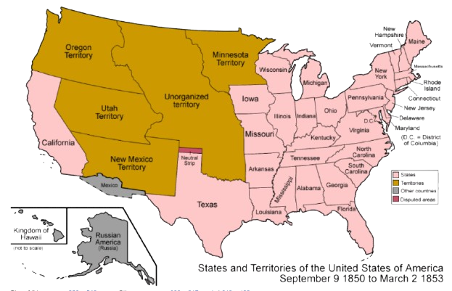
Compromise (n, v)
The question of whether slavery should spread into the new territories of the Mexican Cession caused a lot of intense arguments between people from northern and southern states during this era.
As more and more arguments between the North and South occurred, some political leaders attempted to find compromises suitable to both regions. A compromise is a decision where the people involved all agree to give up certain things in order to come to an agreement that satisfies most people.
One example was the Compromise of 1850. This compromise attempted to satisfy Southern states with stronger laws about capturing runaway slaves, while trying to also satisfy Northern states by admitting California to the Union as a free state.
Notes:
United States, 1850 – 1853. Permission is granted to copy, distribute and/or modify this document under the terms of the GNU Free Documentation License, Version 1.2 or any later version published by the Free Software Foundation; with no Invariant Sections, no Front-Cover Texts, and no Back-Cover Texts. A copy of the license is included in the section entitled GNU Free Documentation License. Accessed on June 26, 2025. This file is licensed under the Creative Commons Attribution-Share Alike 3.0 Unported license. https://commons.wikimedia.org/wiki/File:United_States_1850-1853-03.png

Slide 11
Secede (v)
Throughout the era of early statehood for Texas, debates and arguments over the expansion of slavery continued to grow between the North and the South.
Southern states, including Texas, had economies built almost entirely on plantation agriculture growing cash crops like cotton. Cultivating cash crops on plantations was incredibly labor intensive. It required a lot of workers, working long hours in difficult conditions. Most Southern states argued that slave labor was necessary for their economies to operate successfully.
Some in the South were fearful of the government passing laws to limit or even abolish slavery. Driven by this fear, South Carolina declared that, if necessary, it would secede, or officially separate from the country, to protect its right to maintain slavery. Other southern states, like Texas, began to consider the possibility of secession as well.
By 1860, the United States was facing a crisis: What would happen if the Southern states seceded? Would the U.S. become two different countries, instead of one? Would the separation be peaceful, or would it lead to violence? Would it even lead to war?

Slide 12
Exit Ticket
Follow the directions to complete your exit ticket
Which items in the chart do you think best relate to our unit?
Circle or highlight all related items.
Share your responses with a partner

Slide 13
Share with the class 2
One term I chose was____________. I think this term is related to our unit because ______________________.

