Slide 1
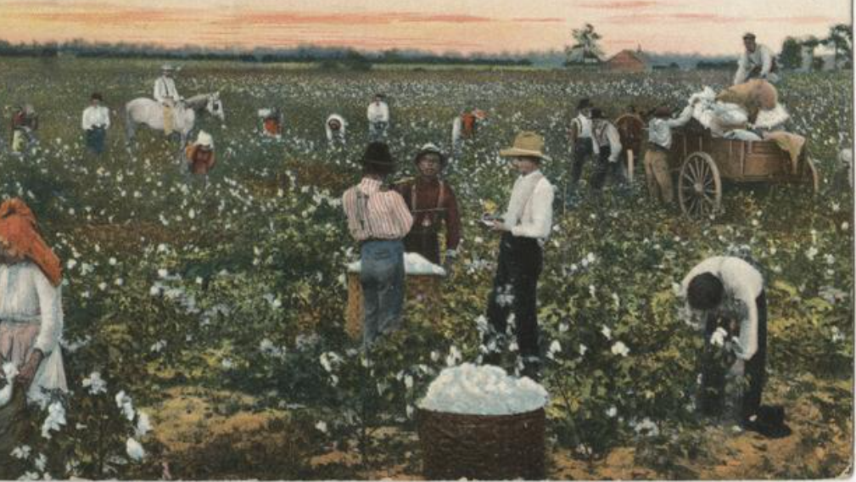
Unit 7:
Early Statehood
Lesson 4:
What’s the story?
Notes:
Elgin, Mrs. Tom. "Picking Cotton", Marshall, Texas, postcard, [1907..1915]; New York, New York. (https://texashistory.unt.edu/ark:/67531/metapth1512357/: accessed July 8, 2025), University of North Texas Libraries, The Portal to Texas History, https://texashistory.unt.edu; crediting Harrison County Historical Museum.

Slide 2
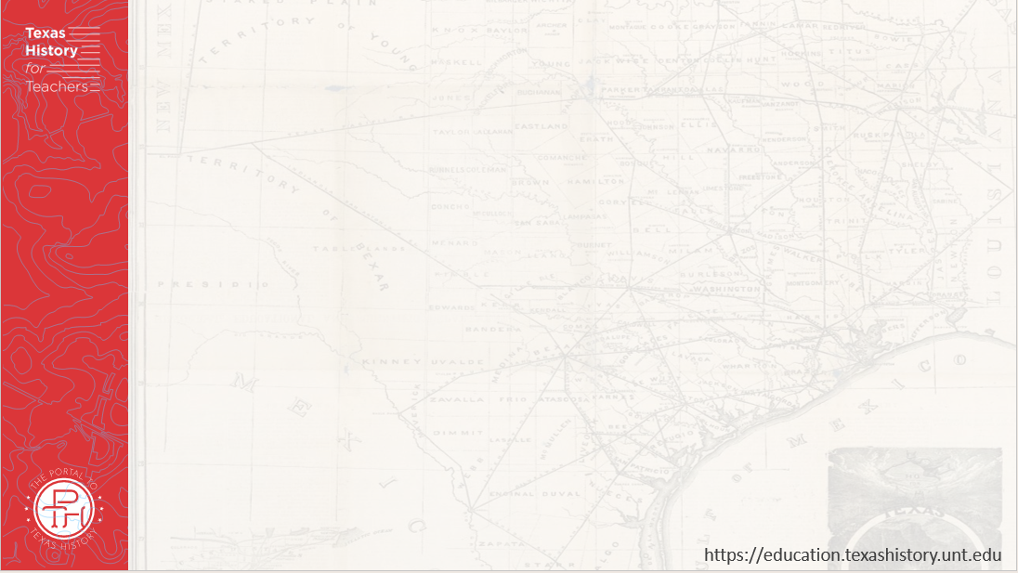

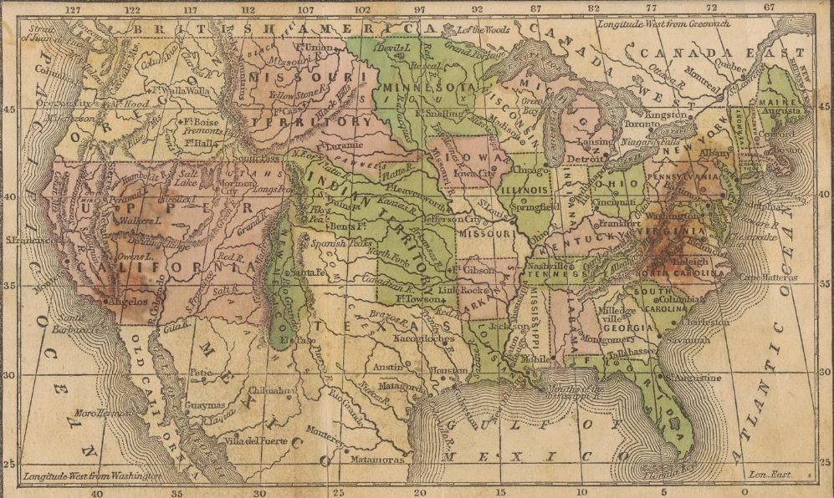




Warm-up
Use the map to complete your warm-up
Notes:
Map of the United States and its territories. ca. 1848-54. University of North Texas Libraries, The Portal to Texas History; crediting University of Texas at Arlington Library. https://texashistory.unt.edu/ark:/67531/metapth288759/

Slide 3
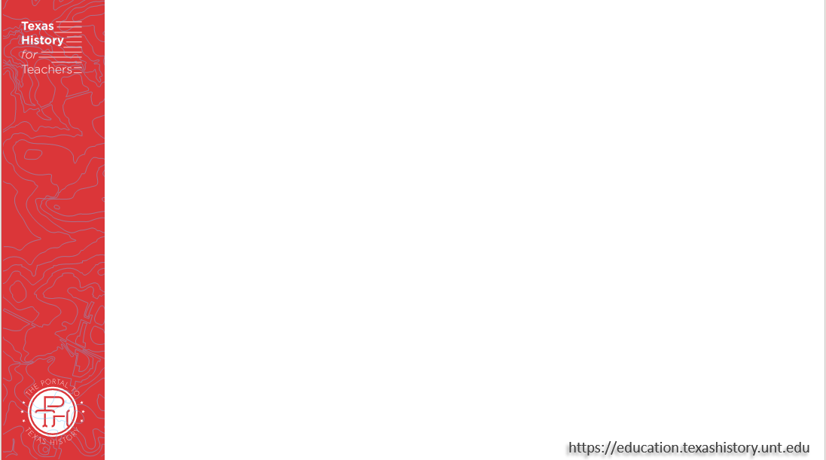
Share with the class:
One thing I observe about the map is ______
One similarity this map shares with current maps of the U.S. is _________
One difference between this map and current maps of the U.S. is _________

Slide 4
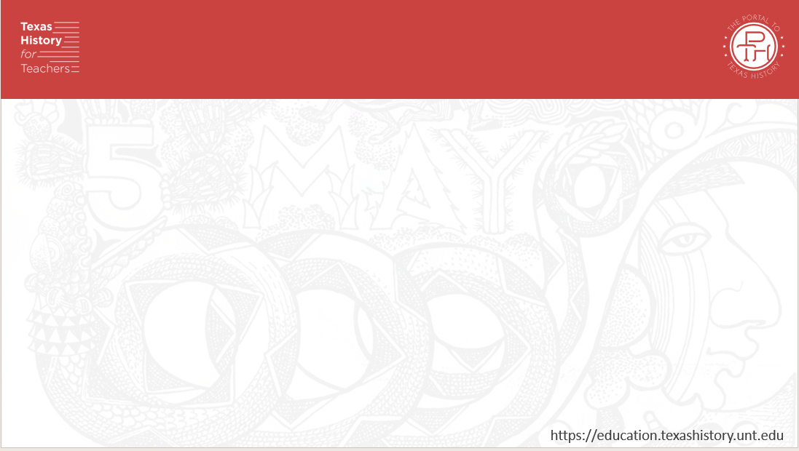
Essential Question
What are the defining characteristics and most significant events of the Early Statehood era? ?

Slide 5
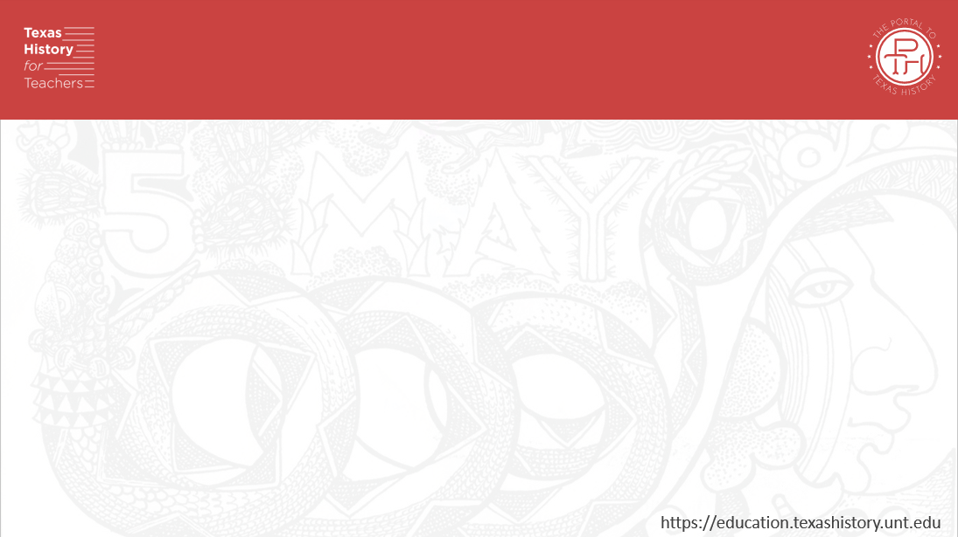
In Today’s Lesson
We will examine a chronology of the significant events that took place during early statehood and identify their significance to Texas history.
I will read short passages about each event, identify key information, explain cause and effect relationships, and determine how the event is significant to Texas history.

Slide 6
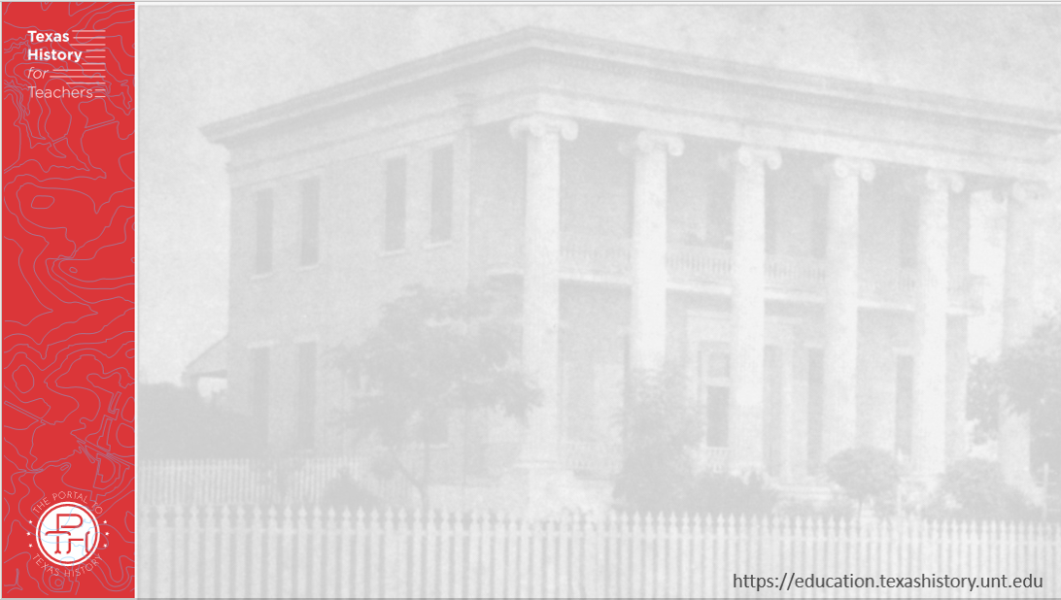
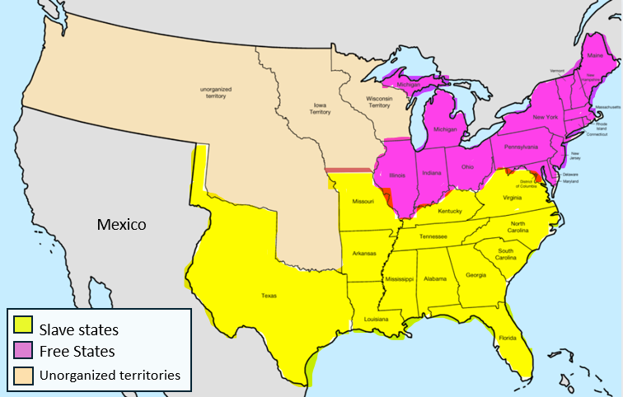
1. The North, the South, and Slavery in America
Notes:
United States Central map 1846-06-15 to 1846-12-28. Map of the United States in central North America from June 15, 1846, to December 28, 1846. This file is licensed under the Creative Commons Attribution-Share Alike 4.0 International license. Edited to include a representation of the location of slave states and free states. Accessed on July 15, 2025. https://commons.wikimedia.org/wiki/File:United_States_Central_map_1846-06-15_to_1846-12-28.png

Slide 7
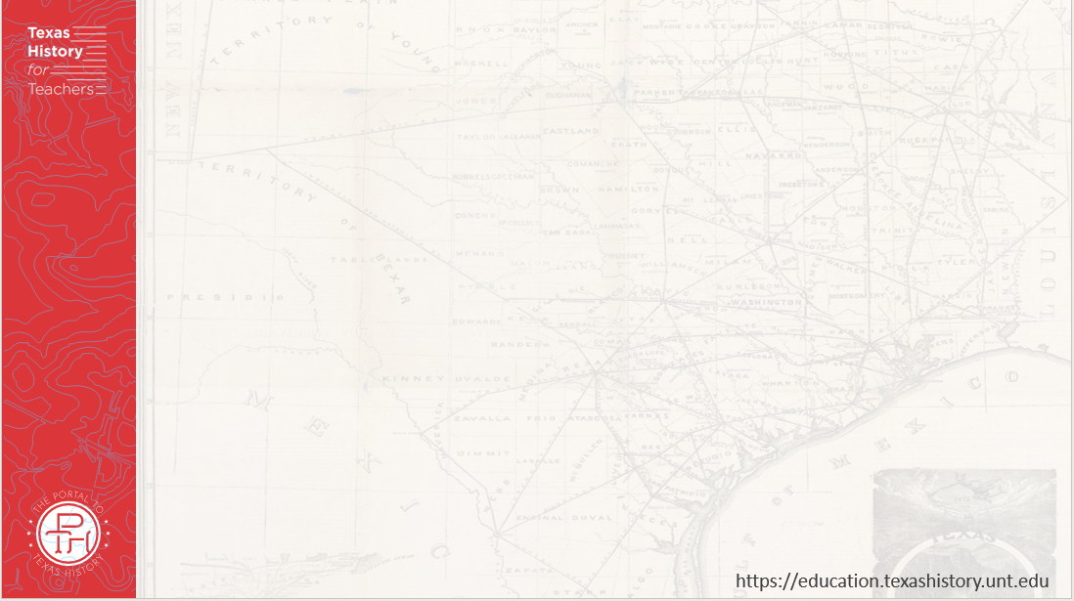
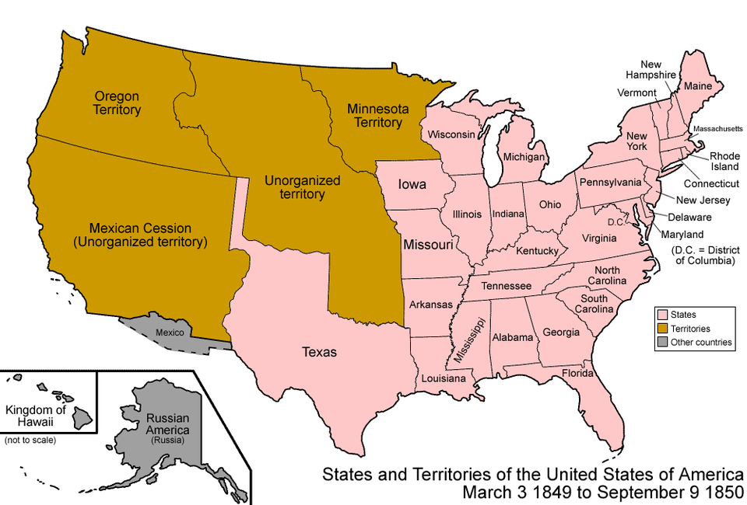
2. The U.S. – Mexico War 1846 – 1848
Notes:
United States 1848-08-1849. Map of the states and territories of the United States as it was from August 1848 to 1849. On August 14 1848, Oregon Territory was organized. On March 3 1849, Minnesota Territory was organized. Accessed on July 15, 2025. This file is licensed under the Creative Commons Attribution-Share Alike 3.0 Unported license. https://commons.wikimedia.org/wiki/File:United_States_1848-08-1849.png

Slide 8
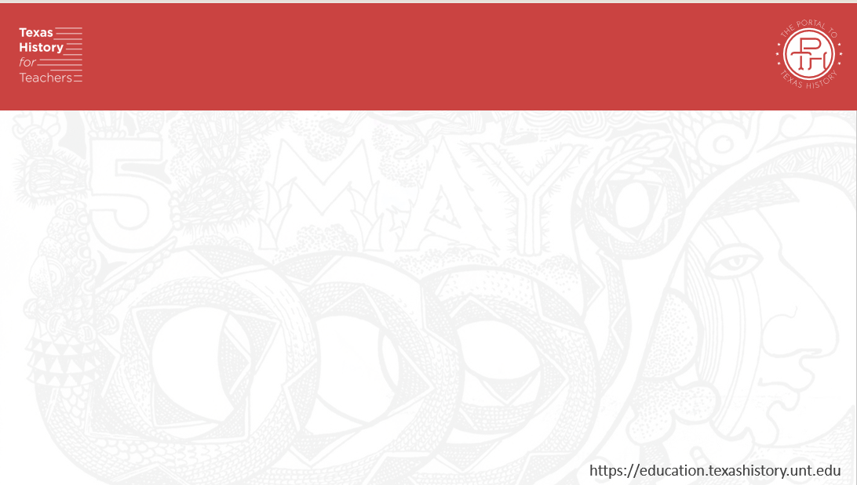
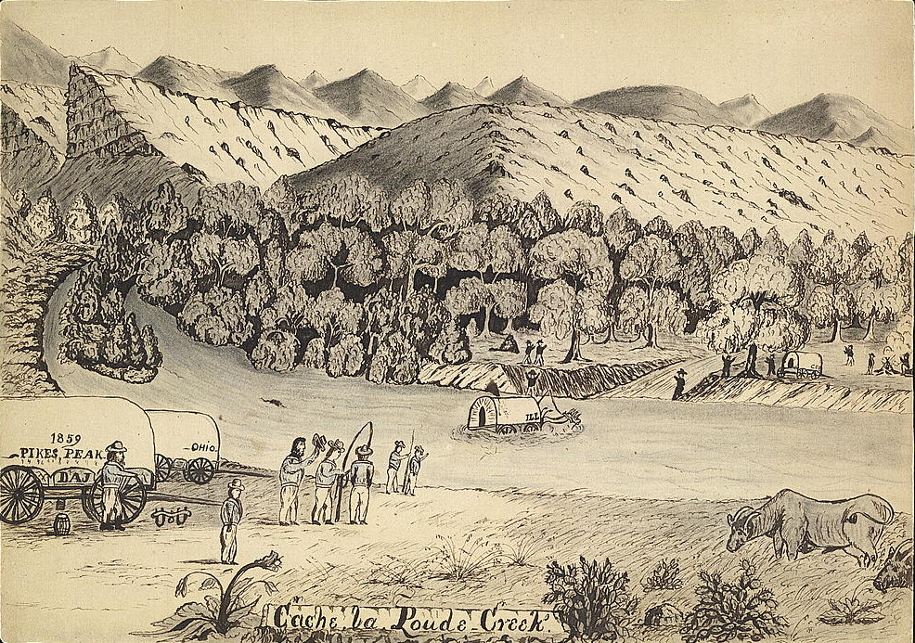
3. The Gold Rush & the Compromise of 1850
Pioneers traveling west during the California Gold Rush.
The Library of Congress
Notes:
Cache la Poudre Creek, by Daniel Jenkins. 1859. Library of Congress. Accessed on July 8, 2025. http://hdl.loc.gov/loc.pnp/ppmsc.04814

Slide 9
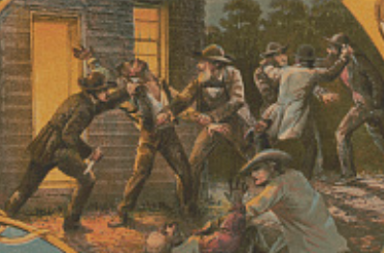
4. The Kansas-Nebraska Act 1854
An image titled, “Old John Brown’s Career.” The caption for this image (not pictured here) states: “Doing his Kansas work murdering Doyle and his 2 sons.” The Library of Congress
Notes:
Queen, James Fuller, 1820 Or , Artist, and Frederick J Pilliner. Old John Brown's career illustrated / J. Queen del & lith ; lith. F. Pilliner Philadelphia. West Virginia Charles Town Kansas, 1860. [Philadelphia, Pa.: Presented to the yearly subscribers of the Philadelphia Weekly All over the Land by E.S. Dean Publisher & Proprietor 337 Chesnut St. Philadelphia, Pa., ?] Photograph. https://www.loc.gov/item/2015647834/.

Slide 10
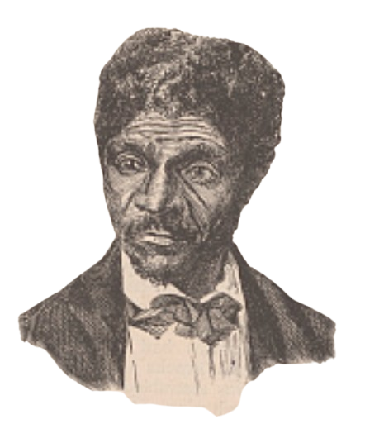
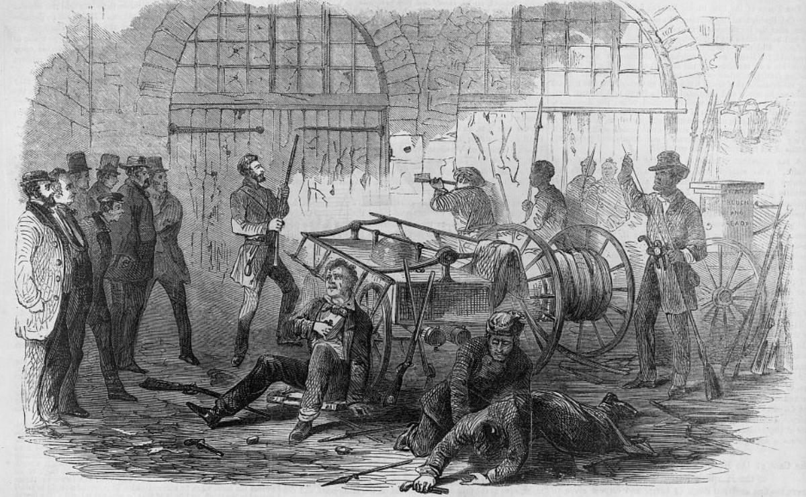
5. Conflicts Over Slavery Continued to Grow
Dred Scott
The Library of Congress
John Brown’s raid on Harper’s Ferry
The Library of Congress
Notes:
Century Company, Publisher. Dred Scott. Harriet, wife of Dred Scott. , 1887. [New York: Century Co., June] Photograph. https://www.loc.gov/item/2014645331/.
Harper's Ferry insurrection - Interior of the Engine-House, just before the gate is broken down by the storming party - Col. Washington and his associates as captives, held by Brown as hostages. Harpers Ferry West Virginia, 1859. Photograph. https://www.loc.gov/item/2002735881/.

Slide 11
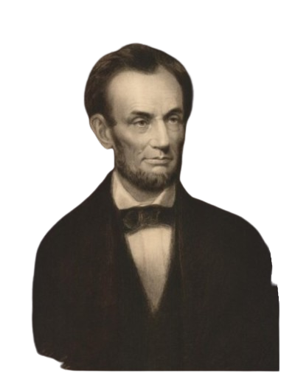
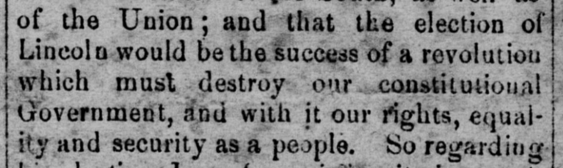
The Election of 1860
The Navarro Express newspaper from Corsicana, Texas
November 23, 1860
The Portal to Texas History
Abraham Lincoln
The Portal to Texas History
Notes:
Carpenter, F. B. Engraved print of Abraham Lincoln, artwork, 1864; (https://texashistory.unt.edu/ark:/67531/metapth31111/: Background removed. accessed July 8, 2025), University of North Texas Libraries, The Portal to Texas History, https://texashistory.unt.edu; crediting Star of the Republic Museum.
Modrall, N. P., Rev. & Van Horn, R. A. The Navarro Express (Corsicana, Tex.), Vol. 2, No. 1, Ed. 1 Friday, November 23, 1860, newspaper, November 23, 1860; Corsicana, Texas. (https://texashistory.unt.edu/ark:/67531/metapth179272/: accessed July 8, 2025), University of North Texas Libraries, The Portal to Texas History, https://texashistory.unt.edu; crediting The Dolph Briscoe Center for American History.

Slide 12
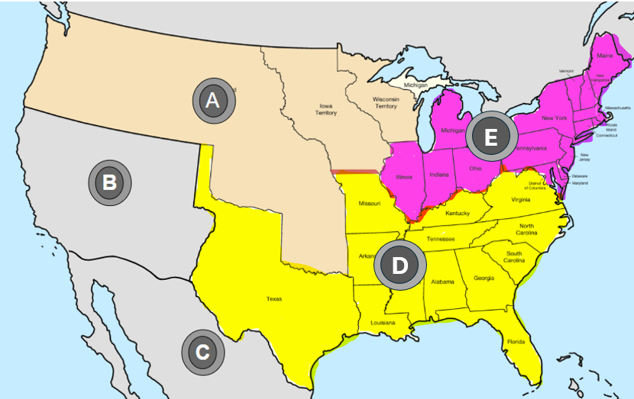
Exit Ticket
Follow the directions to complete your exit ticket
Match the letter on the map with the correct description of each territory on your exit ticket.
Share with a partner
Notes:
United States Central map 1847-03-13 to 1848-05-29. Map of the United States in central North America from March 13, 1847, to May 29, 1848. This file is licensed under the Creative Commons Attribution-Share Alike 4.0 International license. Edited to add 5 letters over prominent regions of North America for students to be able to label. Accessed on July 15, 2025. https://commons.wikimedia.org/wiki/File:United_States_Central_map_1847-03-13_to_1848-05-29.png

Slide 13
Share with the class: 2
The territory located at letter ______ is (answer number and description of territory)

