Slide 1
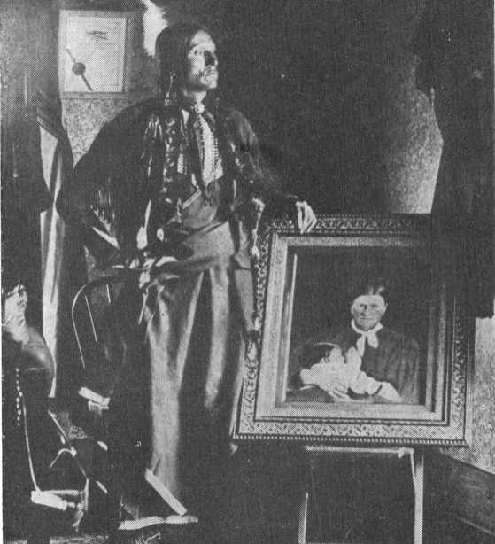





Unit 7:
Early Statehood
Lesson 5:
Who’s Who of Early Statehood
Comanche chief, Quanah Parker, beside a portrait of his mother, Cynthia Ann Parker holding his little sister, Topsannah.
The Portal to Texas History
Notes:
Jackson, Grace. Cynthia Ann Parker, book, 1959; San Antonio, Texas. (https://texashistory.unt.edu/ark:/67531/metapth1013946/: accessed July 18, 2025), University of North Texas Libraries, The Portal to Texas History, https://texashistory.unt.edu; .

Slide 2
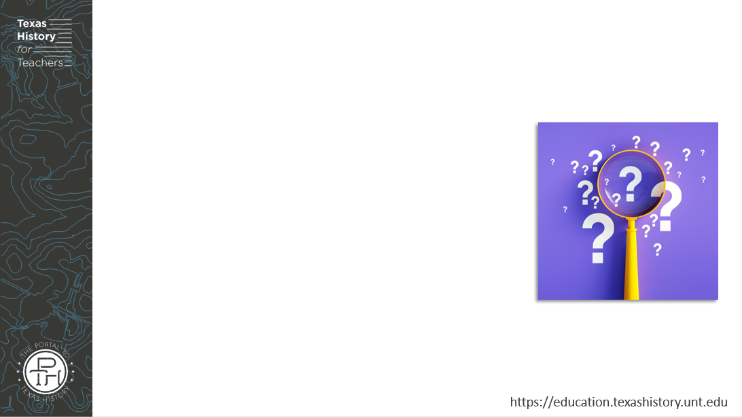
Warm-up
Follow the directions to complete your warm-up
Read the options of different groups of people in Texas during this era.
Choose ONE point of view, circle or highlight it.
Write a short “day in the life” journal entry from that point of view.
Discuss with a partner

Slide 3
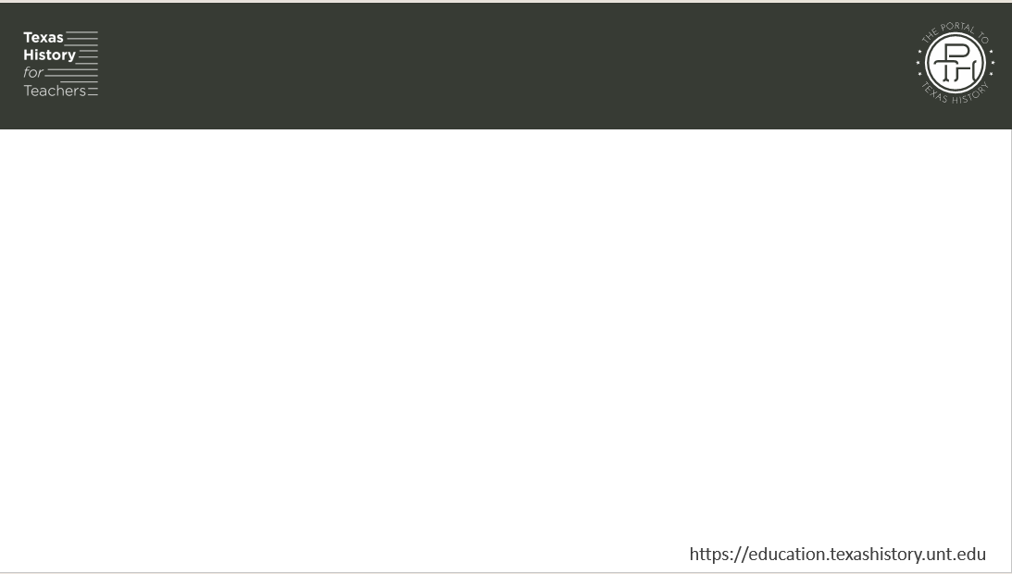
Share with the class
I chose ____________________. A journal entry from a day in the life of this person might sound like _________________________

Slide 4

Essential Question
Who were some of the key people of Early Texas Statehood, and why were they significant to the era?

Slide 5

In today’s lesson…
We will study key people of Early Texas Statehood, identifying important information about their lives and their significance to the era.
I will use the reading or readings provided to record significant information about people from the Early Texas Statehood era.

Slide 6
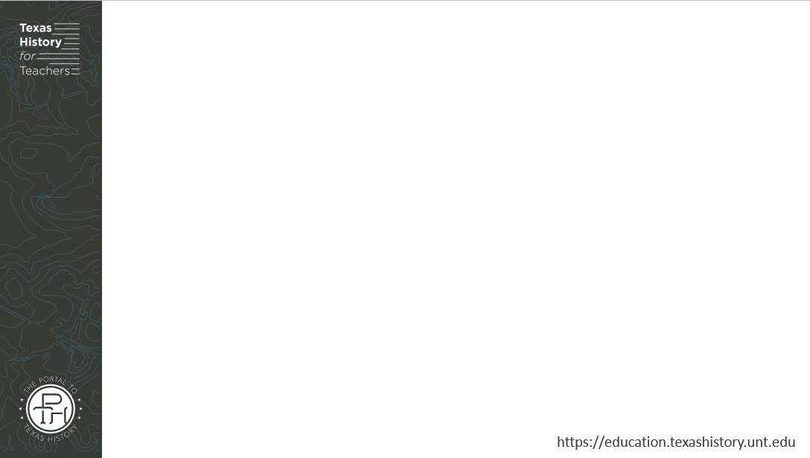
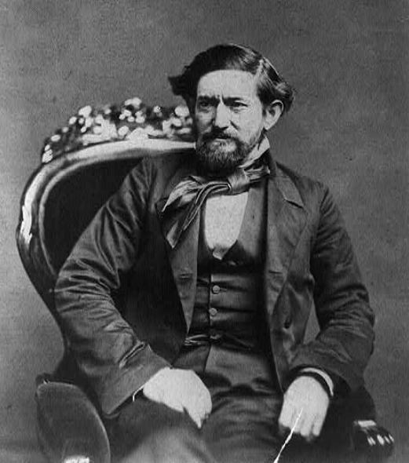
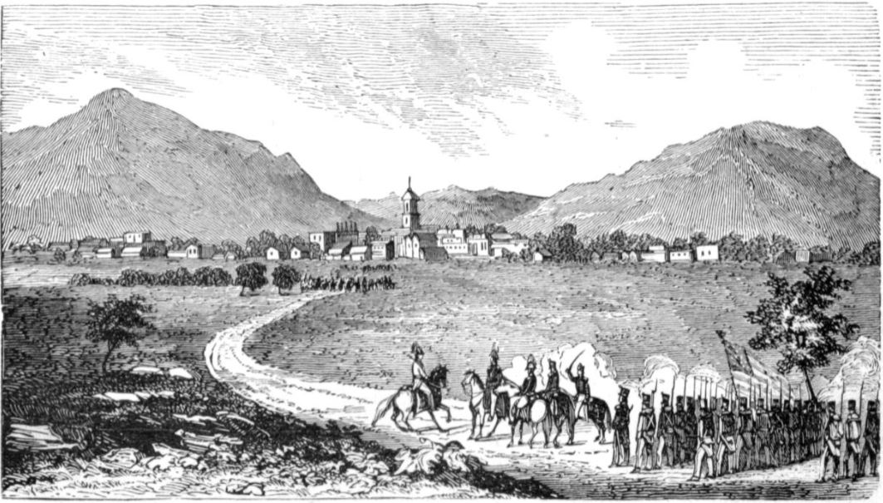
John “Jack” Coffee Hays
Rangers approaching Marín, Mexico.
The Portal to Texas History
Library of Congress
Notes:
Brady, Mathew B. John Coffee Hays, 3/4-length portrait, seated in chair and facing left. ca. 1857. Photograph. Library of Congress Prints and Photographs Division. https://www.loc.gov/item/2002712549/
Reid, Samuel C., Jr. The Scouting Expeditions of McCulloch's Texas Rangers; or, the Summer and Fall Campaign of the Army of the United States in Mexico--1846; including Skirmishes with the Mexicans, and an accurate detail of the Storming of Monterey; also the Daring Scouts at Buena Vista together with anecdotes, incidents, descriptions of country, and sketches of the lives of the celebrated partisan chiefs, Hays, McCulloch, and Walker., book, 1859; Philadelphia, Pennsylvania. (https://texashistory.unt.edu/ark:/67531/metapth38096/: accessed July 18, 2025), University of North Texas Libraries, The Portal to Texas History, https://texashistory.unt.edu; crediting Austin History Center, Austin Public Library.

Slide 7
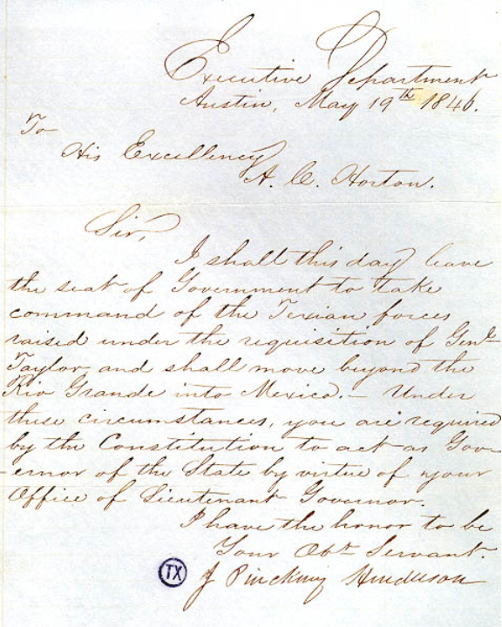
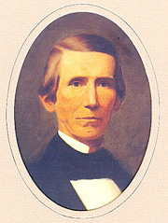
James Pinckney Henderson
Henderson’s letter to his Lieutenant governor before serving in the U.S. – Mexico War.
Texas State Library and Archives Commission
Texas State Library and Archives Commission
Notes:
James Pinckney Henderson. Portraits of Texas Governors. Texas State Library and Archives Commission. Accessed July 18, 2025. Portraits of Texas Governors - Early Statehood - Part 1, 1846-1853 | Texas State Library

Slide 8
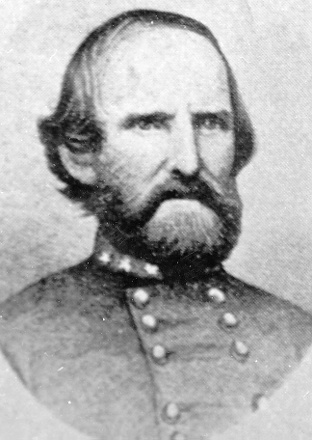
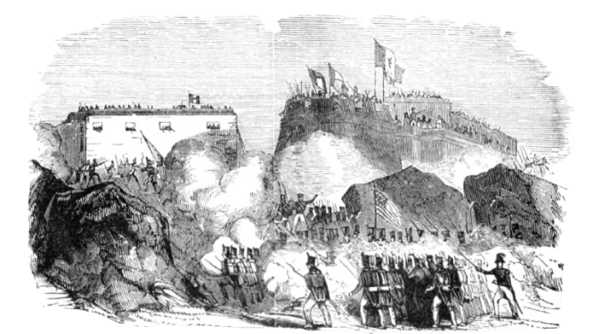
Benjamin McCulloch
The Battle of Monterrey depicted in the book “The Scouting Expeditions of McCulloch’s Texas Rangers.”
The Portal to Texas History
Texas State Cemetery Records
Notes:
Benjamin McCulloch. Texas State Cemetery. Accessed on July 18, 2025. Benjamin Mcculloch | Texas State Cemetery
Reid, Samuel C., Jr. The Scouting Expeditions of McCulloch's Texas Rangers; or, the Summer and Fall Campaign of the Army of the United States in Mexico--1846; including Skirmishes with the Mexicans, and an accurate detail of the Storming of Monterey; also the Daring Scouts at Buena Vista together with anecdotes, incidents, descriptions of country, and sketches of the lives of the celebrated partisan chiefs, Hays, McCulloch, and Walker., book, 1859; Philadelphia, Pennsylvania. (https://texashistory.unt.edu/ark:/67531/metapth38096/: accessed July 18, 2025), University of North Texas Libraries, The Portal to Texas History, https://texashistory.unt.edu; crediting Austin History Center, Austin Public Library.

Slide 9
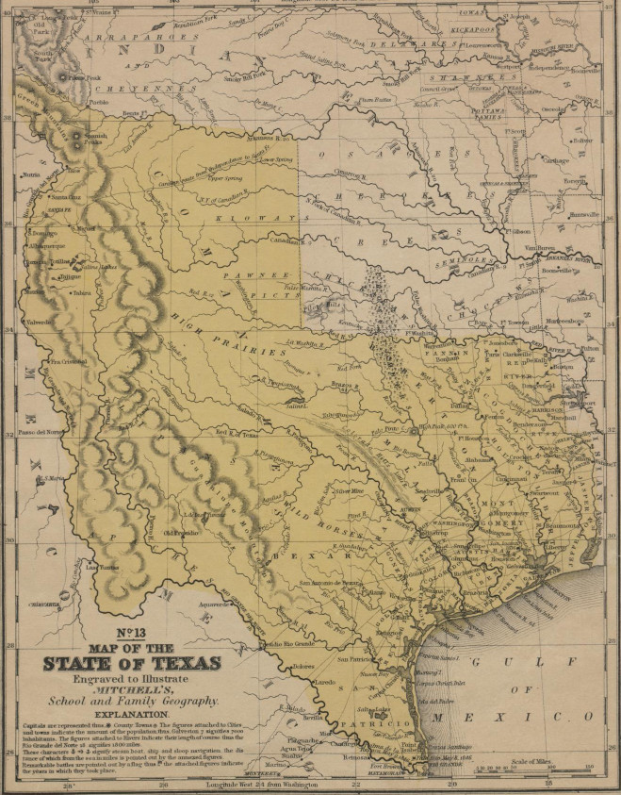
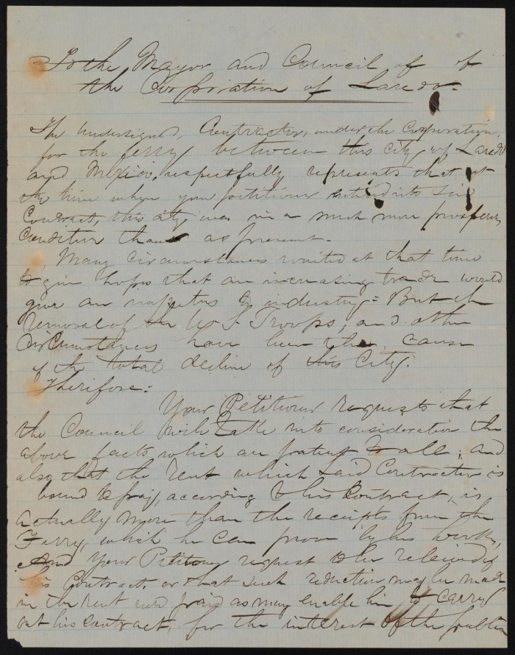
Santos Benavides
A letter from Santos Benavides to the mayor of Laredo regarding a business contract.
The Portal to Texas History.
A map of Texas from 1848. The location of Laredo is circled. The Portal to Texas History.
Notes:
Benavides, Santos. [Letter from Santos Benavides to the Laredo Mayor, October 14, 1859], letter, October 14, 1859; (https://texashistory.unt.edu/ark:/67531/metapth876486/: accessed July 18, 2025), University of North Texas Libraries, The Portal to Texas History, https://texashistory.unt.edu; crediting St. Mary's University Louis J. Blume Library.
Mitchell, S. Augustus (Samuel Augustus), 1792-1868. Map of the state of Texas., map, 1846; (https://texashistory.unt.edu/ark:/67531/metapth2484/: accessed July 18, 2025), University of North Texas Libraries, The Portal to Texas History, https://texashistory.unt.edu; crediting UNT Libraries Special Collections.

Slide 10
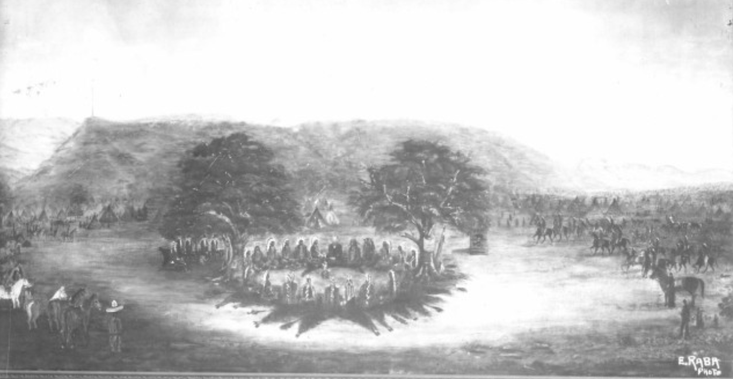
Chief Potsanaquahip or “Buffalo Hump”
The Meusebach-Comanche Treaty, 1847
The Portal to Texas History
Notes:
Raba, Ernst Wilhelm, 1874-1951. [The Meusebach-Comanche Treaty], photograph, Date Unknown; (https://texashistory.unt.edu/ark:/67531/metapth460058/: accessed June 27, 2025), University of North Texas Libraries, The Portal to Texas History, https://texashistory.unt.edu; crediting San Antonio Conservation Society.

Slide 11
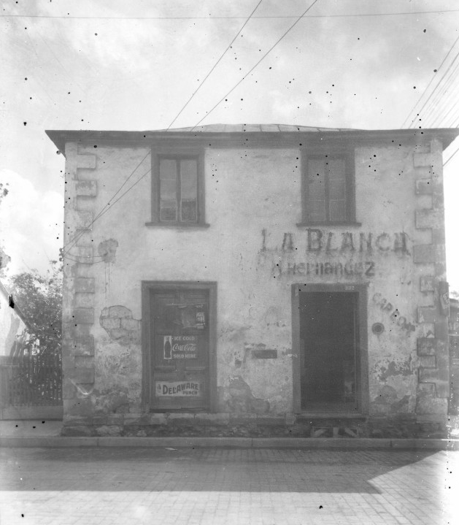
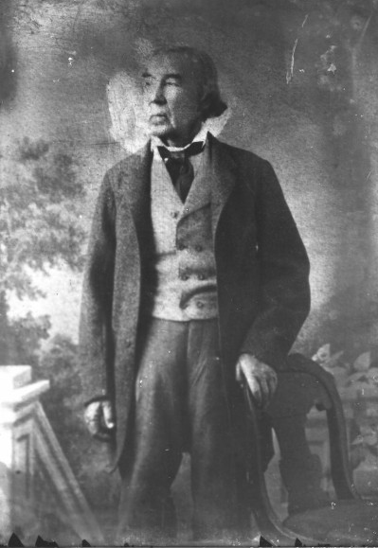
José Antonio Navarro
A building in San Antonio that was once used as Navarro’s law office.
The Portal to Texas History.
The Portal to Texas History
Notes:
Raba, Ernst Wilhelm, 1874-1951. [Jose Antonio Navarro Portrait], photograph, Date Unknown; (https://texashistory.unt.edu/ark:/67531/metapth460098/: accessed July 18, 2025), University of North Texas Libraries, The Portal to Texas History, https://texashistory.unt.edu; crediting San Antonio Conservation Society.
Raba, Ernst Wilhelm, 1874-1951. [Navarro House Complex], photograph, Date Unknown; (https://texashistory.unt.edu/ark:/67531/metapth460060/: accessed July 18, 2025), University of North Texas Libraries, The Portal to Texas History, https://texashistory.unt.edu; crediting San Antonio Conservation Society.

Slide 12
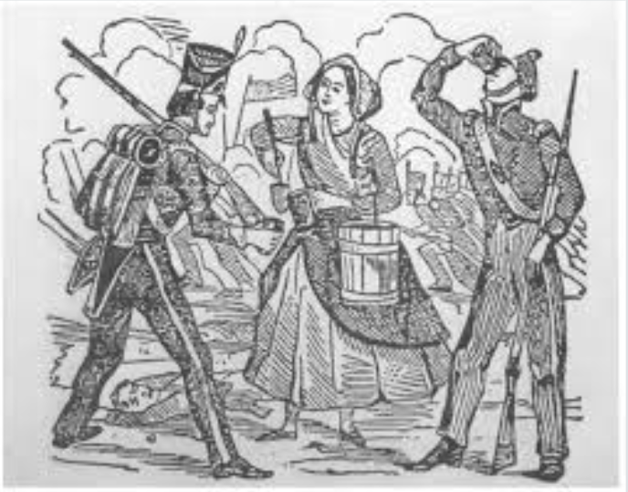
Sarah A. Bowman
Sarah A. Bowman, feeding soldiers at Fort Brown
The Texas State Historical Association
Notes:
Drawing of Sarah Bowman at Fort Brown. Image available on the Internet and included in accordance with Title 17 U.S.C. Section 107. The Handbook of Texas, Texas State Historical Association. Bowman, Sarah

Slide 13
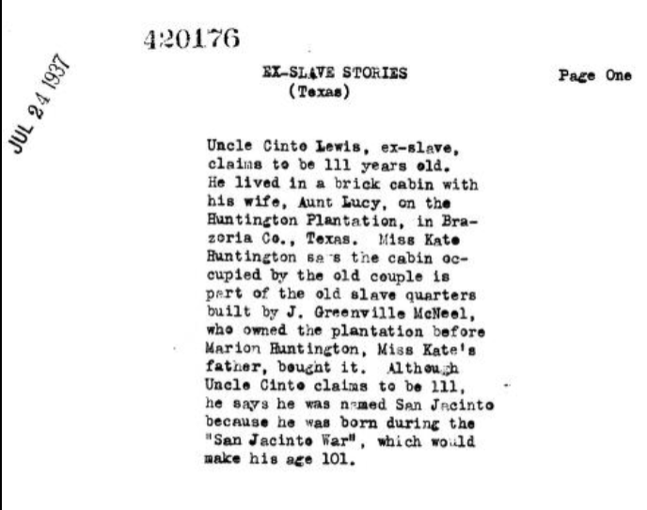
San Jacinto “Cinte” Lewis
The first page of the transcript of Cinte Lewis’ interview for the Slave Narrative Project with the Library of Congress.
Notes:
“Cinto Lewis, Brazoria County, Texas.” The Library of Congress. Accessed November 17, 2021. https://www.loc.gov/resource/mesn.163/?sp=6

Slide 14
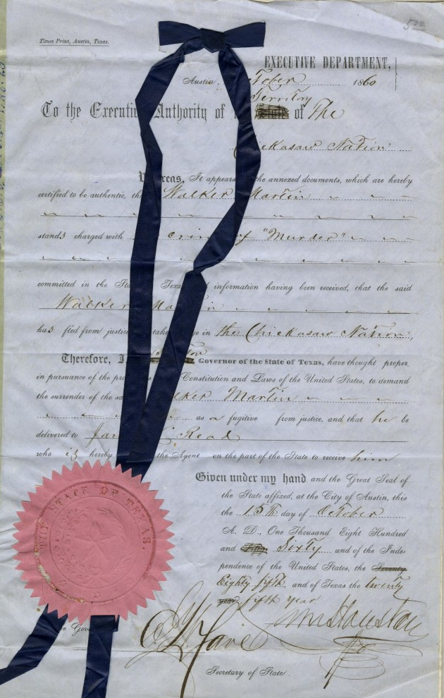
Sam Houston
Letter from Governor Sam Houston to the Chickasaw Nation on October 15, 1860, discussing the extradition of a fugitive named Walker Martin. Included in the letter are indictment charges and documents proving Walker Martin's charges.
The Portal to Texas History
Notes:
Houston, Sam, 1793-1863. [Letter from Sam Houston to the Chickasaw Nation, October 1860], letter, October 15, 1860; (https://texashistory.unt.edu/ark:/67531/metapth866320/: accessed July 28, 2025), University of North Texas Libraries, The Portal to Texas History, https://texashistory.unt.edu; crediting Hardin-Simmons University Library.

Slide 15
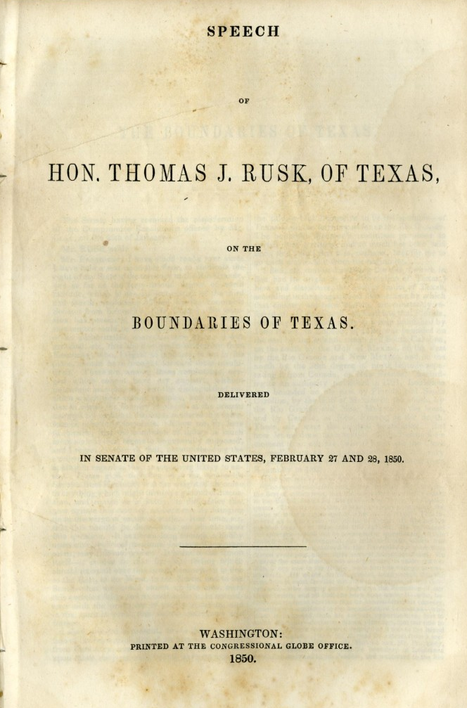
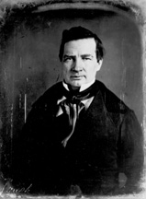
Thomas Jefferson Rusk
Rusk’s 1850 Speech on the borders of Texas The Portal to Texas History
U.S. Senate Historical Office
Notes:
Thomas Jefferson Rusk, Biographical Directory of the United States Congress. U.S. Senate Historical Office. Accessed July 21, 2025. Bioguide Search
Rusk, Thomas J. (Thomas Jefferson), 1803-1857. Speech of Hon. Thomas J. Rusk, of Texas, on the boundaries of Texas. Delivered in Senate of the United States, February 27 and 28, 1850., pamphlet, 1850; (https://texashistory.unt.edu/ark:/67531/metapth497607/: accessed July 21, 2025), University of North Texas Libraries, The Portal to Texas History, https://texashistory.unt.edu; crediting Schreiner University.

Slide 16
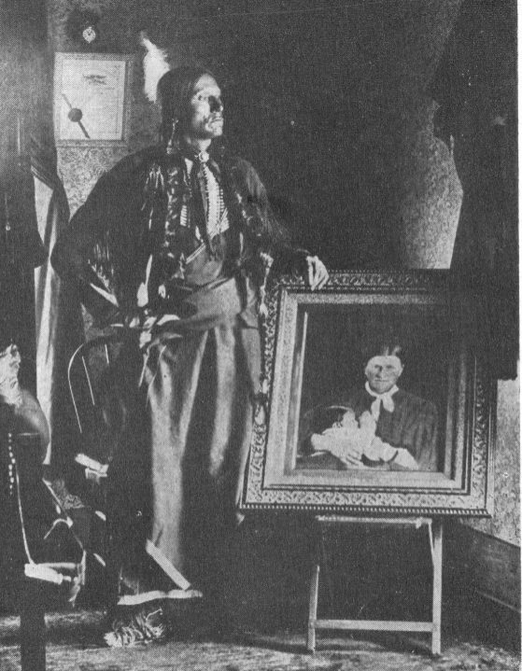
Cynthia Ann Parker
“Nautdah”
Quanah Parker with the only known photograph of his mother, Cynthia Ann Parker, or Nautdah, holding her daughter, Topsannah – Quanah’s little sister. After Cynthia was taken back to her Anglo family, Quanah never saw his mother or sister again.
The Portal to Texas History
Notes:
Jackson, Grace. Cynthia Ann Parker, book, 1959; San Antonio, Texas. (https://texashistory.unt.edu/ark:/67531/metapth1013946/: accessed July 18, 2025), University of North Texas Libraries, The Portal to Texas History, https://texashistory.unt.edu; .

Slide 17
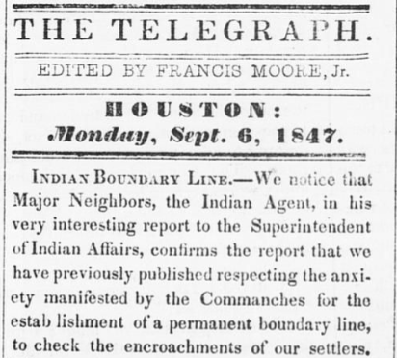
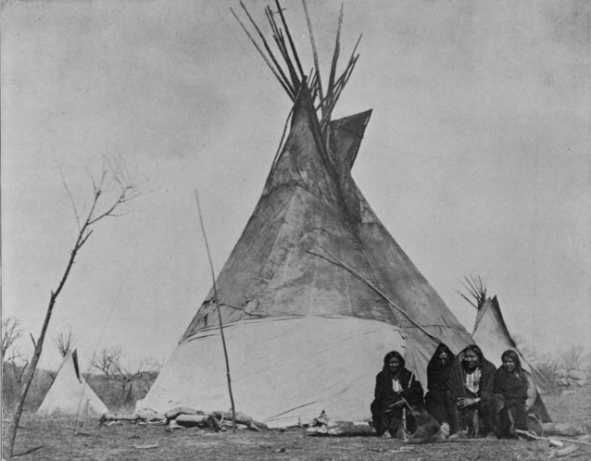
Robert S. Neighbors
A photograph from the 1890s of four Comanches in front of a tipi.
The Library of Congress
The Portal to Texas History
Notes:
Soule, William S. Comanche Indian camp. ca. 1890. Photograph. Library of Congress Prints and Photographs Division. Accessed July 28, 2025. https://www.loc.gov/item/00650194/
Moore, Francis, Jr. Democratic Telegraph and Texas Register (Houston, Tex.), Vol. 12, No. 36, Ed. 1, Monday, September 6, 1847, newspaper, September 6, 1847; Houston, Texas. (https://texashistory.unt.edu/ark:/67531/metapth48467/: accessed July 28, 2025), University of North Texas Libraries, The Portal to Texas History, https://texashistory.unt.edu; crediting The Dolph Briscoe Center for American History.

Slide 18
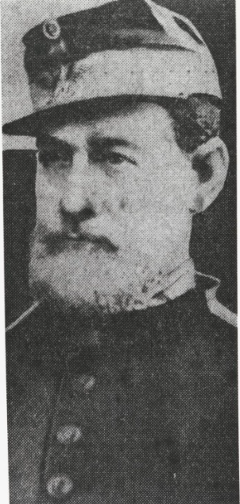
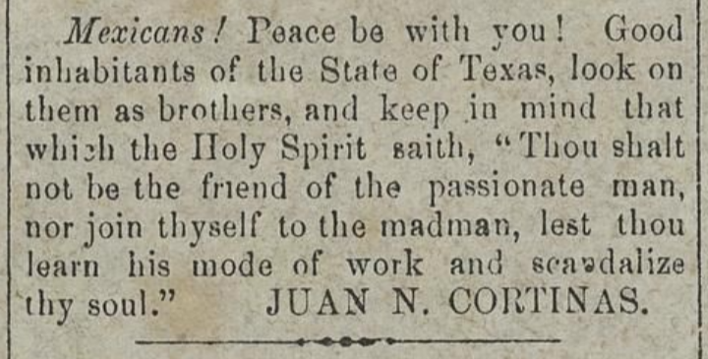
Juan Cortina
The Portal to Texas History
The Portal to Texas History
Notes:
[Juan N. Cortina], photograph, 1874~; (https://texashistory.unt.edu/ark:/67531/metapth1252601/: accessed July 28, 2025), University of North Texas Libraries, The Portal to Texas History, https://texashistory.unt.edu; crediting The University of Texas – Rio Grande Valley.
Baker, James D.; Baker, Ben M. & Baker, A. Hicks. The Colorado Citizen. (Columbus, Tex.), Vol. 3, No. 16, Ed. 1 Thursday, December 15, 1859, newspaper, December 15, 1859; Columbus, Texas. (https://texashistory.unt.edu/ark:/67531/metapth805655/: accessed July 28, 2025), University of North Texas Libraries, The Portal to Texas History, https://texashistory.unt.edu; crediting Nesbitt Memorial Library.

Slide 19
Exit Ticket
Follow the directions to complete your Exit Ticket
Choose any TWO people from today’s lesson.
Determine if these two people would have likely been ALLIES or OPPONENTS.
Write and explain your answer.
Share with a partner.

Slide 20
Share with the class 2
I chose _________ and _________. I think these 2 people would have been allies / opponents because ____________________________.

