Slide 1
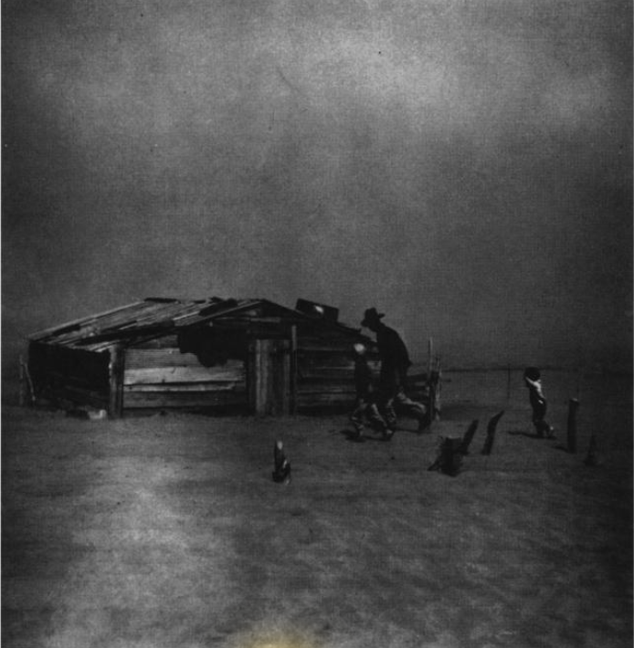
Unit 12:
The Great Depression
Lesson 7:
The Dust Bowl
A family running to their house during a dust storm Cimarron County, OK. 1938 The Portal to Texas History
Notes:
Reid, Robert L., 1938-. Picturing Texas: The Farm Security Administration-Office of War Information Photographers in the Lone Star State, 1935-1943, book, 1994; Austin, Texas. (https://texashistory.unt.edu/ark:/67531/metapth296835/: accessed April 13, 2026), University of North Texas Libraries, The Portal to Texas History, https://texashistory.unt.edu; crediting Texas State Historical Association.

Slide 2

Warm-up:
Follow the directions to complete your warm-up
Read the primary source excerpt about the Dust Bowl.
Respond to the question about the excerpt.
Share with a partner.

Slide 3

Share with the class
One thing I expect to learn in today’s lesson based on the primary source excerpt is ________

Slide 4

Essential Questions
What was the Dust Bowl?
What were its primary causes and significant effects, and how did it affect the lives of Texans?

Slide 5
In today’s lesson…
We will be able to explain what the Dust Bowl was, as well as identify its primary causes and effects.
I will analyze a set of primary source excerpts about the causes and effects of the Dust Bowl, the New Deal programs established to address the Dust Bowl, and how the Dust Bowl and New Deal programs affected Texans.

Slide 6
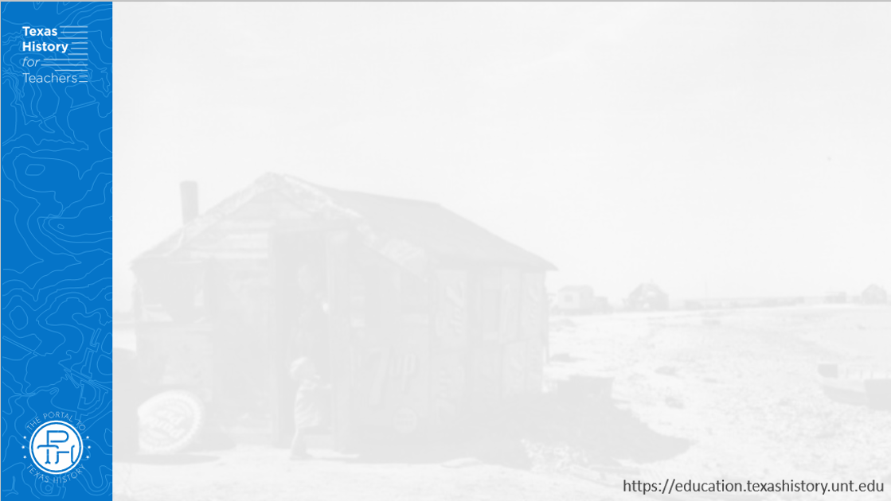
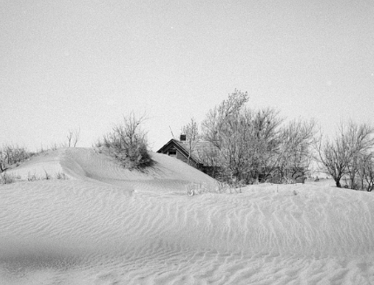
Part I: What was the Dust Bowl?
Severe wind erosion made this farm uninhabitable. Cimarron County, Oklahoma. April 1936. The Library of Congress
Notes:
Rothstein, Arthur. Severe wind erosion made this farm uninhabitable. Cimarron County, Oklahoma. April 1936. Photograph. https://www.loc.gov/item/2017760365/.

Slide 7

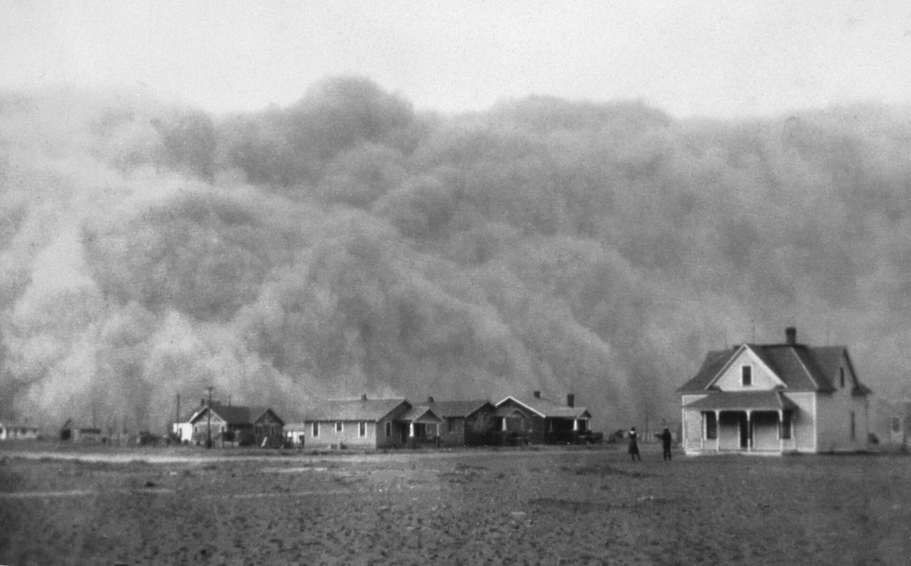
Part II: Primary Source Analysis
Stratford, TX. April 1935. The National Oceanographic and Atmospheric Administration
Notes:
A dust storm approaching Stratford, Texas, in April 1935. In the 1930s, the American prairie states experienced a period of severe drought and dust storms called the “Dust Bowl.” Credit: NOAA George E. Marsh Album. What is a dust storm? National Environmental Satellite, Data, and Information Service.
Accessed 4/13/2026 https://www.nesdis.noaa.gov/about/k-12-education/dust-ash-fire-smoke/what-dust-storm

Slide 8
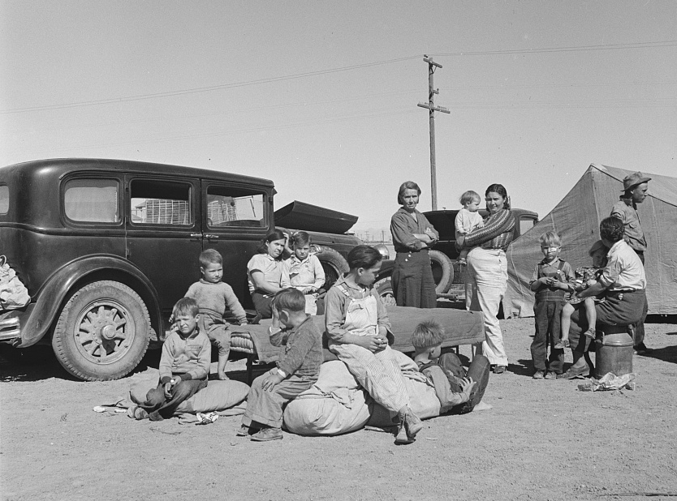
Part III:
In Their Shoes
Image to the right: An example of one point of view related to the Dust Bowl. This depicts three Texas families from the Panhandle fleeing to California to escape the Dust Bowl.
A photograph taken by famous photographer of the Great Depression, Dorothea Lange. 1937. The Library of Congress.
Notes:
Lange, Dorothea, photographer. Four families, three of them related with fifteen children, from the Dust Bowl in Texas in an overnight roadside camp near Calipatria, California. Imperial County Calipatria California United States, 1937. Mar. Photograph. https://www.loc.gov/item/2017769652/.

Slide 9
Exit Ticket:
Follow the directions to complete your exit ticket
Complete the graphic organizer about the Dust Bowl.
Write your responses in the space provided.
Share with a partner.

Slide 10
Share with the class 2
The Dust Bowl was _______
One cause of the Dust Bowl was________
One significant effect of the Dust Bowl was ________

